Slide 1
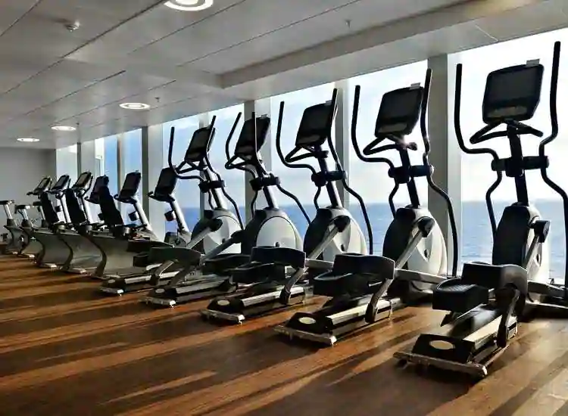
FITNESS CLUB:
NAME: K SAI CHAITRA
BATCH: 2023-9841
ENROLLMENT NUM: EBEON0523807899

Slide 2
It is with no doubt that regular exercise and physical activity contribute to body fitness and psychological health.
Some of the well-known benefits of exercise are controls weight, combats health diseases, improves emotional stability.
Increased participation in fitness and wellness activities can improve their overall health and well-being.
OBJECTIVE:
To develop the Machine Learning Model for Fitness Club Dataset and to predict whether the person attended or not attended.

Slide 3
FITNESS CLUB DATASET
DATA SET FROM KAGGLE: https://www.kaggle.com/code/princeiornongu/fitness-club-kvsm-with-cross-val-score/input
Coding Language: PYTHON
Data Pre-processing:Cleaning and preprocessing the data to ensure it's in a suitable format for machine learning
Performing EDA part

Slide 4
Data Visualisation: The graphical representation of data.
Data Splitting:Split your dataset into 70-30 for training and testing.
Machine Learning Algorithms
Finding the best accuracy among all Machine Learning algorithms.
Taking user input to predict the target value.

Slide 5
Logistic
Random forest classifier
Decision tree
Back propagation
Naïve bayes
KNN
SVM

Slide 6
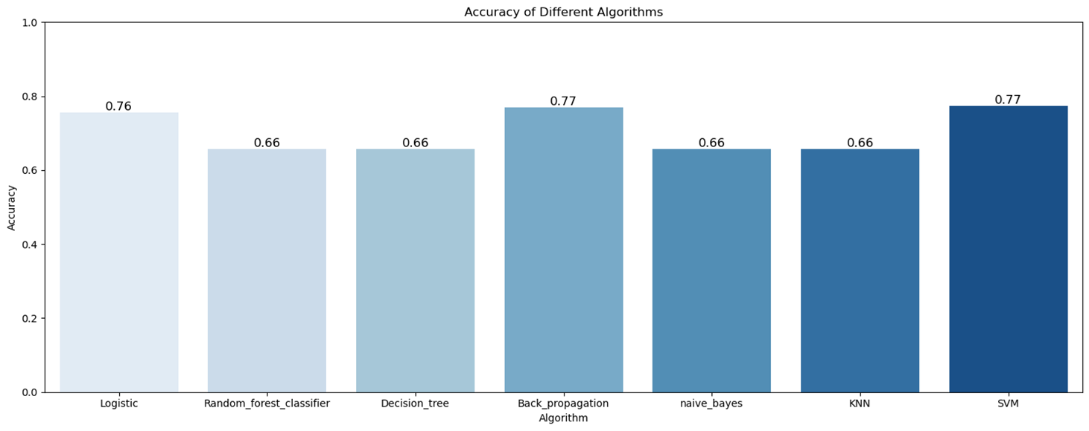
Accuracy of Different Algorithms

Slide 7
THANK YOU

