Slide 1
SENTIMENT ANALYSIS OF TWITTER FEEDS AND CORRELATION WITH ACTUAL STOCK PRICES
Anusha Kowdeed (axk150431)
Bharat Bhavsar (bmb140330)
Manaswi Reddy (mxk154430)
Sai Chakravarthy (sxa158530)
Shakti Shivaputra (sxs159231)
CS 6350
SECTION: 0U1
AUG 08, 2016

Slide 2
PROBLEM DEFINITION
Extract sentiment from real time twitter data and correlate it with the stock prices from the yahoo finance API.
Train a classifier using the data from both sources to sketch the correlation between them and then use the same to predict future trends based on the sentiment identified at that time.

Slide 3
WHAT WE NEED
We use data from tweets about a company to decipher the public opinion/sentiment towards a company.
We then obtain actual stock prices and compare the price movement with the prediction made.
Use Twitter4j API for tweets to store in text form.
Use Yahoo Finance API to extract past stock data as per requirement.

Slide 4
WHAT WE NEED TO DO WITH THIS DATA
We assign labels to the tweets based on the change in open and close prices for that day and consolidate the results in a single file.
This file is uploaded on HDFS and is used as the input dataset for the next stage.
We use Spark MLlib to train a model and classify test tweets.
The chosen classifier in this project is the Logistic Regression classifier.
Once the predictions are obtained, we output the final prediction based on the majority of predicted labels.

Slide 5
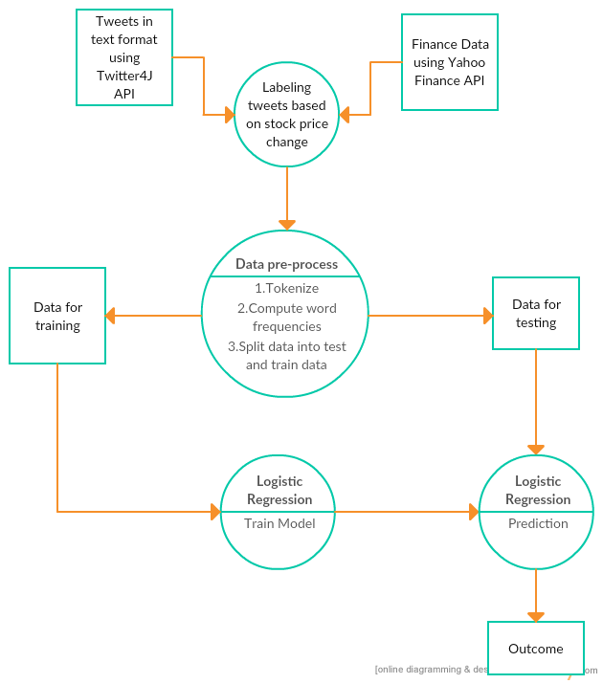
CAN WE VISUALIZE IT?

Slide 6
PSEUDOCODE
Download tweets in text format using twitter4j API.
Download finance data using yahoo finance API.
Create custom labels for tweets based on stock price changes observed from finance data.
if(price increases) then label = 1 (positive sentiment)
if(price decreases) then label = 0 (negative sentiment)
Logistic Regression classifier using Spark MLlib
Train the algorithm with the dataset created above
Obtain predictions on the test data
Obtain label counts of predictions
if (number of 0 label predictions > number of 1 label prediction) then predict “Price is expected to decrease”
else predict “Price is expected to increase”

Slide 7
DID WE USE BIG DATA?
The project uses multiple big data technologies - HDFS, Spark MLlib.
HDFS: We use HDFS during the creation of the input dataset.
Spark MLlib: We use Spark MLlib to perform the classification.
Since Spark MLlib is a scalable Machine Learning library it has the ability to train models and classify large datasets.

Slide 8
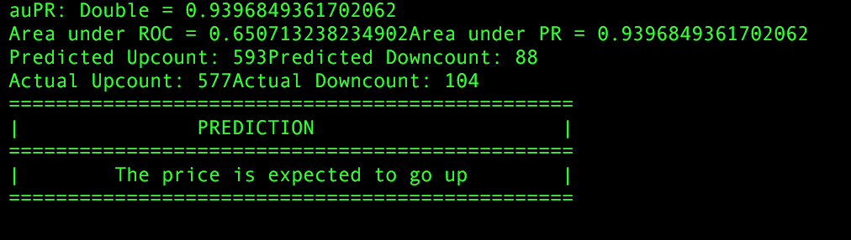
SCREENSHOTS
Output data for tweets from August 1st - August 5th

Slide 9
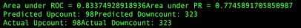
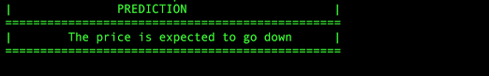
SCREENSHOTS
Output data for tweets from July 20th-27th

Slide 10
SHOW ME THE RESULT:
Sl. No. | Number of instances | Train: Test split | Predicted label counts | Actual labels counts | Area under ROC | Area under PR
1 (100 features) | 1055 | 60:40 | (0): 337 (1): 84 | (0): 328 (1): 98 | 0.788920831490491 | 0.7379962673905667
2 (500 features) | 8144 | 60:40 | (0): 2260 (1): 925 | (0): 2036 (1): 1149 | 0.6608610288950331 | 0.6470447030312751
3 (500 features) | 1055 | 60:40 | (0): 323 (1): 98 | (0): 323 (1): 98 | 0.83374928918936 | 0.7745891705850987
4 (1000 features) | 1055 | 60:40 | (0): 318 (1): 103 | (0): 323 (1): 98 | 0.819359322676439 | 0.7477403617397885

Slide 11
WHAT WE UNDERSTOOD FROM THIS:
We performed different tests by running the classification multiple times varying the number of instances, test to train split ratio, number of features retained after dimensionality reduction.
With the results we notice that, contrary to our initial expectation that the prediction accuracy would increase on increasing the number of instances in the train set, we notice a decrease in the accuracy on increasing the size of the train set.
We also notice the effect of reducing the number of features from the above results.
We obtained best accuracy (Area under ROC = 0.833) using the Logistic Regression classifier with 500 features on a data set containing 1055 tweets split in a ratio of 0.6:0.4 as train and test data.

Slide 12
WERE THERE ANY CHALLENGES?
First challenge was to extract as many tweets as we can. Twitter4j API allows us to extract data for past 7 days with a maximum limit of 1500 tweets.
For this issue we used streaming data. Manage your streaming data storage and reading of this stored data.
Or in the first phase, we could collect data for a few days and then start working on it.
We worked on OPENING and CLOSING stock price details for the day.
This will be enhancement if we can work on streaming stock price data. This will give better labeling for analysis of tweets.

Slide 13
WHAT NEXT?
The efficiency of results obtained can be improved by using shorter time intervals for tracking stock prices and assigning labels.
Also, by using natural language processing techniques to process data before performing the classification, we could improve accuracy of the prediction.
We can collaborate with the RSS feed from companies to corroborate with the sentiment of the tweet.
We can use StockTwits which provide sentiment as the part of the data.

Slide 14
REFERENCES
Sentiment analysis of twitter data for Prediction of Stock Market Movement: http://cs229.stanford.edu/proj2011/ChenLazer-SentimentAnalysisOfTwitterFeedsForThePredictionOfStockMarketMovement.pdf
Logistic Regression using Spark MLlib: http://spark.apache.org/docs/latest/ml-classification-regression.html
Twitter4j API: http://twitter4j.org/en/index.html
Yahoo Finance API: https://developer.yahoo.com/yql/ http://www.jarloo.com/yahoo_finance/

Slide 15
THANK YOU!

