Slide 1
Deep learning and Semantic web technologies for Entity Disambiguation
Saichand, Gourishetti
-Computational Science and Engineering

Slide 2
Outline
Ontologies
OntoGraf
Semantic Web
Deep Semantic Similarity Model (DSSM)
Implementation Details

Slide 3

1.Ontologies
A data model that represents knowledge as a set of concepts within a domain and relationships between concepts.
Policies, Rules, Relationships, Definitions, Processes
Ontologies are simplify the data management
Data available on internet is Heterogeneous
Fig: Data Formats

Slide 4
1.1 Problems with the different type of data
Information can be captured in different formats
It almost impossible to understand existing relationships between different data
Ontology is captured the data in a way that allows these relationships to become visible
Notes:
Difficult to determine how policy is captured in word documents relate to business processes captured in models and how those business processes relate to data captured in the database data needs to be required to be represented in format that allows relationships to be discovered .

Slide 5
Classes and Relationships
In accordance with the RDF and OWL
Ontologies are made up of two main components.
Classes (oval) and Relationships (arrow)
TRIPLE
Subject predicates Object
Person
Organization
has employer

Slide 6
Ontologies Construction
The two standards which govern the construction of ontologies are
RDF(resource description framework)
OWL (web ontology language)
RDF
OWL

Slide 7
Features of Ontologies
Ontologies are easily extensible
You can add and delete classes from Ontology
Ontologies are an excellent alternative to source code

Slide 8
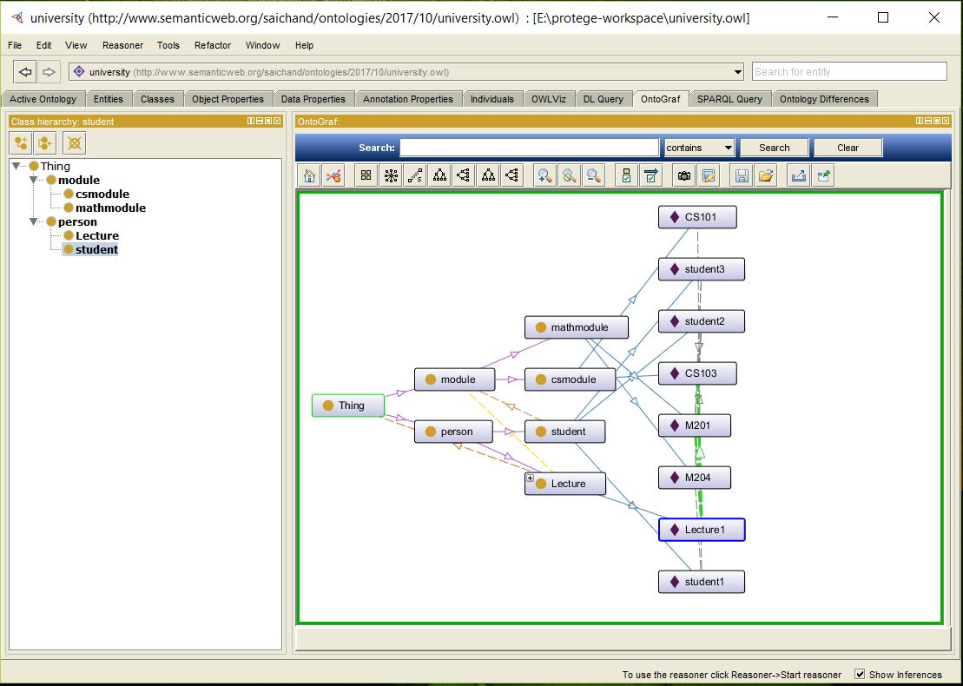
OntoGraf

Slide 9
2. Semantic web
Open standards for describing information on web
Methods for obtaining further information from such descriptions
Fig: Basic idea of Semantic web
a Story
Director
politician
Title
writer
a Movie
actor
publication
Release date
Biography
productions

Slide 10
3. Deep Semantic similarity Model (DSSM)
Semantic similarity:
Spellings and pronunciation of the words are similar but the meaning of the word is different in different contexts.
DSSM is a DNN modeling technique for representing text strings in a continuous semantic space and modeling semantic similarity between two text strings.
Web search ranking | Question answering
Knowledge inference | Image captioning
Machine translation | recommendation

Slide 11
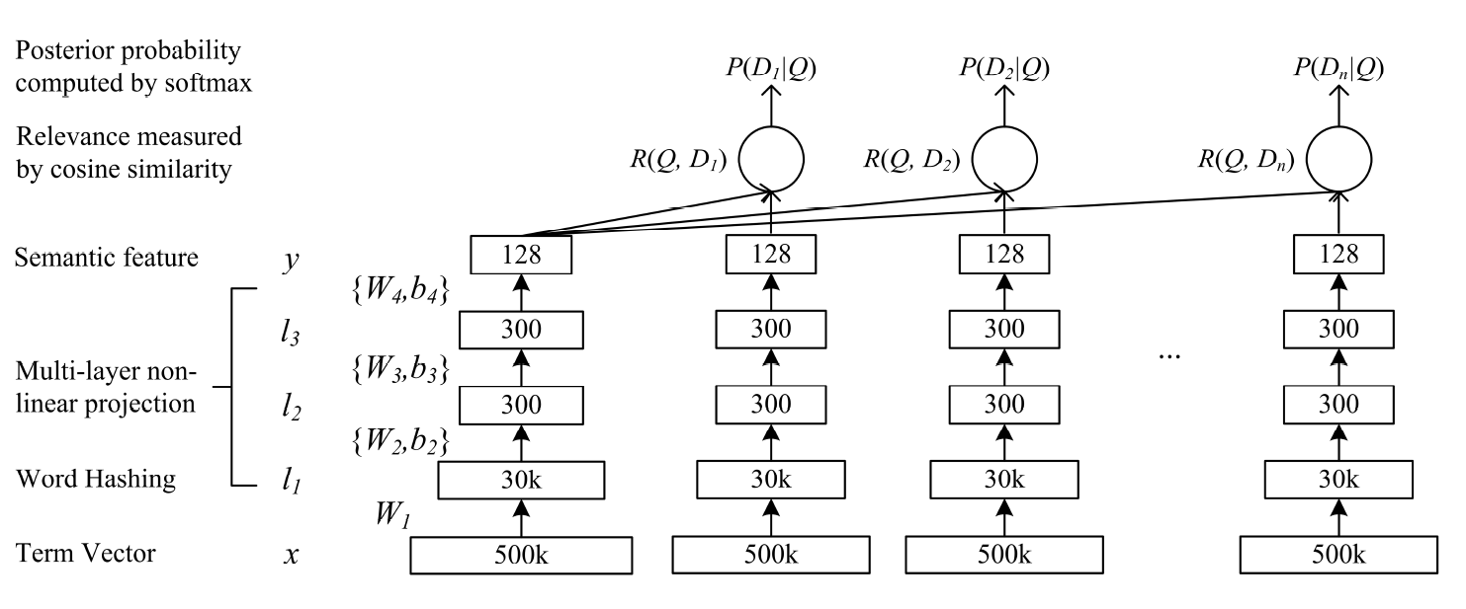
Illustration of the DSSM
Fig: Illustration of the DSSM

Slide 12
DNN for Computing Semantic features
Gather the Datasets i.e., Query (Q) and Document (D)
Convert the Data sets into term vectors to their corresponding semantic concept vectors
l1 = W1(x)
li = f(Wi li-1 + bi), i = 2,….., N-1
y = f(WN lN-1 + bN )
X = input vector
Y= output vector
W i = weight i-th weight matrix
li = intermediate input term vector
b i = bias i-th bias term

Slide 13
DNN for Computing Semantic features
Apply the activation function
Calculate semantic relevance between query Q and document D
Compute posterior probability from semantic relevance score using Softmax function

Slide 14
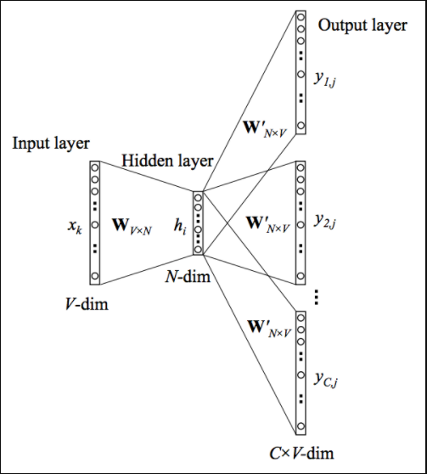
Term vectors
Word embeddings (word2vec)
Frequency based Embedding
Count Vector
TF-IDF vector
Co-Occurrence vector
Prediction based Embedding
Skip-Gram models
Continuous bag of words(CBOW)
Fig: Skip-Gram Model
Notes:
Skip-gram model can capture two semantics for a single word. i.e., it will have two vector representations of Apple. One for the company and other for the fruit.
Skip-gram with negative sub-sampling outperforms every other method generally.

Slide 15
Word Hashing
To reduce dimensionality of the bag-of-words term vectors
Based on letter N-gram
Ex: Word “Grate” (“# Grate #”)
(#Gr, Gra, ate, te#)
Problem with this method is collision (same vector representation or letter trigram representation of two words)
Collision can be solved using Collision resolution process.
Notes:
systematic method for placing the second item in the hash table. This process is called collision resolution
This collision resolution process is referred to as open addressing in that it tries to find the next open slot or address in the hash table. By systematically visiting each slot one at a time, we are performing an open addressing technique called linear probing.

Slide 16
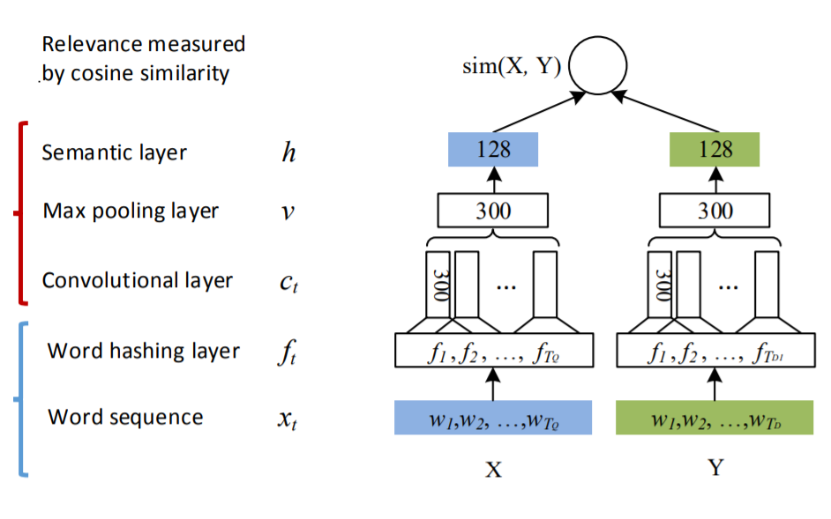
Multi-layer non-linear projection
Deep convolutional neural network

Slide 17
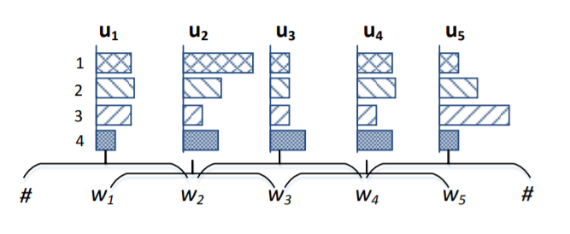
Multi-layer non-linear projection
Convolutional layer
Extract local features using convolutional layer
{w1,w2,w3}
{w2,w3,w4}

Slide 18
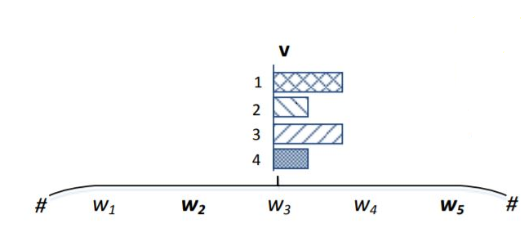
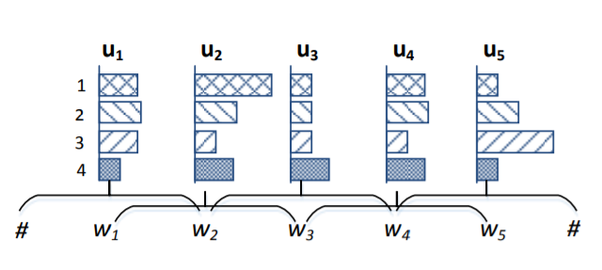
Multi-layer non-linear projection
Max-pooling layer
Generate global features using max-pooling layer
Sample-based discretization process
Keywords are w2 and w5 shown in image

Slide 19
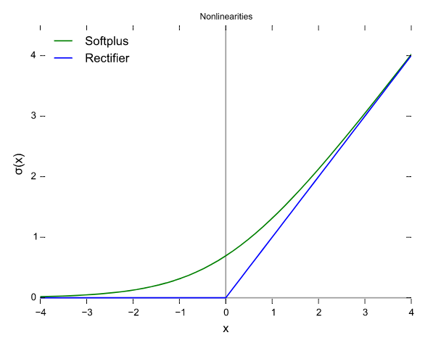
Activation functions
Rectified Linear Activation function (ReLu)
Smooth approximation to the sum of many logistic units
It produce sparse activity vectors
R(x) = max(0, x)
if x < 0 , R(x) = 0 and if x >= 0 , R(x) = x
It avoids vanishing gradients problem

Slide 20


Relevance Measurement and Posterior Probability
Semantic relevance between Query (Q) and Document (D)
R(Q,D) = cosine(YQ,YD) =
YQ, YD = concept vectors of query and document respectively
Compute the Posterior Probability of a document given a query from semantic relevance score between them using a softmax function
γ is smoothing factor in the softmax function

Slide 21

Optimization of a Neural Network
To maximize the likelihood of selected documents given the queries across the training set.
Minimize the loss function
Λ denotes the parameter set of the neutral networks {Wi, bi}
L(Λ) is differentiable using gradient-based numerical algorithms

Slide 22



Optimization of Neural Network
Adam (Adaptive Moment Estimation)
Converges fast and proper learning
Tune the internal parameters so as to minimize the loss function
Learning rate adjusted automatically
M(t), V(t) are first (Mean) and second (un-centered variance) moments of the gradients
Formula for parameter update
Notes:
SGD performs a parameter update for each training model. It is usually much faster technique. It performs one update at a time.
Now due to these frequent updates, parameters update has high variance and causes the Loss function to fluctuate to different intensities. This is actually a good thing because it helps us discover new and possibly better local minima, whereas standard gradient descent will only converge to the minimum of the basin as mentioned.
But the problem with SGD is that due to the frequent updates and fluctuations it ultimately complicates the convergence to the exact minimum and will keep overshooting due to the frequent fluctuations.

Slide 23
References
Foundations of Semantic web Technologies by Pascal Hitzler, Markus Krörtzsch, Sebastian Rudolph
Po-sen Huang, Xiaodong He, Jianfeng Gao, Li Deng., 2013. “Learning Deep Structured Semantic Models for Web Search using Clickthrough Data”
https://www.microsoft.com/en-us/research/wp-content/uploads/2016/02/wsdm2015

Slide 24
Thank you!

