Slide 1
Unveiling Emotions: The Power of Sentiment Analysis

Slide 2
Introduction
In this presentation, we will explore the power of sentiment analysis in understanding and analyzing human emotions. We will delve into the impact of sentiment analysis on various industries and its role in shaping decision-making processes.

Slide 3
Understanding Sentiment Analysis
Sentiment analysis, also known as opinion mining, is the process of identifying and categorizing opinions expressed in text data. It involves the emotional tone behind words to determine whether the expressed sentiment is positive, negative, or neutral.

Slide 4
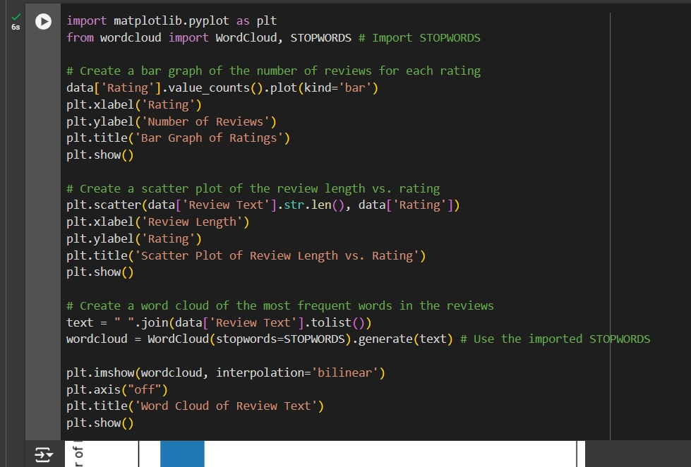
Data Insights

Slide 5
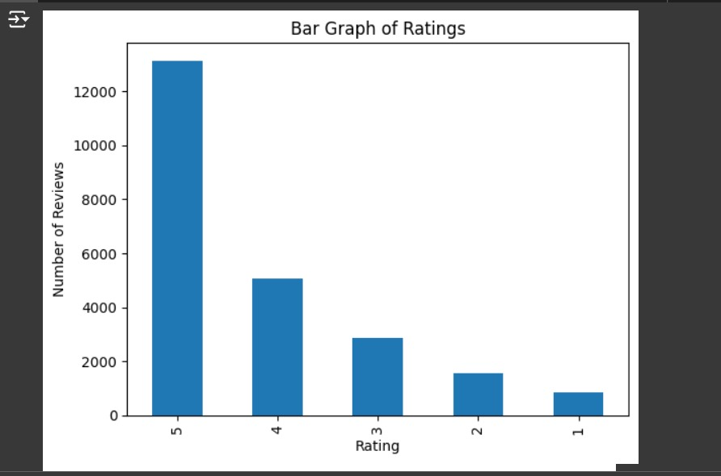
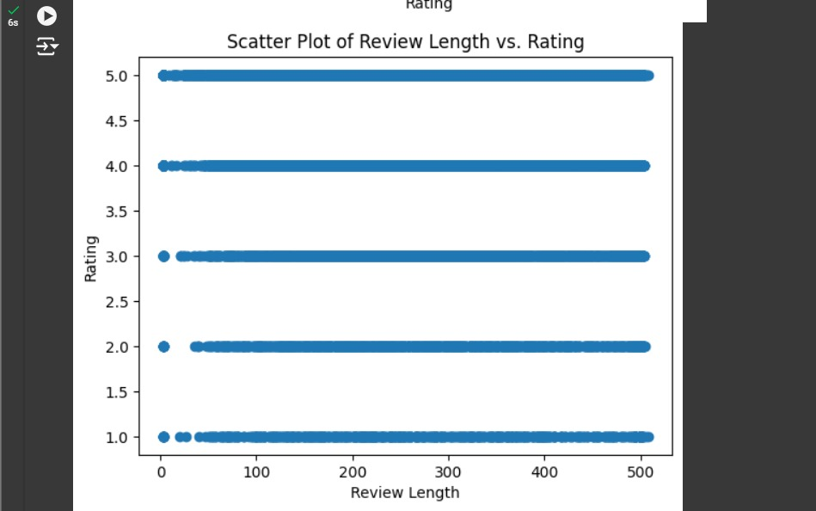

Slide 6
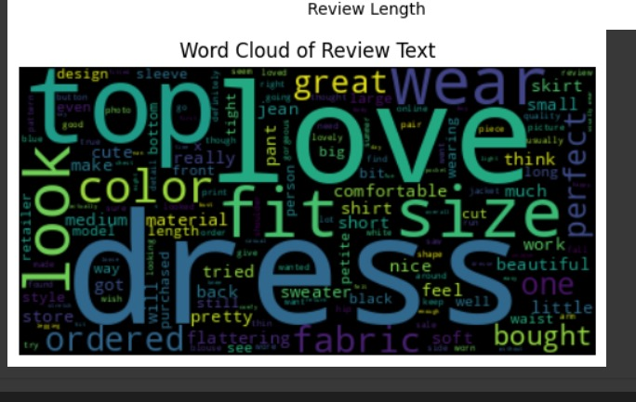

Slide 7
Conclusion
In conclusion, sentiment analysis serves as a powerful tool in deciphering human emotions and sentiments embedded in textual data. Its applications span across diverse industries, from marketing to customer service, and its continued evolution through AI and advanced algorithms promises to revolutionize decision-making processes.

Slide 8
Thanks!

