Slide 1
Linear Algebra
PythonLife

Slide 2
Agenda
Scalar
Vectors

Slide 3
Scalar
A scalar is a number, like 3, -5, 0.368, etc
4, 5, 6, 7.3, 4.5,

Slide 4
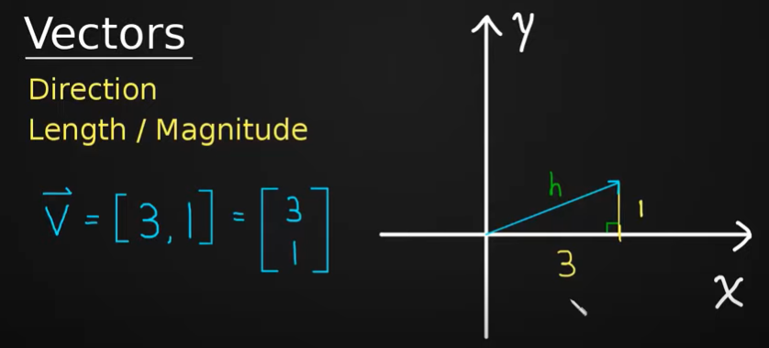
Vectors

Slide 5
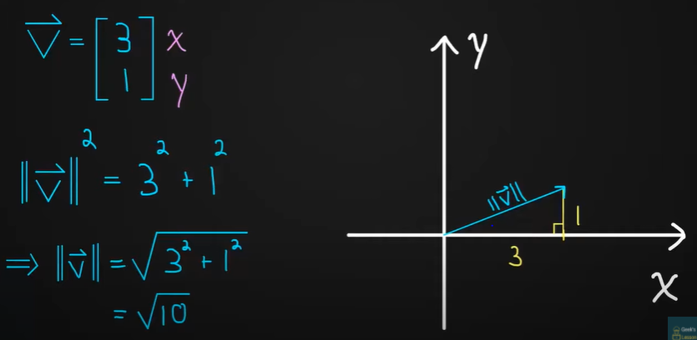
Vector Length/Magnitude

Slide 6
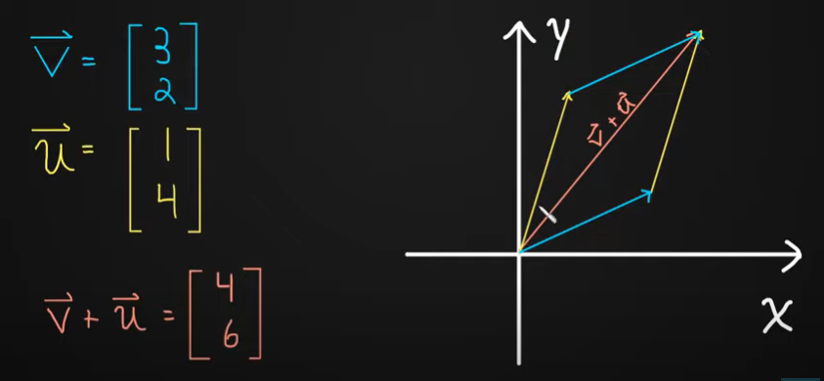
Vector Addition

Slide 7
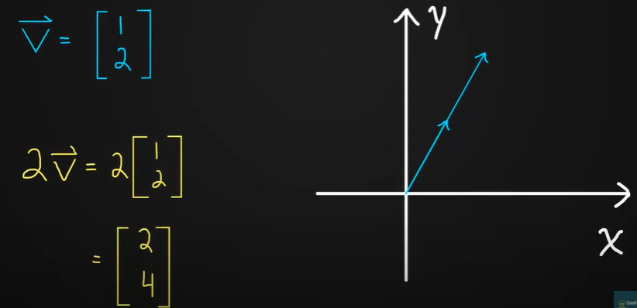
Multiplying the Vectors

Slide 8
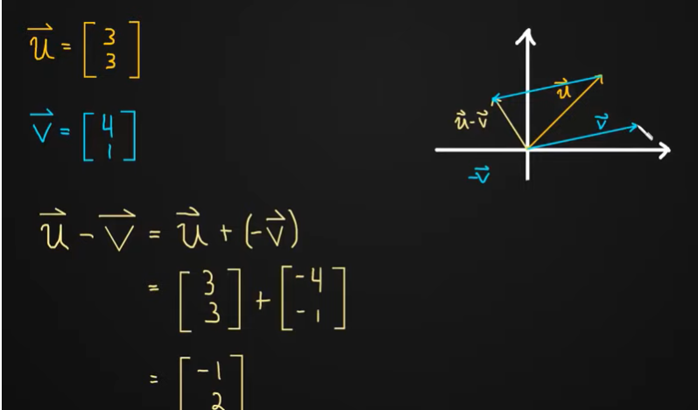
Subtracting the vectors

Slide 9
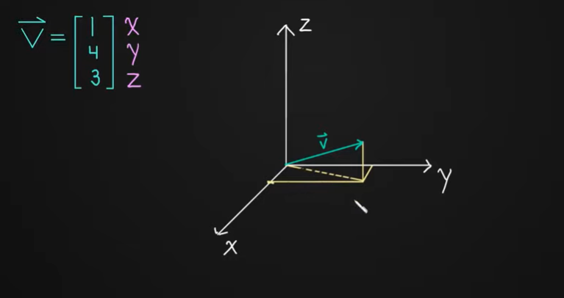
3D Vectors

Slide 10
Thanks for all
Please subscribe and press on bell icon

