Slide 1

One Search - A Simplified Search
A Solution for all Enterprise applications
January 29, 2016 Hyderabad
Authors
Avvaru sai chandu
Prahlad modi

Slide 2
Agenda
Introduction
Business Case
Problem Definition
Proposed Solution
Business Benefits
Future Scope
Conclusion
Contacts

Slide 3
Introduction
“OneSearch”, as the name suggests, searches all the Entities in an Enterprise Application from a single page.
“OneSearch” is about building and maintaining an enterprise search excellence application which is highly functional, scalable and reliable.
This white paper proposes an approach and solution that provides a detailed approach to handle multiple search pages in enterprise applications through a single search page.

Slide 4
Business Case
A case study on a Public Sector Solution for the Life Sciences and Health Care (LSHC) is performed to assess the proposed solution and the outcome.
As the size and complexity of the application increases, the number of search pages will increase at the rate proportional to the number of business modules in the application, resulting into poor user experience.
Indiana Eligibility Determination Services System(IEDSS) consists of more than 16 business modules having multiple search pages for each module. When an end user logs into this application system, the user has to navigate through many levels in the menu items to find a specific search page to perform the search.

Slide 5
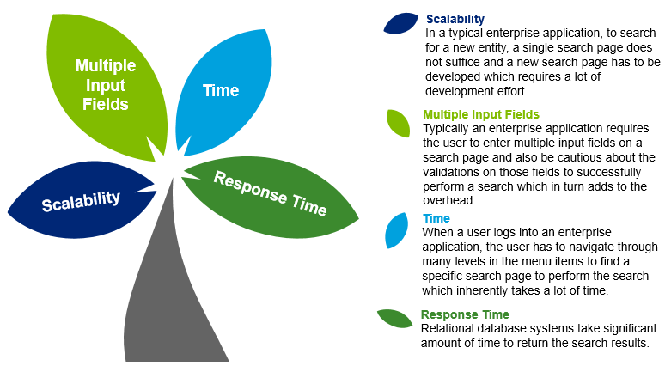
Problem Definition

Slide 6
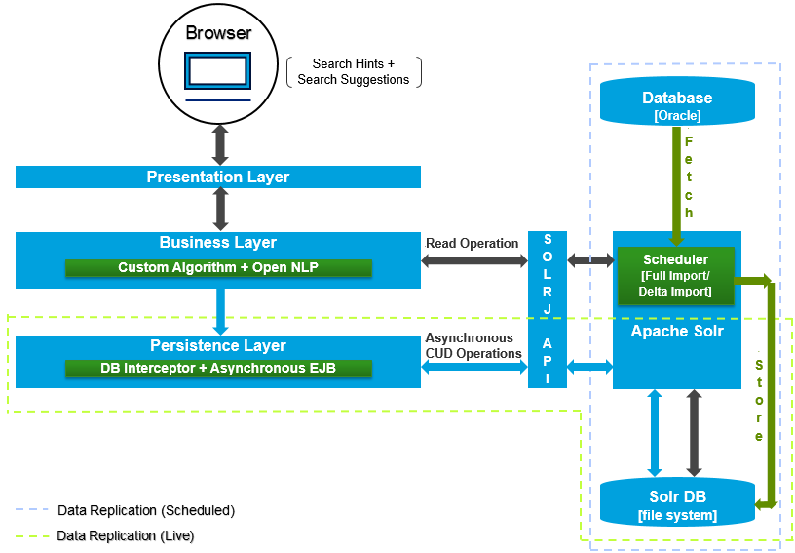
Proposed Solution

Slide 7
Application of Solution
A case study on WorkerPortal application which consists of more than 16 business modules having multiple search pages for each module. For the sake of brevity of the solution, we have considered following three entities:
1. Application
2. Criteria
3. Task
All the entities mentioned above have different search pages with multiple fields in WorkerPortal.
“OneSearch” solution is implemented to come up with single search page for searching for all three entities.

Slide 8
Components of “OneSearch” page
Ticker - The search page has scrollable search hints which has been implemented using jQuery.
Search Box - An autocomplete enabled text field where in the user can input a search query.
Search Suggestions - A search algorithm has been implemented to help the user with appropriate suggestions to build a search query.
Search Button – A button with the label ‘GO’ performs an Ajax call to fetch the search results.
Search Grid - A jQuery grid to show the results with actions associated with the respective entities.

Slide 9
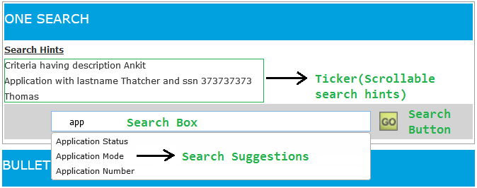
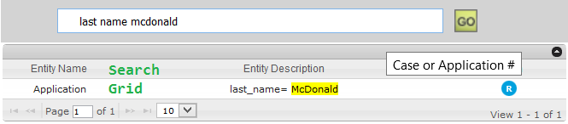
Putting in Perspective

Slide 10
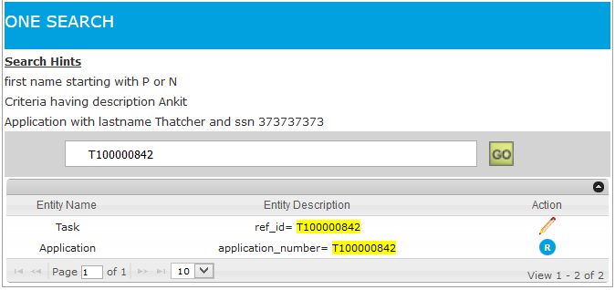
Sample Screenshot

Slide 11
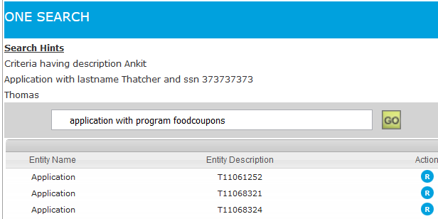
Semantic Search
“OneSearch” has the capability to perform a semantic search.
Example:
Search Keywords “cashassistance”,”cash”,”TANF” map to TF
Search Keywords “SNAP”,”snapassistance”,”foodcoupons”,”food” map to FS
Search Keywords “Medicaid”,”healthcoverage” map to MA

Slide 12
Business Benefits
User Experience: The UX/UI has been significantly improved in a way that the user can perform the search using simple English.
Scalability: Single search page with single search field can handle multiple entities search in the application. Searching a newly added Entity will be a breeze.
Time and Effort: Traditional way of developing a search involves a Jsp, EJB (backend bean) and DAO call. The development/Enhancements can be speeded up with “OneSearch” Solution implementation. Also, the time taken to navigate to various search pages in the application is curtailed.
Response Time: “OneSearch” uses indexed based search which generates results in very short span of a time compared to Oracle SQL search.
Too many input fields: “OneSearch” just has one text box for search and is independent of the entity the user is searching for thereby eliminating the need of multiple input fields.

Slide 13
Business Benefits(continued..)
Direct Navigation: Users can go directly to an application menu function or option based on keywords. For example, typing in “Individual id: 132561253” should be able to provide a link that can take the user directly to an application with the requested individual id.
Visualization: Finally, the visualization of information specific to a data source can further enhance the productivity of the end user. For example, instead of showing a standard hit list of all the search results, it might be more useful to show a simple table for each hit that contains the relevant information (e.g. entity name, description, navigation link etc.) upfront in an easy-to-understand format.

Slide 14
Future Scope
In the available timeframe, “OneSearch” solution has been implemented for limited number of entities in IEDSS.
However, given the scale of Enterprise applications, there is a huge scope of embellishment in the current solution and further exploration of immense potential of “OneSearch”.
The mere fact that the proposed solution is generic, makes it easy to adopt and implement across the projects there by inflating the business value of the Enterprise application.

Slide 15
Conclusion
OneSearch is the solution and approach that can be used in any Enterprise solutions, custom development projects, enterprise applications having multiple search pages to achieve better user experience and improved productivity while performing the search with the desired criteria on a single search page.
The day-to-day marginal gains in business effectiveness, agility and productivity are tough to assign specifically to enterprise search…
But they exist, and they make a difference.

Slide 16

Questions

Slide 17
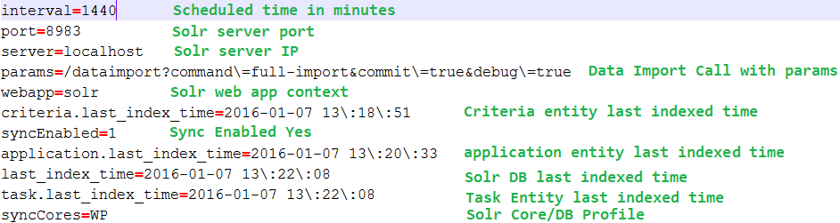
Appendix
DataImport configuration property file

Slide 18
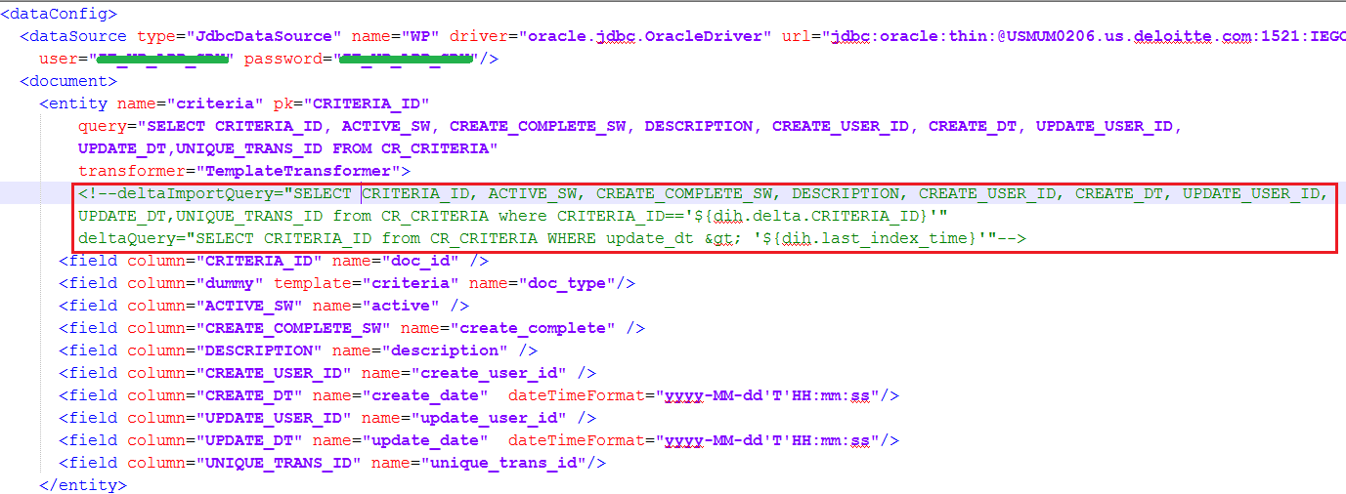
DataConfiguration property file

Slide 19
Search Suggestions Alogrithm: It suggests the suitable keywords/parameters of the system entities and helps user to quickly build the search query.
Criteria Formation Algorithm: It analyzes and parses user queries with the help of NLP to create context based search. OpenNLP library is a machine learning based toolkit for the processing of natural language text. The two important techniques used are: 1. Parts-of-Speech Tagging 2. Parsing Along with these, the algorithm uses the entity mappings to process and build the search query. This query/criteria is sent to search engine through Java API - SOLRJ.
Search Engine: Apache Solr is a standalone enterprise search engine comprising of Server, Rest API, Data Handlers and Data Analyzers. Solr internally uses Lucene to index and search the data. Solr receives and parses the criteria to provide search results and sends the response back through http in different data formats like JSON, XML, Text etc.

Slide 20
Data Replication(Scheduled): A HttpPostScheduler is configured and plugged into the Solr exploded .WAR to enable the data replication from the Application Database to Solr Database. DataConfiguration property file which contains configuration like data source, queries, fields against each entity is placed in Solr Core/Profile. This property file is used by the ‘HttpPostScheduler’ to replicate the data.
Data Replication(Live): Live Data replication is achieved using a Database Interceptor. The Interceptor will make a call to Asynchronous process(Asynchronous EJB) to convert the Data Access Object to the Solr Document and will update the Solr Database through SOLRJ API.

