Slide 1
COLLEGE EVENT MANAGEMENT PLATFORM
EventFlow
Built using Java Swing and Data Structures & Algorithms
A modular desktop application for centralized event administration, resource allocation, and conflict management.
STUDENT NAME
[Student Name]
ROLL NUMBER
[Roll Number]
DEPARTMENT
[Department Name]
PROJECT GUIDE
[Guide Name]

Slide 2
CHALLENGES IN COLLEGE EVENT MANAGEMENT
Problem Statement
Manual Administration & Fragmented Data
FRAGMENTED MANAGEMENT
• Managing events, participants, venues, and student volunteers manually leads to data inconsistency.
• Lack of a centralized real-time dashboard creates communication gaps and tracking errors across departments.
Search & Information Retrieval Inefficiencies
RETRIEVAL INEFFICIENCIES
• Searching through hundreds of registration records and log files causes computational delay.
• Basic text lookups fail to support substring pattern matching and document similarity evaluations.
Resource Allocation & Scheduling Conflicts
OPERATIONAL BOTTLENECKS
• Allocating auditoriums, labs, and equipment without automated scheduling leads to frequent venue overlaps.
• Manual volunteer mapping and schedule validation fail to detect multi-variable conflicts efficiently.
CORE REQUIREMENT: A unified platform combining interactive administrative management with custom Data Structures & Algorithms for real-time searching, optimization, and conflict resolution.
EventFlow — College Event Management Platform | Java Swing & DSA Project Review

Slide 3
THE EVENTFLOW MANAGEMENT ARCHITECTURE
Proposed Solution
1. Core Administrative Modules
Organizes event-related information cleanly across 4 core panels:
• Dashboard Panel
Displays real-time metric statistics (Total Events, Registrations, Active Statuses) and live event directory.
• Event Directory
Centralized hub for managing event records, schedule dates, registration limits, and category filters.
• Participant Registry
Manages student registration records, department affiliations, and participant contact details.
• Venue Manager
Tracks auditorium and lab seating capacities, locations, and booking availability across campus.
2. DSA Algorithmic Processing Engine
Supports administrative operations with specialized DSA algorithms:
• High-Performance Pattern Matching
Executes KMP exact matching and Rabin-Karp rolling hashes to locate search terms instantenously.
• Activity Optimization & Distance
Uses Bitmask Dynamic Programming for sub-event scheduling and Levenshtein Distance for fuzzy string matching.
• Resource & Volunteer Allocation
Applies Dinic's Maximum Flow and Bipartite Graph Matching to allocate volunteers and equipment efficiently.
• Conflict Management & Analytics
Utilizes 3-SAT logic and Vertex Cover Approximation to detect schedule overlaps and compute minimal monitor nodes.
EventFlow — College Event Management Platform | Java Swing & DSA Project Review

Slide 4
SOURCE CODE COMPONENT DIAGRAM & DATA FLOW
System Architecture
Application Entry Point (Main.java)
Java Swing UI Window & Navigation Controller (MainFrame.java / UIUtils.java)
Management View Panels
• DashboardPanel (System overview metrics & active events)
• EventPanel (Event directory & category filter controls)
• ParticipantPanel (Student registrations table & search)
• VenuePanel (Auditorium & laboratory capacity directory)
Six DSA Module Processing Panels
• M1SearchPanel (KMP & Rabin-Karp String Search UI)
• M2DocumentPanel (Suffix Array & LCP Similarity UI)
• M3OptimizationPanel (Bitmask DP & Distance UI)
• M4ResourcePanel & M5ConflictPanel & M6AnalyticsPanel UI
Algorithmic Core Execution Layer (src/algorithms/)
m1 (KMP, Rabin-Karp) | m2 (Suffix Array, Kasai's LCP) | m3 (Bitmask DP, Levenshtein) | m4 (Dinic Max Flow, Bipartite Matching) | m5 (3-SAT, Vertex Cover) | m6 (QuickSort, Reservoir Sampling)
Data Domain Models & In-Memory Service Layer (src/model/ & src/service/)
Domain Objects (Event.java, Participant.java, Activity.java, Venue.java, Volunteer.java) populated via in-memory DataService.java
EventFlow — College Event Management Platform | Java Swing & DSA Project Review

Slide 5
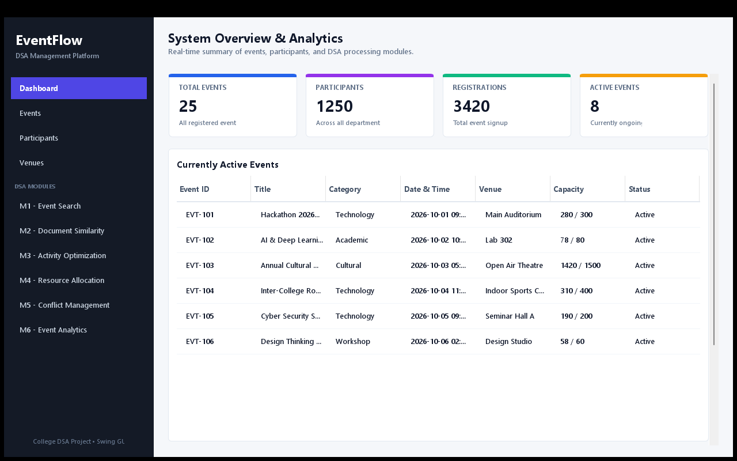
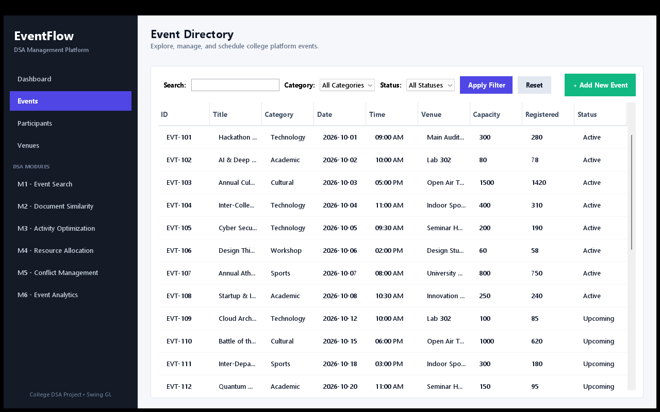
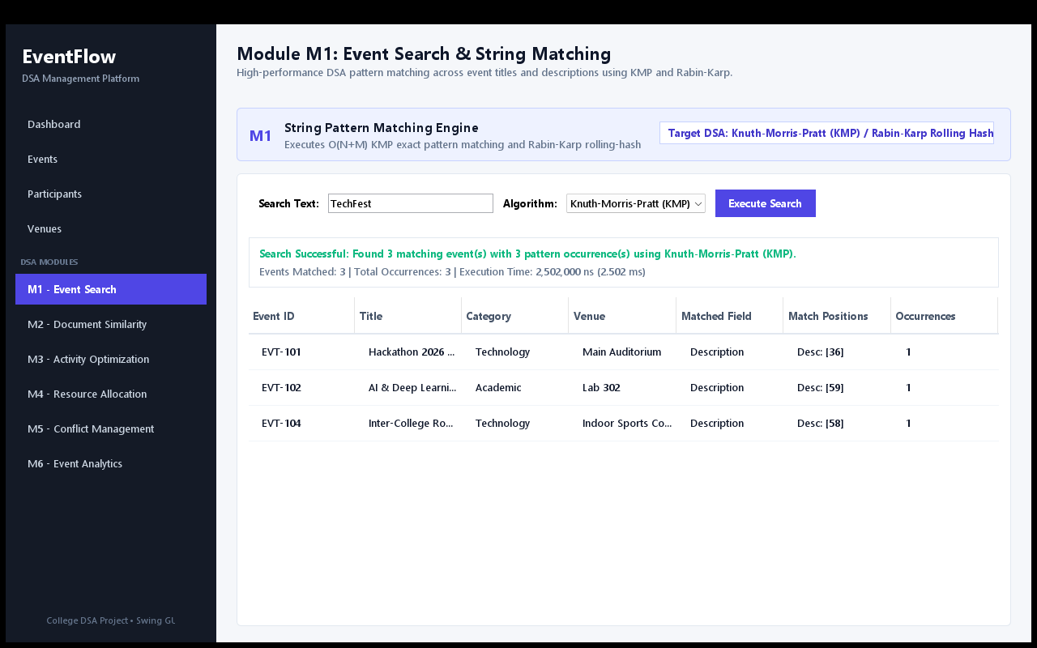
GENUINE EVENTFLOW SYSTEM INTERFACE SCREEN CAPTURES
Application Interface
System Overview Dashboard
Displays high-level statistical summary cards (25 Total Events, 1250 Participants, 3420 Signups) and active event directory.
Event Management Directory
Provides structured tabular view of all campus events with category dropdown filtering, status flags, and capacity tracking.
Module M1 Pattern Search
Demonstrates live execution of KMP and Rabin-Karp pattern matching algorithms on event title and description data.
EventFlow — College Event Management Platform | Java Swing & DSA Project Review

Slide 6
SIX CORE DATA STRUCTURES & ALGORITHMIC MODULES
DSA Modules
MODULE M1 • String Pattern Matching
Knuth-Morris-Pratt (KMP) & Rabin-Karp
Executes exact pattern matching and rolling-hash searching across event titles and description records.
MODULE M2 • Document Similarity
Suffix Array & Kasai's LCP Array
Constructs suffix arrays and longest common prefixes to evaluate structural similarity in event documents.
MODULE M3 • Activity Optimization & Distance
Bitmask Dynamic Programming & Levenshtein
Computes optimal sub-event activity sequences and fuzzy string distances for typo-tolerant queries.
MODULE M4 • Resource Allocation
Dinic's Maximum Flow & Bipartite Matching
Models capacity networks to allocate volunteers to events and optimize equipment distribution.
MODULE M5 • Conflict Management
3-SAT Solver & Vertex Cover Approximation
Validates boolean scheduling constraints and computes 2-approximation vertex covers for venue monitoring.
MODULE M6 • Event Analytics
Randomized QuickSort & Reservoir Sampling
Ranks multi-attribute event records efficiently and selects uniform random samples for participant surveys.
EventFlow — College Event Management Platform | Java Swing & DSA Project Review

Slide 7
CORE TECH STACK & ALGORITHMIC INTEGRATION WORKFLOW
Implementation and Technology
Technology Stack & Architecture
• Programming Language: Java SE (JDK 21 tested, JDK 8+ compatible).
• UI Framework: Pure Java Swing (JFrame, CardLayout, JTable, JPanel, Graphics2D) without external GUI libraries.
• Design Paradigm: Object-Oriented Programming (OOP) with clean encapsulation and model separation.
• Modular Architecture: Structured packages: main, ui, model, algorithms (m1-m6), service.
• Data Management: In-memory DataService providing pre-populated sample records for fast evaluation.
Component Integration Workflow
• User Interaction: User triggers search, optimization, or allocation requests via Swing UI panels.
• Service Coordination: UI controllers invoke DataService to fetch active model collections.
• In-Memory Processing: Target DSA modules process objects in memory without disk I/O bottlenecks.
• Result Wrapping: Algorithms return structured outputs, match positions, or flow values.
• Dynamic UI Rendering: Swing components refresh custom JTable views and metric stat cards instantaneously.
Note on Data Storage: Built as a pure Java desktop platform using in-memory data structures via DataService.java; does not require external database drivers or permanent database setup.
EventFlow — College Event Management Platform | Java Swing & DSA Project Review

Slide 8
PROJECT SUMMARY & ACKNOWLEDGEMENTS
Conclusion
Project Summary & Core Accomplishments
• Centralized Event Administration: EventFlow successfully organizes college events, student registrations, and campus venues into a modern desktop platform.
• Practical Application of DSA: Implements 6 specialized DSA modules (KMP, Rabin-Karp, Suffix Array, Kasai's LCP, Bitmask DP, Levenshtein, Dinic Max-Flow, Bipartite Matching, 3-SAT, Vertex Cover, QuickSort, Reservoir Sampling) to solve real-world operational challenges.
• Clean Modular OOP Design: Strict decoupling of Swing presentation panels, domain models, in-memory data service, and algorithmic execution units.
Thank You!
EventFlow — College Event Management Platform | Open for Questions & Discussion
EventFlow — College Event Management Platform | Java Swing & DSA Project Review

