Slide 1
Diabetes Prediction App
-using Flask, ML

Slide 2
Abstract
Diabetes is a chronic disease with the potential to cause a worldwide health care crisis. According to the International Diabetes Federation 382 million people are living with diabetes across the whole world. By 2035, this will be doubled as 592 million. Diabetes mellitus or simply diabetes is a disease caused due to the increased level of blood glucose. Various traditional methods, based on physical and chemical tests, are available for diagnosing diabetes. However, early prediction of diabetes is quite a challenging task for medical practitioners due to complex interdependence on various factors as diabetes affects human organs such as kidney, eye, heart, nerves, foot etc. Data science methods have the potential to benefit other scientific fields by shedding new light on common questions. One such task is to help make predictions on medical data. Machine learning is an emerging scientific field in data science dealing with the ways in which machines learn from experience. The aim of this project is to develop a system which can perform early prediction of diabetes for a patient with a higher accuracy by combining the results of different machine learning techniques. This project aims to predict diabetes via three different supervised machine learning methods including: SVM, Logistic regression, ANN. This project also aims to propose an effective technique for earlier detection of the diabetes disease.

Slide 3
Introduction
Diabetes Mellitus
Diabetes is one of deadliest diseases in the world. It is not only a disease but also a creator of different kinds of diseases like heart attack, blindness, kidney diseases, etc. The normal identifying process is that patients need to visit a diagnostic center, consult their doctor, and sit tight for a day or more to get their reports.
Machine Learning
Machine learning is the scientific field dealing with the ways in which machines learn from experience. For many scientists, the term “machine learning” is identical to the term “artificial intelligence”, given that the possibility of learning is the main characteristic of an entity called intelligent in the broadest sense of the word. The purpose of machine learning is the construction of computer systems that can adapt and learn from their experience.

Slide 4
Flask
Flask is a web framework, it’s a Python module that lets you develop web applications easily. It has a small and easy-to-extend core: it’s a microframework that doesn’t include an ORM (Object Relational Manager) or such features.
It does have many cool features like url routing, template engine. It is a WSGI web app framework.

Slide 5
Project Implementation
The whole project will be completed in 2 complex steps
Creating a model using machine learning
Creating a web app using flask and connecting it with model

Slide 6
Creating a model using machine learning
Install all required packages
all the packages can be installed using pip from cmd(terminal)
pip install pandas,numpy,matplotlib,scikit-learn,seaborn
Also you can install all the required packages by using requirements.txt provided in the code folder
pip install -r requirements.txt
Install jupyter notebook
pip install jupyter
Open jupyter notebook
python -m notebook

Slide 7
Open jupyter notebook
python -m notebook
Open a new notebook in jupyter, follow the below steps along
Import the necessary libraries
Load the dataset
EDA on dataset
Modeling and training
Improve accuracy using Hyperparameter tuning
Evaluate the model
Save and load the model

Slide 8
Creating a web app using flask and connecting it with model
Create folder structure as follow:

Slide 9
flask(root)
|____templates
|___index.html
|____static
|____css
|_____js
|____app.py
|_____Diabetes.pkl
Write code in app.py

Slide 10
EXECUTION
a.Open cmd navigate to project>code>flask
b. Run the command
python app.py

Slide 11
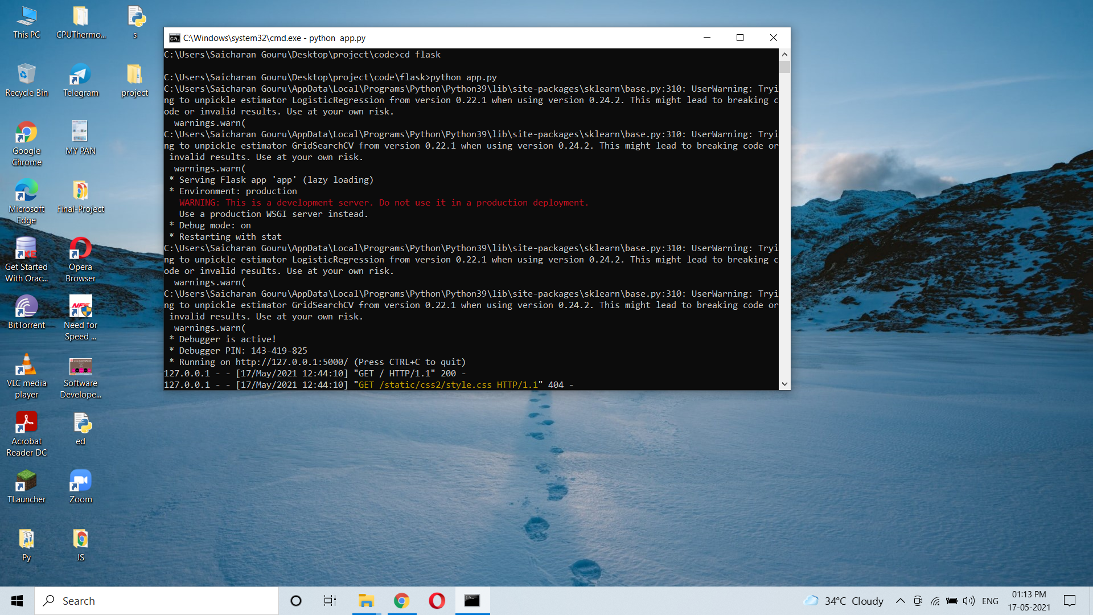
EXECUTION SCREENSHOTS

Slide 12
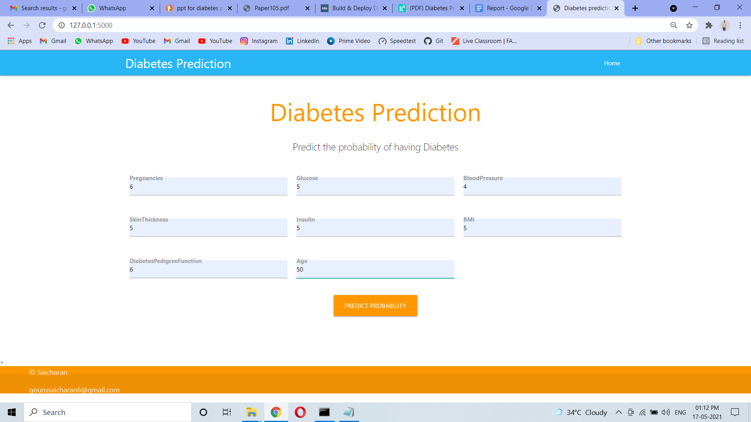

Slide 13
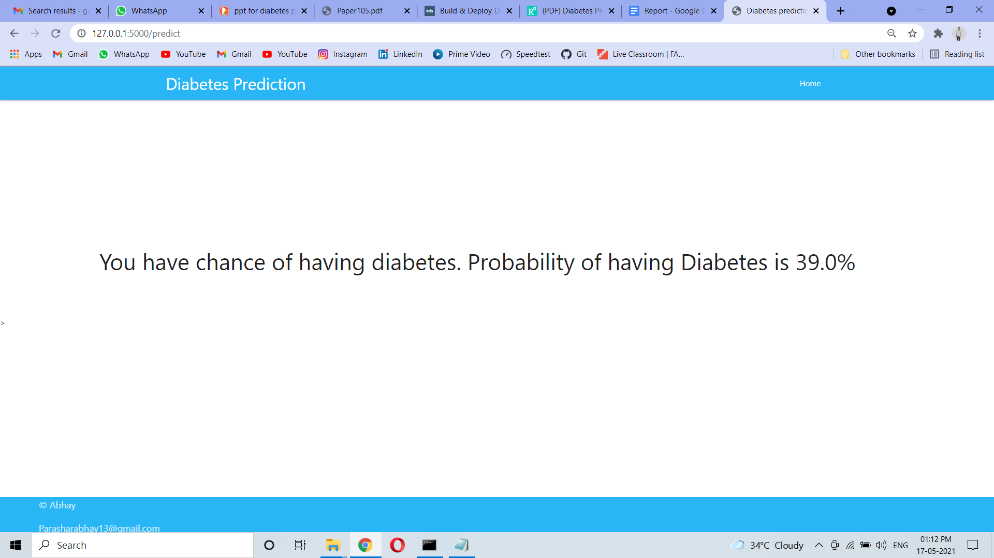

Slide 14
CONCLUSION
Machine learning has the great ability to revolutionize the diabetes risk prediction with the help of advanced computational methods and availability of large amount of epidemiological and genetic diabetes risk dataset. Detection of diabetes in its early stages is the key for treatment. This work has described a machine learning approach to predicting diabetes levels. The technique may also help researchers to develop an accurate and effective tool that will reach at the table of clinicians to help them make better decision about the disease status.

Slide 15
THANK YOU
SAICHARAN GOURU

