Slide 1
Caravel++
A System on Module
Steve Casselman, CEO
Hotwright

Slide 2
OpenFPGA needs a better prototyping system
The Caravel framework currently being used does not have the resources to address the many needs of the industry
To address this, I propose a SOM approach
First, I propose a Caravel like framework that has more capabilities
64-bit RISCV
DDR
A/D
D/A
MIPI
USB-JTAG
USB-UART
Ethernet
Network on chip
Quad SPI
4-bit PCIe
HDMI in and out

Slide 3
Build a standard baseboard for the SOM to plug into
Possible baseboard formats
Low-profile 4-bit PCIe
Mini PCIe (for laptops)
https://www.assured-systems.com/us/news/article/what-are-mini-pci-express-mpcie-cards/
FlexATX with one 4-bit expansion slot
Board features
DRAM
USB ports
HDMI in and out ports
VRM (to support different geometries)
Audio
Ethernet
Different baseboard might have different sets of features, but they all accept thestandard Caravel++ SoM

Slide 4
Caravel++ SoM
Caravel++ has a standard set of pinouts
Caravel expects the baseboard to supply the correct voltages needed
Uses VRM on the baseboard
Voltage requirements are sourced from the device, not the SoM PCB
Caravel++
Chip
SoM PCB

Slide 5
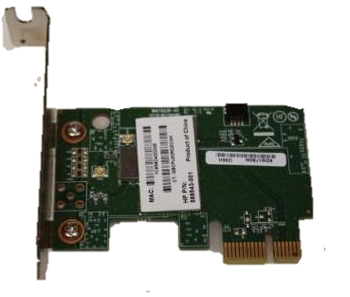
PCIe baseboard with Caravel++ SoM
SD card
Caravel ++
SoM

