Slide 1

Iteration 1- Truffle
TEAM-1
SAICHARAN PAGIDIMUNTHALA - 1002006773
RAMYA MADDINENI - 1001965818
BHARGAV SUNKARI - 1002028016
DILEEP KUMAR NAIDU RAVI - 1002023397

Slide 2
We have gone through various tools and extensions while doing the research we found these which can be used in this project the various personal blockchain Ethereum like Ganache, Embark, Remix and tools like Lerna, Yarn Workspaces and Bolt.

Slide 3


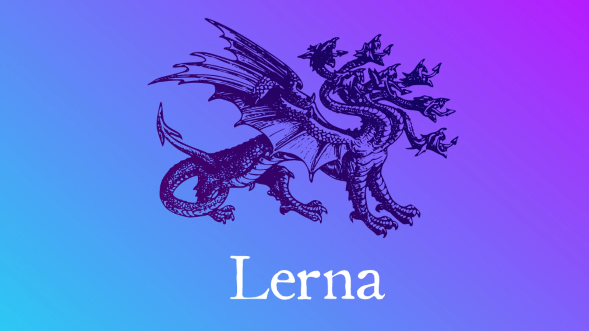
Tools That We are Using
TRUFFLE
GANACHE
LERNA

Slide 4
Planning for Remaining Iterations:
Iteration 1 : Reproduce all the issues, explore the packages and find the issue.
Iteration2 : Bootstrap truffle source code and integrate ts-node locally.
Iteration 3 : Add a Flag to unbox typescript added boxes.

Slide 5
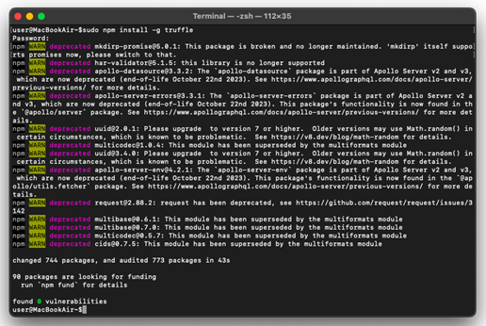
Installation Of Truffle.
We First install the package manager that is NPM and Node.
NPM – It is the default package manager for the the JavaScript which is primarly used for node.js projects.
The Node and Npm are some of the most powerful tools for allowing developers to build complex projects.
Then we install truffle with the command $npm install –g truffle .
For this project to fix the issue that is there we are going to use the truffle version@5.5.24

Slide 6
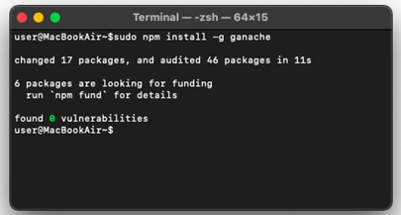
Installing Ganache
Ganache is one of the personal blockchain Ethereum development platform which frequently used with the Truffle framework.
It simulates different network conditions such as slow transaction which are used to generate custom block chain events for testing purposed.
To use the Ganache with the truffle the developer can configure them by running the truffle project on ganache running in their machine.
To install Ganache on our machine we can use the command $ npm install –g ganache.

Slide 7
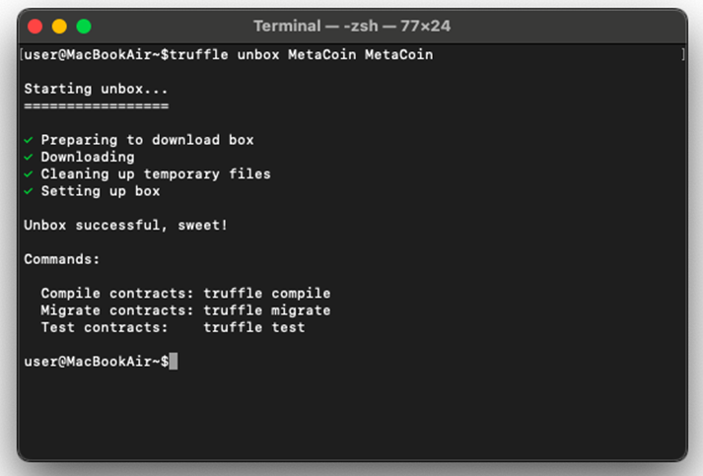
Reproducing The Issue
I have reproduced the issue by following the steps as mentioned in the issue.
With the truffle installed, unbox any templates. we unboxed Metacoin by running: [3]
$ truffle unbox MetaCoin MetaCoin
Change the working directory to MetaCoin and run the below commands to add typescript modules: [4]
$ npm i -D typescript
$ npm i -D ts-node

Slide 8
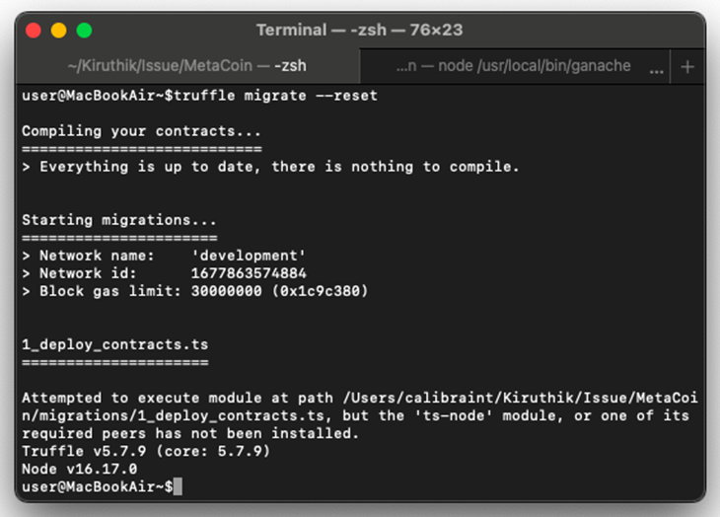
Reproducing The Issue( Cont..)
Configure truffle-config.js to connect to my local node by running the below command in a separate terminal: [5]
$ ganache
Rename 1_deploy_contracts.js to 1_deploy_contracts.ts and run:
$ truffle migrate --reset

Slide 9
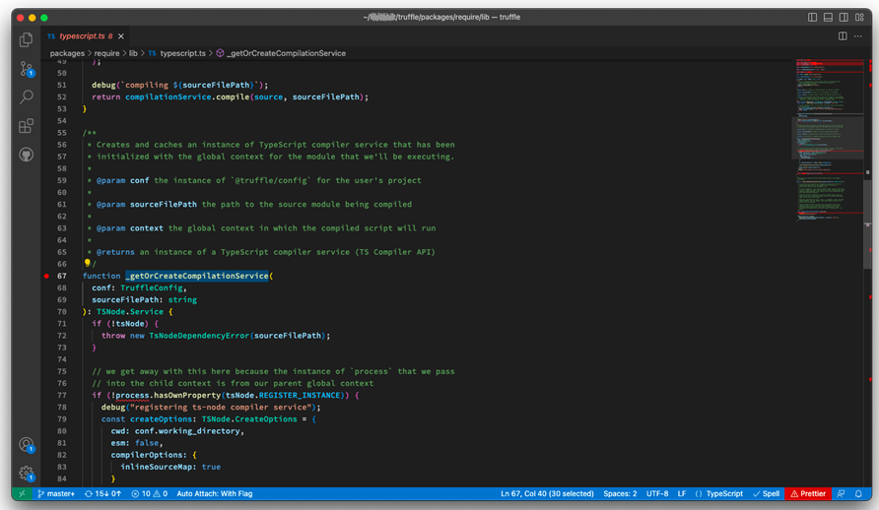
Finding The Issue
@truffle/require is responsible for importing modules
its supported typescript in default but fails to do so when the project couldn’t check for its (ts-node) peer dependencies.

Slide 10
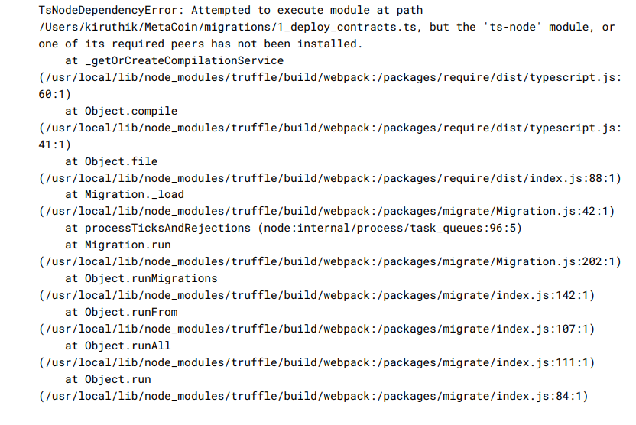
Node Dependency Error:
This issue does not reproduce when running truffle from the local dev environment (either via cli.js or the webpack bundle)[3]

Slide 11
Customers and Users
●As these are primarily used for building the Decentralized applications.
The Customers and the users are primarily the Developers who build smart contracts and Decentralised apps who deploy their contracts on the Ethereum blockchain technology.
Also many organisations started using these blockchain technologies Organisation such as the Financial institutes such as banks for cross border money transfer services etc.
Health care industry also using these services as it provide more security to the patient data and also for medicinal drug supply etc.
Additionally Governments across the world are using these technologies however it might be difficult to tell which technology they are specifically using but Governments like Dubai, India, China, Estonia etc.
After the modifications that are to be done users that use typescript to deploy the contracts on the local environment can use this tool .

Slide 12
Risk Factors and Mitigation Plans
Risk | Mitigation Plan
Analyzing Dependency issue | Considering a solution to solve the typescript error
Adapt Typescript programming language syntax | Daily Spending Some time for Typescript language.
Some bugs and defects may go unnoticed until and unless deployed on the live Ethereum Network | Must use built-in tools for testing the smart contract and also use the code Reviews and formal verifications.

Slide 13
References
● https://github.com/trufflesuite/truffle#install [1]
● https://github.com/trufflesuite/ganache#command-line-use [2]
● https://github.com/trufflesuite/truffle/issues/5381 [3], [4] and [5]

Slide 14
THANK YOU
Any Questions?

