Slide 1
Advance Software Engineering CSE 6324 -004 Iteration 2
Team 1:
SAICHARAN PAGIDIMUNTHALA - 1002006773
RAMYA MADDINENI - 1001965818
BHARGAV SUNKARI - 1002028016
DILEEP KUMAR NAIDU RAVI - 1002023397
GitHub Repository:
https://github.com/saicharan1248/cse6324_team1_project.git

Slide 2
Project Plan:
Install Python v3.6+ & solc compiler.
Install Slither.
Load the solidity contract.
Set up the solc compiler version.
Add error_top_level to compilation unit.
Update flattening.py to read the custom errors from top level.
Analyze the solidity contract.
Generate the report.

Slide 3
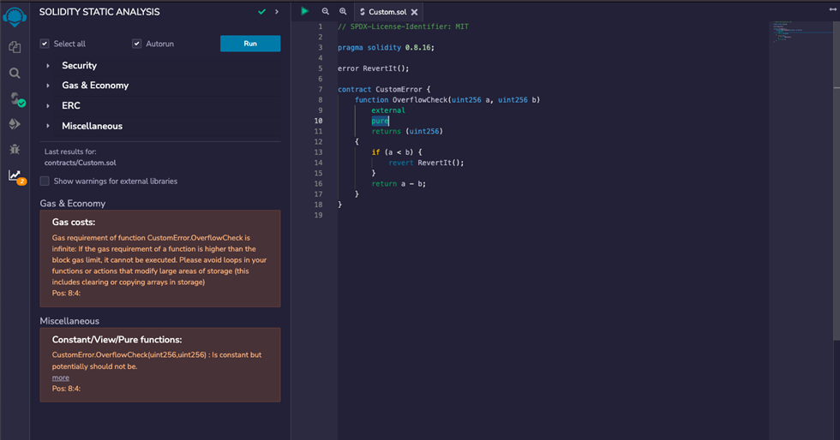
COMPETITOR – REMIX IDE
We checked the possible vulnerability that can possibly be caused by that issue. And this is what we found on the analysis report generated by Solidity Static Analysis extension[1].
The storage warning is irrelevant as the custom error is defined outside the contract which is misread by the slither-flat tool.

Slide 4
DEMO

Slide 5
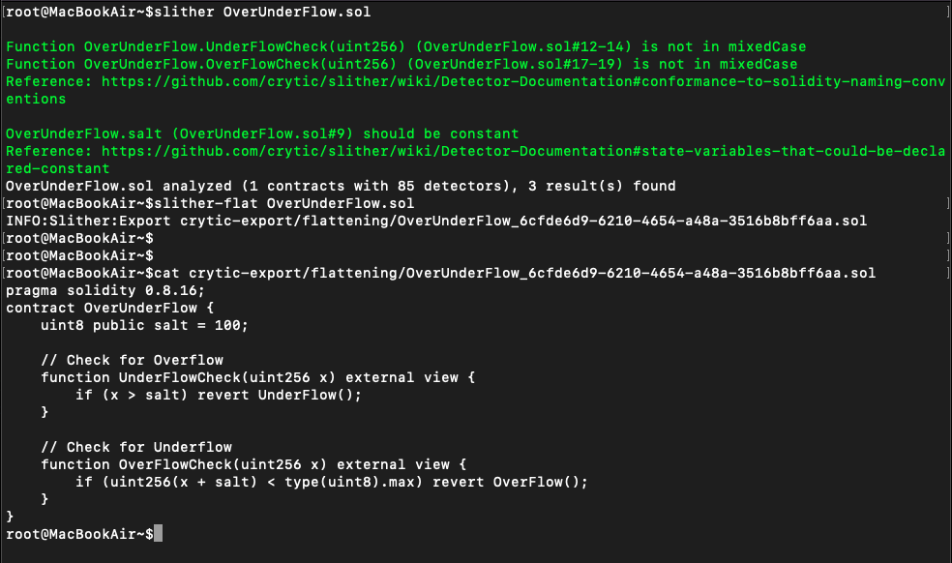
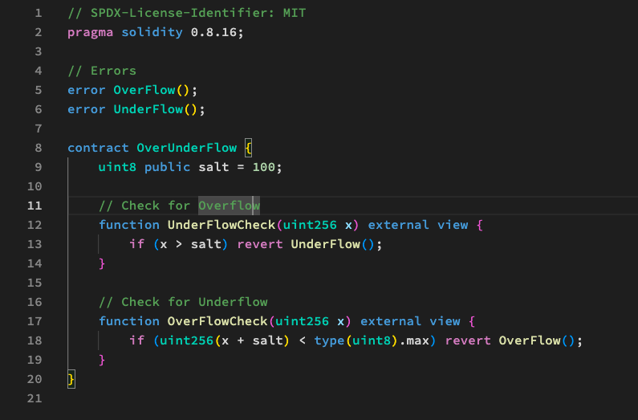
Flattening Smart Contract

Slide 6
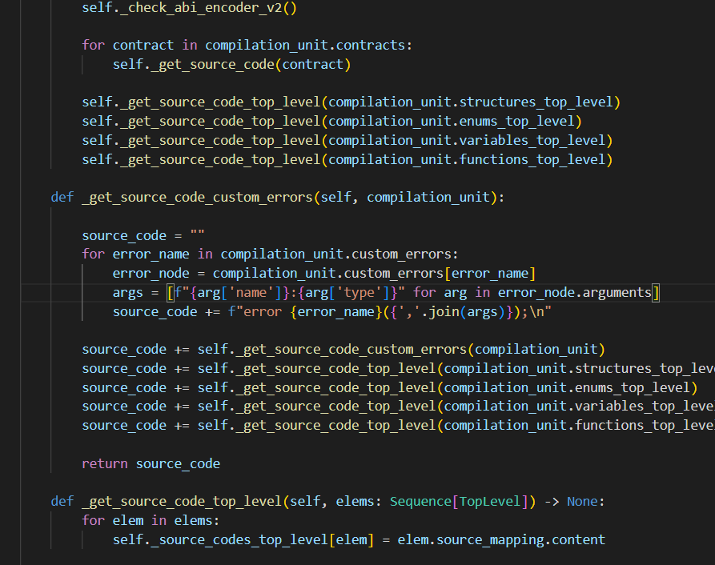
Implementation

Slide 7
Pseudo Code
This defines a method called _get_source_code_custom_errors that takes in a compilation_unit object as a parameter. This method will extract any custom errors defined outside of a contract and add them to the flattened code.
This initializes an empty string called source_code that will be used to accumulate the flattened code.
This loop iterates over each custom error defined outside of a contract in the compilation_unit.
This line retrieves the node representing the current custom error being iterated over.
This list comprehension generates a list of strings for each argument in the current custom error node, where each string is of the form "argument_name:argument_type".
For example, if a custom error has two arguments called "a" and "b" of type "uint256" and "address", respectively, the resulting list would be ["a:uint256", "b:address"].

Slide 8
Pseudo Code
This line adds a string to source_code that represents the current custom error being iterated over, in the form "error error_name(argument1_name:argument1_type, argument2_name:argument2_type, ...);".
For example, if a custom error called "MyError" has two arguments called "a" and "b" of type "uint256" and "address", respectively, the resulting string would be "error MyError(a:uint256,b:address);".
This line recursively calls the _get_source_code_custom_errors method to include any nested custom errors defined inside other custom errors.
These lines call the _get_source_code_top_level method on each of the top-level components of the compilation_unit (structures, enums, variables, and functions) and add the resulting strings to source_code.
Finally, this line returns the flattened source code, which includes any custom errors defined outside of a contract.

Slide 9

Risks & Mitigation Plan
Risk | Mitigation
Lack of understanding of Solidity language | Spend time understanding the language before starting the work and seek advice from experts through the developer community.
Technical issue - inexperience in static analysis | Spend time understanding Slither.
Technical issue - inexperience with Python | Spend time learning python.
[1]

Slide 10

User's & Customers
Customer | User
Aishwarya Kalmangi | More sample solidity contracts must be tested for This method to Work.
Sai Nikhil Kanchukatla (CSE 6324-Team8) | Simple method to implement But, still need some modification .

Slide 11
References:
Slither, the Solidity source analyzer [1]
Contract Flattening in Slither flat [2]
Solc compiler [3]
Solc select [4]
Installing Solidity compiler [5]
Installing solc-select [6]
Install Slither [7]
Tools: slither-flat [8]
Compilation Unit [9]
RemixIDE - Static analysis [10]

Slide 12

Thank You
Any Questions?

