Slide 1
Advance Software Engineering CSE 6324 -004 Final Iteration
Team 1:
SAICHARAN PAGIDIMUNTHALA - 1002006773
RAMYA MADDINENI - 1001965818
BHARGAV SUNKARI - 1002028016
DILEEP KUMAR NAIDU RAVI - 1002023397
GitHub Repository:
https://github.com/saicharan1248/cse6324_team1_project.git

Slide 2






Contents:
Introduction
Project Plan
Issue Resolved
Users and Customers
References

Slide 3
Introduction:
Flattening is accomplished by substituting the actual source code of the imported contracts for the import statements in the contract.
Flattening, which is often done before deployment, offers a single contract file including all of the necessary code, which helps to simplify interaction with smart contracts.

Slide 4
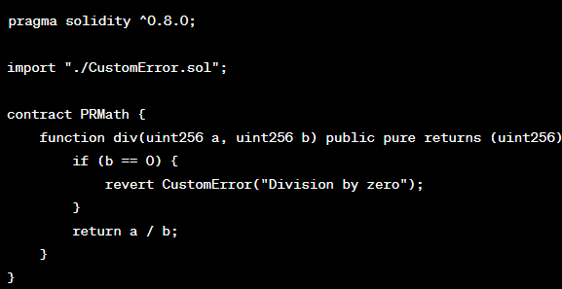
Custom Errors And Flattening
Custom Errors : The Custom Errors are introduced to the Solidity with the version 0.8.4 they allow developers to define the custom error and use them in smart contracts, It provides more efficient way of handling the errors when compared to the revert and require.
The Custom errors are defined with the error keyword and then by a name and an list of optional parameters.
Flattening is often used when the tools require a single solidity file as input, like the static analysis tool.

Slide 5







Project Plan: Final Iteration
Introduction: [2]
Install Python v3.6+ & solc compiler.
Install Slither.
Load the solidity contract.
Set up the solc compiler version.
Add error_top_level to compilation unit.
Update flattening.py and compliation_unit to read the custom errors from top level.
Analyze the solidity contract.
Link: https://github.com/crytic/slither/issues

Slide 6
Resources Used
Programming Language: Solidity v0.8.16
Tools: Visual Studio Code v1.77.3
Repository: GitHub
Compiler: SolC v0.8.16
Python v3.11
Pull request raised for the issue #1410:

Slide 7
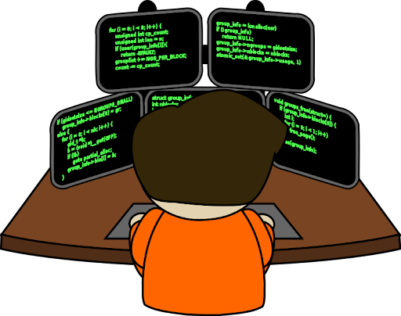
What kind of customers/users use Slither and how is it useful for them? [3]
Developers, security auditors, and blockchain researchers frequently use Slither to examine Solidity smart contracts.
The custom error problem has just been resolved by Slither, ensuring that the tool correctly recognizes and handles custom errors in contracts, making it simpler to investigate them.
Since they must find and assess potential contract vulnerabilities, security auditors in particular can gain from this update.
Thanks to Slither's logging level modification, the flattening tool output is now simpler to read and comprehend.
These changes improve Slither's accuracy and usability, making it more advantageous for Solidity smart contract users across a variety of industries.

Slide 8
Competitors for Slither
Competitors | Why they better than Slither Flat
Truffle’s Built-in Flattener | The Truffle suite has a built-in flattener tool that can flatten Solidity smart contracts. The flattener is easy to use and is included with the Truffle suite
Solidity Flattener | The tool is available as an NPM package and can be installed via the command line. It supports custom error messages and can flatten contracts with multiple inheritance

Slide 9
DEMO

Slide 10
Implementation
Code And Tests: Issue Worked upon

Slide 11
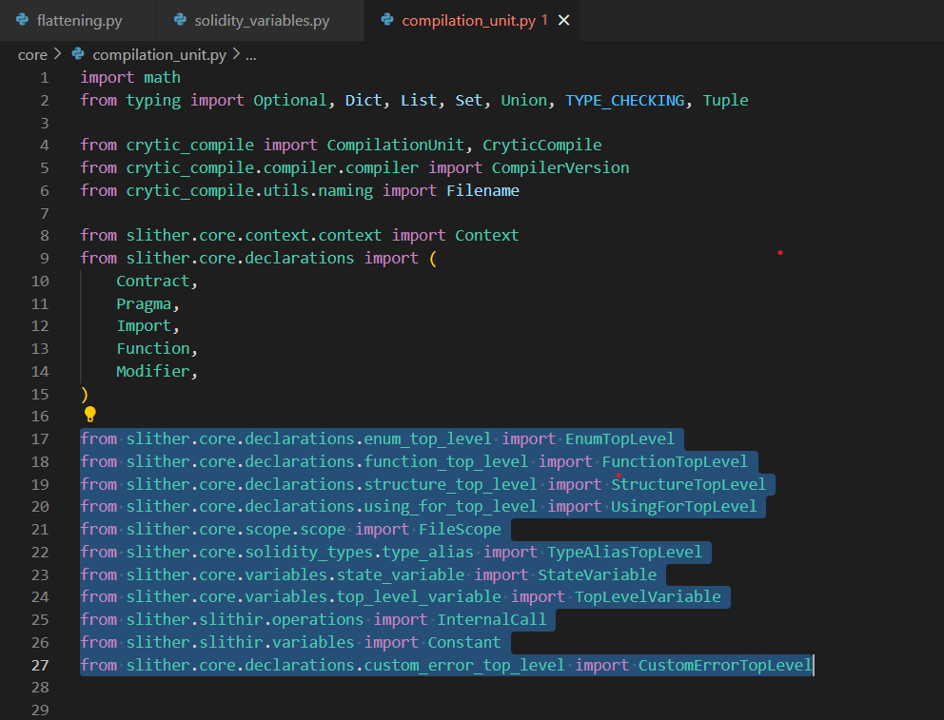



Slide 12
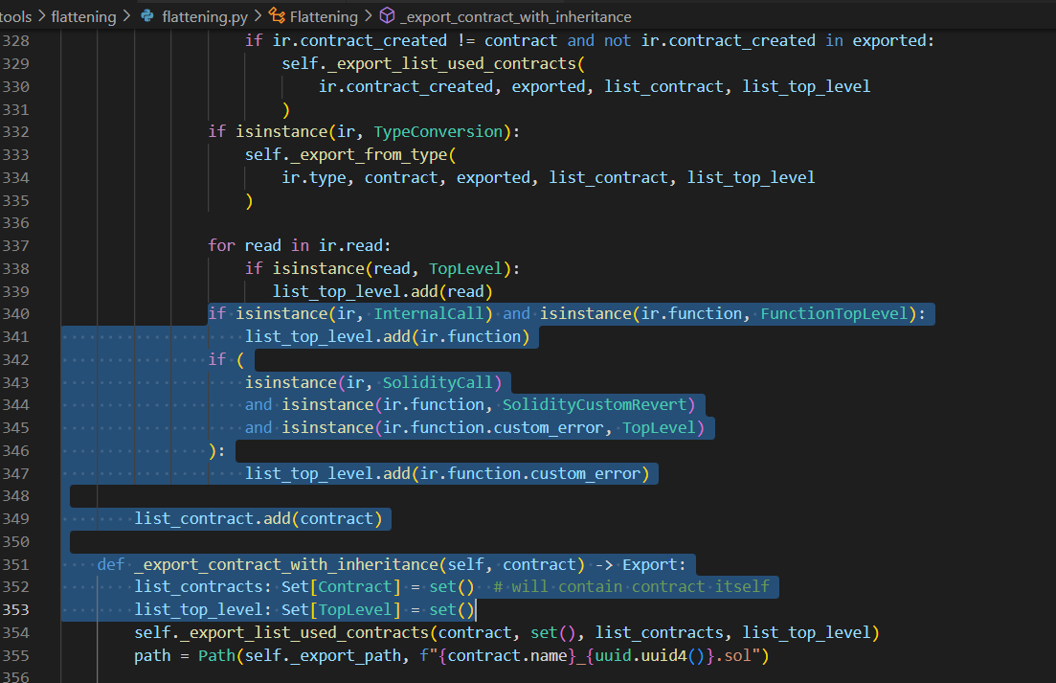

Slide 13
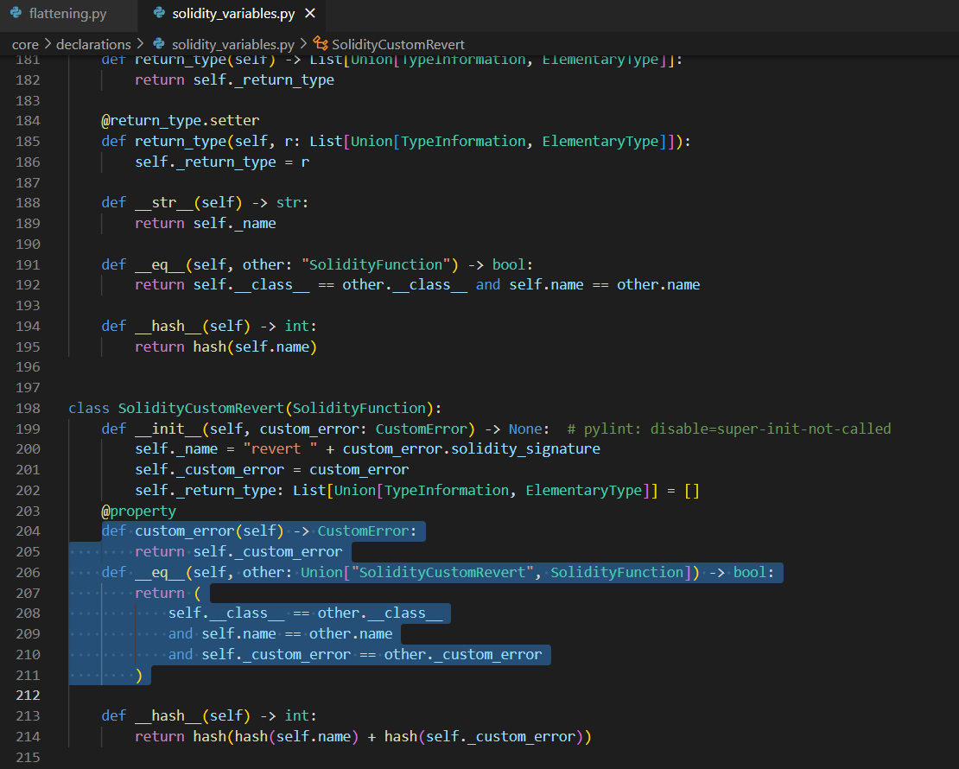

Slide 14
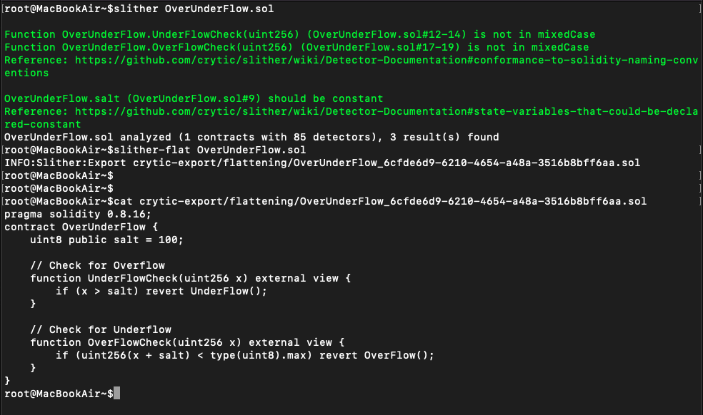
Flattening Smart Contract Issue in Contract

Slide 15
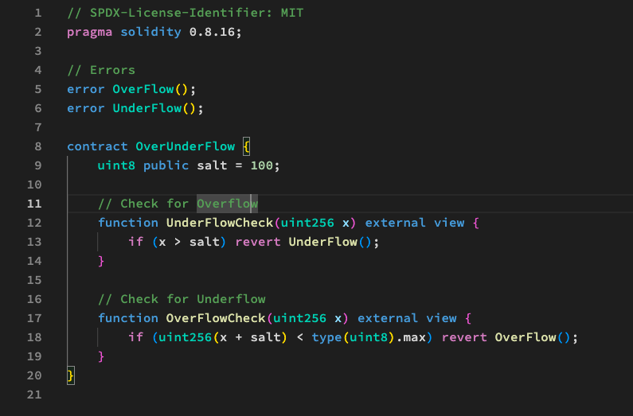
OverUnderFlow Smart Contract

Slide 16
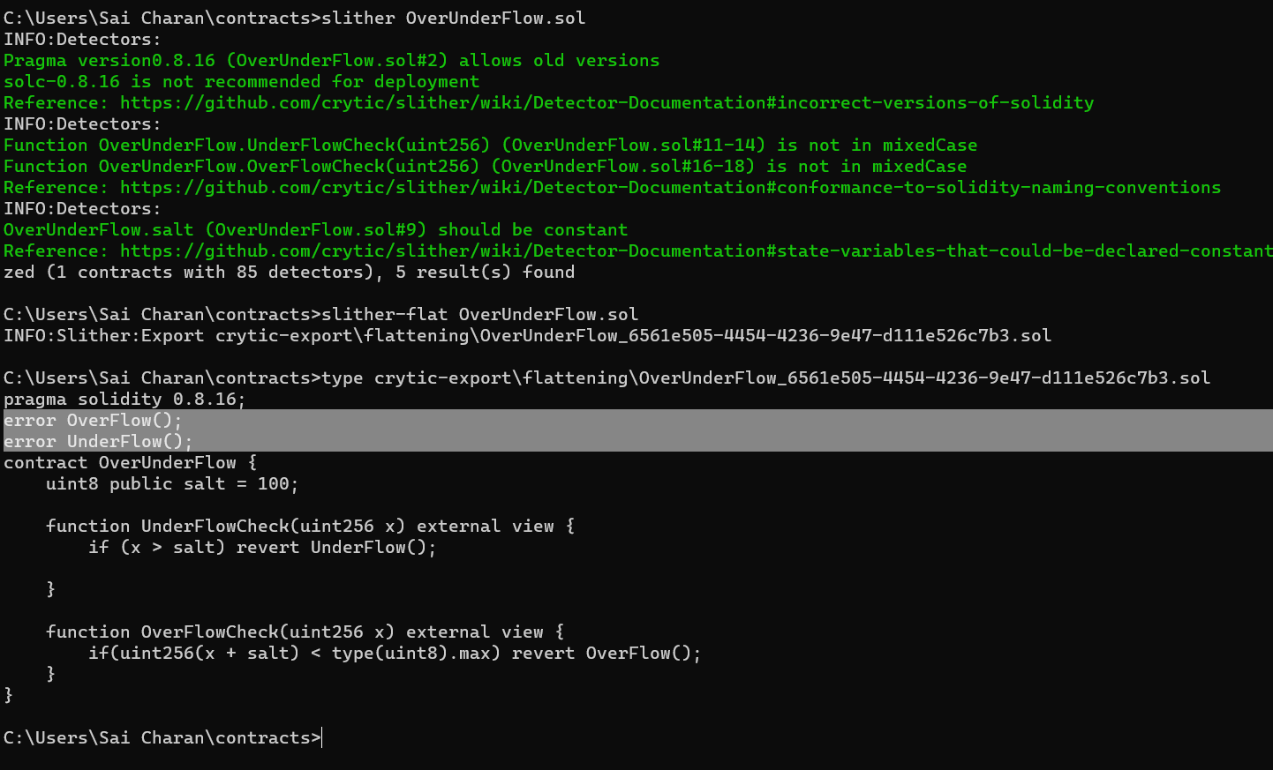
Flattening Smart Contract After Issue Resolved

Slide 17
Risks & Mitigation Plan
Risk | Mitigation
The Slither file modification in local proved to be very difficult because of editing the existing code. | We needed a strong local machine setup for the quicker analysis.
The modified termination may lead towards having the false positives/negatives. | For the false positives/negatives validate the tool’s output so that we can be sure about the accuracy of the results
Technical issue - Inexperience in static analysis and solidity | Progress as moving forward.
[1]

Slide 18

Users and Customers
Customer | User
Aishwarya Kalmangi | Because of this issue many smart contracts can be tested for excepted erros.
Sai Nikhil Kanchukatla (CSE 6324-Team8) | Simple method to implement, Modifications are done well. It can be useful for code analysis.
Sai Dinesh Reddy Palavalli | Looking forward for the Professor/TA evaluation on the suggested solution.

Slide 19
References:
Slither, the Solidity source analyzer [1]
Contract Flattening in Slither flat [2]
Solc compiler [3]
Solc select [4]
Installing Solidity compiler [5]
Installing solc-select [6]
Install Slither [7]
Tools: slither-flat [8]
Compilation Unit [9]
RemixIDE - Static analysis [10]

Slide 20

Thank You
Any Questions?

