Slide 1
UE19CS390B – Capstone Project Phase – 2
SEMESTER - VII
END SEMESTER ASSESSMENT
Project Title : Automated MCQ Generation
Project ID : PW22_DS_02
Project Guide : Prof. Dinesh Singh
Project Team : Saicharan-PES1UG19CS329
Abhishek M Bhayya-PES1UG19CS022
Kundansai-PES1UG19CS049
Rashi-PES1UG20CS827

Slide 2
Outline
Abstract
Team Roles and Responsibilities.
Summary of Methodology / Approach (Capstone Phase - 1)
Modules and Implementation Details
Results and Discussion
Conclusion and Future Work
References

Slide 3
Abstract
The most important thing in learning is assessment and the question is crucial for assessment. Online tests are becoming more common at universities, colleges and other educational institutions. The assessment pattern is largely evolving towards objective assessment, i.e., MCQ’s, Fill in the blanks, Match the following and True or False based. Even though MCQ’s have many advantages like electronic evaluation and less testing time, exam question preparation by hand is a difficult undertaking for educators, when the time is limited. To address this issue in the development of objective assessment, this study offers an automated exam question generator.
Following the reading of an instructive line from the book, which is a true sentence, several fake phrases are created, not only by replacing the true statement’s core terminology with an antonym but also by negating it. The True and False statements are randomly rearranged to create the test questions.
In order to perform well in examinations, students must be able to recall and apply key ideas from their course material. Practice and self-evaluation through questions are essential to accomplishing this. Therefore, we introduce an automated system for Gap-Fill Question generators.
An automated MCQ Generation system is both cost- and time-effective is becoming increasingly necessary. Distractors are created using Wordnet and Sense2Vec in order to generate options for queries.

Slide 4
Team Roles and Responsibilities
Work roles | Name
MCQ Generation, True or False Questions | Saicharan Polishetty
Fill in the Blanks, True or False Questions | Abhishek M Bhayya
Match the Following, True or False Questions | Amadaguru Kundansai
Generation of Distractors and Keyword Extraction | Rashi

Slide 5
Summary of Methodology / Approach
The methodologies general framework is to produce pertinent questions from literature to assess the user’s comprehension. We created a variety of questions using middle school literature as the input, including Multiple Choice Questions, False from True assertions, Match the Following and Fill in the Blanks.
MCQ Generation
There are two main steps that must be used in order to construct a MCQ question.
● Creation of Distractors (WordNet,ConceptNet,Sense2Vec,Sentence Transformers)
● Creation of Questions (T5)
MATCH THE FOLLOWING
We’ll utilize the Python Keyword Extraction package to extract the keywords from the context. Therefore, once the keywords have been extracted, those keywords can be used to replace the words on the left of the following match, and their meanings are provided on the right side.
We’ve taken the keywords from a piece of material, but the task here is to take the sense of the word. We won’t be able to discern the precise meaning of the word being used in our context without knowing the context’s specifics. The term for this issue is Word Sense Disambiguation (WSD)

Slide 6
Summary of Methodology / Approach
Fill in the Blanks
● Utilize the Python Keyword Extraction package to extract keyphrases(unsupervised keyphrase extraction with multipartite graph algorithm).
● Return to our content and collect every sentence containing a specific key phrase.
● We choose any sentence from the list of sentences, just change our keyword to “blank”, and then instruct the reader to fill in the blanks.
Our objective is to identify the top-ranking nodes among all the nodes with associated edges and use them as the top 10 keywords or key phrases in the article.
Generate False statements from True statements
Using Constituency Parsing and OpenAI GPT2, we will create True or False questions based on the input text.
Using Natural Language Processing techniques, we will change the verb or noun phrase in a valid statement to create a false one.
● Finding a noun phrase is the first step in using constituency parsing techniques to comprehend the sentence and identify the final noun or verb phrase.
● Split out the final word or verb to finish the sentence.
● Give the incomplete sentence to the OpenAI GPT-2 to finish it.

Slide 7
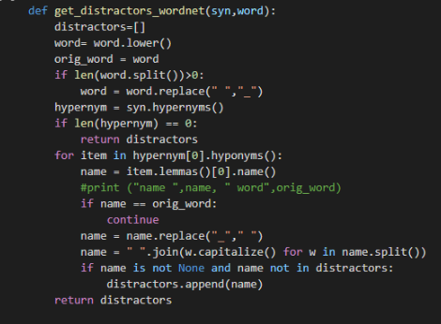
Modules and Implementation Details
Distractor Generation
(1) WordNet
This lexical database covers the connections between words' meanings. It collects associations between words and marks their semantic relationships.

Slide 8

Modules and Implementation Details
So, given a word that is our best guess, we produce all of its synsets (senses), select the first sense from the list, and provide it to the function. First, all the hypernyms for the word are generated in the function. Then, the first hypernym is selected, and then all the hyponyms are generated for the word. We perform the lemma.
(2)Concept Net
A free multilingual knowledge graph is Conceptnet. Similar to wordnet, it labels the semantic connections between the words, though these connections are more thorough. The notion network contains several relationships, such as is a, part of, made of, and similar to. However, we just employ a portion of the relation to generate the distractor. In order to identify all the hypernyms for a word, we first query the conceptnet using the url and query all the relations that have a part of relationship and start with the word. To retrieve the hyponyms, go over each word and look for where it appears on the right side of the relation. Co-hyponyms for the given word are obtained by combining the two lists.

Slide 9
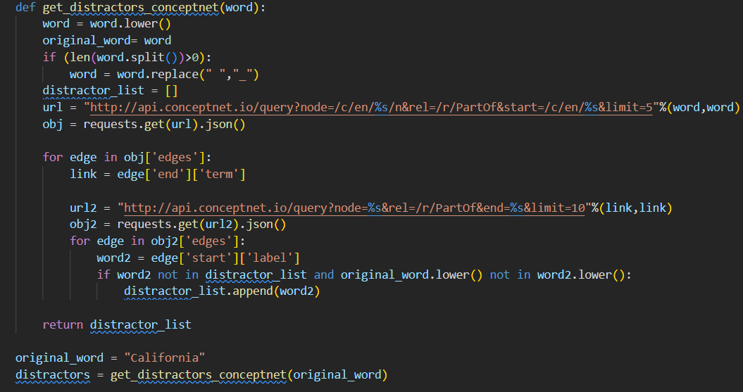
Modules and Implementation Details

Slide 10
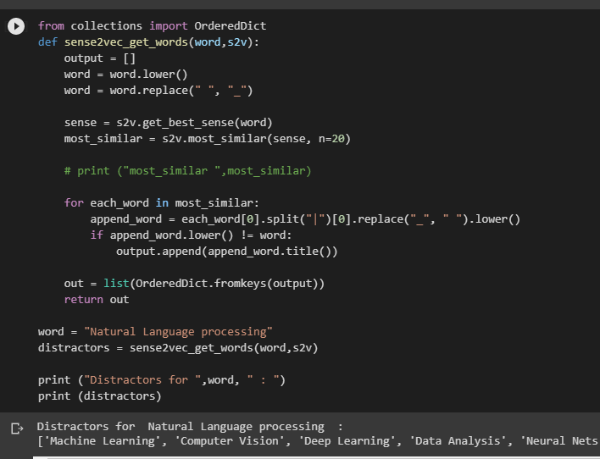
Modules and Implementation Details
(3)Sense2Vec

Slide 11
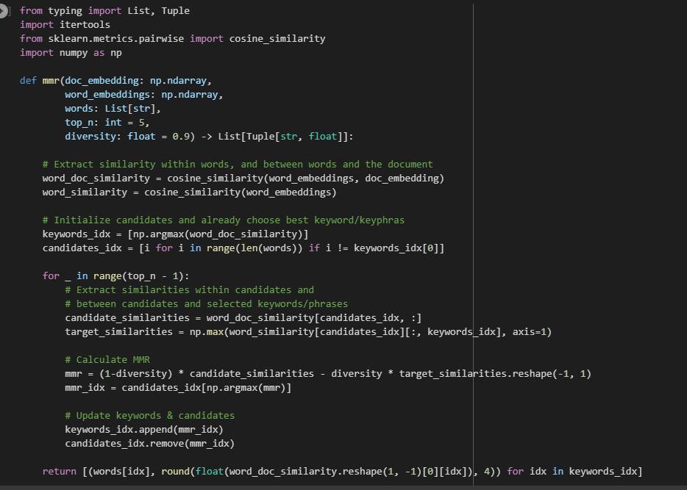
Modules and Implementation Details
(4) Sentence Transformers

Slide 12
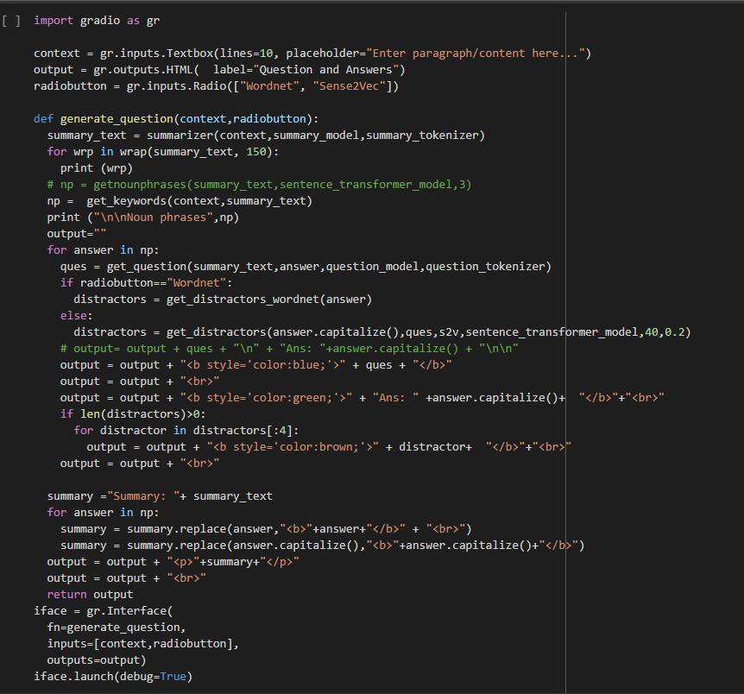
Modules and Implementation Details
MCQ Generation

Slide 13
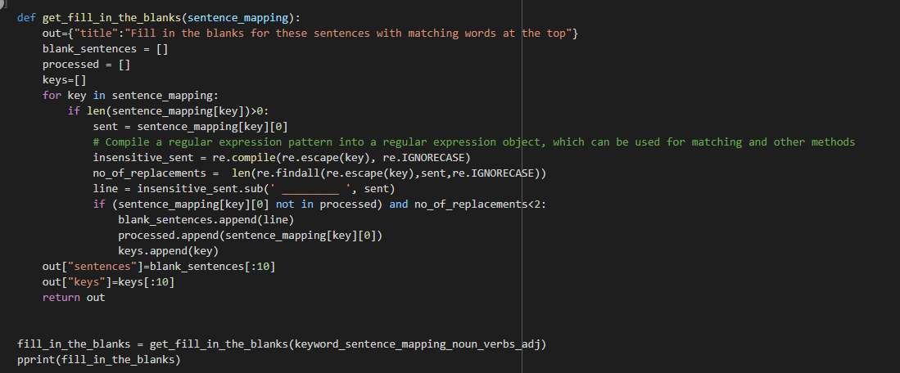
Modules and Implementation Details
FILL IN THE BLANKS
First given a context we store all the sentences in an array and discard any sentence greater than 20.then we find all the keywords from the text which are combination of nuns words and adjective using multipartite rank library.we then go back to our context and for all the keywords we find the corresponding sentences and store it in a dictionary which are sorted according to their length.we get the first sentence and replace the keywords with a blank thus getting the fill in the blanks.

Slide 14
Modules and Implementation Details
Match the Following
Given an input text, key words are extracted using the built-in Yake algorithm from the Python keyword extraction module because keywords for just one-word Yake gives us better results. After that, we will divide the content into sentences in order to extract all the sentences from the story that contain our keywords. By doing this, we will be able to determine what each keyword means and build our Bert base model.
We are going to take the last output vector's hidden state and map it to only one value, adding the special token TGT to help with disambiguation, and switching our model to evaluation mode because we are doing inference rather than training. Create feature records adds the tokens CLS and SEP, uses the Truncate Sequence pair function to pair sequences of different lengths (128), then passes the tokenized sentences and receives the score after randomising the sentences and key words using the Shuffle in Random Module.

Slide 15
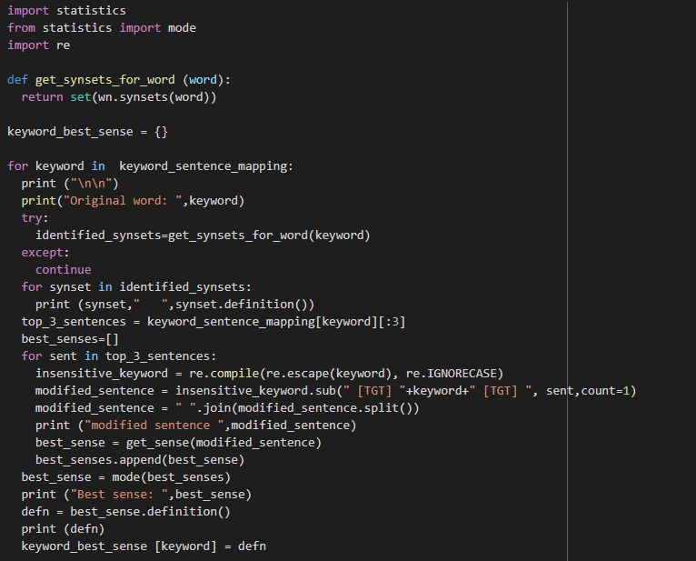
Modules and Implementation Details

Slide 16
Modules and Implementation Details
True or false
Using the Allen NLP Constituency Parser, we first transform the given text into a tree object with all of its characteristics. Then we attempt to spit the noun or verb phrase that ends that tree. However, there is an issue. After separating the final noun phrase and verb phrase, we select the larger of the two and eliminate it from the original sentence. String matching cannot be used since there is no exact correspondence between the final sentence and the starting sentence. To autocomplete the text with a false option, we feed the altered sentence to an openAI GPT-2 model.
T5
We first obtain the squad dataset from the dataset library. Make a data frame with the context, the question, and the response. then use the context and the response as inputs to the model's training and validation datasets, which in turn provide the question as an output. and train a T5 transformer model question generator. then create a pytorch dataset from the previously trained T5 transformer model, conduct inferences using this trained model.

Slide 17
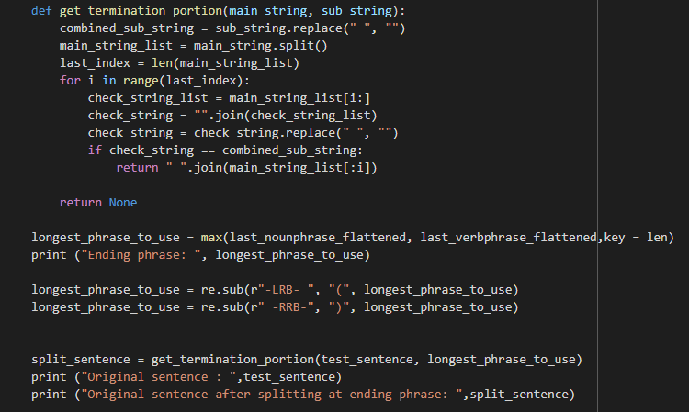
Modules and Implementation Details

Slide 18
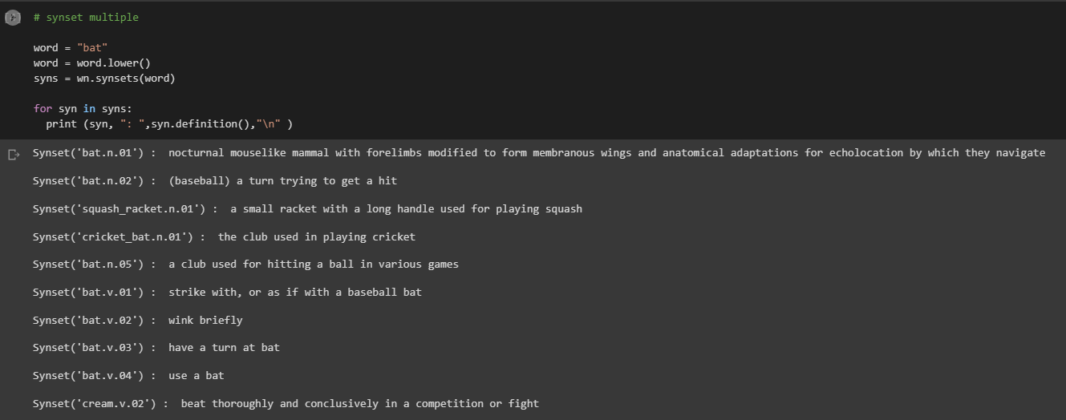
Results and Discussion
MCQ Generation
Distractors generation
Wordnet

Slide 19
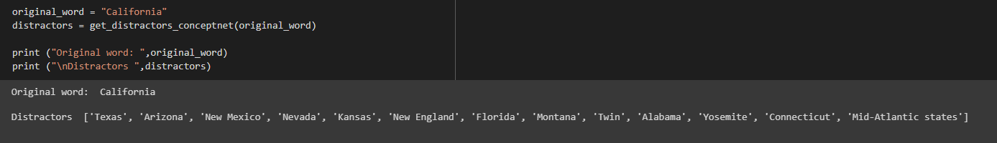
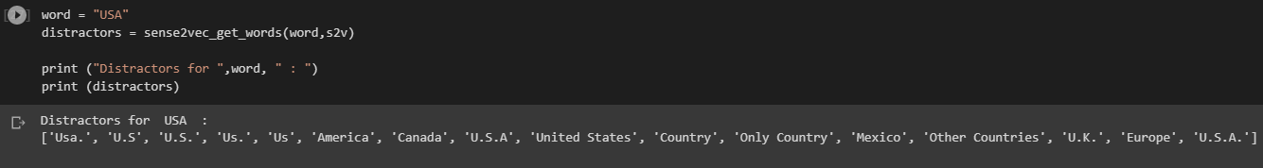
Results and Discussion
ConceptNet
Sen2Vec

Slide 20
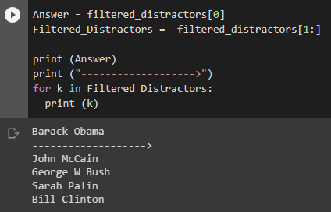
Results and Discussion
Sentence transformers

Slide 21
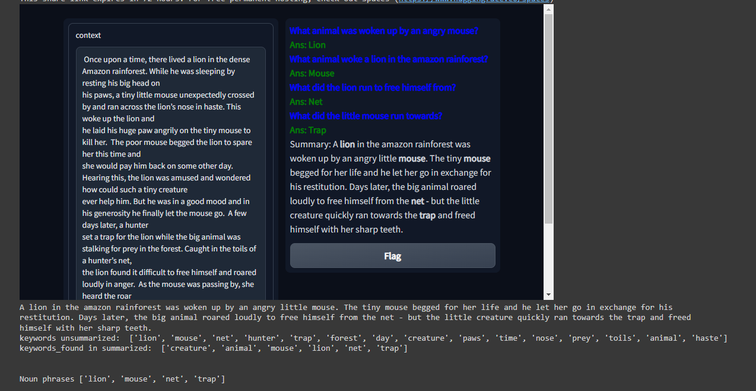
Results and Discussion
Question Generation

Slide 22
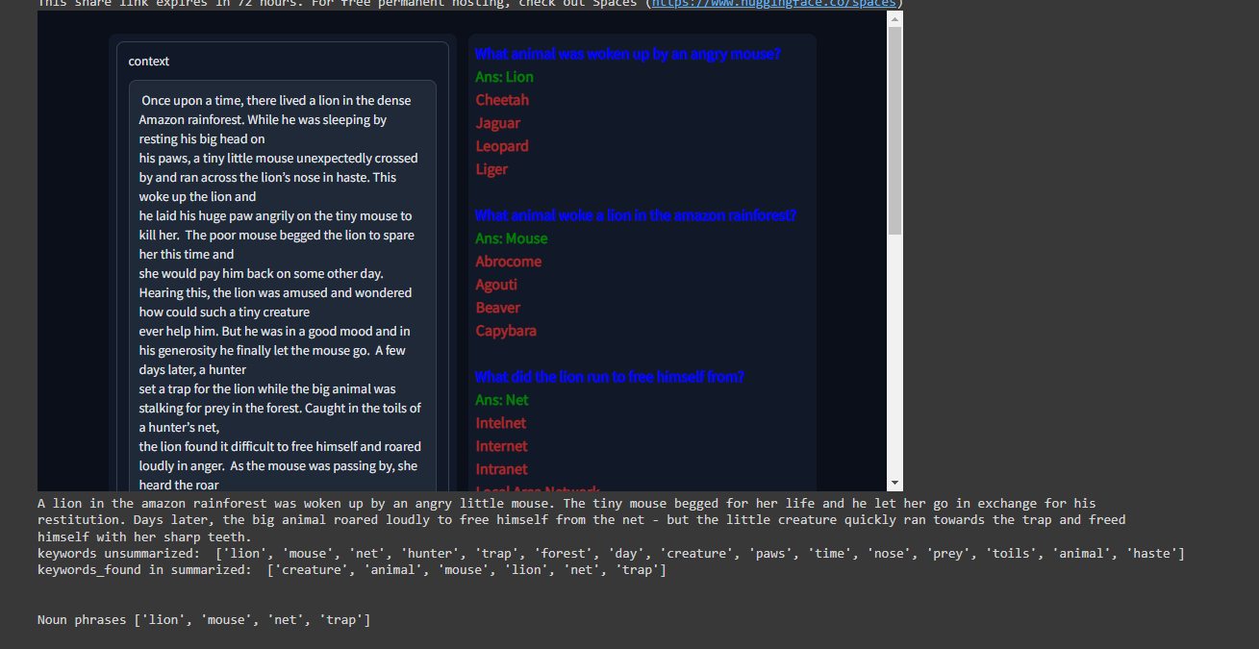
Results and Discussion
MCQ generation

Slide 23
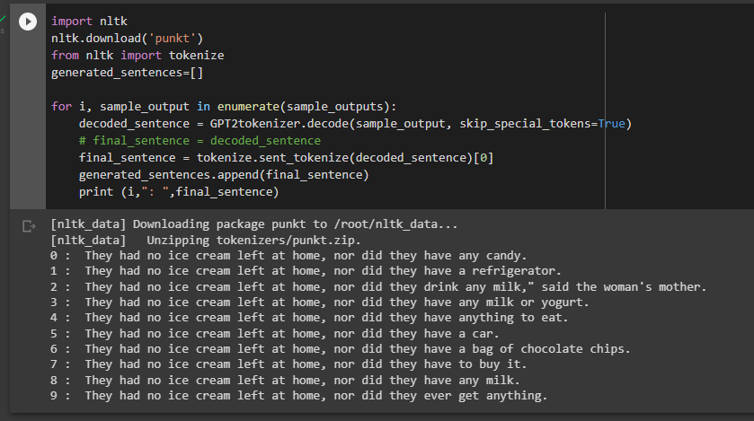
Results and Discussion
True or False Questions

Slide 24
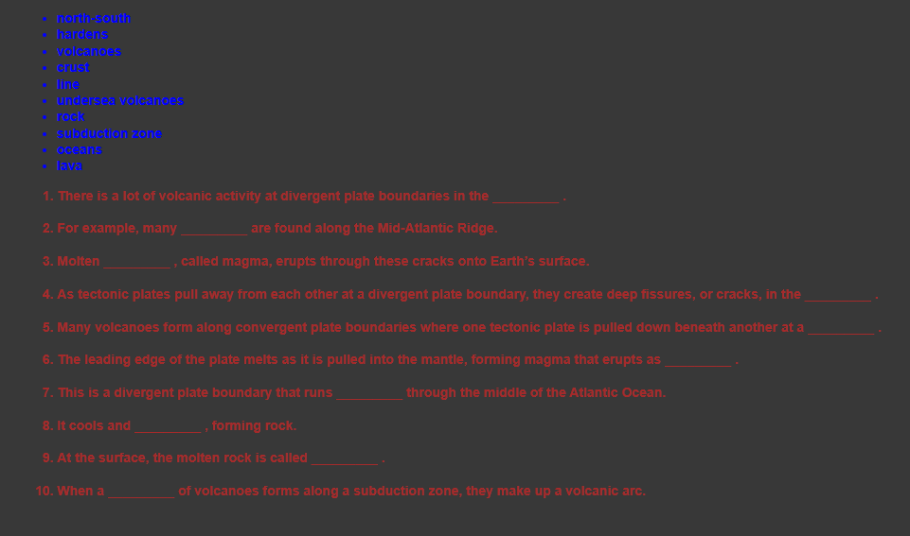
Results and Discussion
Fill in the Blanks

Slide 25
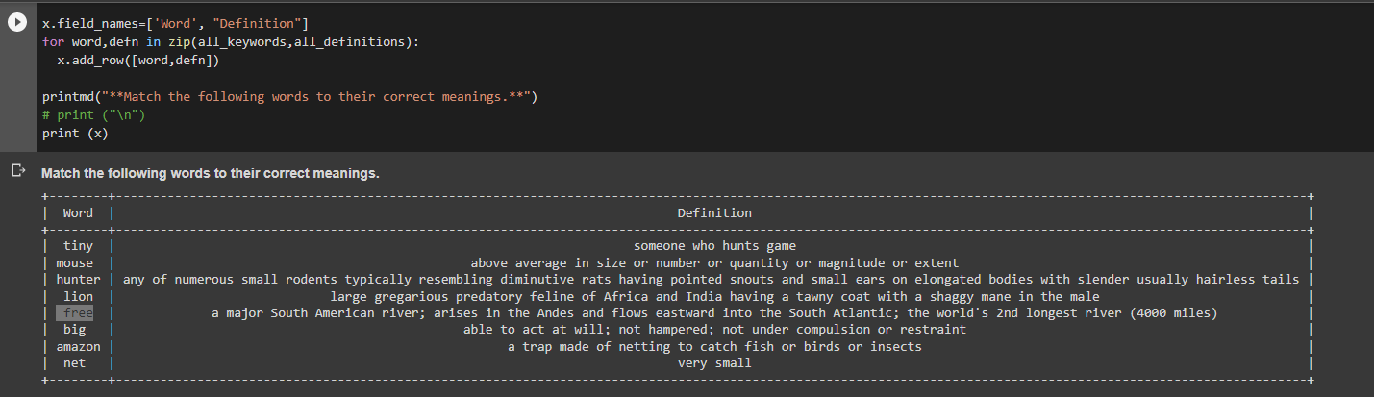
Results and Discussion
Match the Following

Slide 26
Conclusion and Future work
The Extensive Literature Survey was the initial stage in figuring out the project's scope. The
concepts can be made more specific in order to more effectively incorporate them. During this time, we
looked at some publications that were related to our problem. Extensive literature searches on each of these
modules were done in order to understand the models that are accessible and the implementation
components. A few applications of already-used methods were also tested. We looked into a number of
study articles and blogs to gain understanding about that. After reading, we received a synopsis of the
model we intend to construct.
We come to the conclusion that creating a variety of questions not only acts as an assessment tool
but also influences student learning. The maximum number of Multiple-Choice Questions(MCQs) we can
produce from a text is 4, which is an area that needs improvement.

Slide 27
References
[1] Ahmed Emad, Fady Bassel, Mark Refaat, Mohamed Abdelhamed , Nada Shorim , Ashraf AbdelRaouf , “Automatic Video summarization with Timestamps using natural language processing text fusion”, Misr International University, Cairo,Egyptahmed1703326,fady1710742,mark1711712,mohamed1701989,nada.ayman,ashraf.raouff@miuegypt.edu.egg,2021
[2] Chi Zhang, Shagan Sah, Thang Nguyen, Dheeraj Peri, Alexander Louiy , Carl Salvaggio , Raymond Ptucha , “Semantic Sentence Embeddings for Paraphrasing and Text Summarization” Rochester Institute of Technology, Rochester, NY 14623, USA , Kodak Alaris Imaging Science R&D, Rochester, NY 14615, USA,2017
[3] Pritam Kumar Mehta, Prachi Jain, Chetan Makwana, M Raut, “Automated MCQ Generator using NLP”, Datta Meghe College of Engineering, Navi Mumbai, India,Dept. of Computer Engineering, Datta Meghe College of Engineering, Navi Mumbai, India ,2021
[4] Zygmunt Pizlo, Arnon Amir, Dulce B. Ponceleon, Edward J.Delp, “Automated Video Program Summarization using Speech transcripts”, Article in IEEE Transactions on Multimedia, September 2006
[5] Marco Furini, Vittorio Ghini, “An audio-video summarization scheme based on audio and video analysis”, Conference Paper · February 2006

Slide 28
References
[6] Pravin Khandare, Sanket Gaikwad, Aditya Kukade, Rohit Panicker, Swaraj Thamke, “AUDIO DATA SUMMARIZATION SYSTEM USING NATURAL LANGUAGE PROCESSING”, Assistant Professor, Dept. of Computer Engineering, Vishwakarma Institute of Technology, Pune, Maharashtra, 2,3,4,5UG Student, Vishwakarma Institute of Technology, Pune, Maharashtra (India)
[7] Dr. S. Muthusundari, Vishwa A, Srinivasa kiruthik K S, Sukesh Raj R, “Automatic MCQ Generator”, Associate Professor, Computer Science & Engineering Department R.M.D Engineering College Kavaraipettai, Chennai, India 2Zoho Corporation, Chennai
[8]Edison Marrese-Taylor, Ai Nakajima, Yutaka Matsuo,“Learning to Automatically Generate Fill-In-The-Blank Quizzes”,Graduate School of Engineering The University of Tokyo
[9]Regina Kasakowskij , Thomas Kasakowskij, Niels Seidel,”Generation of Multiple True False Questions”

Slide 29
Thank You

