Slide 1

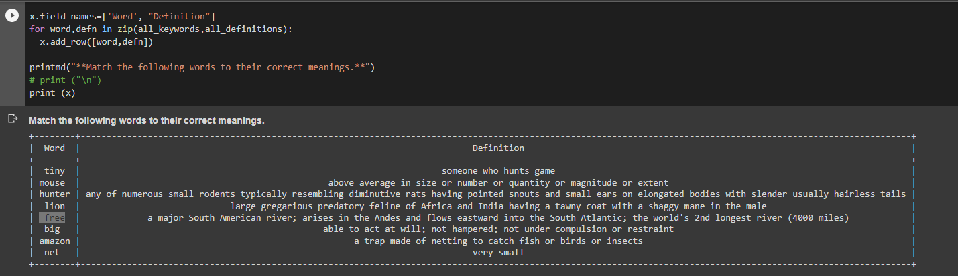
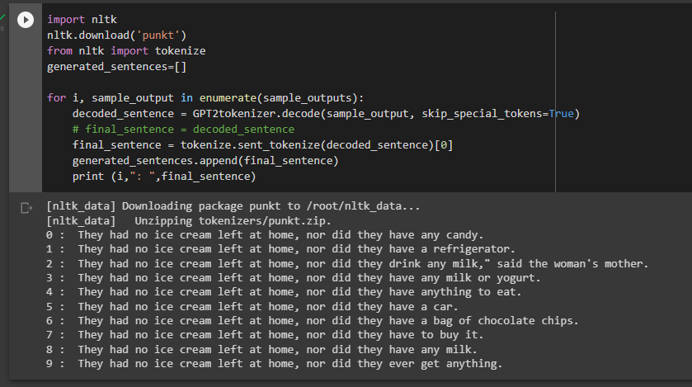
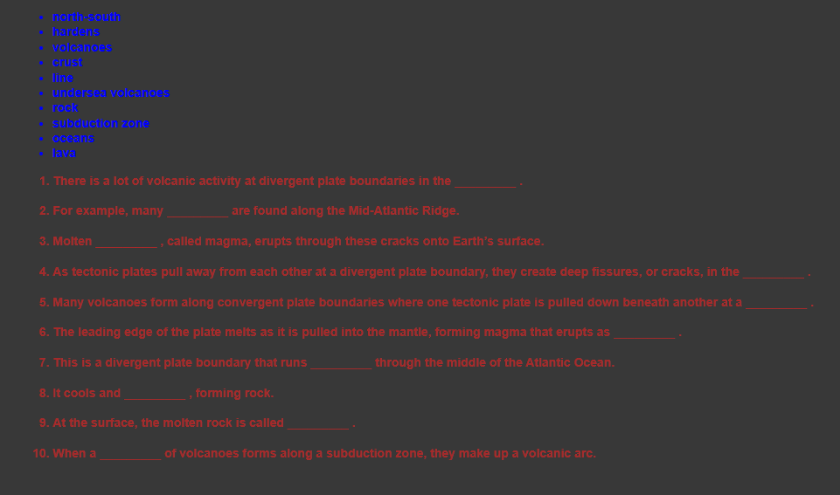
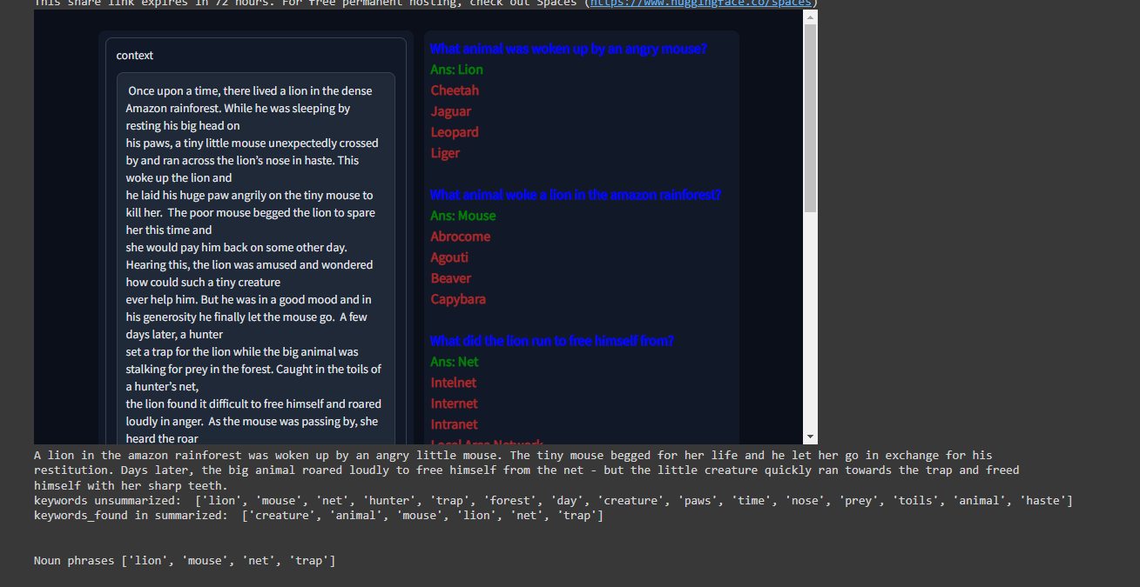
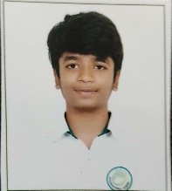
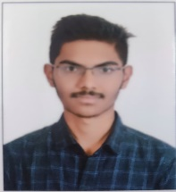

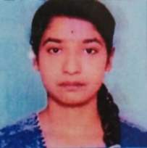

Automated MCQ Generation
Department of Computer Science and Engineering
PES University, RR Campus, Bengaluru – 560085.
Problem Statement
Design Approach / Methods
Match the Following:
True or False:
In Education evaluation, Automated Question Generation plays an important role. Handmade question design requires a lot of time, effort and money, and manual answer evaluation is likewise time consuming. To solve this issue, we build a model which aims to generate relevant questions automatically and it even makes the diversions in the options for MCQ’s to test the learners. The objective questions allow students to choose the best response from four alternatives to finish a statement.
Test items can be divided into two general categories in which objective items, which ask students to choose the right response from a range of options or to add a word or phrase to a question or finish a sentence item that allow the learner to express themselves subjectively or in an essay; and organize and deliver a unique response. Multiple choice, True or False, Match the following and completion are examples of objective items, whereas subjective things include prolonged response, brief answer, performance, problem solving testing items in which one or more may be used for instructive reasons.
Generating False sentences from True sentence, among other educational-purposes questions, can produce valid evaluations directly, easily, and efficiently which is helpful to determine whether the students have any misconceptions about the subject matter. Instead of using an interrogative language to define the T/F question, we will instead use a declarative sentence in this essay. However, the paucity of training data and difficulty in extracting appropriate testing points from a particular passage, as well as the high frequency of grammatical and semantic errors, prevent the quality of the generated questions from being adequate for evaluation.
The methodologies general framework is to produce pertinent questions from literature to assess the user’s comprehension. We created a variety of questions using middle school literature as the input, including Multiple Choice Questions, False from True assertions, Match the Following and Fill in the Blanks.
MCQ Generation:
There are 2 main steps that must be used in order to generate MCQ’s: (1)Creation of Distractors (WordNet, ConceptNet, Sense2Vec, Sentence Transformers)
(2)Creation of Questions(T5)
Match the following:
We’ll utilize the Python Keyword Extraction package to extract the keywords from the context. Therefore, once the keywords have been extracted, those keywords can be used to replace the words on the left of the following match, and their meanings are provided on the right side. We’ve taken the keywords from a piece of material, but the task here is to take the sense of the word. We won’t be able to discern the precise meaning of the word being used in our context without knowing the context’s specifics. The term for this issue is Word Sense Disambiguation (WSD) .
Fill in the Blanks:
Utilize the Python Keyword Extraction package to extract key phrases(unsupervised key phrase extraction with multipartite graph algorithm). Return to our content and collect every sentence containing a specific key phrase. We choose any sentence from the list of sentences, just change our keyword to “blank”, and then instruct the reader to fill in the blanks. Our objective is to identify the top-ranking nodes among all the nodes with associated edges and use them as the top 10 keywords or key phrases in the article.
Generate True or False Statements:
Using Constituency Parsing and OpenAI GPT2, we will create True or False questions based on the input text. Using Natural Language Processing techniques, we will change the verb or noun phrase in a valid statement to create a false one. Finding a noun phrase is the first step in using constituency parsing techniques to comprehend the sentence and identify the final noun or verb phrase. Split out the final word or verb to finish the sentence. Give the incomplete sentence to the OpenAI GPT-2 to finish it.
Fill in the Blanks
Background
The Extensive Literature Survey was the initial stage in figuring out the project's scope. The concepts can be made more specific in order to more effectively incorporate them. During this time, we looked at some publications that were related to our problem. Extensive literature searches on each of these modules were done in order to understand the models that are accessible and the implementation components. A few applications of already-used methods were also tested. We looked into a number of study articles and blogs to gain understanding about that. After reading, we received a synopsis of the model we intend to construct.
MCQ Generation:
Conclusion
Results and Discussion
We come to the conclusion that creating a variety of questions not only acts as an assessment tool but also influences student learning. The maximum number of Multiple-Choice Questions (MCQs) we can produce from a text is 4, which is an area that needs improvement.
References
Edison Marrese-Taylor, Ai Nakajima, Yutaka Matsuo,“Learning to Automatically Generate Fill-In-The-Blank Quizzes”,Graduate School of Engineering The University of Tokyo
Regina Kasakowskij , Thomas Kasakowskij, Niels Seidel,”Generation of Multiple True False Questions”
Name : Saicharan SRN : PES1UG19CS329 | Name : Abhishek SRN : PES1UG19CS329 | Name : Kundansai SRN : PES1UG19CS049 | Name : Rashi SRN : PES1UG20CS827 | Guide: Prof. Dinesh Singh

