Slide 1

J. COMPUTER APPLICATIONS IN ARCHAEOLOGY · 8(1) · 2025
Finding Hillforts at Scale
An end-to-end deep-learning pipeline that searches LiDAR across 180,000 km² of Europe
Landauer · Maddison · Fontana · Posluschny
England · Hesse · Molise
Notes:
Hook: LiDAR has flooded archaeology with elevation data far beyond what experts can scan by hand. This paper builds an end-to-end pipeline that hunts hillforts across 180,000 km² of Europe. The talk is organized around that pipeline — how they built it, stage by stage.

Slide 2
01 — WHY AUTOMATE
Too much LiDAR, too few hillforts
~1M
<0.05%
180,000 km²
image patches to scan in England alone (266 GB)
of land is hillfort — a needle in a haystack
searched by one automated workflow
The contribution isn't a new network — it's a working end-to-end pipeline that turns raw national LiDAR into a short list an archaeologist can actually check.
Notes:
Quick framing of why a pipeline is needed. LiDAR coverage has exploded into a Big Data problem, but hillforts are vanishingly rare — under 0.05% of land. England alone is about a million patches. No expert can eyeball that, so the whole task has to be automated end-to-end. Keep this short — the workflow is the focus.

Slide 3
02 — THE PIPELINE, END TO END
Three phases: train → detect → verify
→
→
PHASE A
PHASE B
PHASE C
Train the model
Scan the country
Verify with experts
Known hillforts → vignettes
Tile country: 768 m patches
Ranked candidate list
↓
↓
↓
Train ConvNeXt CNN
Slide window, 384 m step
Expert checks in GIS
↓
↓
↓
Pseudo-label → retrain
Score each patch 0–100%
LiDAR + maps + imagery
↓
↓
↓
Final detector
Cluster hits >90%
New / recovered sites
Notes:
This is the map for the whole talk. The pipeline has three phases. TRAIN: turn known hillforts into a labelled image set and train a CNN, with a self-cleaning step. DETECT: slide that CNN across an entire country and cluster the hits into candidate sites. VERIFY: hand the ranked candidates to an expert who confirms them in GIS. The next slides zoom into each phase. Everything downstream is just these three boxes.

Slide 4
03 — PHASE A · BUILD THE TRAINING SET
From map points to labelled images
→
→
→
01
02
03
04
Atlas points
Cut vignettes
Prune bad sites
Labelled dataset
4,000+ hillfort centres, no outlines
768 × 768 m image per point
drop destroyed / built-over
579 forts + 20,000 negatives
Raw DEM, no hillshade
Detection becomes ordinary image classification — and the elevation grid is fed in directly with min/max normalization, which trained better than rendered visualizations.
Notes:
Phase A, step one — turn a point database into an image dataset. The Atlas of Hillforts gives centre coordinates but no shapes, so they cut a fixed 768m vignette around each point and treat it as a labelled image: 'is there a hillfort here, yes or no?' That reframes detection as plain image classification. After dropping destroyed and built-over sites, 579 positives remain, paired with 20,000 random land patches as negatives. The one non-obvious choice: feed the raw DEM straight in with min/max normalization — no hillshade — because their earlier work showed it trains better.

Slide 5
04 — PHASE A · TRAIN, CLEAN, RETRAIN
A CNN that cleans its own labels
→
→
→
→
01
02
03 · pseudo-label
04
ImageNet pretrain
Train 50 epochs
Drop contradictions
Retrain 12 epochs
Final detector
ConvNeXt backbone
flip/crop · weighted loss
fort <85% or non-fort >5% → cut
505 forts · 15,156 neg.
+4%
accuracy from one self-cleaning pass — the model flags its own mislabelled training examples, no extra annotation needed.
Notes:
Phase A, step two — the training loop itself, and the one clever trick inside it. Start from a ConvNeXt pretrained on ImageNet, fine-tune 50 epochs with flip/crop augmentation and a weighted label-smoothing loss for the class imbalance. Then pseudo-labelling: run the trained model back over its own training data and delete the contradictions — hillforts it scores below 85%, non-hillforts it scores above 5% — which are likely mislabels. Retrain 12 epochs on the cleaned set and accuracy climbs about 4%. It's cheap, automatic label hygiene.

Slide 6
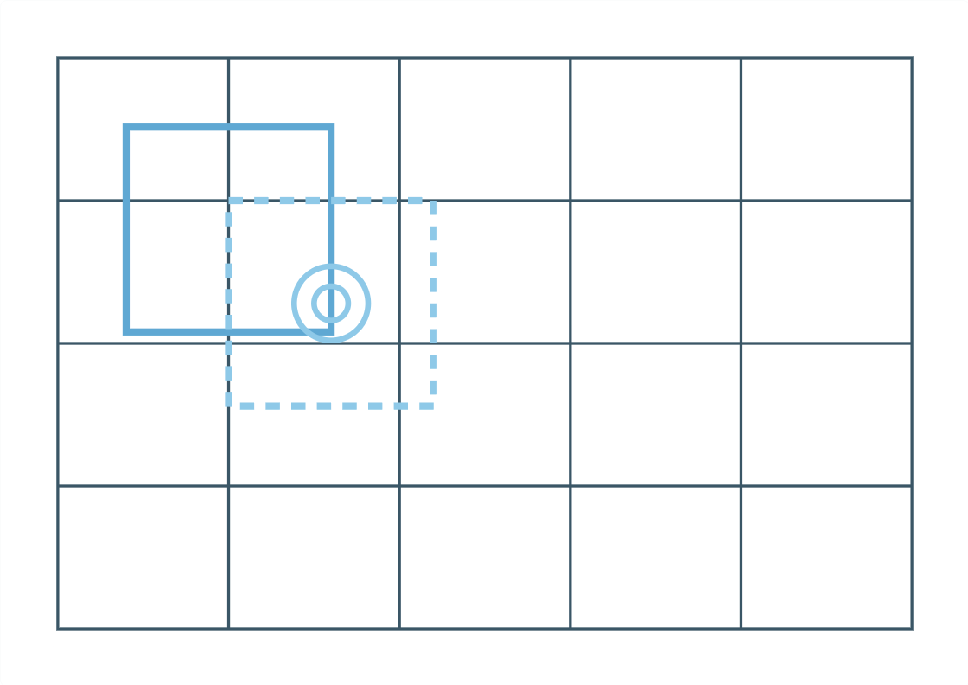
05 — PHASE B · SLIDING-WINDOW SCAN
One detector, slid across a nation
tile
country → 768 m patches
↓
step 384 m
half-overlap each neighbour
↓
score
CNN rates each patch 0–100%
overlapping 768 m windows step across the DEM grid
↓
>90% · cluster
candidate sites
< 5 hrs
all of England · ~1M patches · single RTX 2060
Notes:
Phase B — apply the detector across a whole nation. Tile the country into 768m patches, then slide the window in 384m steps so every patch half-overlaps its neighbour; that overlap empirically catches forts that straddle a tile edge. Each patch gets a confidence score; keep everything above 90% and cluster adjacent hits so one fort doesn't get reported five times. Engineering-wise this is the heavy part — about a million patches for England — but multiprocessed loading on a single RTX 2060 runs the entire country in under five hours. The output is a ranked list of candidate sites.

Slide 7
06 — PHASE C · SCORE & VERIFY
The machine ranks; the human decides
AUTOMATED SCORING
HUMAN VERIFICATION
TP
candidate within 500 m of a known fort
Ranked candidates → open in GIS
FP
detection with no fort nearby
↓
Cross-check LiDAR · maps · imagery
FN
known fort the model missed
↓
Confirm or reject the site
Report F1 , not accuracy — the landscape is almost entirely negative.
~4 s
per site, first pass — 1,500 candidates triaged in 1 h 41 m
Notes:
Phase C splits in two. On the left, automated scoring: a candidate counts as a true positive if it's within 500m of a known fort, otherwise a false positive; missed forts are false negatives. They report F1, not accuracy — true negatives are the entire empty landscape, so accuracy would look misleadingly perfect. On the right, the human loop: the ranked candidates go to an archaeologist who checks each in GIS against LiDAR, hillshade, aerial imagery and historic maps. The payoff is triage speed — about four seconds per site on the first pass, so 1,500 candidates get filtered in well under two hours instead of eyeballing 6,000 km².

Slide 8
07 — PORTING THE PIPELINE ABROAD
Fine-tune, don't rebuild
England detector
Apply abroad
Fine-tune locally
Recovered
→
→
3,000 patches + 22–32 forts · 12 epochs
→
trained on British forts
drift → F1 21% / 12%
F1 38% / 34%
Hesse
+22 forts
Molise
+32 forts
before
21%
before
12%
+ fine-tune
38%
+ fine-tune
34%
Notes:
The pipeline is portable — this is how they moved it to Germany and Italy. Apply the English detector straight to Hesse or Molise and it collapses: F1 of 21% and 12%. That's model drift — different scanners, terrain and elevation statistics. The fix is deliberately lightweight: collect 3,000 random local patches plus a tiny handful of known local forts — 22 in Hesse, 32 in Molise — and fine-tune just 12 epochs. F1 roughly doubles, to 38% and 34%. So adapting to a brand-new country is hours of work and a couple dozen examples, not a full retrain.

Slide 9
08 — WHAT THE PIPELINE FOUND
F1 ≈ 34–38% — but real discoveries
England
F1 36%
Hesse
F1 38%
Molise
F1 34%
1 new fort
12 + 4
15 / 100
previously unrecognized, confirmed in the Chilterns
forts recovered from outside the Atlas, plus 4 new candidates
of the top-ranked detections were genuine hillforts
Same false positives everywhere — hilltop villages, terraces, forest tracks all ring a summit like ramparts. That's why a human stays in the loop.
Notes:
Briefly, what the pipeline actually delivered — the point is the finds, not the F1. Across three regions F1 sat in a tight 34–38% band. England: a genuinely new, previously unrecognized hillfort confirmed in the Chilterns. Hesse: 12 forts missing from the Atlas recovered plus 4 new candidates. Molise: 15 of the top 100 detections were real hillforts. The recurring false positives are instructive and consistent everywhere — medieval hilltop villages ringed by roads, agricultural terraces, and forest tracks all mimic ditch-and-rampart rings, which is exactly why the human verification step stays essential.

Slide 10
09 — TAKEAWAYS
A pipeline that scales, ports, and stays human-checked
WHY IT MATTERS
OPEN CHALLENGES
→
Detects complex, irregular structures — not just simple shapes
·
F1 of 34–38% leaves real headroom on precision
·
Fails where LiDAR fails — maquis and terraced hillsides
→
Runs at national scale — 180,000 km², the largest such search to date
·
Next: more regions, faster review, a shared benchmark
→
Ports to new countries with a light fine-tune, not a rebuild
Notes:
Wrap-up, tied back to the pipeline. Three things make this work matter: the pipeline detects complex, irregular features — not just simple geometric shapes; it runs at national scale, 180,000 km², the largest automated archaeological search to date; and it ports to new countries with a light fine-tune instead of a rebuild. The honest limits: F1 of 34–38% leaves headroom on precision, and the detector fails exactly where LiDAR itself fails — dense Mediterranean maquis and terraced hillsides. The road ahead is more training regions, faster verification, and a shared community benchmark.

