Slide 1
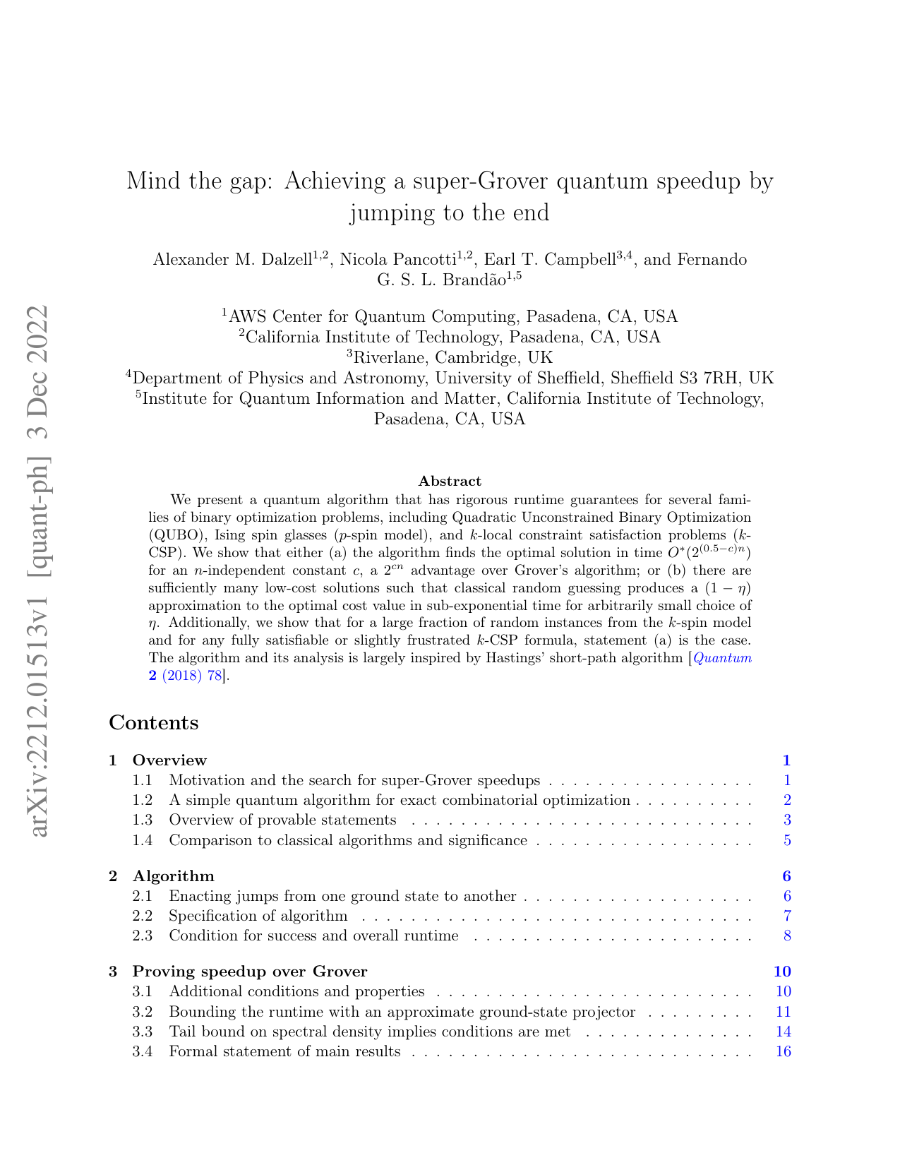
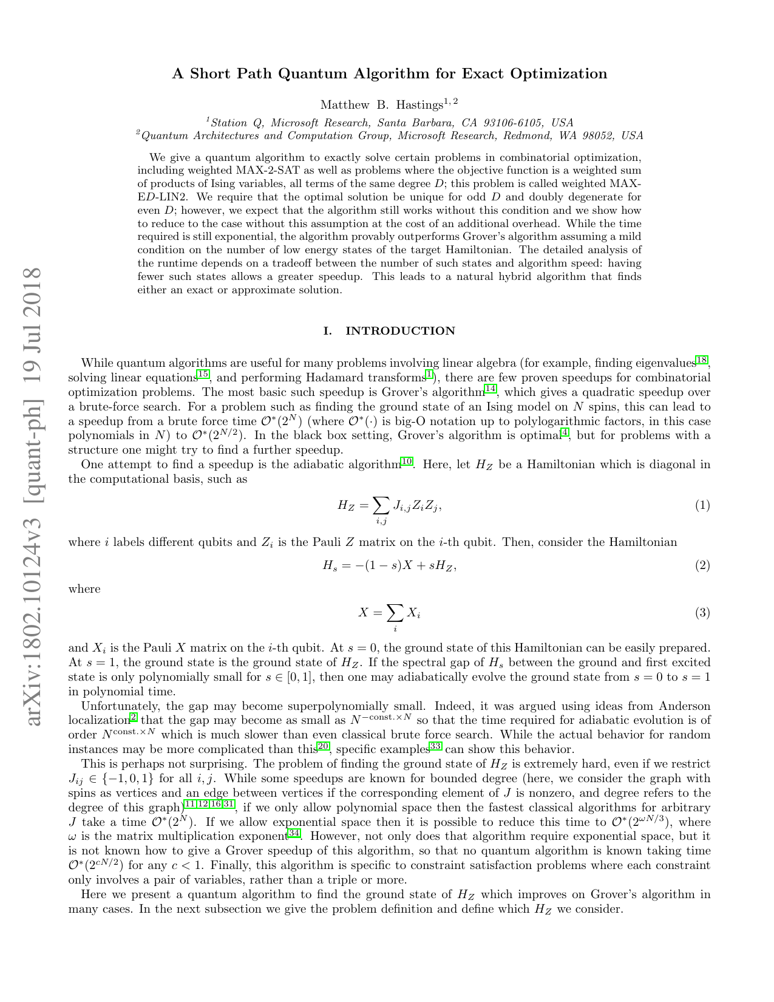
Proposal: A Hybrid Short–Long–Short Jump Scheme
Combine Dalzell's extended-phase anchor with Hastings' localized short-path anchor, then test whether the middle overlap is easier than the direct one.
Core thesis
Use two genuine anchors on opposite sides of the phase transition:
• ψ_D for the extended side
• ψ_H for the localized side
so the main cost becomes 1 / |⟨ψ_D|ψ_H⟩| instead of 1 / |⟨z*|ψ_D⟩|.
Dalzell et al. (2023)
Hastings (2018)
Research motivation: both papers avoid the bad gap region — but from opposite sides.
Can their two anchor states be stitched into one better pathway?
Papers used: Dalzell et al., “Mind the Gap: Achieving a Super-Grover Quantum Speedup by Jumping to the End” (STOC 2023); Hastings, “A Short Path Quantum Algorithm for Exact Optimization” (Quantum 2, 78, 2018).

Slide 2
Why a naive extra midpoint does not help
The midpoint must be a genuine anchor state, not just a filtered version of ψ_D.
Direct long jump
Fake midpoint
Real anchor midpoint
ψ_D → z*
If |⟨z*|ψ_D⟩| = 0.01,
then cost ≈ 1 / 0.01 = 100.
This direct jump is the bottleneck.
ψ_D → φ → z*
Take φ = Πψ_D / ||Πψ_D||.
If 0.01 = 0.1 × 0.1, the two pieces look easier,
but φ is not independently accessible.
So the effective cost still behaves like 10 × 10 = 100.
ψ_D → φ → z*
Now let φ be the unique gapped ground state
of an accessible Hamiltonian H_φ.
Then reflections about φ are available directly,
so the two jump costs can add.
Example: 10 + 10 = 20, genuinely better than 100.
Key point: one small overlap controls the expensive step.
Key point: splitting a projection is a wash.
Key point: find a true anchor, not a filter.
Context: Dalzell et al. jump framework and Hastings-style short-path grounding motivate the distinction between a real anchor state and a merely projected midpoint.

Slide 3
Proposed hybrid pathway
A short–long–short chain that uses one anchor from each paper.
Dalzell anchor
Extended side of the transition
Gap argument via tail bound
Hastings anchor
Localized side of the transition
Gap argument via low-energy density assumption
|+⟩
cheap
ψ_D
main bottleneck
ψ_H
cheap
|z*⟩
Research hypothesis
If |⟨ψ_D|ψ_H⟩| decays exponentially slower than |⟨z*|ψ_D⟩|, then replacing the direct long jump by a bridge between the two anchors should improve the exponent.
Why it might help
ψ_H collects amplitude from a neighborhood around z*, not only from the single optimum string.
So the middle overlap can benefit from constructive support over many nearby deep-valley states.
Anchor sources: Dalzell et al. (STOC 2023) for ψ_D and Hastings (Quantum 2, 78, 2018) for ψ_H. This slide proposes their composition as a new research direction.

Slide 4
Cheap go/no-go experiment
Before proving anything, test whether the middle overlap is empirically better on small instances.
1. Generate many small 3-spin / MAX-E-D-LIN2 instances (for example n ≈ 14–22).
Decision rule
If B(n) decays slower than A(n), the idea is alive.
If B(n) does not beat A(n), the proposal dies cheaply.
2. Exact diagonalize the Dalzell-style and Hastings-style Hamiltonians for each instance.
Success criterion
3. Compute two overlaps: A(n) = |⟨z*|ψ_D⟩| and B(n) = |⟨ψ_D|ψ_H⟩|.
median slope of log₂ B(n) > median slope of log₂ A(n)
Interpretation
A positive gap here means the hybrid bridge is empirically easier than the direct Dalzell-to-optimum jump, which is enough to justify deeper theory and larger benchmarking.
4. Fit exponential slopes across many instances and compare the medians.
This deck proposes a testable research question, not a theorem.
Motivation for combination: Dalzell et al. conclude that their speedup mechanism may be worth combining with other techniques; the hybrid Dalzell–Hastings bridge is a natural quantum-side candidate.

Slide 5
References
Core papers behind the proposed hybrid pathway.
[1] Dalzell, A. M., Pancotti, N., Campbell, E. T., and Brandão, F. G. S. L.
Mind the Gap: Achieving a Super-Grover Quantum Speedup by Jumping to the End.
Proceedings of the 55th Annual ACM Symposium on Theory of Computing (STOC ’23), 2023.
arXiv:2212.01513.
[2] Hastings, M. B.
A Short Path Quantum Algorithm for Exact Optimization.
Quantum 2, 78 (2018). DOI: 10.22331/q-2018-07-26-78.
arXiv:1802.10124.
Proposed question for next work: can a Dalzell anchor and a Hastings anchor be chained so that the middle overlap exponent beats the direct Dalzell-to-optimum overlap exponent?
Reference metadata taken from the papers themselves: Dalzell et al. arXiv/ACM STOC 2023; Hastings, Quantum 2, 78 (2018).

