Slide 1
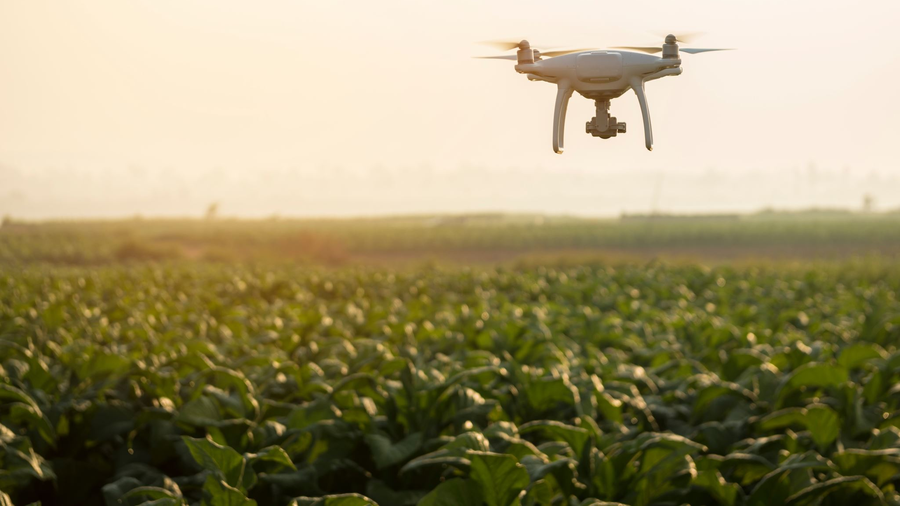
Trajectory Generation and Tracking of Quadcopter
Saicharan Balamurali and Yu-Heng Deng
Notes:
Good morning, everyone, my name is Yu-Heng, and this is my teammate, Saicharan. We're going to talk about how we applied nonlinear control to the quadcopter's trajectory generation and tracking.

Slide 2
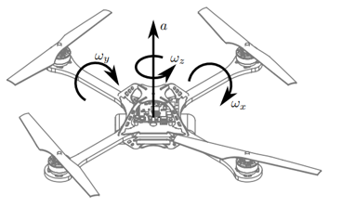
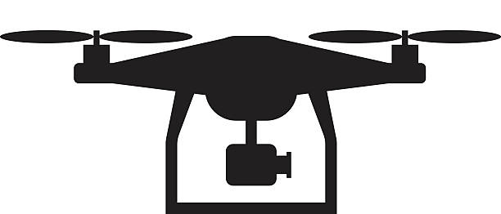

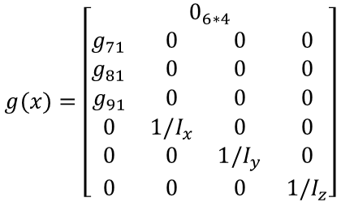
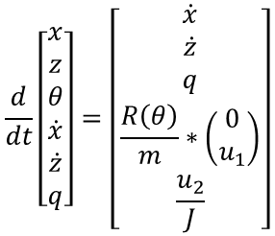

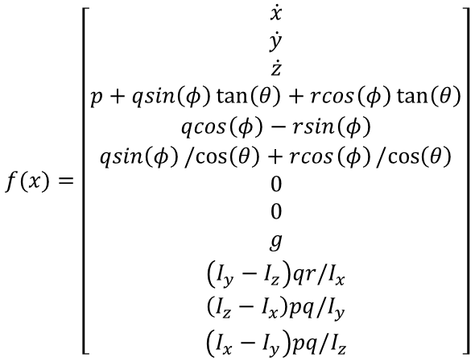










Quadcopter Dynamics
$$s={\left[\begin{matrix}x & y & z & φ & θ & ψ & \dot{x} & \dot{y} & \dot{z} & p & q & r\end{matrix}\right]}^{T}$$
$$u_{1}$$
$$u_{3}$$
$$u_{1}$$
$$u_{4}$$
$$\dot{s}=f\left(x\right)+g\left(x\right)u$$
$$u_{1}$$
$$u_{1}$$
$$f(x)=\left[\begin{aligned}\dot{x} \\ \dot{y} \\ \dot{z} \\ p+qsin\left(φ\right)\tan\left(θ\right)+rcos\left(φ\right)\tan\left(θ\right) \\ qcos\left(φ\right)−rsin\left(φ\right) \\ qsin\left(φ\right)/cos\left(θ\right)+rcos\left(φ\right)/cos\left(θ\right) \\ 0 \\ 0 \\ g \\ \left(I_{y}−I_{z}\right)qr/I_{x} \\ \left(I_{z}−I_{x}\right)pq/I_{y} \\ \left(I_{x}−I_{y}\right)pq/I_{z}\end{aligned}\right]$$
$$u_{2}$$
$$g(x)=\left[\begin{aligned}0_{6∗4} \\ \begin{matrix}g_{71} & 0 & 0 & 0 \\ g_{81} & 0 & 0 & 0 \\ g_{91} & 0 & 0 & 0 \\ 0 & 1/I_{x} & 0 & 0 \\ 0 & 0 & 1/I_{y} & 0 \\ 0 & 0 & 0 & 1/I_{z}\end{matrix}\end{aligned}\right]$$
2D Simplified mode:
$$\frac{d}{dt}\left[\begin{aligned}x \\ z \\ θ \\ \dot{x} \\ \dot{z} \\ q\end{aligned}\right]=\left[\begin{aligned}\dot{x} \\ \dot{z} \\ q \\ \frac{R\left(θ\right)}{m}∗\left(\begin{matrix}0 \\ u_{1}\end{matrix}\right) \\ \frac{u_{2}}{J}\end{aligned}\right]$$
$$u_{1}$$
$$u_{2}$$
$$g_{71}=−\frac{1}{m}(\sin\left(φ\right)\sin\left(ψ\right)+\cos\left(φ\right)\cos\left(ψ\right)\cos\left(θ\right))$$
$$g_{81}=−\frac{1}{m}(\sin\left(φ\right)\cos\left(ψ\right)−\cos\left(φ\right)\sin\left(ψ\right)\sin\left(θ\right))$$
$$g_{91}=−\frac{1}{m}(\cos\left(φ\right)\cos\left(θ\right))$$
Notes:
Here are the equations of motion of a quadcopter. There are 12 states in total. It contains the position, orientation, linear velocity, and the angular velocity in the body frame. The four control inputs are in fact not the force provide by the propellers. Actually, u1 represents the vertical thrust on the z axis of the body frame, while the others each represents a torque.
For simplicity, we first try to control the quadcopter in 2-dimension model. This model is obtained by setting y phi and xi to 0. And the equation of motion can be expressed as this.

Slide 3
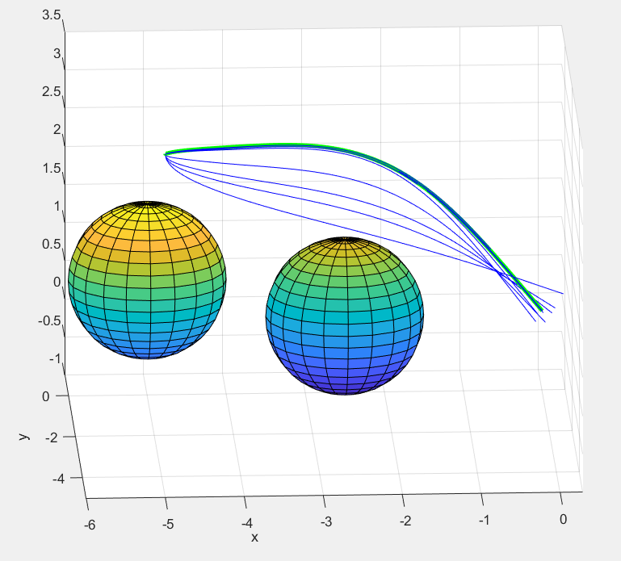
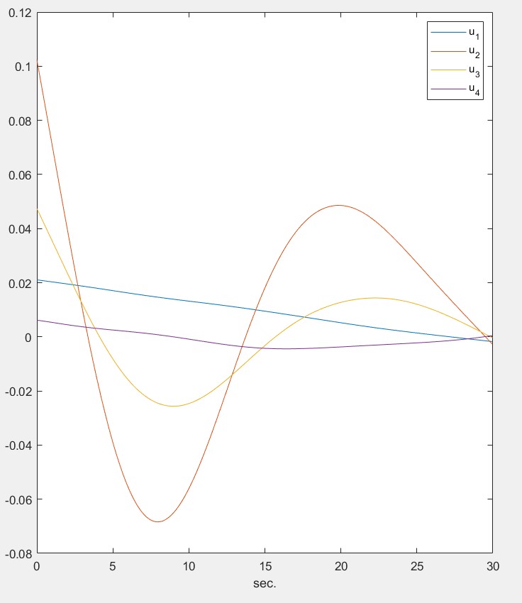
Trajectory Generation using DDP
Generate trajectory using Differential Dynamic Programming
Convert discrete states into continuous desired states
Design a control law to track the trajectory
Dealt with obstacles by augmenting the cost function.
Discrete states converted into continuous states using polyfit.
Passed this continuous desired state as the trajectory to be tracked by our feedback linearization controller.

Slide 4
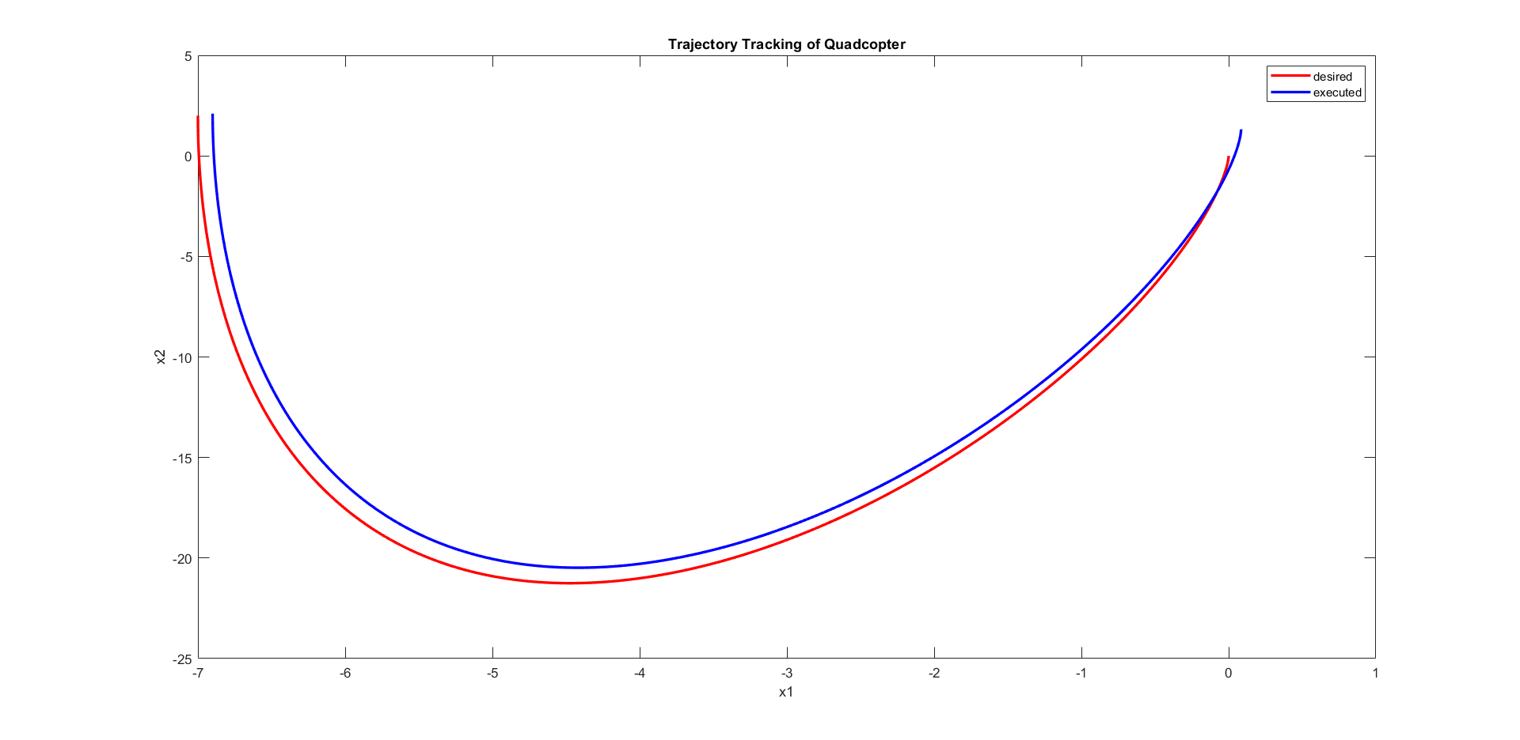

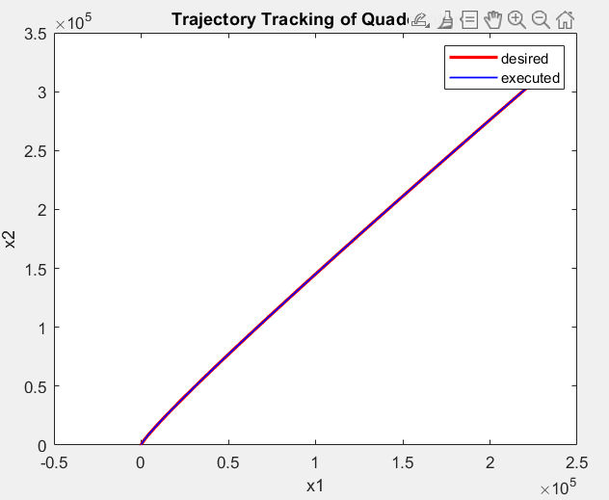
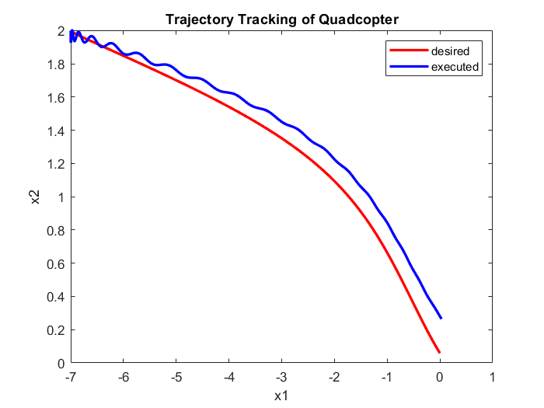


Feedback Linearization
Dynamic Compensator
Virtual Control

Slide 5
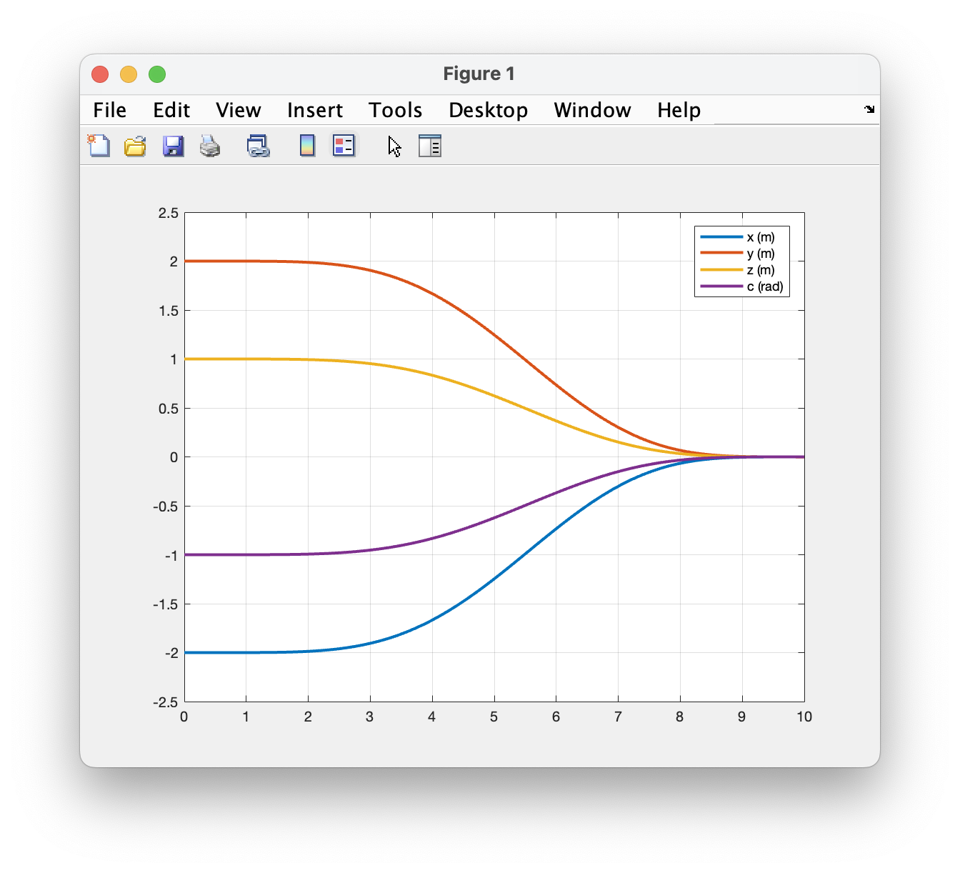
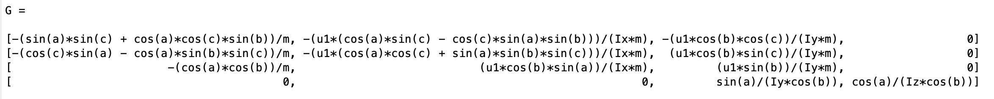





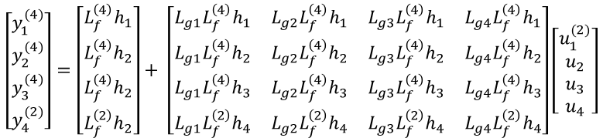
Full Model Feedback Linearization
$y={\left[\begin{matrix}h_{1} & h_{2} & h_{3} & h_{4}\end{matrix}\right]}^{T}$ $={\left[\begin{matrix}x & y & z & ψ\end{matrix}\right]}^{T}$
$$\left[\begin{matrix}y_{1}^{(4)} \\ y_{2}^{(4)} \\ y_{3}^{(4)} \\ y_{4}^{(2)}\end{matrix}\right]=\left[\begin{matrix}L_{f}^{\left(4\right)}h_{1} \\ L_{f}^{\left(4\right)}h_{2} \\ L_{f}^{\left(4\right)}h_{2} \\ L_{f}^{\left(2\right)}h_{2}\end{matrix}\right]+ \left[\begin{matrix}L_{g1}L_{f}^{\left(4\right)}h_{1} & L_{g2}L_{f}^{\left(4\right)}h_{1} & L_{g3}L_{f}^{\left(4\right)}h_{1} & L_{g4}L_{f}^{\left(4\right)}h_{1} \\ L_{g1}L_{f}^{\left(4\right)}h_{2} & L_{g2}L_{f}^{\left(4\right)}h_{2} & L_{g3}L_{f}^{\left(4\right)}h_{2} & L_{g4}L_{f}^{\left(4\right)}h_{2} \\ L_{g1}L_{f}^{\left(4\right)}h_{3} & L_{g2}L_{f}^{\left(4\right)}h_{3} & L_{g3}L_{f}^{\left(4\right)}h_{3} & L_{g4}L_{f}^{\left(4\right)}h_{3} \\ L_{g1}L_{f}^{\left(2\right)}h_{4} & L_{g2}L_{f}^{\left(2\right)}h_{4} & L_{g3}L_{f}^{\left(2\right)}h_{4} & L_{g4}L_{f}^{\left(2\right)}h_{4}\end{matrix}\right]\left[\begin{matrix}u_{1}^{(2)} \\ u_{2} \\ u_{3} \\ u_{4}\end{matrix}\right]$$
$$F$$
$$G$$
$${\left[\begin{matrix}ξ_{1} & ξ_{2}\end{matrix}\right]}^{T}={\left[\begin{matrix}u_{1} & u_{1}^{(1)}\end{matrix}\right]}^{T}$$
$v_{1−3}=y_{d1−3}^{(4)}−K_{0}(y_{1−3}−y_{d1−3})$ $−K_{1}(y_{1−3}^{\left(1\right)}−y_{d1−3}^{(1)})$ $−K_{2}(y_{1−3}^{\left(2\right)}−y_{d1−3}^{(2)})$ $−K_{3}(y_{1−3}^{\left(3\right)}−y_{d1−3}^{(3)})$
$v_{4}=y_{d4}^{(2)}−K_{5}(y_{4}−y_{d4})$ $−K_{5}(y_{4}^{\left(1\right)}−y_{d4}^{(1)})$
$$u_{a}=G^{−1}(v−F)$$
Notes:
After controlling the simplified model, we also apply feedback linearization on the full 3D model. The output y is chose to be xyz position and xi, which is the angle where the quadcopter is heading. To achieve a linearized input-output system, we have to find the fourth derivate of x y z. This gives us linearized u1 to u3. And the second derivative of xi will give us linearized u3 and u4. Here, we also need to apply the concept of dynamic compensator and treat u1 and du1 as an augmented state. As for the virtual control, since v123 and v4 are in different order, we need to design the error dynamics separately. In the end, we can obtain the augmented output this equation. Below are the actual matrices that we used in the simulation, and apparently, they are super long and are very hard to calculate by hand. The figure shows that this controller can take all four states to their desired outputs.

Slide 6
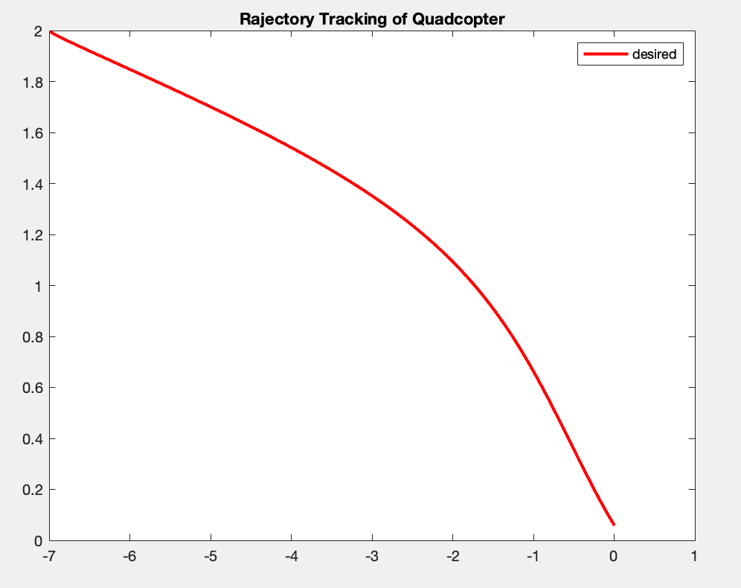
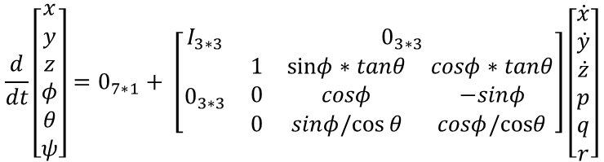
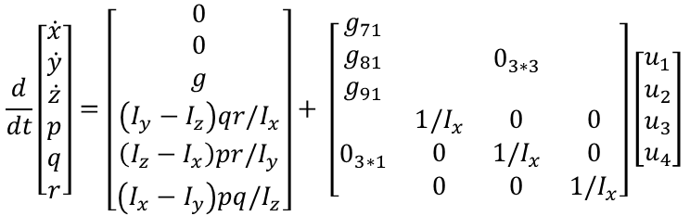
Future work
Block backstepping control
Discrete trajectory problems
$$\frac{d}{dt}\left[\begin{matrix}x \\ y \\ z \\ φ \\ θ \\ ψ\end{matrix}\right]=0_{7∗1}+ \left[\begin{matrix}I_{3∗3} & 0_{3∗3} \\ 0_{3∗3} & \begin{matrix}1 & sinφ∗tanθ⁡ & cosφ∗tanθ \\ 0 & cosφ & −sinφ \\ 0 & sinφ/cos⁡θ & cosφ/cosθ\end{matrix}\end{matrix}\right]\left[\begin{matrix}\dot{x} \\ \dot{y} \\ \dot{z} \\ p \\ q \\ r\end{matrix}\right]$$
$$\frac{d}{dt}\left[\begin{matrix}\dot{x} \\ \dot{y} \\ \dot{z} \\ p \\ q \\ r\end{matrix}\right]=\left[\begin{matrix}0 \\ 0 \\ g \\ \left(I_{y}−I_{z}\right)qr/I_{x} \\ \left(I_{z}−I_{x}\right)pr/I_{y} \\ \left(I_{x}−I_{y}\right)pq/I_{z}\end{matrix}\right]+ \left[\begin{matrix}\begin{matrix}g_{71} \\ g_{81} \\ g_{91}\end{matrix} & 0_{3∗3} \\ 0_{3∗1} & \begin{matrix}1{/I}_{x} & 0 & 0 \\ 0 & 1{/I}_{x} & 0 \\ 0 & 0 & 1{/I}_{x}\end{matrix}\end{matrix}\right]\left[\begin{matrix}u_{1} \\ u_{2} \\ u_{3} \\ u_{4}\end{matrix}\right]$$
Notes:
For the future work of this project, we like to apply Block backstepping to control, since it supposed to have a better performance. If we separate the original dynamics in this way, it almost fits perfectly to the block backstepping model that we learned from the lecture. But one key different is that the ga matrix in NOT a square matrix, and quick experiment shows that at most only one of the x y or z will converge if we just use pinv on ga.
Another focus that we planned to improve on is to deal with the problem that we encountered when tracking a discrete trajectory. Since the controller required us to use at least 6 order polynomials to track, when applying polyfit to the discrete trajectory, it will create some tiny loops or peaks in the path and causing the controller to be unstable.
That's all we have for you today, thank you.

