Slide 1
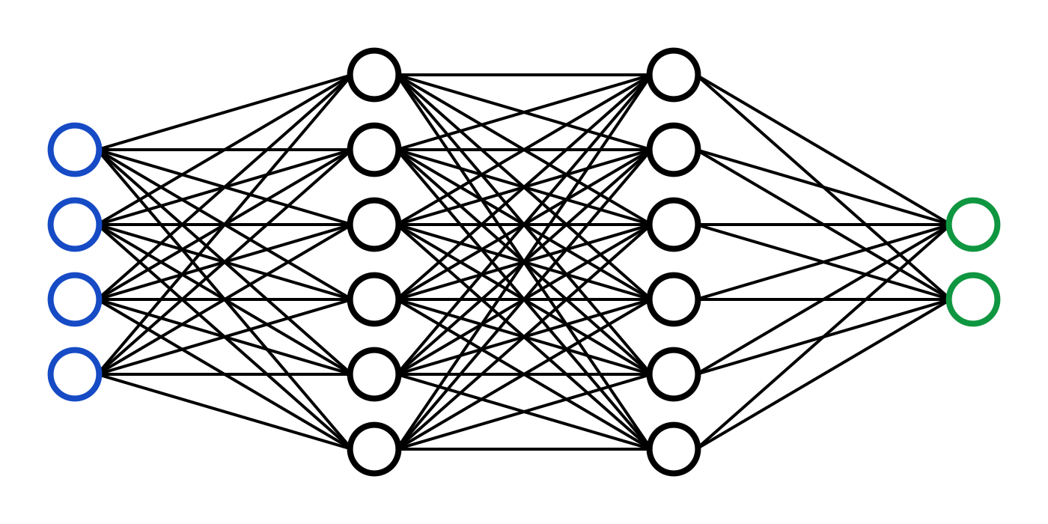
Diagnosing COVID-19 Using Deep Learning Applied On Radiography
Leveraging Convolutional Neural Networks and Transfer Learning
Team B4

Slide 2
Abstract
A Convolutional Neural Network based on VGG16 architecture is trained and analyzed on around 21000 lung X-ray images using transfer learning. Out of the 21170 images obtained from Kaggle repository, 16500 images have been used for training, 3130 have been used for validation and 1540 for testing the validated model. The goal is to accurately screen the patients suffering from Covid-19 against those who also suffer from Ground Glass Opacity and Viral Pneumonia which have a similar effect on human lungs as that of Covid-19.

Slide 3



Tools and Software Used
Development Tool: Kaggle Notebook
Programming Language: Python
Deep Learning Framework: TensorFlow V2.0
Base Hardware: TPU (Tensor Processing Unit)
Base CNN Architecture: VGG16
Dataset: https://www.kaggle.com/tawsifurrahman/covid19-radiography-database

Slide 4
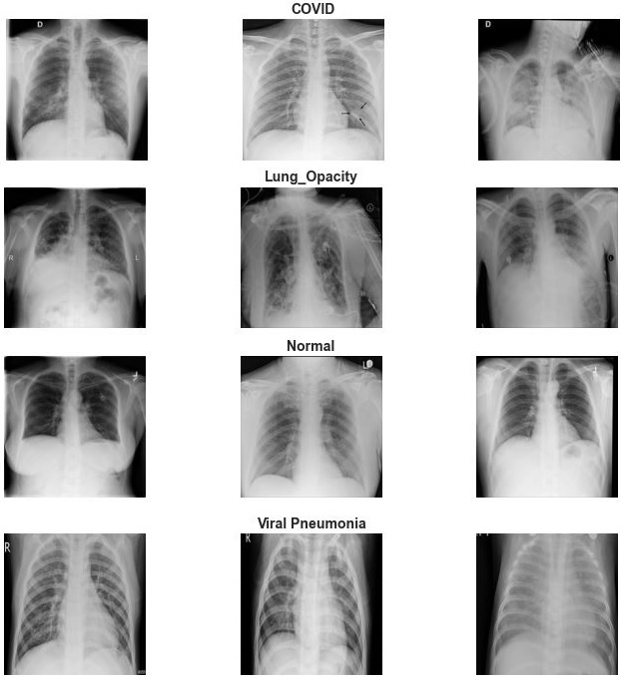
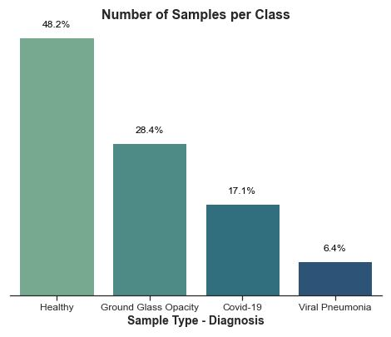
Dataset

Slide 5
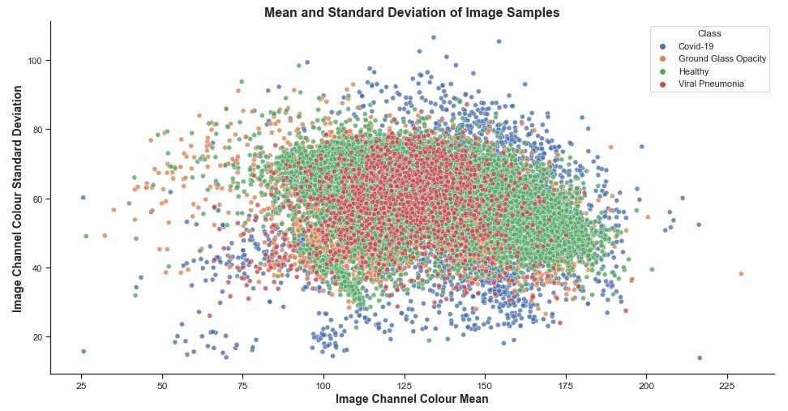
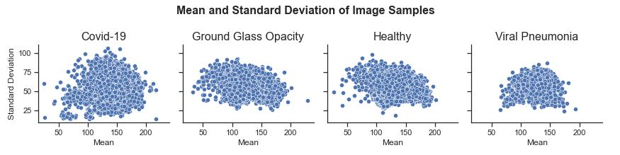

Slide 6
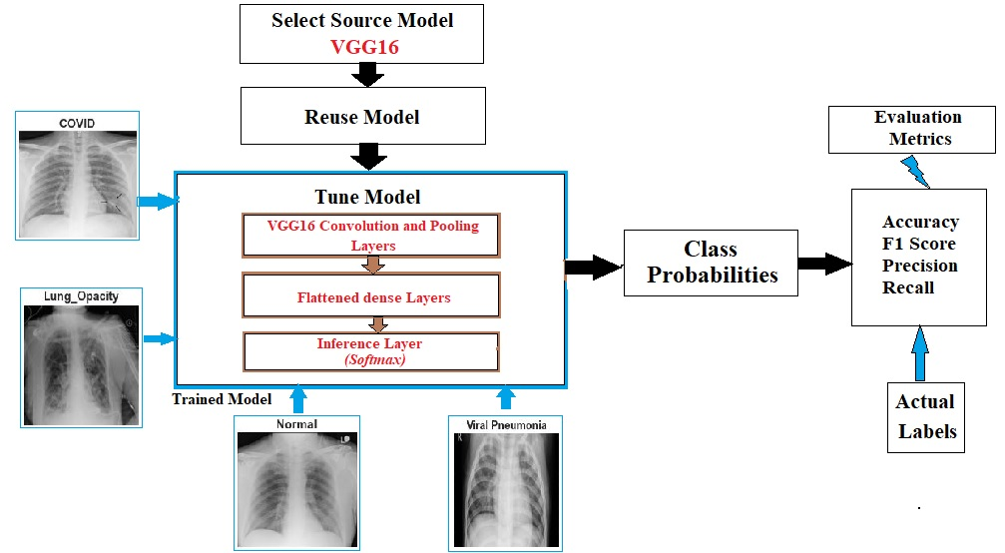
Model Formulation

Slide 7
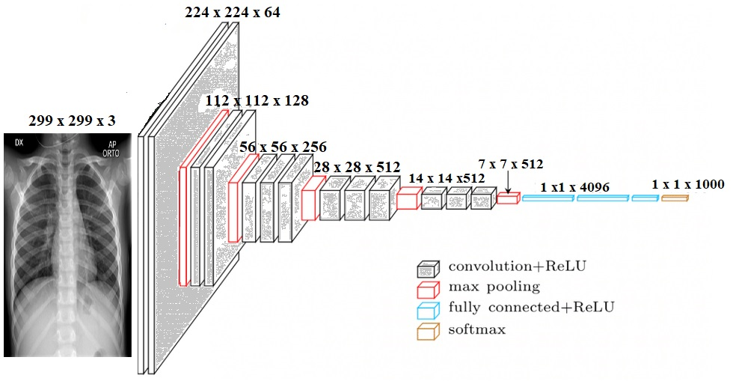
299x299x3
1x1x4
X-Ray Image
VGG16 (Visual Geometric Group) Architecture

Slide 8
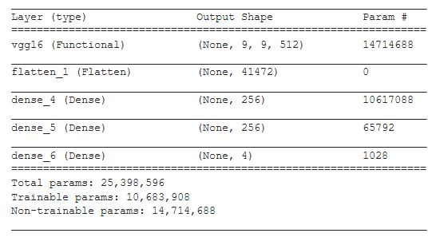
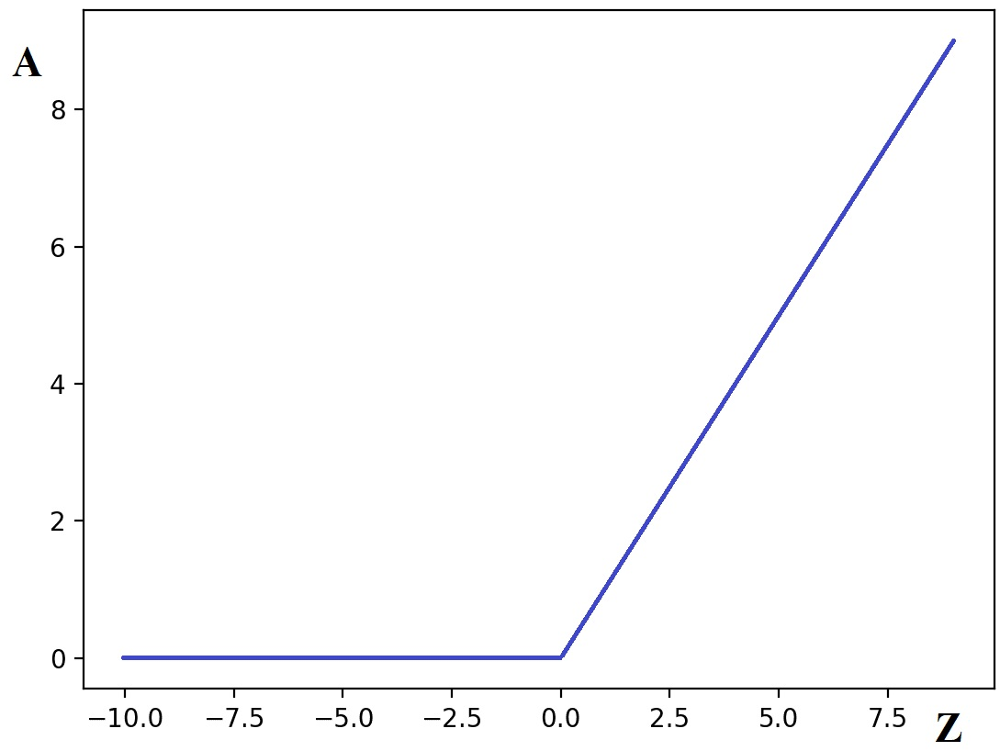
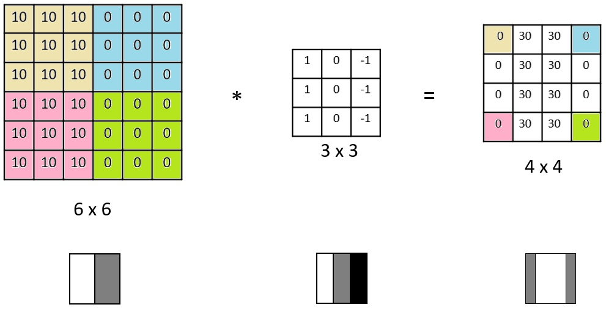
Model Summary
ReLU Activation Function
CNN Working

Slide 9
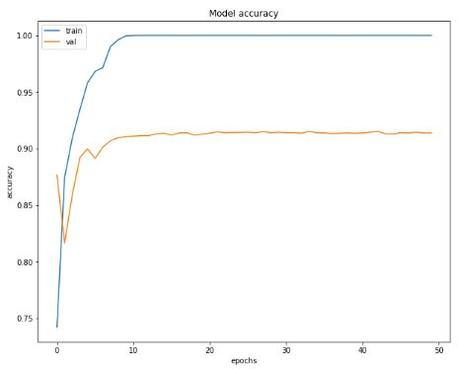
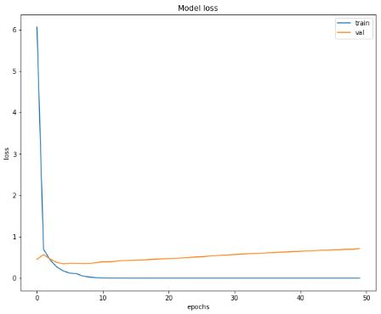
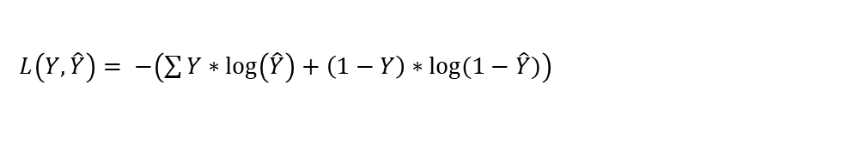
Accuracy and Loss
Training and Validation Accuracy
Training and Validation Loss
$L\left(Y,\hat{Y}\right)= −\left(\sum{Y∗\log\left(\hat{Y}\right)+\left(1−Y\right)∗log⁡(1−\hat{Y})}\right)$

Slide 10
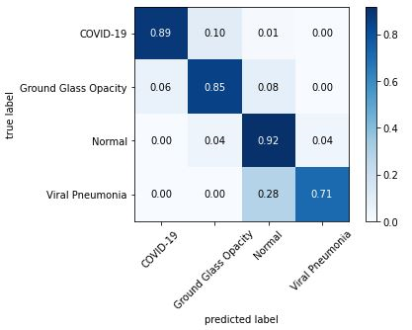
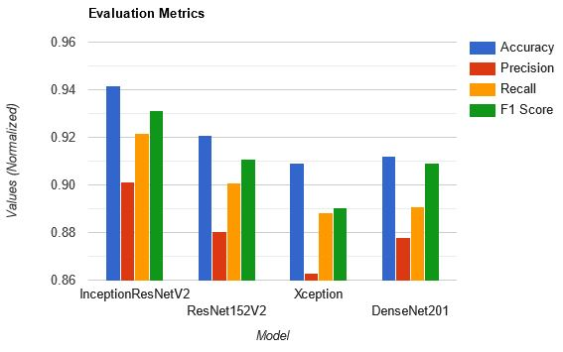
Evaluation Metrics
Confusion matrix of the Model
Comparison of different models

Slide 11
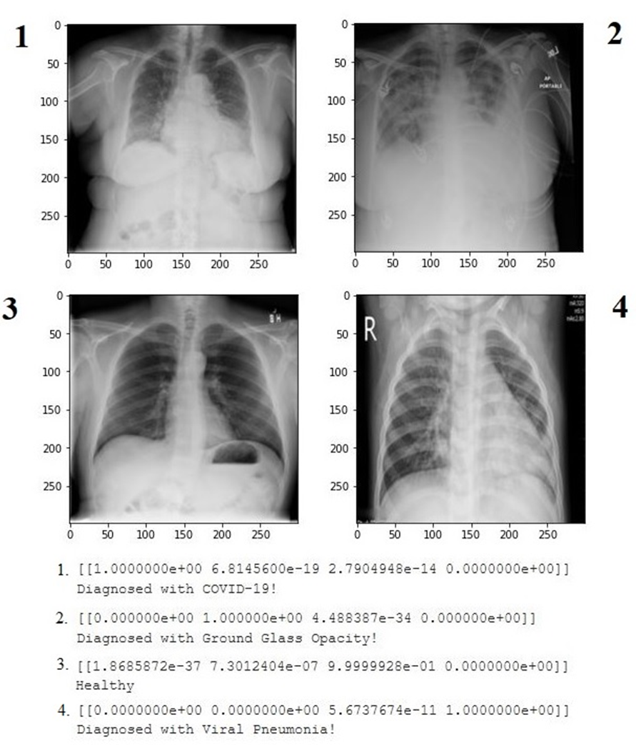
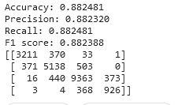

Slide 12
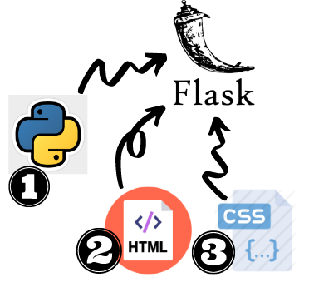
WEB DEPLOYMENT USING FLASK
The website runs with a background application coded in python.
The application makes use of well-known modules like pandas, MIME package, tensorflow, flask.
With the help of flask, a customized hierarchy was made to run on cloud platforms. Considering we deploy with flask, our primary focus is to make available the python script in the root directory in any platform.
The trained model that was saved earlier in ‘.h5’ format was placed in model directory and website UI material was placed in template directory.
User’s can simply click on the upload file button in the website and submit their X-Ray image.

Slide 13
Future Scope
As part of our future work, we intend to localize (using Object Localization) the regions in the X-ray that are peculiar and differentiate COVID-19 disease from other similar-in-effect diseases.
Build a GAN that generates artificial data to account for the imbalance of number of images in the dataset so that accuracy is improved.
Deploy the model using AWS ElasticBeanStalk or Docker Container images.
Build a hybrid neural network based on ResNet and VGG architectures to better handle X-ray images.

Slide 14
References
M.E.H. Chowdhury, T. Rahman, A. Khandakar, R. Mazhar, M.A. Kadir, Z.B. Mahbub, K.R. Islam, M.S. Khan, A. Iqbal, N. Al-Emadi, M.B.I. Reaz, M. T. Islam, “Can AI help in screening Viral and COVID-19 pneumonia?” IEEE Access, Vol. 8, 2020, pp. 132665 - 132676.
Rahman, T., Khandakar, A., Qiblawey, Y., Tahir, A., Kiranyaz, S., Kashem, S.B.A., Islam, M.T., Maadeed, S.A., Zughaier, S.M., Khan, M.S. and Chowdhury, M.E., 2020. Exploring the Effect of Image Enhancement Techniques on COVID-19 Detection using Chest X-ray Images.

