Slide 1
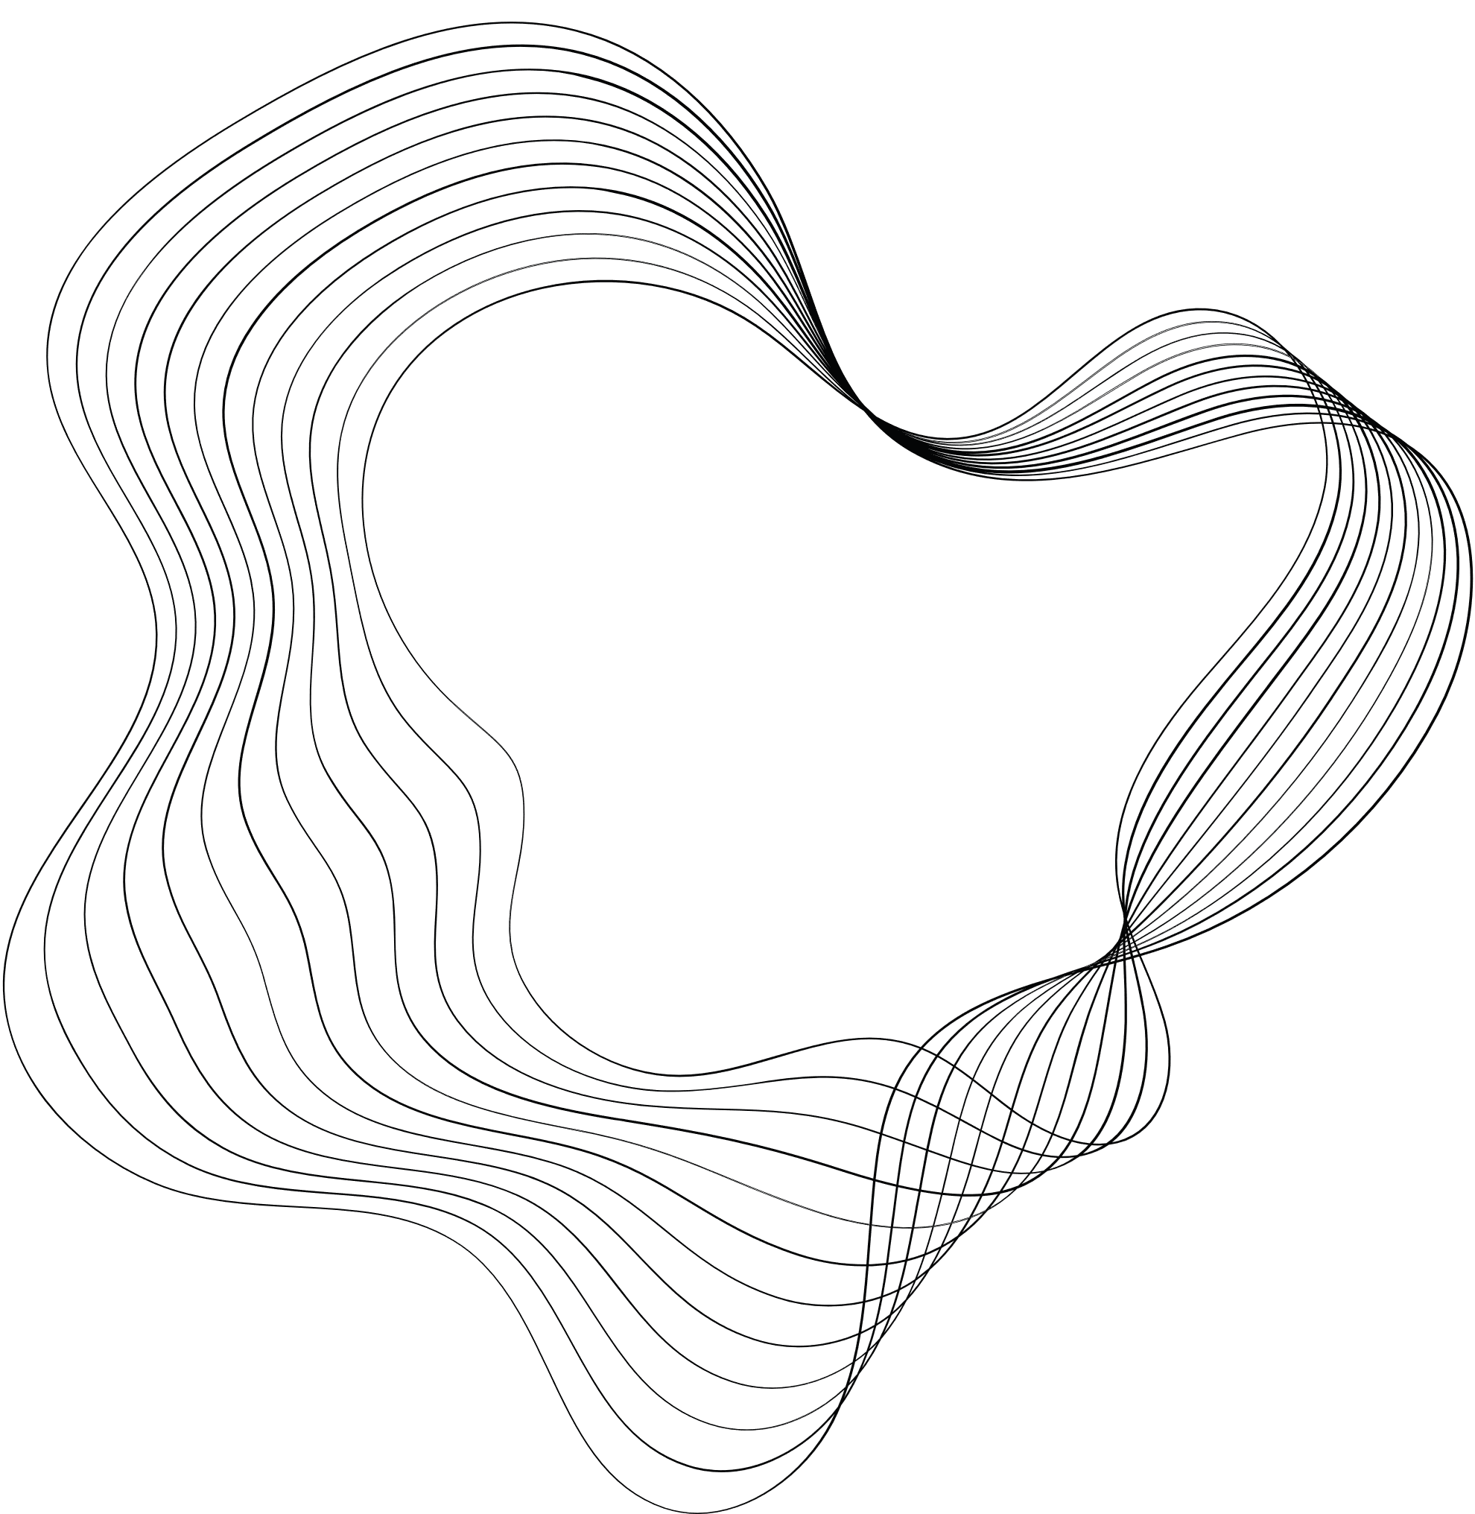
Plagiarism Detection Using Transformer Models
An Advanced Approach to Detecting Plagiarized and Paraphrased Text
Team Members
VAISHNAVI KUKKALA ​
HARIKRISHNA PARA​
SAI CHARAN CHANDU PATLA

Slide 2

CONTENT
01
Introduction
02
Statement of Value
03
Review of the State of Art
04
Approach
05
Evaluation & Results
06
Conclusion
07
Future Work & Impact

Slide 3


Introduction
Our project focuses on developing a plagiarism detection system using natural language processing (NLP) techniques and transformer-based models to accurately find the text similarities and potential plagiarism, promoting academic integrity and protecting intellectual property. Our key objectives include:
Build an advanced plagiarism detection system using state-of-the-art NLP models like BERT+LSTM, BERT, RoBERTa, and T5.
Identify plagiarism and paraphrased content in text by leveraging deep learning techniques.
Importance:
Maintains academic integrity, protects intellectual property, and ensures content originality.

Slide 4
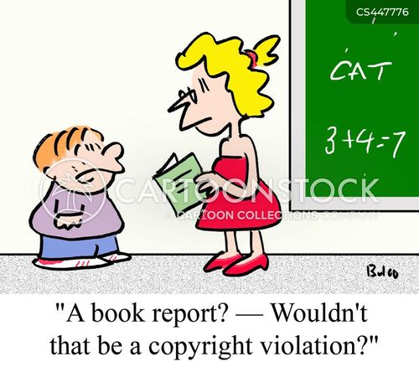



Statement Of Value
Promoting Academic Integrity: Our plagiarism detection system is designed to maintain the integrity of academic institutions by verifying the originality of submitted work and ensuring proper citation. This system fosters a culture of honesty and accountability among students, educators, and researchers.
Protecting Intellectual Property: By identifying instances of unauthorized content reuse, our project safeguards the intellectual poperty of creators, researchers, and organizations. This proactive detection helps prevent disputes and legal challenges related to content duplication.
Ensuring Quality and Credibility: A robust plagiarism detection system enhances the quality of academic and professional work by promoting originality and adherence to citation standards. This contributes to maintaining high standards in research, writing, and publishing, ultimately bolstering the credibility and reputation of educational institutions and organizations.

Slide 5
State of Art
Plagiarism detection is essential for maintaining academic integrity, originality, and ethical standards in writing and research.
Existing plagiarism detection tools struggle to identify paraphrased or semantically similar content, limiting their effectiveness.
This project leverages state-of-the-art transformer models (e.g., BERT, RoBERTa, T5) to understand the context and meaning of text, improving accuracy in detecting reworded or subtle plagiarism.
It provides a scalable and modular framework that can be adapted to other NLP tasks, such as text similarity scoring, paraphrase detection, and fake news identification.
Automated plagiarism detection reduces manual effort for educators, publishers, and reviewers, saving time and improving efficiency.
Transformer-based models offer a significant improvement over traditional similarity metrics, addressing gaps in current plagiarism detection systems.

Slide 6
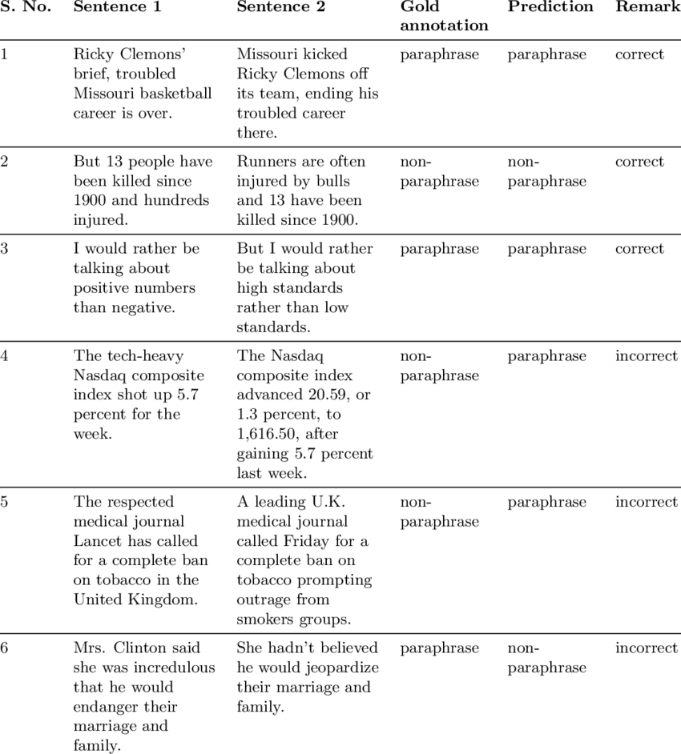
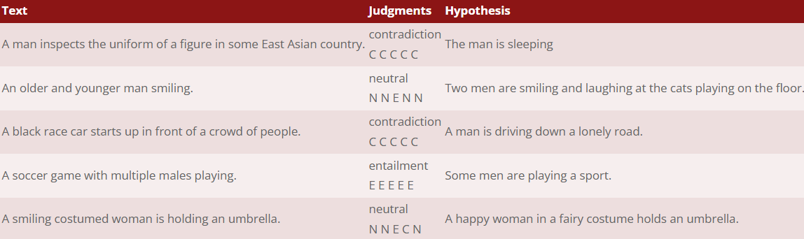
Approach
Algorithms
Transformer-based Models: These models utilize the transformer architecture, which is the basis for advanced NLP algorithms. They are designed to process sequential data efficiently by using self-attention mechanisms.
Fine-Tuning: Fine-tuning pre-trained models on a specific task (plagiarism detection, paraphrase detection) through supervised learning.
Classification Algorithms: These algorithms are used to classify text pairs into categories (e.g., plagiarized or not plagiarized) after feature extraction from transformer models.
Datasets
SNLI (Stanford Natural Language Inference): total of 570,152 pairs of sentences
MRPC (Microsoft Research Paraphrase Corpus): dataset with 5801 pairs of labelled sentence

Slide 7
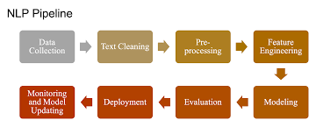
Approach
BERT (Bidirectional Encoder Representations from Transformers):
A pre-trained model that uses bidirectional transformers for generating contextual embeddings of text. BERT is fine-tuned for text classification tasks, making it useful for identifying relationships between sentence pairs, such as plagiarism or paraphrasing.
BERT+BiLSTM:
Combines BERT’s token embeddings with a Bidirectional Long Short-Term Memory (BiLSTM) network. BiLSTM helps capture sequential dependencies in text, improving performance in understanding complex paraphrasing.
RoBERTa (Robustly Optimized BERT Pretraining Approach):
An improved version of BERT that removes the Next Sentence Prediction (NSP) task and trains on more data. RoBERTa is typically more robust and performs better on sentence-pair tasks, like paraphrase detection.
T5 (Text-to-Text Transfer Transformer):
A versatile model that reframes all NLP tasks as text-to-text problems. T5 can generate outputs like "Plagiarized" or "Not Plagiarized" from input sentence pairs, making it suitable for paraphrase and plagiarism detection.
Tools: Hugging Face Transformers, PyTorch, Tokenizers, Scikit-learn.
Techniques: Text tokenization and preprocessing. Fine-tuning transformer models for classification. Evaluation using metrics like accuracy, precision, recall, and F1 score.

Slide 8
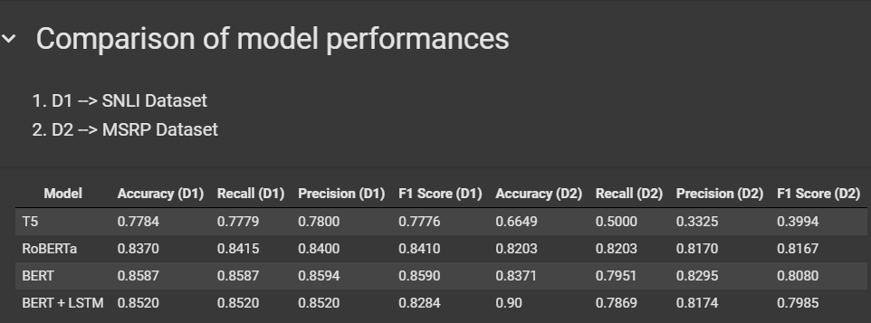
Evaluation & Results
Evaluation Metrics
Accuracy: Measures the overall correctness of the model.
Precision: The proportion of true positive results among the predicted positives.
Recall: The proportion of true positive results among all actual positives.
F1 Score: The harmonic mean of precision and recall, balancing both metrics.

Slide 9
Conclusion
Summary:
Plagiarism detection using transformers provides an advanced, accurate solution.
The project demonstrates the effectiveness of models like BERT, RoBERTa, BERT+LSTM and T5 for identifying both direct plagiarism and paraphrased content.
BERT emerges as the best-performing model for plagiarism detection, demonstrating high accuracy and reliability on both SNLI and MSRP datasets, followed closely by RoBERTa.
The BERT + LSTM hybrid model shows strong performance, particularly on the MSRP dataset, highlighting the potential of combining transformer embeddings with recurrent layers for specific tasks.
T5 underperforms in comparison, indicating that not all transformer architectures are equally suited for plagiarism detection.
The project successfully validates transformer models as effective and scalable solutions for identifying both direct and paraphrased plagiarism, paving the way for future enhancements like multilingual and real-time detection capabilities.

Slide 10
Future Work & Impact
Future Work
Model Optimization:
Further optimize transformer models for faster inference.
Scalability:
Scale the system to handle larger datasets and real-world use cases.
Deployment:
Deploy the solution as an API or integrate it into educational platforms and content platforms.
Impact
Enhances academic integrity, ensures content originality.
Legal Applications: Detects content duplication in legal documents and contracts to protect intellectual property.
Improved Ethics: Promotes ethical writing practices and protects original content creators.
Industry Adoption: Provides a scalable, robust plagiarism detection tool for integration into various industries like education, media, and law.

Slide 11
Citations
R. Patil, V. Kadam, R. Nakate, S. Kadam, S. Pattade and M. Mitkari, "A Novel Natural Language Processing Based Model for Plagiarism Detection," 2024 International Conference on Emerging Smart Computing and Informatics (ESCI), Pune, India, 2024, pp. 1-5, doi: 10.1109/ESCI59607.2024.10497386.
S. K. Pal, O. J. Raffik, R. Roy, V. B. Lalman, S. Srivastava and B. Sharma, "Automatic Plagiarism Detection Using Natural Language Processing," 2023 10th International Conference on Computing for Sustainable Global Development (INDIACom), New Delhi, India, 2023, pp. 218-222.
An, R., Yang, Y., Yang, F., & Wang, S. (2023). Use prompt to differentiate text generated by ChatGPT and humans. Machine Learning with Applications, 14 , 100497.
B. Ko and H. -J. Choi, "Paraphrase Bidirectional Transformer with Multi-task Learning," 2020 IEEE International Conference on Big Data and Smart Computing (BigComp), Busan, Korea (South), 2020, pp. 217-220, doi: 10.1109/BigComp48618.2020.00-72.
Barman, U., Das, S., & Das, A. (2020). An empirical analysis of plagiarism detection across programming languages. In 2020 10th Annual Computing and Communication Workshop and Conference (CCWC) (pp. 0670-0675). IEEE.
J. V. Latina, G. M. Cabalsi, J. R. Sanchez, E. D. M. Vallejo, C. J. Centeno and E. A. Garcia, "Utilization of NLP Techniques in Plagiarism Detection System through Semantic Analysis using Word2Vec and BERT," 2024 International Conference on Expert Clouds and Applications (ICOECA), Bengaluru, India, 2024, pp. 347-352, doi: 10.1109/ICOECA62351.2024.00068.

Slide 12
THANK YOU!

