Slide 1
LEARNING PLATFORM
with AI Doubt Solver
Frontend Architecture & Database (ER) Design
TEAM 10 · SECTION 10
S. Sai Kaushik • Ch. Ganesh • A. Sai Charan Teja
Database Systems Engineering & Distributed Backend Development · KL University

Slide 2




What We'll Walk Through
Frontend Architecture
Tech stack, page structure, and how the UI is organized
Design System
The “Catalog & Ledger” visual language — color, type, layout rules
Entity-Relationship Diagram
Relational schema, vector search, and MongoDB asset storage
How the Pieces Connect
Mapping UI screens to the data they read and write
Learning Platform with AI Doubt Solver
Section 10 · Team 10

Slide 3




Frontend Tech Stack
A lightweight, fast-build React stack — no framework bloat for a project that needs to iterate quickly.
React (Vite)
Tailwind CSS
React Router
Mock / Live API layer
Component-driven UI, fast dev server & build
Utility-first styling, consistent design tokens
Client-side routing across every screen
Runs standalone, swaps to the real FastAPI backend
Learning Platform with AI Doubt Solver
Section 10 · Team 10

Slide 4






Six Screens, One Consistent System
Every page shares the same catalog/ledger visual language and talks to the same API contract.
Login / Signup
Student Dashboard
Course Catalog
Role-based entry — student or instructor
Enrolled courses, recent doubts, quick actions
Browse courses & modules as catalog entries
Doubt Solver
My Doubts
Instructor View
Ask a question, get an AI answer with sources
Full history with status — pending / answered
Doubt analytics across owned courses
Learning Platform with AI Doubt Solver
Section 10 · Team 10

Slide 5

Design System — "Catalog & Ledger"
Built to feel like a library catalog & reference desk, not a generic SaaS dashboard.
#28333A
#ECEAE4
#A8742C
#6E2A32
#8A9A8C
Ink Slate
Parchment Fog
Brass
Burgundy
Sage Mist
Primary text
Background
Primary accent
Status / alerts
Muted text
Typography
Layout
Headlines: Fraunces (serif, ledger character)
Body / UI: IBM Plex Sans
Hairline rules instead of card shadows
Catalog-style lists, not rounded card grids
Minimal border-radius (2–4px)
Learning Platform with AI Doubt Solver
Section 10 · Team 10

Slide 6
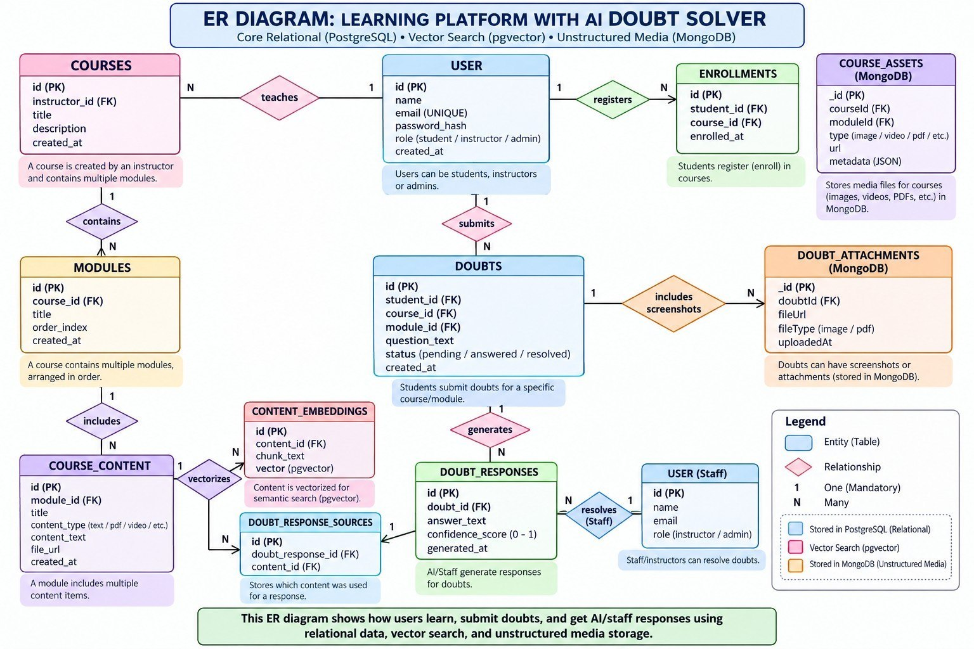
Entity-Relationship Diagram
Relational core (PostgreSQL) · Vector search (pgvector) · Unstructured media (MongoDB)

Slide 7
Core Entities at a Glance
USERS
Students, instructors & admins — the root of every relationship
COURSES → MODULES → COURSE_CONTENT
Catalog hierarchy; content is the source material for doubts
DOUBTS → DOUBT_RESPONSES
A student's question and its AI/staff-generated answer
DOUBT_RESPONSE_SOURCES
Join table — tracks exactly which content answered a doubt
CONTENT_EMBEDDINGS (pgvector)
Vectorized chunks powering semantic search for the doubt solver
COURSE_ASSETS & DOUBT_ATTACHMENTS (MongoDB)
Flexible, schema-less media — images, PDFs, screenshots
Learning Platform with AI Doubt Solver
Section 10 · Team 10

Slide 8



Three Databases, One Purpose Each
Polyglot persistence: each store is used for exactly what it's best at.
PostgreSQL
pgvector
MongoDB
Structured core
Semantic search
Flexible media
Users, courses, modules, doubts — strict relationships, transactions, ACID guarantees
Content embeddings for similarity search — powers the AI doubt solver's retrieval step
Course assets & doubt attachments — images, PDFs, variable metadata per item
Learning Platform with AI Doubt Solver
Section 10 · Team 10

Slide 9
Thank You
Questions & Discussion
TEAM 10 · SECTION 10
S. Sai Kaushik • Ch. Ganesh • A. Sai Charan Teja
Database Systems Engineering & Distributed Backend Development · KL University

