Slide 1
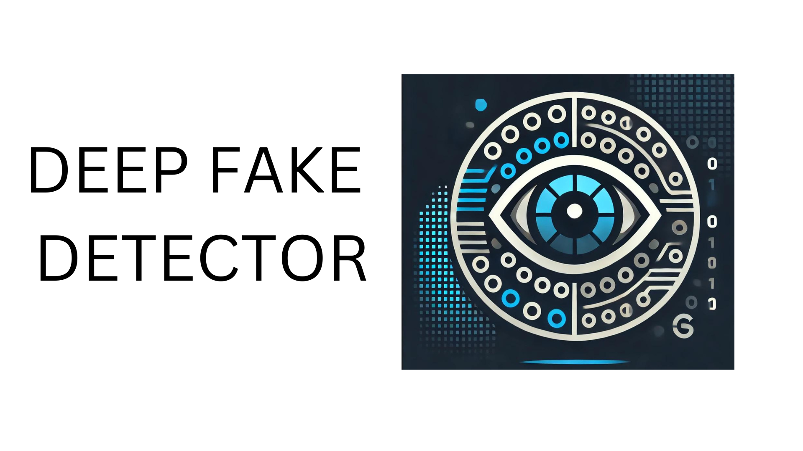

Slide 2


Slide 3

BATCH NUMBER-19
TEAM MEMBERS
BUKKA HARSHA - 2103A54007
CHALLA SAI CHETANA - 2103A54047
KOTHAKONDA SRISHANKA - 2103A54023
DUBASI ABHIGNYA - 2103A54013
SRIRAM PRANEETH - 2103A54036
UNDER THE GUIDANCE
OF
RAMESH BABU SIR

Slide 4
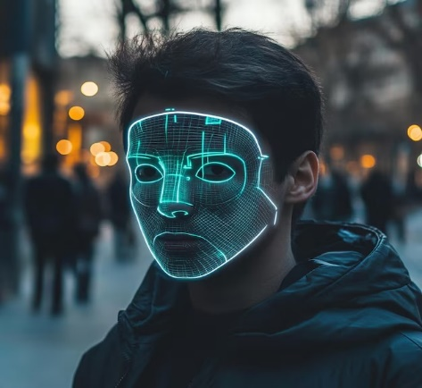
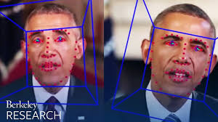
Problem Statement
Deepfakes are AI-generated media that mimic real people, making it hard to tell fake content from real. They are often misused to spread misinformation, commit fraud, or harm reputations.
Deepfake detection addresses this issue by using deep learning techniques to identify subtle inconsistencies in media.
This ensures the authenticity of digital content and helps protect against the risks posed by manipulated media.
Continuous advancements in detection techniques will play a vital role in staying ahead of this challenge.

Slide 5

Literature Review
Increased Complexity: Recent advances in GAN-based models have made deepfake detection more challenging by creating more subtle manipulations in both images and videos.
Transformer Models: While Vision Transformers (ViT) effectively detect image anomalies, their high computational demands limit their use in real-time applications.
Cross-Modal Detection: Combining audio and video analysis improves detection accuracy by addressing deepfakes that only manipulate one modality.
Current Gaps: Existing tools have high false positive rates, focus on either images or videos (not both), and struggle with real-time detection, highlighting the need for a more versatile and accurate system.

Slide 6
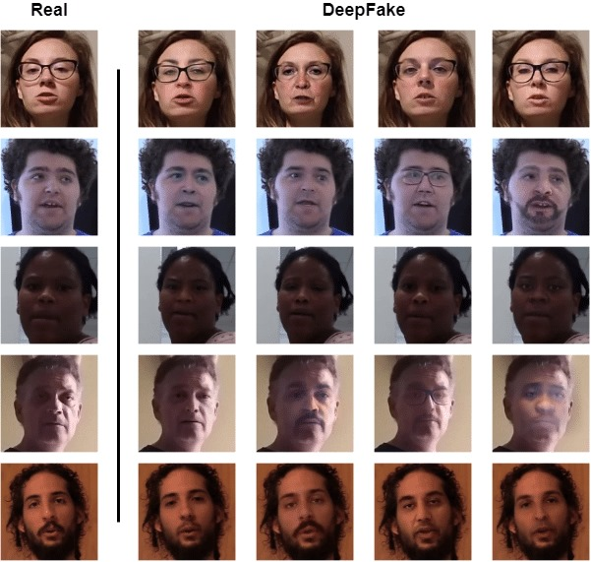
Data Collection
We collected the dataset from Kaggle.com, which consists of both real and fake videos and photos, enabling comprehensive detection of deepfakes in both formats.
For videos, frames were extracted and resized, while photos were directly processed to match the input requirements of the ResNet50, VGG16 and EfficientNet models.
The dataset includes a diverse range of real and fake content, ensuring the models are trained to detect deepfakes across various scenarios. Videos and photos were carefully preprocessed to maintain quality and consistency, allowing for accurate feature extraction and reliable classification during testing.
The dataset is balanced, with an equal distribution of real and fake samples, ensuring unbiased training and effective performance for detecting deepfakes in both videos and photos.

Slide 7
Proposed Method
Proposed Method:
Dual Detection: Our system will analyze both deepfake images and videos, allowing for more versatile use across different media formats.
Dual Detection: Our system will analyze both deepfake images and videos, allowing for more versatile use across different media formats.
Real-Time Processing: By optimizing Resnet50 and EfficientNet models, our system will detect deep fakes in real time, addressing delays in current tools.
User Engagement: Incorporates interactive features like a deepfake quiz, educational resources, and real-time feedback, improving user awareness and system usability.
Enhanced UI Design: Focuses on a user-centered design with clear feedback, educational prompts ("What is a deepfake?"), and real-time alerts on video and image detection results.

Slide 8
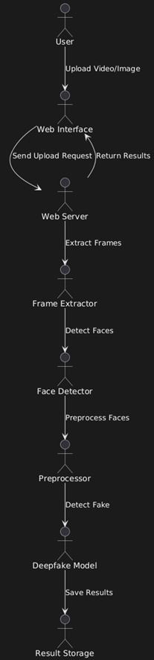
Methodology
The deepfake detection system involves multiple stages to ensure accurate identification of fake videos and photos. Initially, after collecting the data the frames were extracted from videos, and all inputs, including photos, were resized to meet the requirements of ResNet50, VGG16 and EfficientNet architectures. Both models were utilized for feature extraction and classification due to their proven efficiency in handling image-based tasks.
The process begins with preprocessing, where input data is normalized and augmented to improve model generalization. The prepared data is then fed into the models for training, using labeled datasets of real and fake samples.
The final model predicts the authenticity of the input by analyzing extracted features, producing outputs of either "Real" or "Fake."

Slide 9
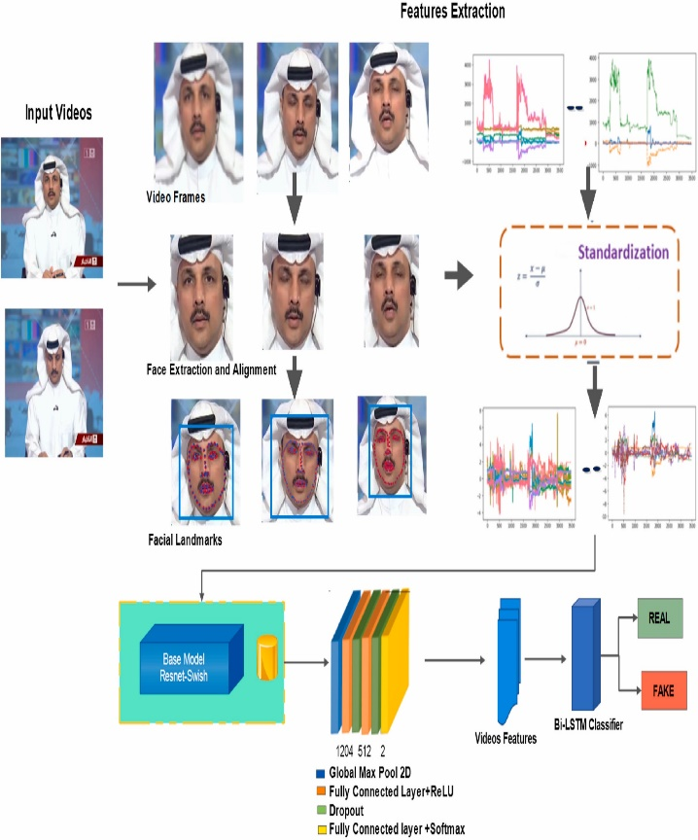
Implementation
The implementation began with preprocessing the dataset, which included real and fake photos and video frames. The data was split into training and testing sets with balanced distributions. Frames were extracted from videos, and both images and frames were resized for model input. After training, the models were tested on unseen data to assess their ability to classify inputs as "Real" or "Fake," ensuring reliable deepfake detection across different formats and scenarios.
ResNet50, EfficientNet, VGG16, and a custom CNN were selected for feature extraction and classification due to their effectiveness in image classification tasks. ResNet50 and EfficientNet were used for high-level feature extraction, while VGG16 provided a simpler approach, and the custom CNN explored an alternative method for deepfake detection.

Slide 10
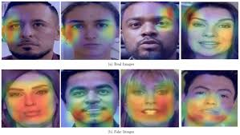
Implementation
The models were trained with carefully selected hyperparameters, and the data was enhanced to improve the models' ability to generalize to new inputs. Measures were taken to prevent overfitting, ensuring the models could learn effectively from the data.
Finally, the models were evaluated on unseen data by assessing their ability to correctly classify inputs as “Real” or “Fake,” using various performance metrics. This ensured reliable deepfake detection across both images and videos.

Slide 11
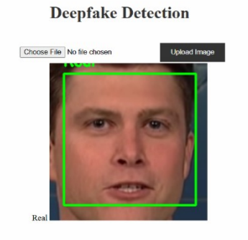
Results
The models demonstrated strong performance in classifying real and fake images and videos. Evaluation of the test data showed high accuracy in detecting deepfakes, with the models consistently distinguishing between real and fake content.
The models performed well across both image and video data, showing their robustness in handling different types of inputs
Overall, the results validated the effectiveness of using advanced deep learning architectures, such as ResNet50, EfficientNet, VGG16, and Hybrid models, for deepfake detection, ensuring reliable performance across various formats.

Slide 12
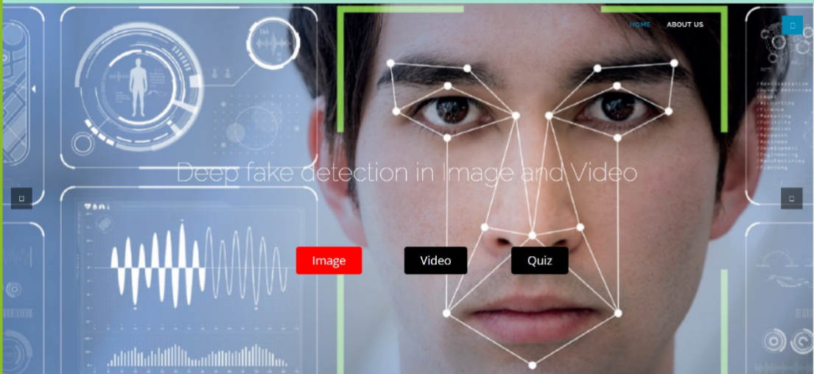
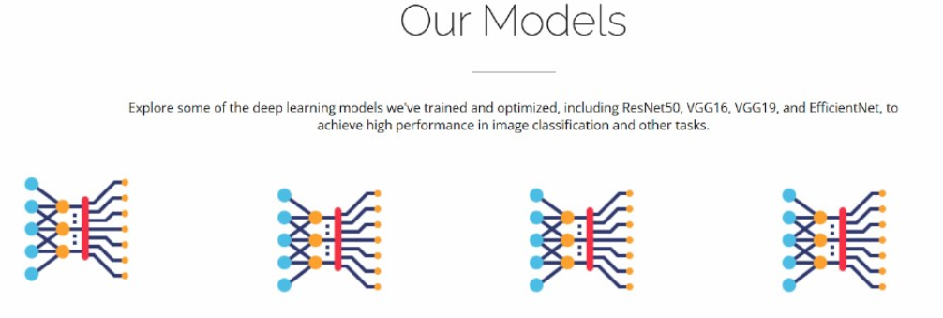
SYSTEM FEATURES
User-Centered Design: The interface is designed to be highly user-friendly and easy to navigate. It provides a simple and intuitive experience for users, allowing them to upload images or videos for deepfake detection with minimal effort.
Simplified UI with educational prompts like “What is a deepfake?” for easy navigation.
Users can easily access the upload section, where they can choose their files, and the system will quickly process and classify the content as either “Real” or “Fake.”

Slide 13
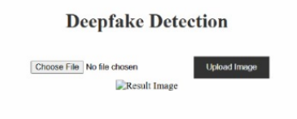
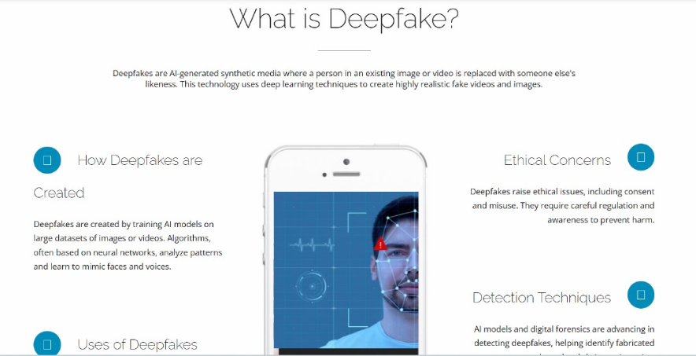
SYSTEM FEATURES
Real-Time Feedback: Immediate results indicating whether content is real or fake.
Interactive Elements: Include quizzes and links to relevant research to enhance user awareness of deepfakes.
“What is Deepfake?" Section: The project also includes a section titled "What is Deepfake?," which provides comprehensive information about deepfakes. This section explains the concept of deepfakes, how they are created, and the potential risks and impacts they have in various areas such as media, security, and entertainment. It serves as an educational resource, helping users understand the technology behind deepfakes, how they work, and why it is important to be aware of them.

Slide 14
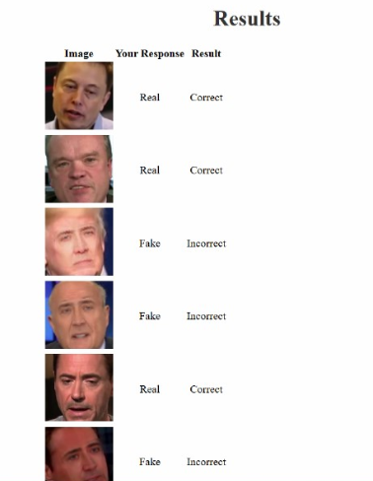
SYSTEM FEATURES
Interactive Quiz:
Our project includes a quiz feature to help users better understand deepfakes. When users click on the quiz, they are shown a series of real and fake images.
The task is for users to identify which images are real and which are fake. Once all the selections are made, the results are displayed, showing which images were real and which were fake.
This interactive feature helps users learn more about deepfake detection in an engaging and educational way.

Slide 15
Conclusion
Our deepfake detection project successfully implemented advanced deep learning models, including ResNet50, EfficientNet, VGG16, and custom CNN architectures, to identify real and fake images and videos.
The system demonstrated strong performance, accurately classifying content and providing reliable deepfake detection across various formats.
The user-friendly interface, combined with interactive features like the quiz and educational sections, enhances the learning experience and helps users understand deepfake technology better. This project offers a robust solution to the growing challenge of deepfake content, ensuring both effective detection and awareness.

Slide 16
Future Scope
The project has significant potential for further development and applications. Real-time deepfake detection can be implemented to analyze live video streams and address immediate concerns.
More advanced models and techniques can be integrated to enhance accuracy and adapt to evolving deepfake methods. Expanding the dataset to include diverse deepfake content will improve robustness.
Support for multiple languages can make the system globally applicable. Collaboration with social media platforms can help detect and flag deepfake content, reducing misinformation.
Additionally, creating more interactive tools and educational resources will raise awareness and help users better understand deepfakes. These advancements will enhance the system's reliability and impact.

Slide 17
THANK YOU

