Slide 1

SMART INDIA HACKATHON 2026
TITLE PAGE
Problem Statement ID - [Leave Blank]
Problem Statement Title - Detection & Characterization of Subsurface Ice in Lunar South Polar Doubly-Shadowed Craters
Theme - Space Technology
PS Category - Software
Team ID - [Leave Blank]
Team Name (Registered on portal) - storm Breaker

Slide 2
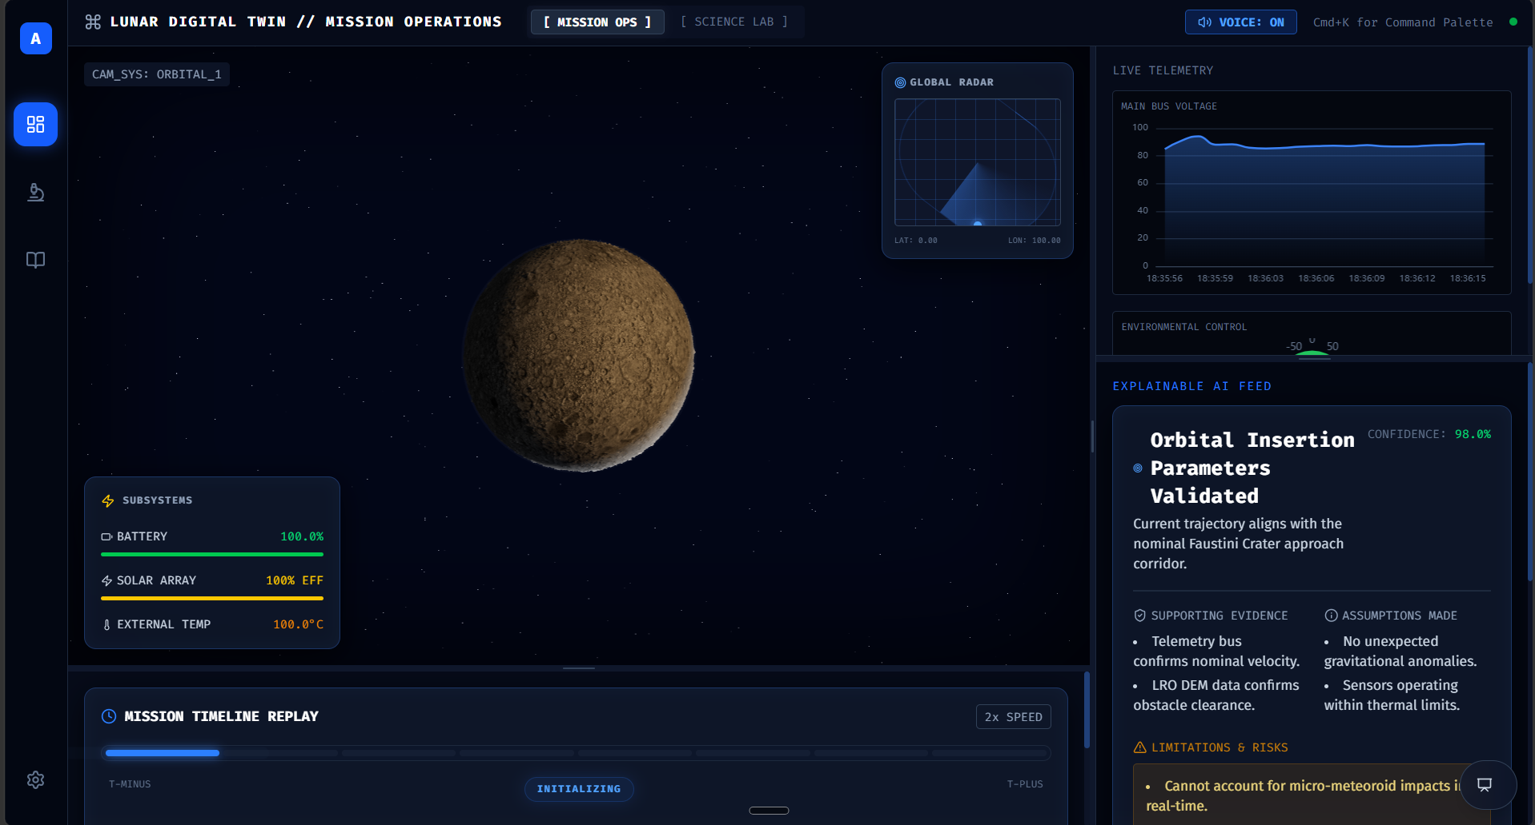
IDEA TITLE: Lumina - Lunar Digital Twin
storm Breaker
Proposed Solution:
• A real-time 3D browser-native Digital Twin mirroring Faustini Crater using Chandrayaan-2 DFSAR and CLASS data.
• Orchestrates 64 autonomous micro-rovers using Boids Swarm Algorithm for optimal sub-surface ice mapping.
• Unique USP: Explainable AI reasoning cards and physics-accurate 2.6-second Earth-Moon latency simulator.

Slide 3
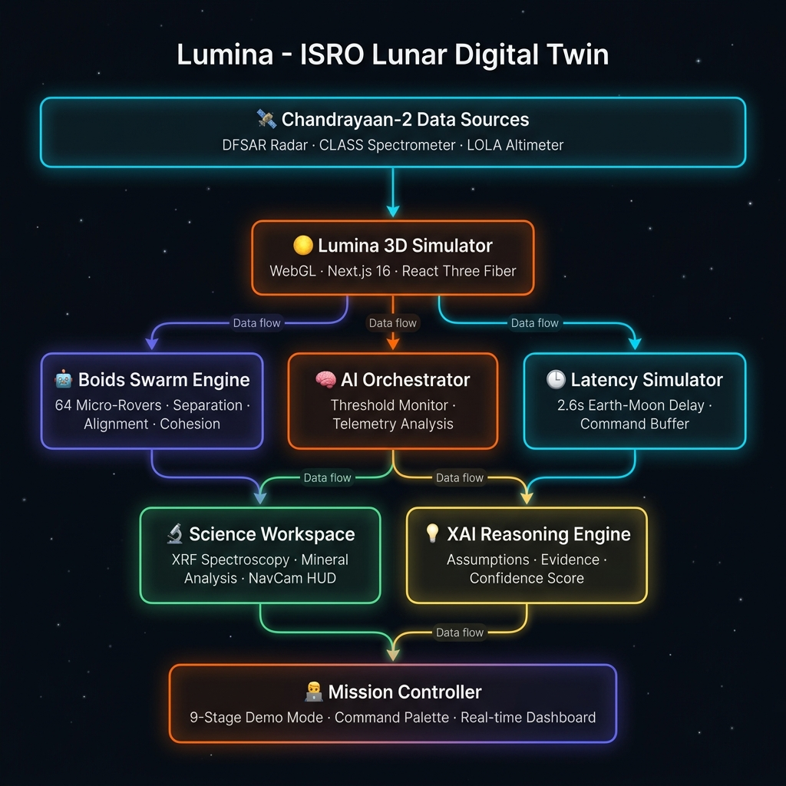
TECHNICAL APPROACH
storm Breaker
Core Tech Stack:
• Frontend & 3D: Next.js 16, React 19, Three.js, React Three Fiber (WebGL 60FPS).
• AI & Data: TensorFlow.js (NavCam CV), Zustand (State), Craig Reynolds' Boids Algorithm.
• No-Server Architecture: Runs 100% client-side via Vercel for zero infrastructure cost.

Slide 4
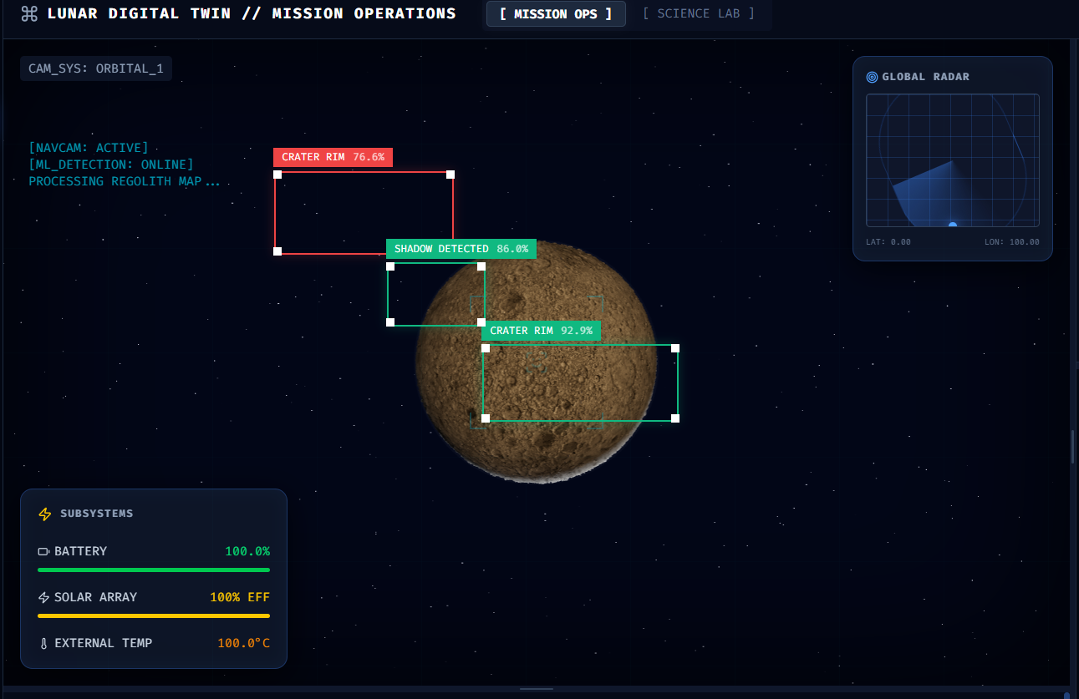
FEASIBILITY AND VIABILITY
storm Breaker
Feasibility & Risk Mitigation:
• High Feasibility: Built entirely on open-source tools and publicly available ISRO/NASA datasets.
• Challenge: Rendering 64 complex 3D rovers without lag.
• Solution: Utilizes Three.js InstancedMesh to draw all rovers in a single GPU draw call.

Slide 5
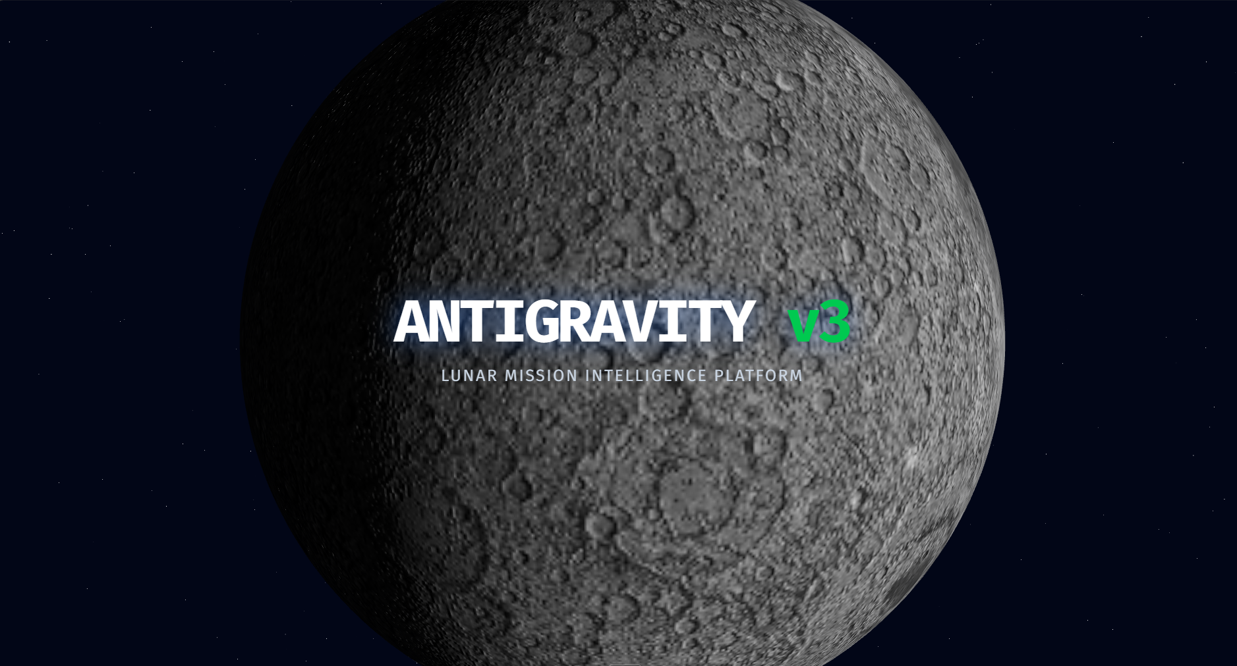
IMPACT AND BENEFITS
storm Breaker
Strategic Impact for ISRO:
• Pre-deployment Testing: Allows mission planners to simulate complex multi-agent swarms safely.
• Explainable AI: Builds trust between human operators and AI by visualizing exact reasoning and confidence bounds.
• Cost Efficiency: Instant accessibility across teams directly via web browser without specialized hardware.

Slide 6
RESEARCH AND REFERENCES
storm Breaker
Research & Data Sources:
• Chandrayaan-2 Dual-Frequency Synthetic Aperture Radar (DFSAR) parameters (CPR > 1, DOP < 0.13).
• Chandrayaan-2 CLASS X-Ray Spectrometer and NASA LOLA Altimeter.
• Craig Reynolds' Flocks, Herds, and Schools: A Distributed Behavioral Model (Boids).

