Slide 1

SMART INDIA HACKATHON 2026
TITLE PAGE
Theme: Space Technology
PS Category: Software
Team Name (Registered on portal): storm Breaker

Slide 2
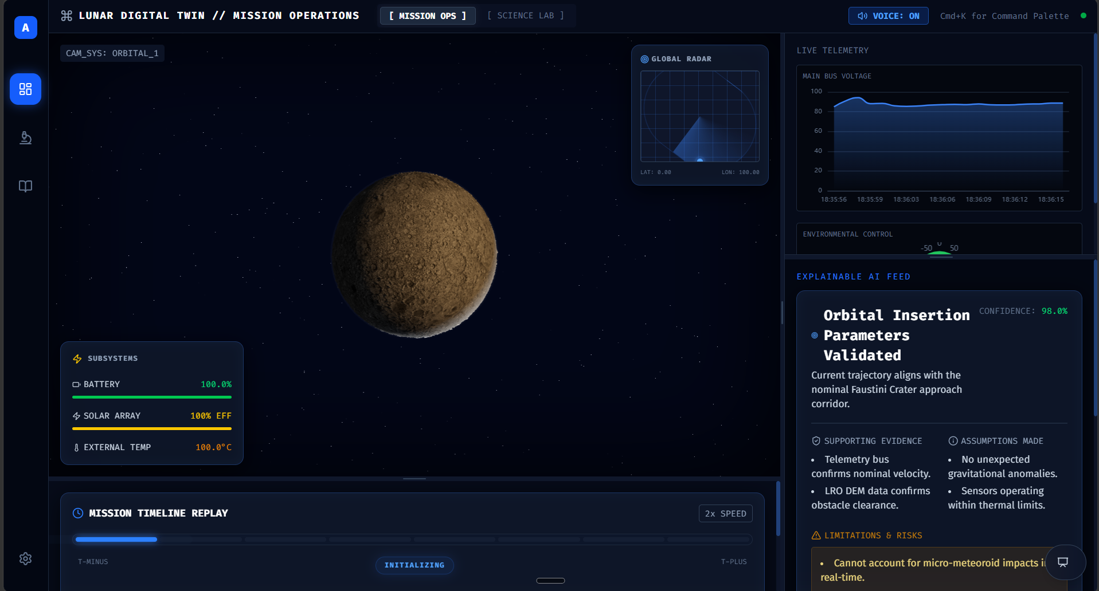
IDEA TITLE: Lumina - Autonomous Lunar Digital Twin
storm Breaker
Proposed Solution:
• Real-time, browser-native 3D Digital Twin of the Faustini Crater (WebGL 60FPS).
• Simulates 64 autonomous micro-rovers using Craig Reynolds' Boids Algorithm for sub-surface mapping.
• Integrates an Explainable AI (XAI) orchestrator providing real-time reasoning for telemetry.
• Physics-accurate simulation including a 2.6-second Earth-Moon communication latency.

Slide 3
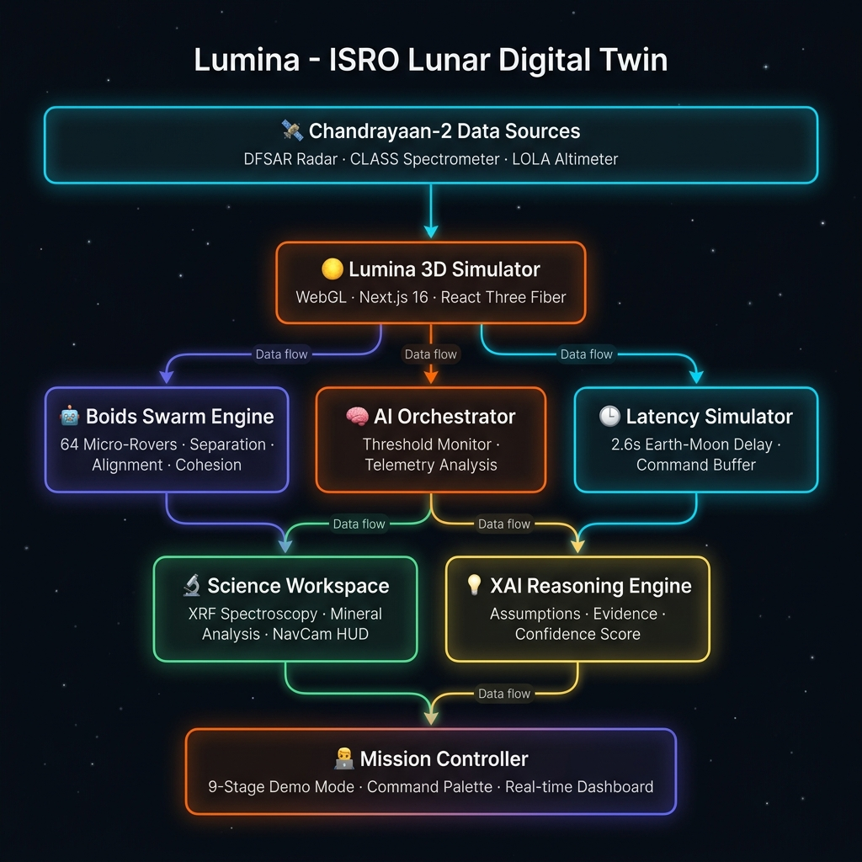
TECHNICAL APPROACH
storm Breaker
Technical Stack & Innovation:
• Frontend & 3D: Next.js 16, React Three Fiber, Three.js (InstancedMesh for swarm rendering).
• Core Science: We reject the flawed 'CPR > 1' assumption for ice.
• Innovation: Our pipeline strictly requires a two-parameter criterion (CPR > 1 AND DOP < 0.13) to eliminate surface roughness artifacts.
• Pathfinding: A* algorithm dynamically avoids slopes > 15°.

Slide 4
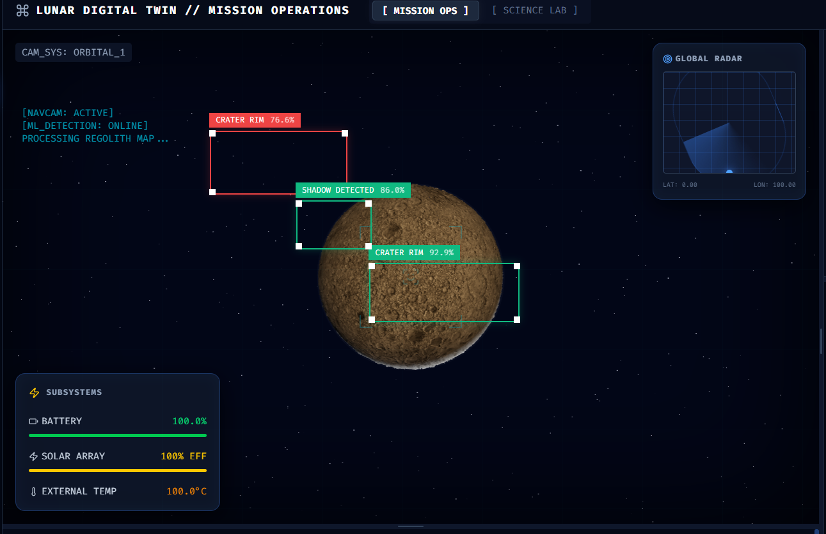
FEASIBILITY AND VIABILITY
storm Breaker
Feasibility & Risk Mitigation:
• Feasibility: 100% serverless, zero-infrastructure architecture deployed via Vercel.
• Risk: Rendering 64 3D rovers and real-time shadows typically causes severe browser lag.
• Mitigation: Implemented highly optimized GPU shaders and InstancedMesh rendering, achieving a stable 60 FPS even on mid-range devices.

Slide 5
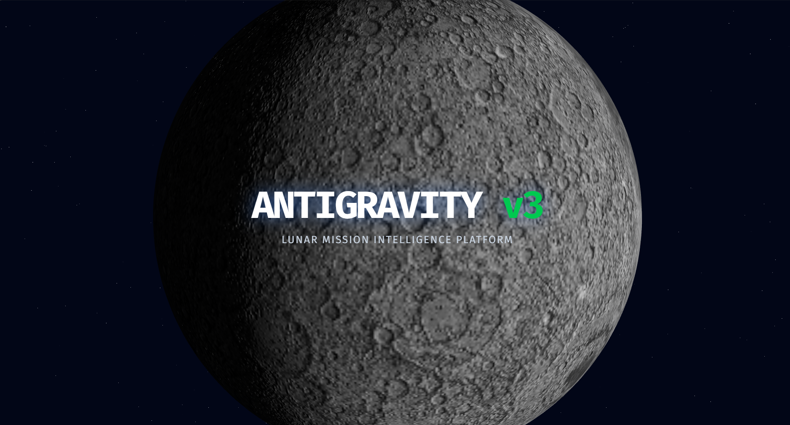
IMPACT AND BENEFITS
storm Breaker
Strategic Impact for ISRO:
• Mission Sandbox: Provides engineers with a risk-free, highly accurate environment to stress-test swarms.
• AI Trust & Transparency: Explainable AI bridges the gap between autonomous decisions and human operators.
• Scalability: The architecture is fully prepared to ingest data from future missions (e.g., LUPEX).

Slide 6
RESEARCH AND REFERENCES
storm Breaker
Research & Repository Links:
• Repository: https://github.com/saichintamani/Lumina-
• Live Demo: https://antigravity-faxkdjo57-sai-chintamanis-projects.vercel.app
• Data Sources: Chandrayaan-2 DFSAR and CLASS Spectrometer datasets.
• Scientific Basis: Sinha et al. (2026) and Verma et al. (2025) on two-parameter (CPR/DOP) ice inversion.
• Algorithms: Craig Reynolds (Boids).

