Slide 1
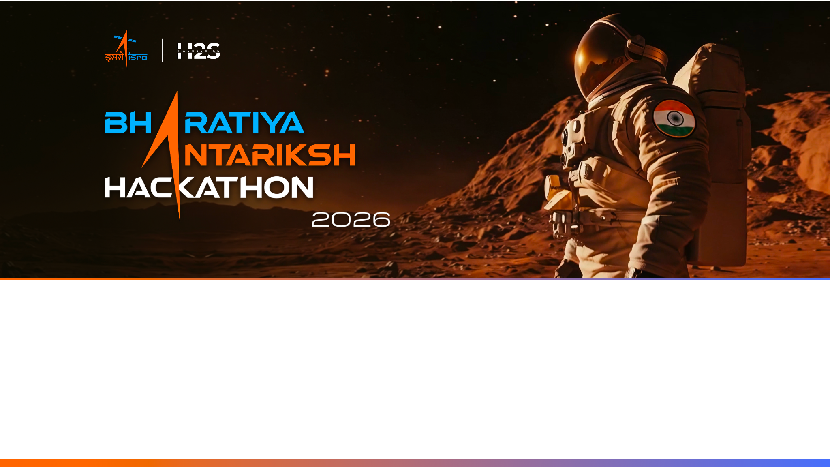
Team Name : [YOUR TEAM NAME]
Team Leader Name : [YOUR NAME]
Problem Statement : Detection & Characterization of Subsurface Ice in Lunar South Polar Doubly-Shadowed Craters Using Chandrayaan-2 DFSAR/OHRC Data

Slide 2

Team Members
Team Leader: Name: [YOUR NAME] College: G.H. Raisoni College of Engineering, Nagpur | Team Member-1: Name: [TEAMMATE NAME] College: G.H. Raisoni College of Engineering, Nagpur
Team Member-2: N/A (2-member team) | Team Member-3: N/A (2-member team)

Slide 3
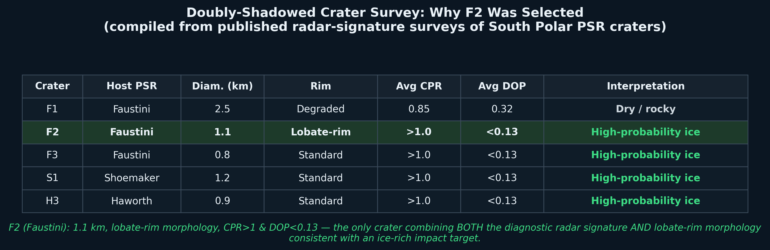
Our Approach: Differentiation, Solution Path & USP
Differentiation: Most teams apply CPR>1 alone (a contested, roughness-confounded metric per Eke et al. 2014, Fa & Eke 2018). We apply the refined two-parameter criterion (CPR>1 AND DOP<0.13) plus an explicit roughness-discrimination layer using slope, separating genuine volumetric-ice signatures from rough-terrain artifacts.
Solution path: DFSAR CPR/DOP polarimetric mapping to detect ice-bearing pixels -> OHRC-based slope/illumination/roughness terrain analysis -> multi-criteria landing site scoring -> slope-and-power-aware A* rover traverse planning -> dielectric-mixing based ice volume estimation with quantified uncertainty.
USP: A validated, end-to-end pipeline (built and stress-tested on a physically-motivated synthetic DFSAR scene before real data arrives) that reports uncertainty honestly -- detector precision/recall, ice-volume confidence bounds, and traverse slope-limit sensitivity -- rather than presenting single point answers.

Slide 4
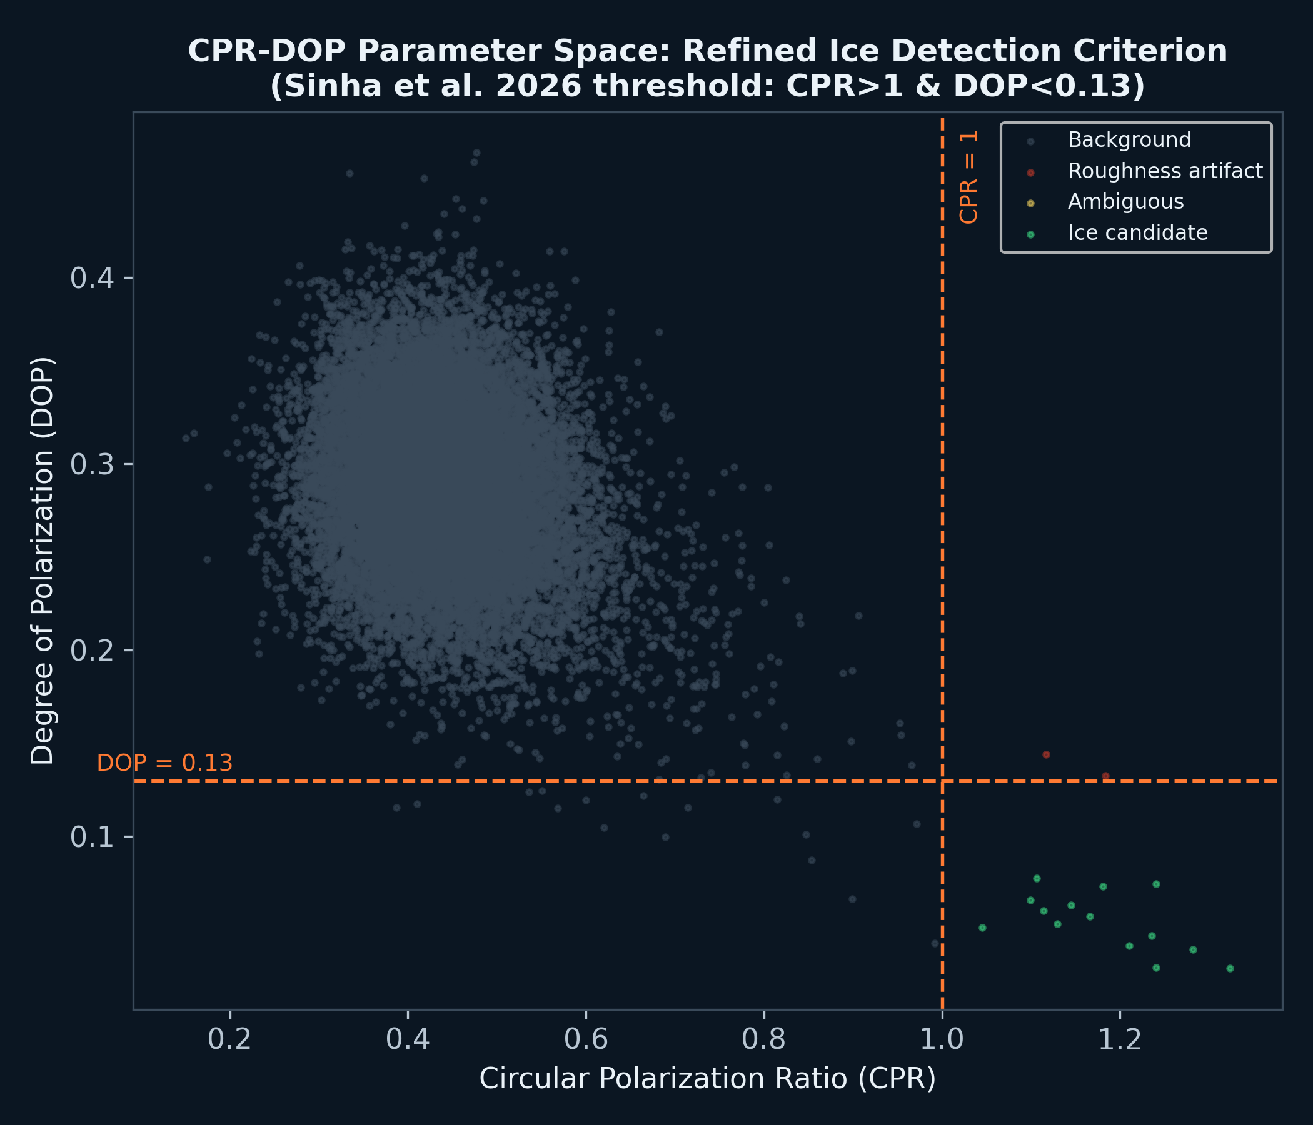
Key Features of the Proposed Solution
Refined two-parameter ice detector (CPR>1 & DOP<0.13) with an added roughness-discrimination layer that flags steep/rough false positives separately from genuine ice candidates.
Multi-criteria landing site scorer (slope, illumination, hazard-roughness, comm-range) producing a ranked, auditable shortlist rather than one black-box answer.
Slope- and power-aware A* rover traverse planner that auto-detects the gentlest safe rim crossing, with a documented final battery-powered sortie into the PSR.
Uncertainty-bounded ice-volume estimator (dielectric-mixing proxy with bootstrap P10-P90 range) instead of a single unjustified number.

Slide 5
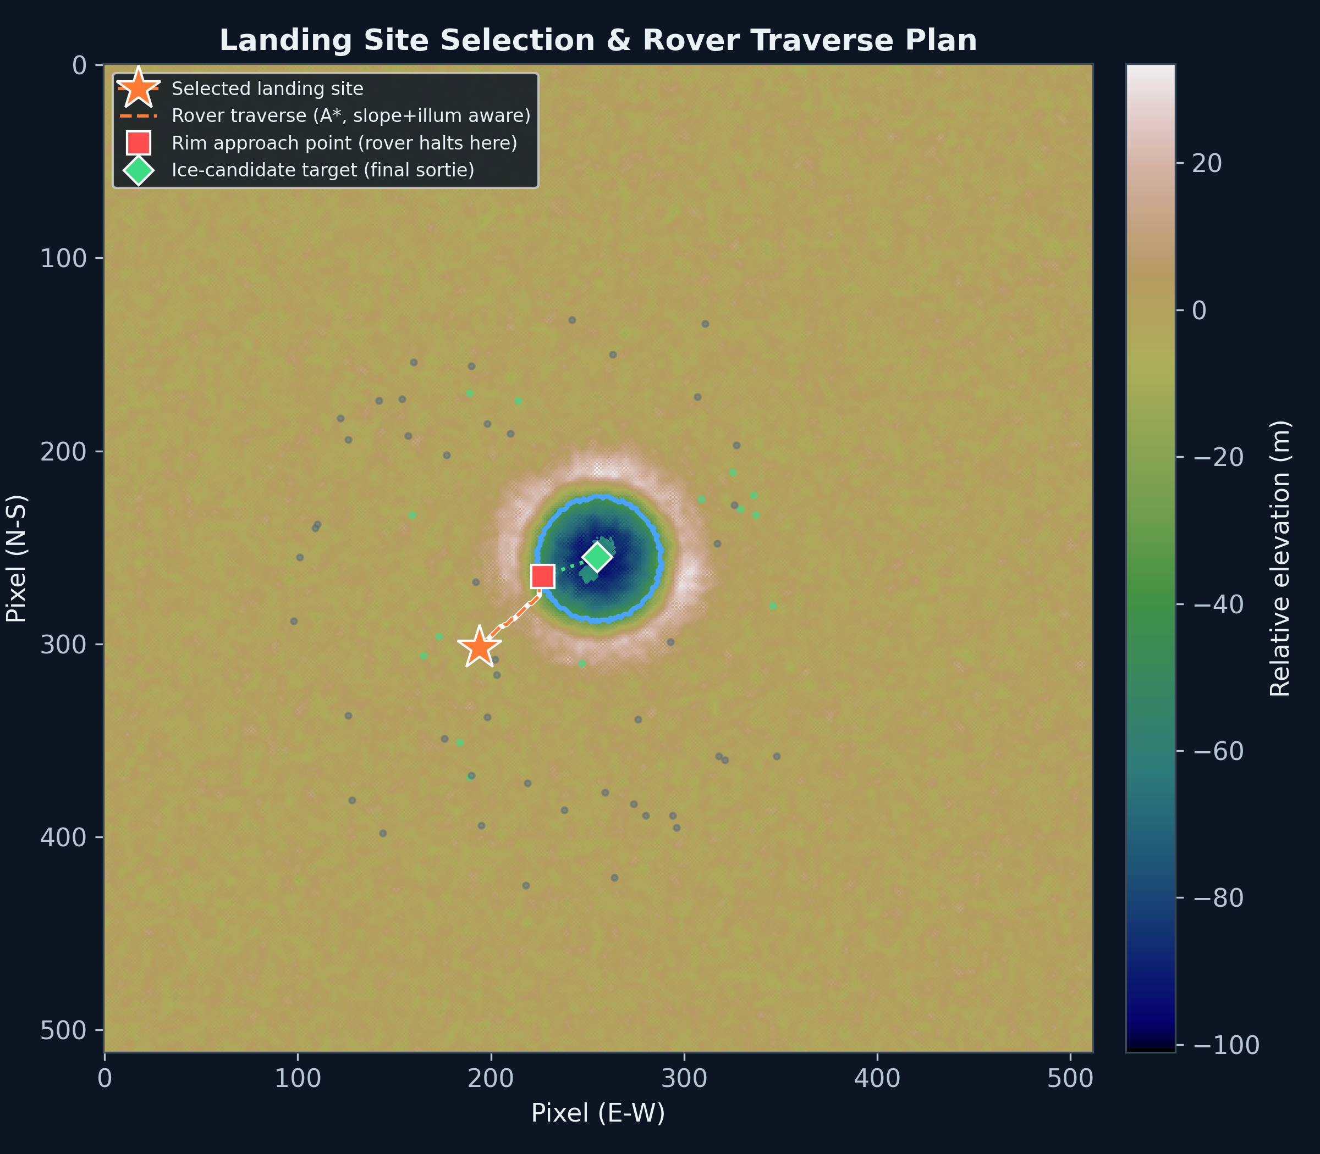
Process Flow: Detection -> Landing Site -> Traverse -> Volume Estimate
Five-stage pipeline (figure below shows Stage 3-4 output: landing site + rover traverse over the doubly-shadowed crater)

Slide 6
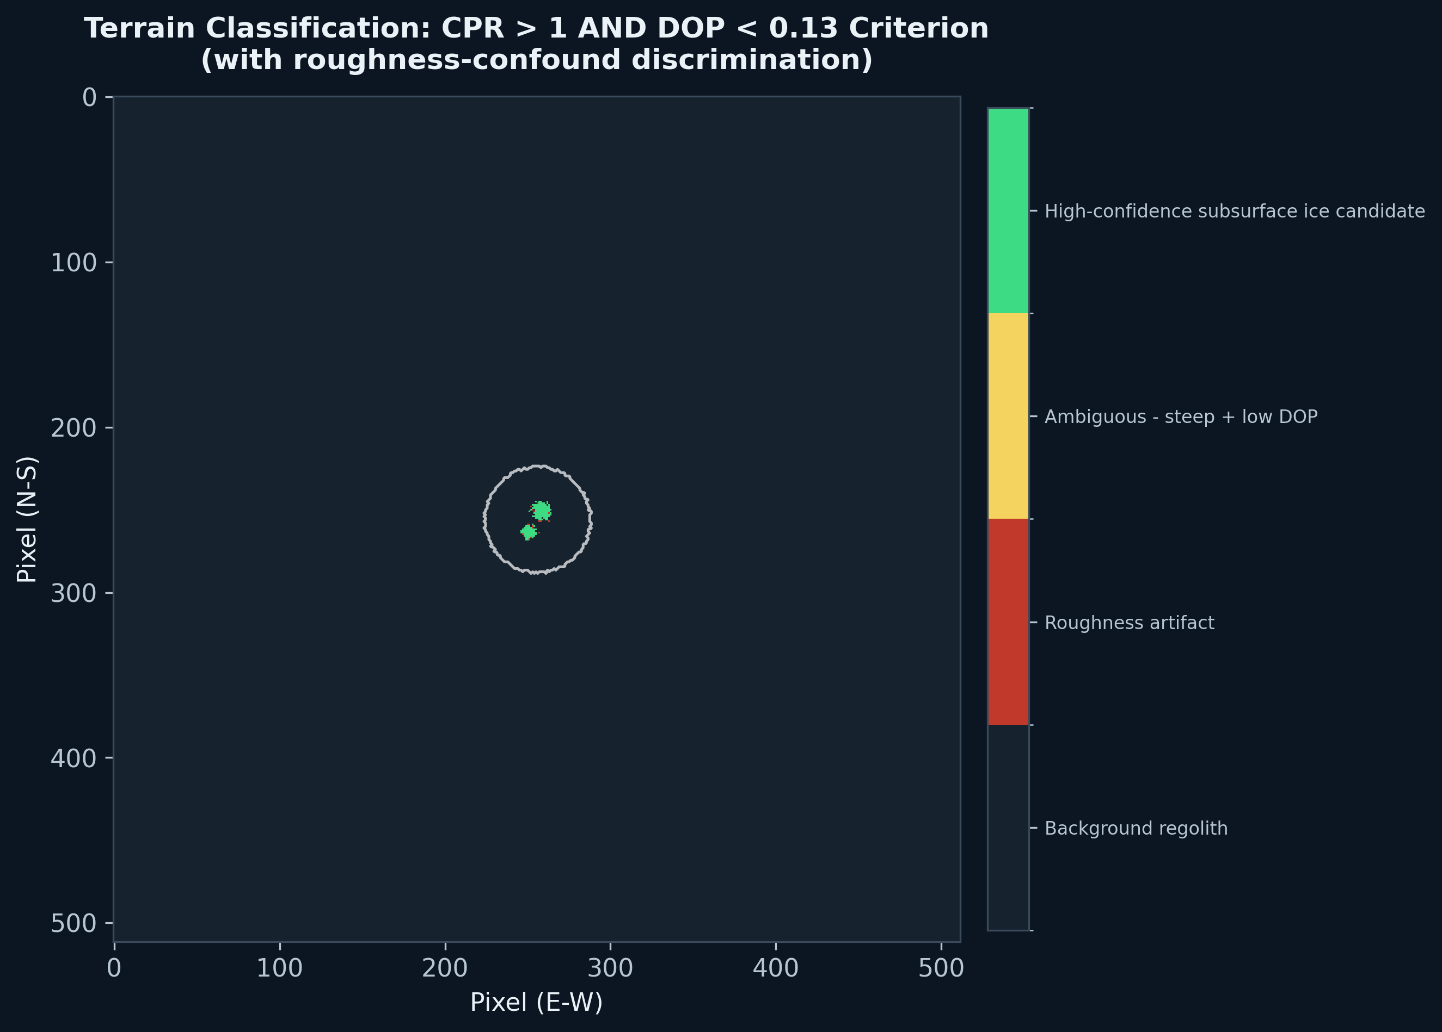
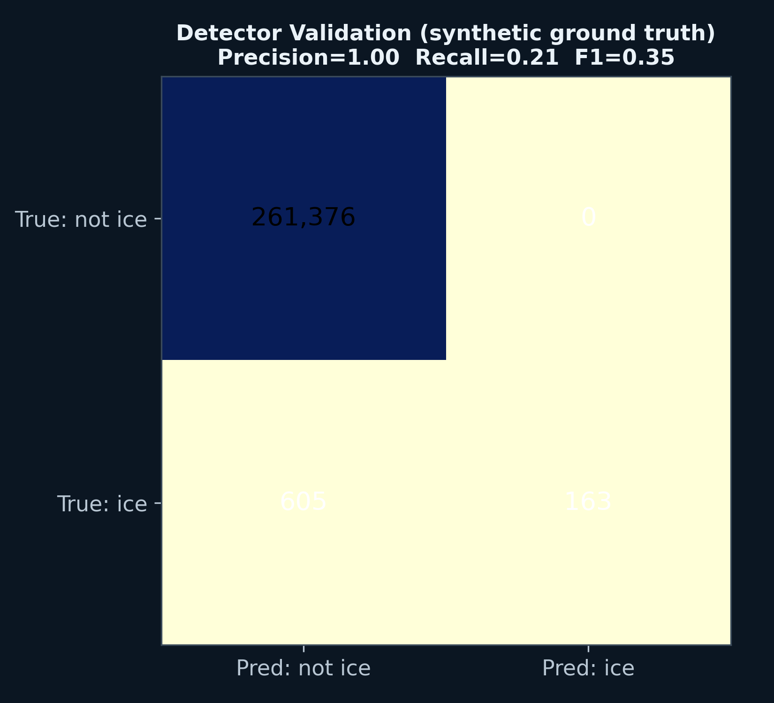
Terrain Classification & Detection Validation

Slide 7
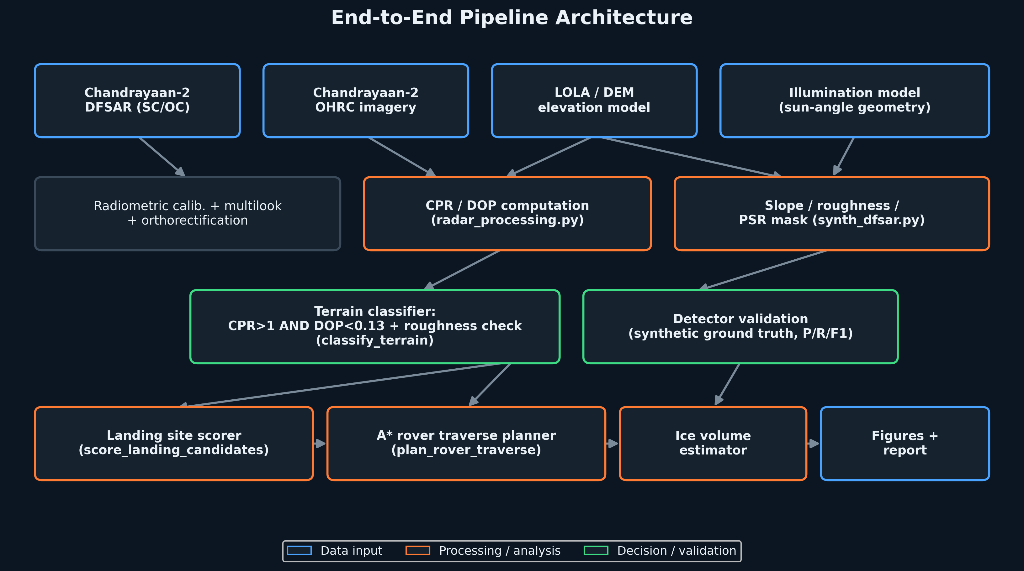
System Architecture

Slide 8
Technologies to be used in the solution:
Geospatial / radar processing: Python, NumPy, SciPy, rasterio, GDAL (DFSAR/OHRC ingestion, calibration, multilook, orthorectification); Birchak/CRIM dielectric mixing model for ice-fraction inversion
GIS / terrain analysis: QGIS / ArcGIS for DEM-derived slope, roughness, and illumination-model cross-checks against our Python pipeline
Path planning: A* search (custom implementation) with slope- and illumination-aware edge costs; auto-relaxation logic for steep rim crossings
Visualization & reporting: Matplotlib (publication-quality figures), Claude Code (pipeline development & iteration), Pandoc/LaTeX (PDF report)

Slide 9
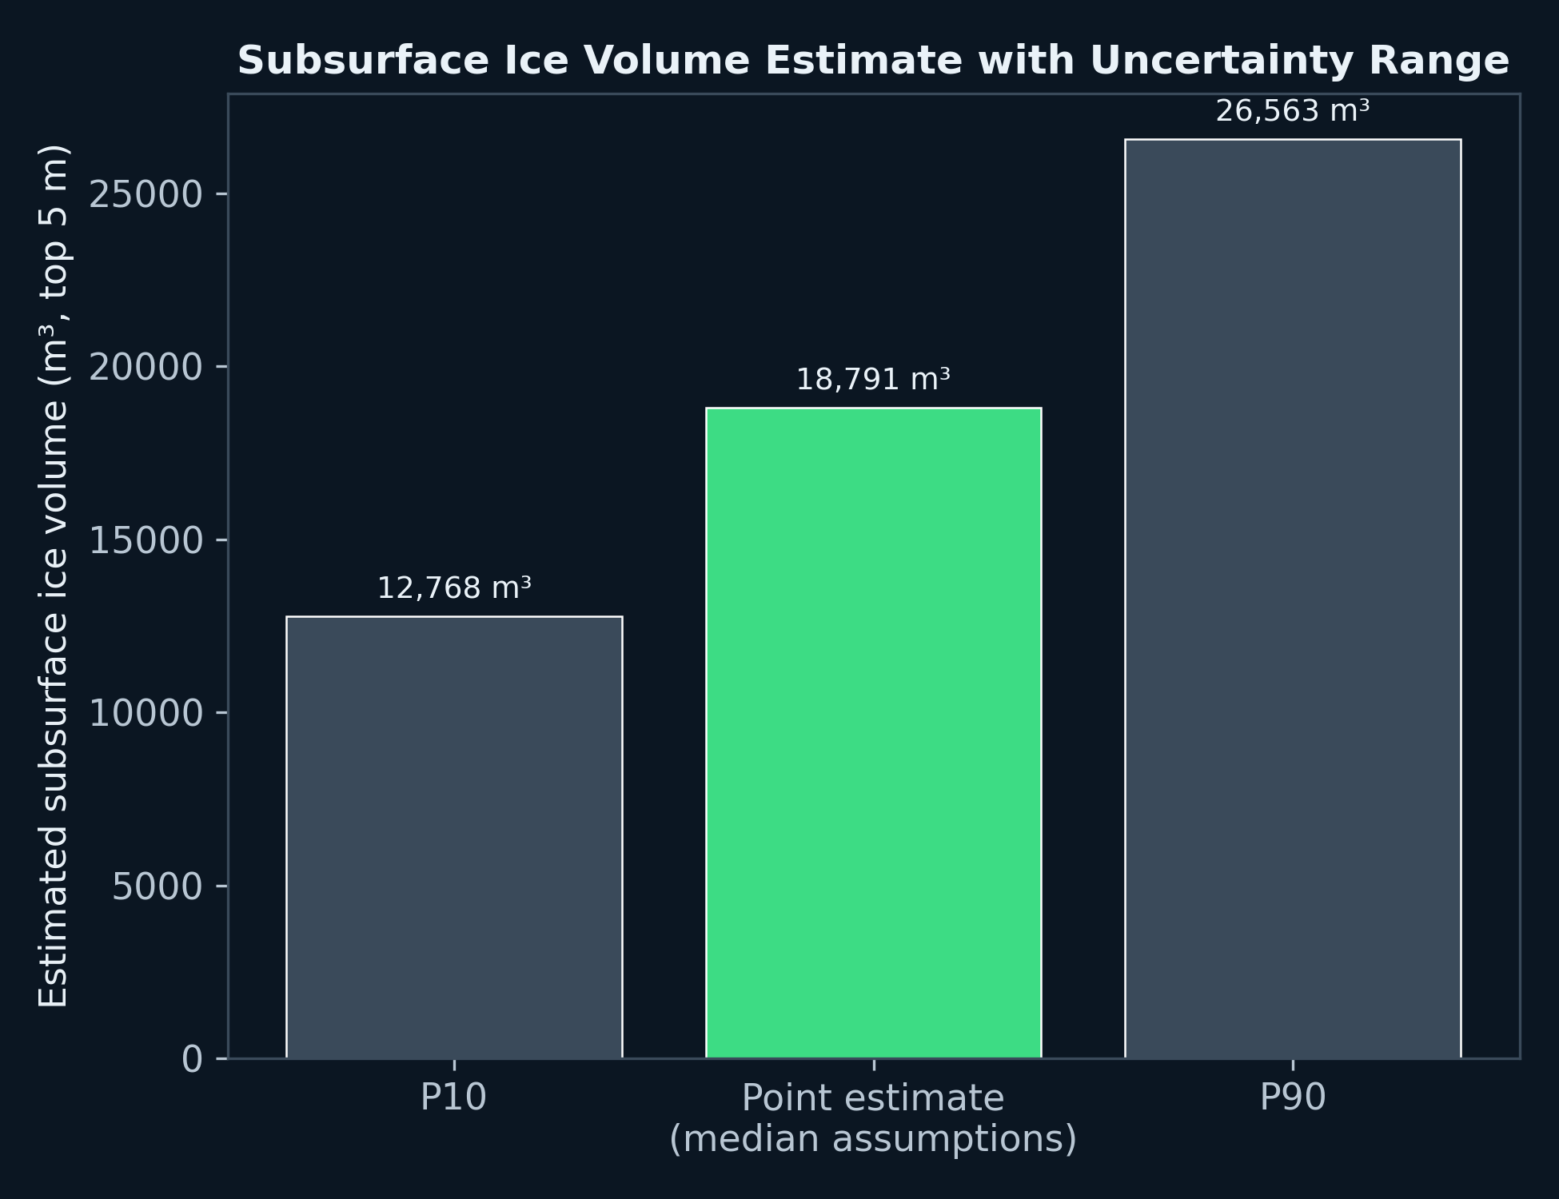
Estimated Implementation Cost (Software/Algorithm Scope)
This problem statement asks for a detection/planning methodology, not deployable flight hardware -- so cost here means compute & tooling cost to run the pipeline, not spacecraft/rover hardware cost (which is out of scope and would require ISRO mission-engineering inputs we don't have).
All processing (CPR/DOP, classification, traverse planning, volume estimation) runs on a single CPU core in under 2 minutes per crater scene at 512x512 resolution -- no GPU or specialized hardware required, making it deployable on standard ISRO ground-segment workstations at near-zero marginal cost.

Slide 10
