Slide 1
Final Review Text and Image Plagarism detection
Guide detail’s Presented by,
Prof.V Nagalakshmi M S V Raghavendra chowdary
Dept of CS,CSS M.Sc(Data Science)VP22CSCI020024

Slide 2
Content
Abstract
Introduction
Problem Statement
Existing and Proposed system
UML diagrams
Problem Solution
Frontend and backend Specfications
Frontend Sample Screen
Backend Code

Slide 3
Abstract
Plagiarism detection is a critical concern across various domains, including academia, journalism, and content creation. In this project, we present an enhanced system for detecting plagiarism in both text and image files.
The system is implemented as a web application using the Flask framework in Python. It allows users to upload text and image files, which are then analyzed for potential plagiarism. The system consists of two main components: text plagiarism detection and image plagiarism detection.
For text plagiarism detection, the system employs advanced techniques such as TF-IDF (Term Frequency-Inverse Document Frequency), cosine similarity, and difflib. Text files uploaded by users are compared with a corpus of existing text documents to identify similarities. Additionally, the system generates difference reports in HTML format, highlighting the similarities and differences between the uploaded text and existing documents.

Slide 4
In image plagiarism detection, the system utilizes computer vision techniques implemented using the OpenCV library. Uploaded images are compared with a database of existing images to detect similarities. The system considers images with identical dimensions and pixel values as potential instances of plagiarism.
Both components of the system offer real-time feedback to users, indicating whether plagiarism is detected and providing relevant details such as similarity percentages and plagiarized content. The user interface is designed to be intuitive and user-friendly, allowing users to easily upload files and interpret the analysis results

Slide 5
Introduction
Plagdetect is a powerful tool designed to help you identify potential plagiarism in both text and image content. Whether you're a student ensuring the originality of your work or a content creator safeguarding your creations, Plagdetect is here to assist you.
Text Plagiarism Detection:
Upload your text document, and our algorithm will meticulously analyze it against a collection of reference texts. By employing advanced text comparison techniques, PlagDetect identifies similar passages and provides you with a detailed report highlighting potential instances of plagiarism. With features like similarity percentage calculation and HTML difference reports, you'll gain insights into the uniqueness of your content effortlessly.

Slide 6
Image Plagiarism Detection:
Concerned about the originality of your images. PlagDetect extends its capabilities to image content as well. Simply upload your image, and our system will compare it against a database of images, detecting any visual similarities or duplications. Whether it's academic work, professional projects, or creative endeavors, you can trust PlagDetect to help you maintain the integrity of your visual content.
How It Works:
Choose whether to check text or image content.
Upload your file.
Let PlagDetect analyze your content against our comprehensive database.
Receive detailed reports highlighting potential instances of plagiarism.
Take necessary actions to ensure the originality and authenticity of your work.
With PlagDetect, you can embark on your creative journey with confidence, knowing that your content is unique and protected.

Slide 7
Problem Statement
The problem statement revolves around the pervasive issue of plagiarism in textual and visual content across various domains, including academia, journalism, publishing, and digital media. Plagiarism undermines the integrity of intellectual property, erodes trust in information sources, and poses ethical and legal challenges. Despite the existence of manual detection methods and some automated tools, current approaches are often labor-intensive, prone to errors, and limited in scope. Therefore, there is a critical need for advanced text and image plagiarism detection

Slide 8
Existing System
Text Plagiarism Detection:
Uploading Files: Users can upload text files for plagiarism detection.
File Comparison: The system compares the uploaded text file with other text files in the "textdataset" directory.
Plagiarism Detection: It identifies similarities between the uploaded file and other files using the difflib library and calculates a similarity percentage.
Result Presentation: Plagiarized content and the similarity percentage are displayed to the user. Additionally, HTML difference reports are generated for detailed comparison.

Slide 9
Image Plagiarism Detection:
Uploading Images: Users can upload images for plagiarism detection.
Image Comparison: The system compares the uploaded image with images in the "images" directory.
Plagiarism Detection: It checks if the uploaded image matches any of the images in the directory by pixel-wise comparison using OpenCV.
Result Presentation: If plagiarism is detected, the matching images are displayed to the user; otherwise, a message indicating no plagiarism is shown.
Web Interface:
Users interact with the system through a web interface with different routes for text and image plagiarism detection.
Additional routes like "about", "contact", and "index" provide information and navigation options.

Slide 10
Proposed System
The proposed system aims to significantly enhance the existing plagiarism detection capabilities by introducing advanced algorithms and multi-modal analysis techniques. It will provide users with a comprehensive solution for detecting plagiarism in both textual and visual content, addressing the limitations of current systems. Through the integration of machine learning models and computer vision algorithms, the system will accurately identify instances of plagiarism, including nuanced forms such as paraphrasing and content manipulation.

Slide 11
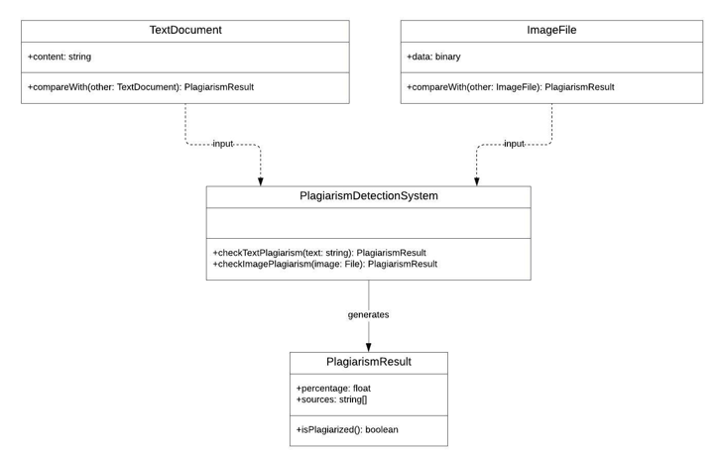
UML Diagrams
Use Case Diagram:

Slide 12
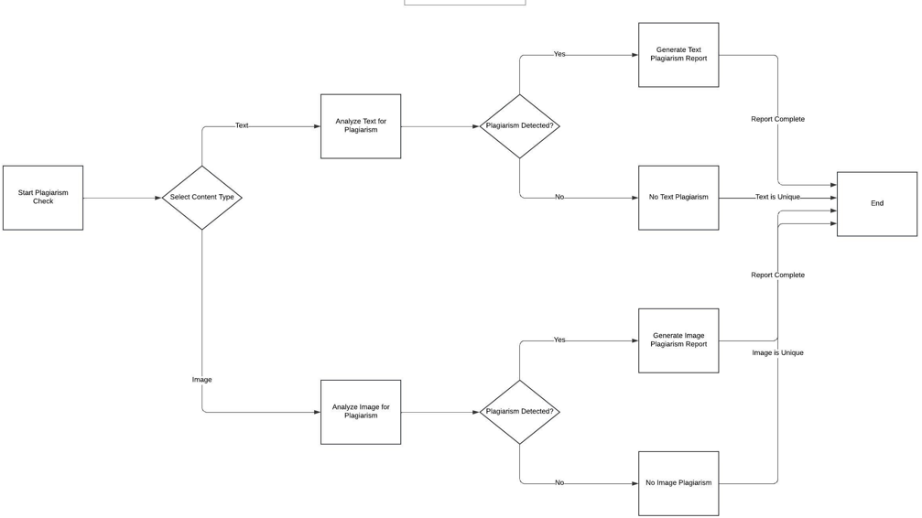
Activity Diagram:

Slide 13
Problem Solution
PlagDetect is a web-based application designed to the flask framework the process of detecting plagiarism in both text and image content. It leverages advanced techniques to analyze uploaded files and compare them against a comprehensive database of reference materials.
Here's how PlagDetect addresses the problem:
Text Plagiarism Detection
Image Plagiarism Detection
User-Friendly Interface.

Slide 14
Frontend and Backend Specifications
Frontend
Backend
Homepage (index.html):
Text Plagiarism Detection (text.html):
Image Plagiarism Detection (image.html):
About Page (about.html):
Contact Page (contact.html):
Flask Application:
Text Plagiarism Detection (textprediction route/function):
Image Plagiarism Detection (imageprediction route/function):

Slide 15
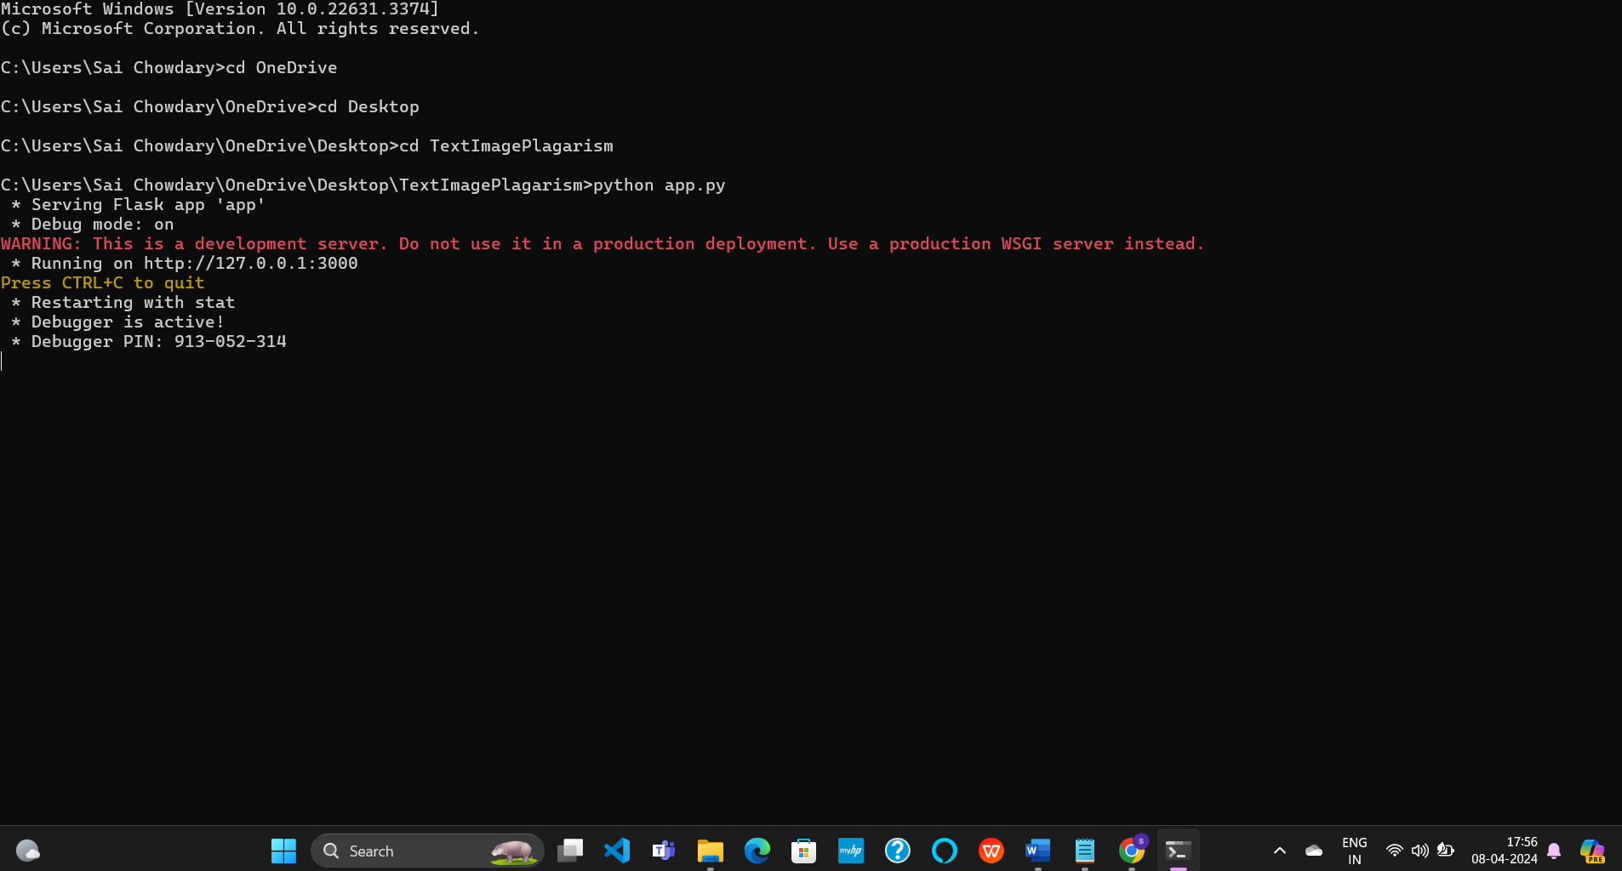
Connecting to localhost

Slide 16

Frontend Sample Screen

Slide 17
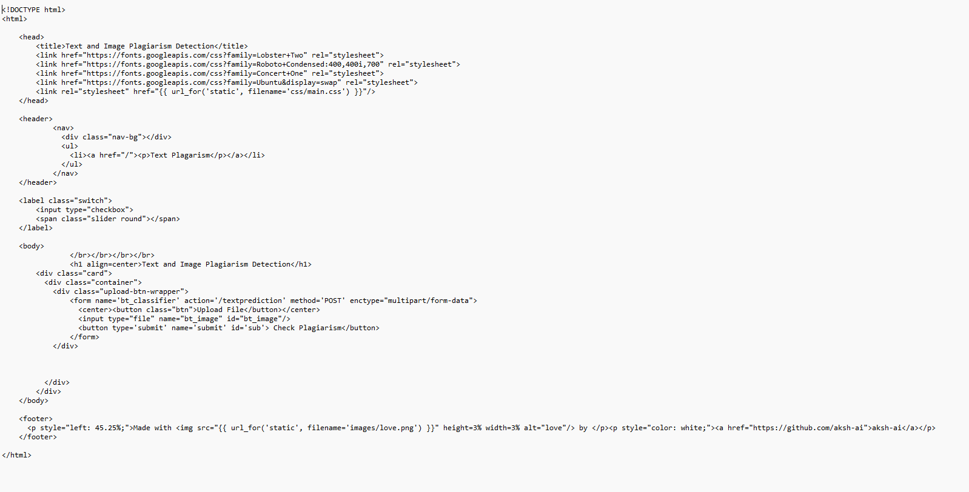
Frontend Code(HTML)
Text Code:

Slide 18
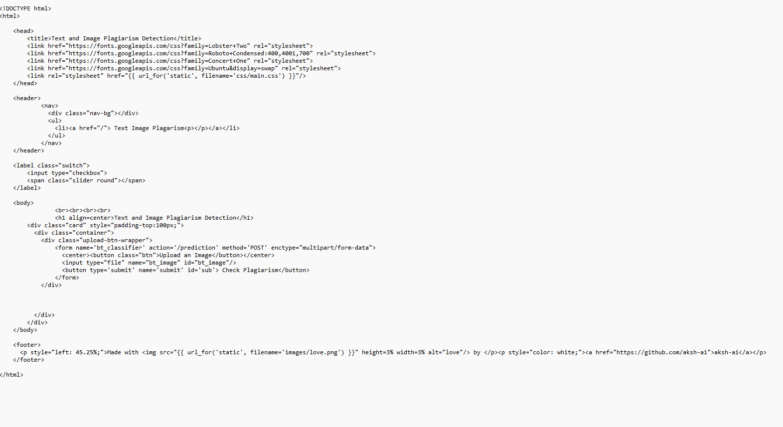
Image code:

Slide 19
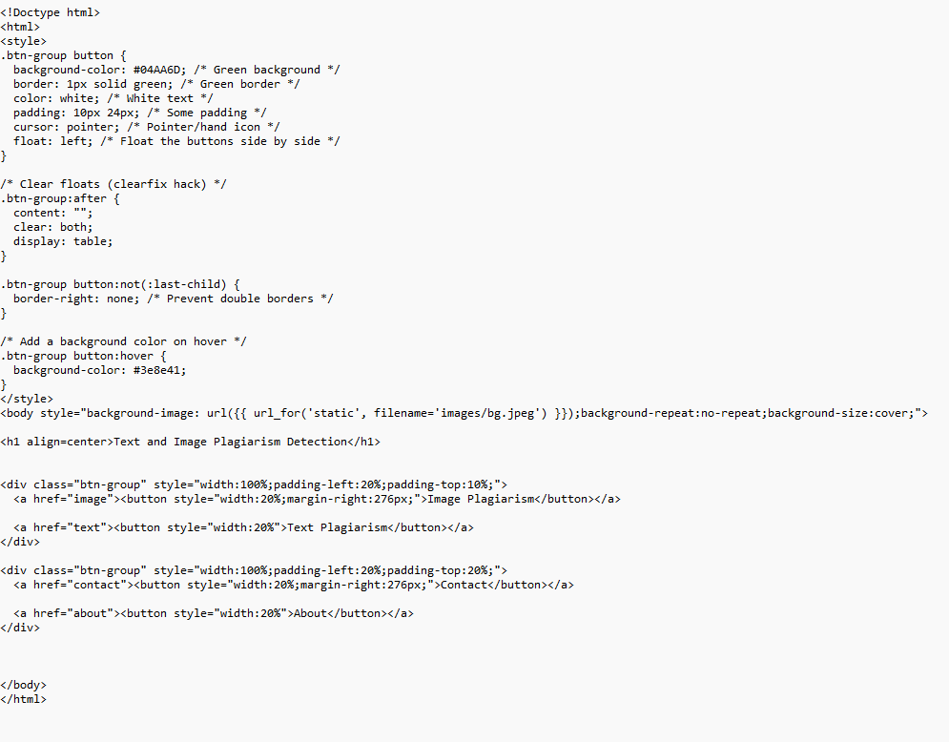
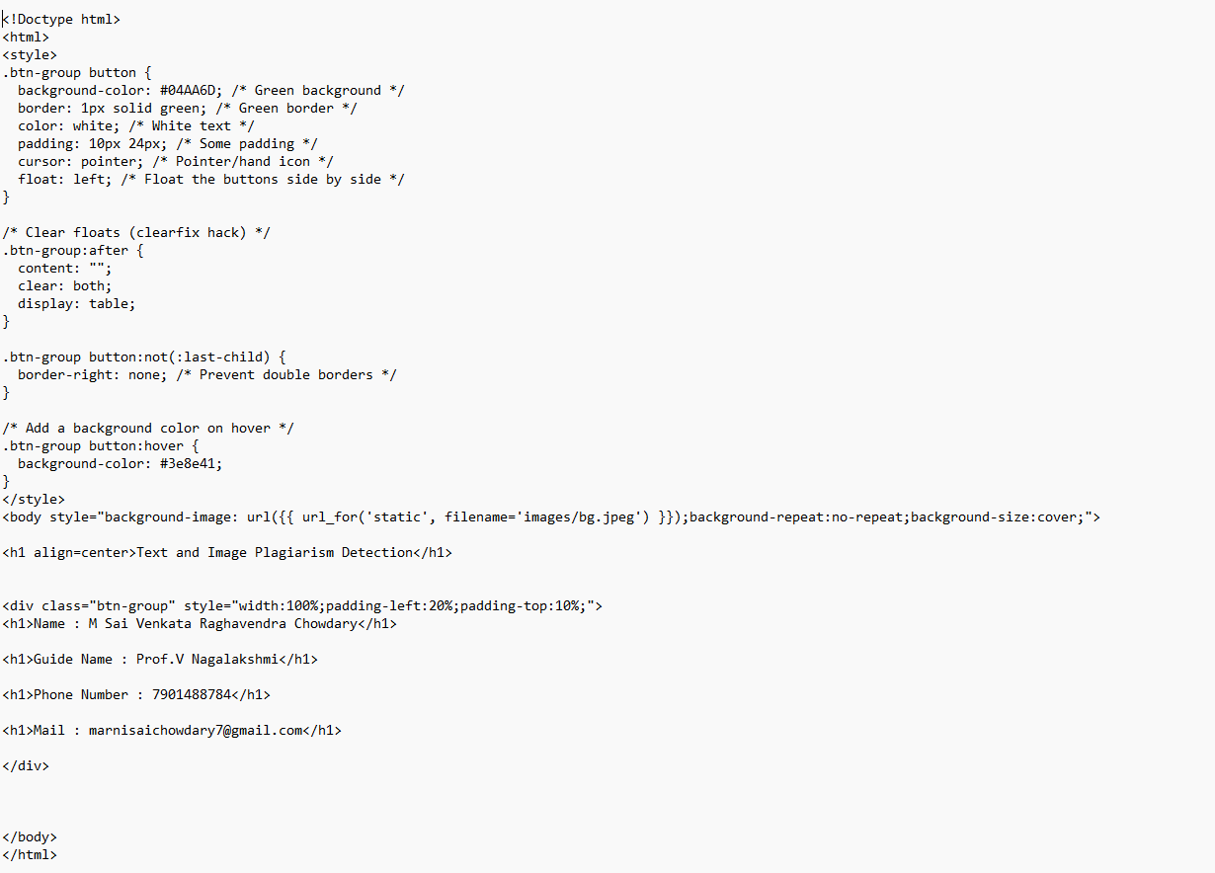
Index:
Contact:

Slide 20
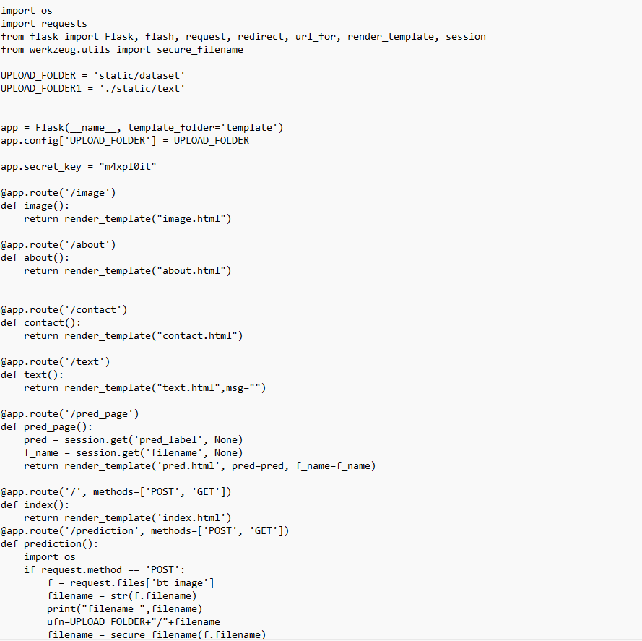
Backend Code

Slide 21
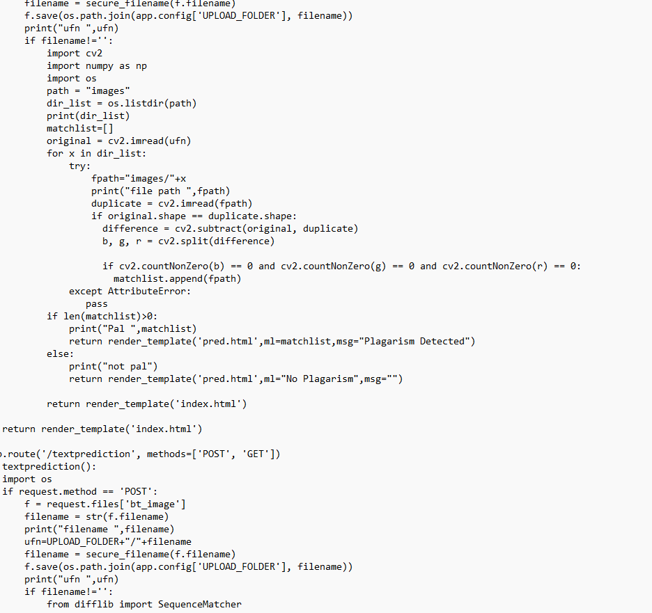

Slide 22
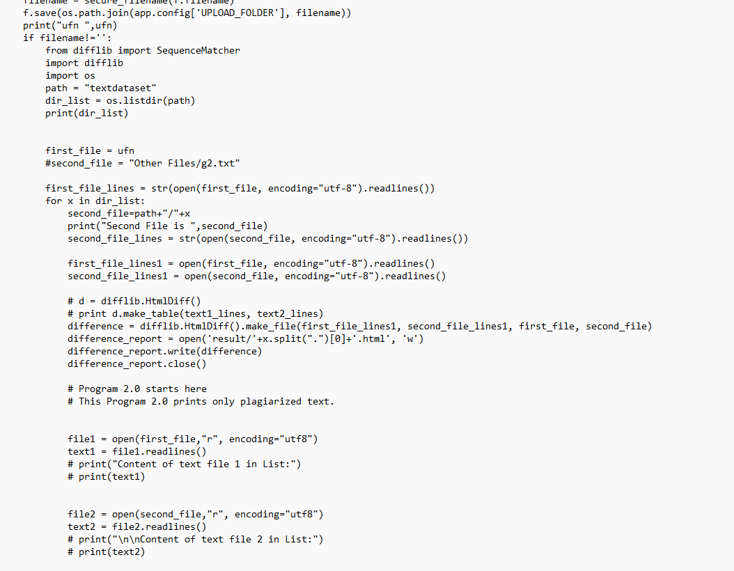

Slide 23
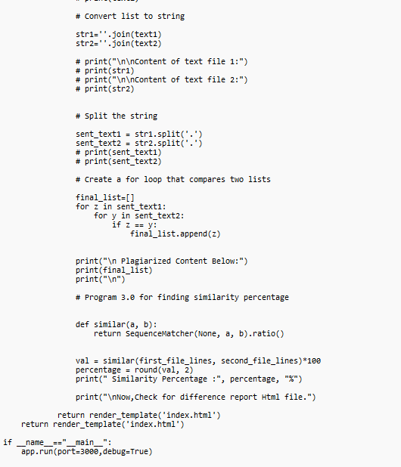

Slide 24
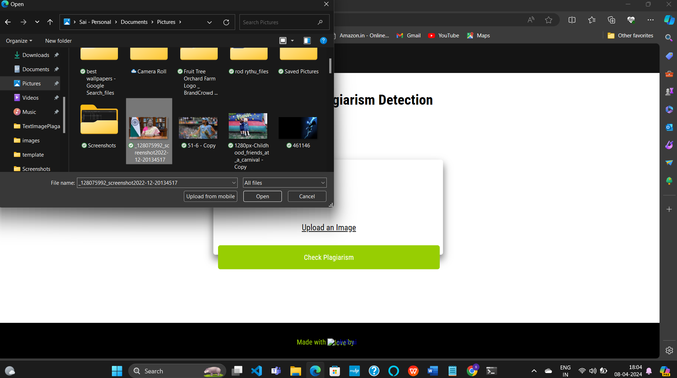
Plagarism Result
Upload the image:

Slide 25
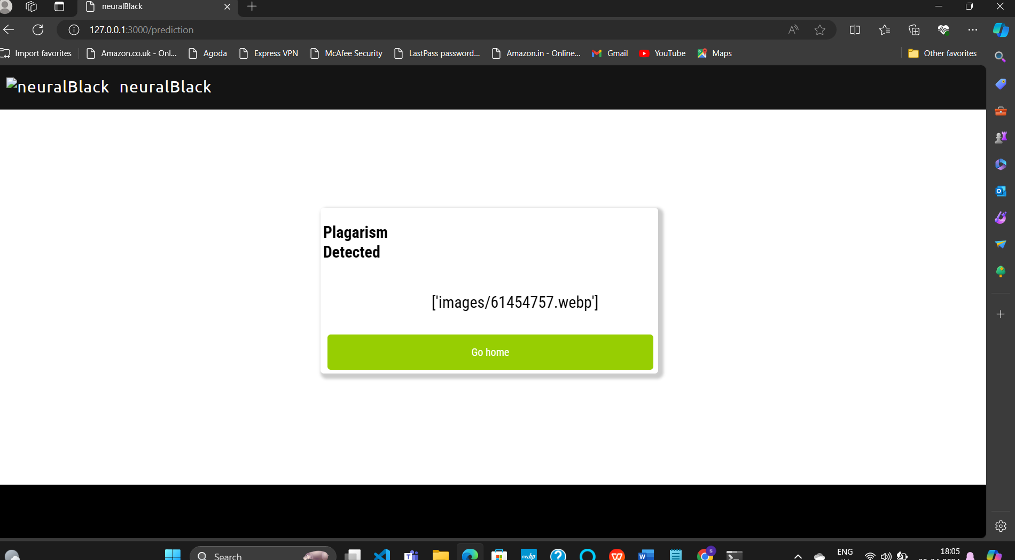

Slide 26
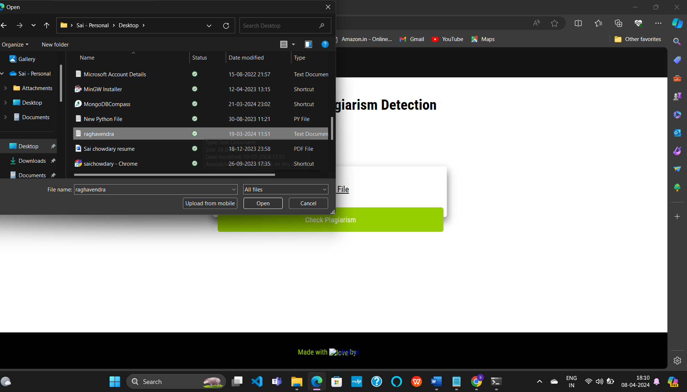
Upload the file:

Slide 27
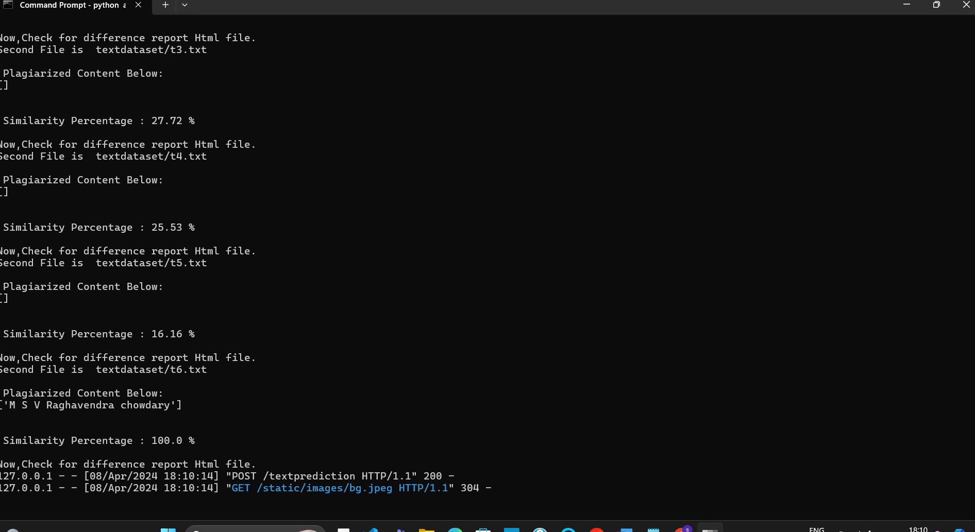

Slide 28
THANK YOU

