Slide 1

CHHATRAPATI SHIVAJI MAHARAJ UNIVERSITY PANVEL
MINI PROJECT PRESENTATION
ATTENDANCE SYSTEM USING FACE RECOGNITION
Department of Computer Science & Engineering
PRESENTED BY
Saikumar Penke
F233005
Under the Guidance of: Dr. Rahul Shingare | 2025-2026

Slide 2

Abstract & Problem Statement
ABSTRACT
PROBLEM STATEMENT
Traditional attendance systems are slow, error-prone, and vulnerable to proxy. This project presents an automated, real-time Attendance System using Face Recognition. It uses a webcam to detect faces, matches them against stored encodings, and records attendance to a Firebase cloud database — all without any manual input.
Manual attendance is time-consuming and inefficient
High risk of proxy attendance by students
Physical records are error-prone and hard to retrieve
No real-time visibility of attendance data
Lack of integration with digital student records
B.Tech CSE | Batch 2023–2027 | Sem 6

Slide 3
Objectives & Scope
Automate Attendance
Accurate Identification
Eliminate manual roll-calls using real-time facial recognition via webcam.
Match detected faces against pre-encoded student images with >90% confidence threshold.
Cloud Integration
Prevent Proxy
Sync attendance records to Firebase Realtime Database for instant cloud access.
Ensure only physically present students are marked using biometric face data.
CSV Logging
Cooldown Mechanism
Generate local backup CSV logs with student ID, name, and timestamp.
30-second cooldown prevents duplicate entries for the same student.
Attendance System Using Face Recognition

Slide 4
System Architecture & Workflow
1
2
3
4
5
Capture
Webcam Frame
Detect
Face Locations
Generate
Face Encoding
Match vs
Stored Encodings
Mark
Attendance
►
►
►
►
DATA FLOW
SYSTEM MODES
Webcam → OpenCV frame capture
Mode 0:
Idle — waiting for face detection
face_recognition → HOG / CNN detection
Mode 1:
Processing — face matched, logging
Pickle file → stored encoding lookup
Mode 2:
Success — attendance marked, info shown
Firebase DB → cloud attendance update
CSV file → local backup log
Mode 3:
Cooldown — already marked, wait timer
Attendance System Using Face Recognition

Slide 5
Technologies & Tools Used
Python 3.x
OpenCV (cv2)
face_recognition
Core programming language
Webcam capture & image processing
Face detection & 128-D encoding (dlib)
Firebase Realtime DB
Firebase Storage
pickle
Cloud storage for attendance records
Cloud hosting of student images
Serialization of face encodings
NumPy
CSV module
PyCharm IDE
Euclidean distance & array ops
Local backup attendance logging
Development & debugging environment
Attendance System Using Face Recognition

Slide 6
Code: EncodeGenerator.py
# EncodeGenerator.py — Key Logic
HOW IT WORKS
for imageFile in imageFiles:
1
Scan Images Folder
img = cv2.imread(imagePath)
imgRGB = cv2.cvtColor(
Reads all student images from local disk
img, COLOR_BGR2RGB)
locs = face_recognition
2
Upload to Firebase
.face_locations(RGB)
Stores images in Firebase Storage bucket
enc = face_recognition
.face_encodings(
3
Detect Faces
imgRGB, locs)[0]
Uses HOG model to find face bounding boxes
encodeList.append(enc)
4
Generate Encodings
# Save encodings to pickle
Creates 128-D numerical face vector per student
with open('EncodeFile.p','wb') as f:
pickle.dump([encList,ids], f)
5
Serialize & Save
Saves [encodings, IDs] to EncodeFile.p (pickle)
Attendance System Using Face Recognition

Slide 7
Code: main.py — Core Recognition Loop
# main.py — Face Matching Core
KEY FEATURES
# Scale frame down for speed
25% Scale Detection
small = cv2.resize(frame, (0,0),
fx=0.25, fy=0.25)
Frames shrunk to 25% for fast face_locations()
rgb = cv2.cvtColor(small, BGR2RGB)
Confidence Filter
faceLocs = face_locations(rgb)
Only accepts matches with confidence > 50%
faceEncs = face_encodings(rgb, locs)
Cooldown (30s)
for enc, loc in zip(faceEncs, locs):
Prevents duplicate attendance in same session
dists = face_distance(
knownEncs, enc)
Firebase + CSV
best = np.argmin(dists)
Dual logging: cloud DB and local CSV backup
conf = 1 - dists[best]
if matches[best] and conf>0.50:
Live UI Overlay
mark_attendance(studentId)
Bounding boxes + student info drawn on-screen
Attendance System Using Face Recognition

Slide 8
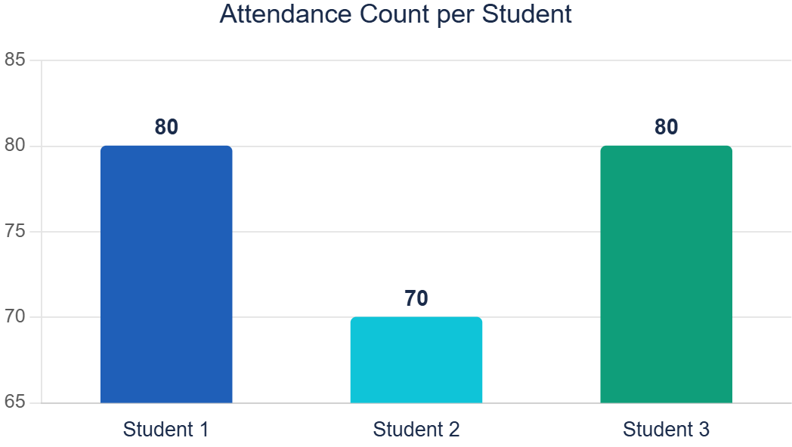
Results & Performance Analysis
50ms
>90%
30s
Real-time
Avg Detection Time
Face Match Accuracy
Duplicate Cooldown
Firebase Sync
Attendance System Using Face Recognition

Slide 9
Future Enhancements & Conclusion
FUTURE ENHANCEMENTS
CONCLUSION
🔐
Multi-Factor Auth:
Add OTP or PIN alongside face recognition
The Attendance System Using Face Recognition successfully automates attendance marking using real-time facial recognition.
Key achievements:
• Eliminated manual attendance process
• Achieved reliable face identification at >50% confidence threshold
• Integrated Firebase for cloud-based real-time records
• Implemented duplicate prevention via cooldown mechanism
• Dual logging: Firebase DB + local CSV backup
The system provides a secure, efficient, and scalable solution for modern educational institutions.
🤖
ML Optimization:
Deep CNN models for higher accuracy in varied lighting
📱
Mobile App:
React Native app for real-time attendance dashboard
😷
Mask Detection:
Detect faces even when wearing protective masks
🔗
LMS Integration:
Sync with Learning Management Systems
📊
Analytics Dashboard:
Web-based reporting with attendance trends
Attendance System Using Face Recognition

Slide 10

References & Acknowledgements
Joseph et al. — "Automated Attendance Management using Face Recognition", IJSR 2013
Bhatti et al. — "Smart Attendance Management Using Face Recognition", EAI Transactions
Kutty & Mathai — "Face Recognition for Automated Attendance", IJARCSSE (Vol.7, Issue 6)
Lukas et al. — "Student Attendance Using Face Recognition", ICTC Conference 2016
Wagh et al. — "Attendance using Eigenface & PCA Algorithms", ICGCloT 2015
Katara et al. — "Attendance System Using Face Recognition", IJRITCC Vol.5, Feb 2017
Thank You!
Saikumar Penke
Guide: Dr. Rahul Shingare | CSE Dept., CSMU Panvel | 2025-2026

