Slide 1

AI News Briefing Service
TOPIC 3 · AI ACADEMY · AI-ENG-110
Team: AIngels — Saida Arabova, Nigar Rustamova, Laman Mirzayeva, Nazrin Aliyeva
Date: May 24, 2026 | Repo: github.com/saidaarna/news-briefing-service

Slide 2
The Problem in One Sentence
What the System Does
Inputs
A user configures their preferred news sources and topics; the service fetches all feeds concurrently, removes duplicate stories automatically, and delivers a personalized AI-generated Markdown briefing — daily, in under one second of network time.
RSS feed URLs + raw HTML news pages
User profile: preferred topics, excluded sources, section cap
Outputs
Personalized daily digest (Markdown file)
Structured logs with per-article latency and cache-hit telemetry

Slide 3
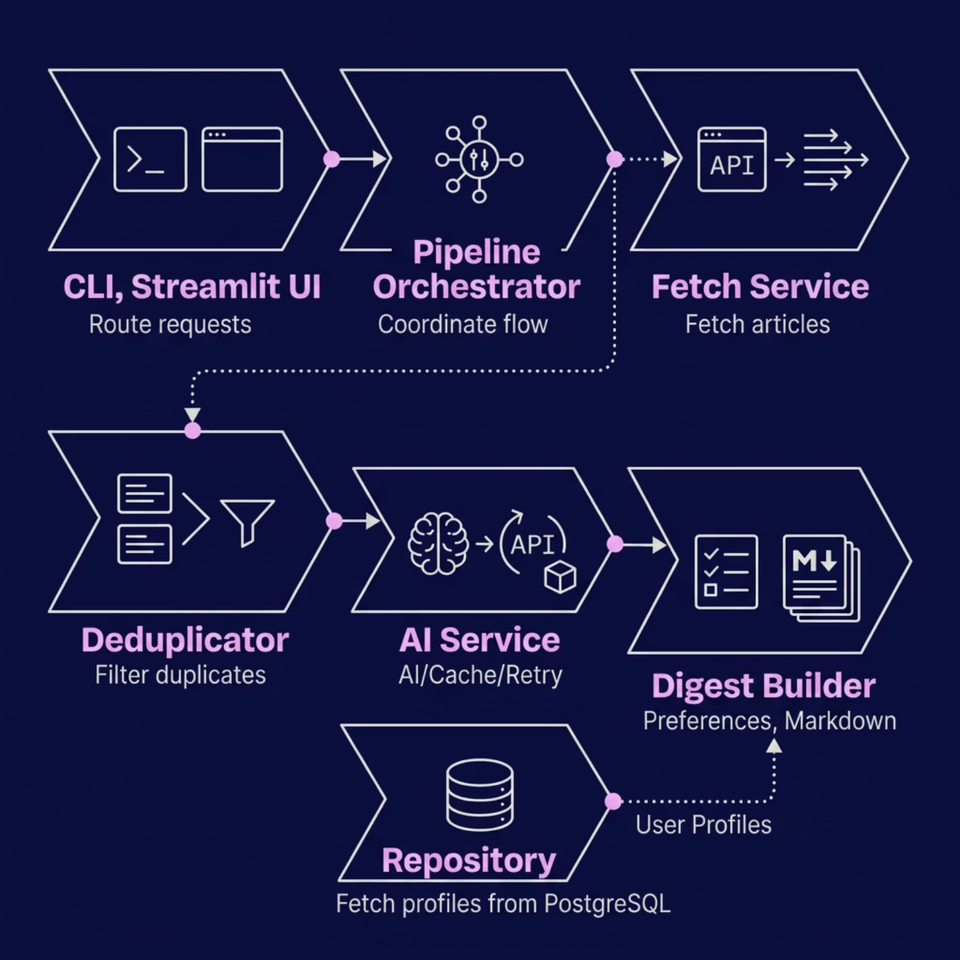

Architecture
Module Boundaries and Data Flow
CLI & Streamlit UI
Pipeline
Routes requests to the Pipeline orchestrator.
Triggers the Fetch Service concurrently.
Deduplicator
AI Service
Filters identical articles using Jaccard k-shingles (via provided ai/ package).
Handles API calls, caching, and retries (via provided ai/ package).
Digest Builder
Repository
Applies user preferences and outputs Markdown.
Connects to PostgreSQL to fetch user profiles.

Slide 4
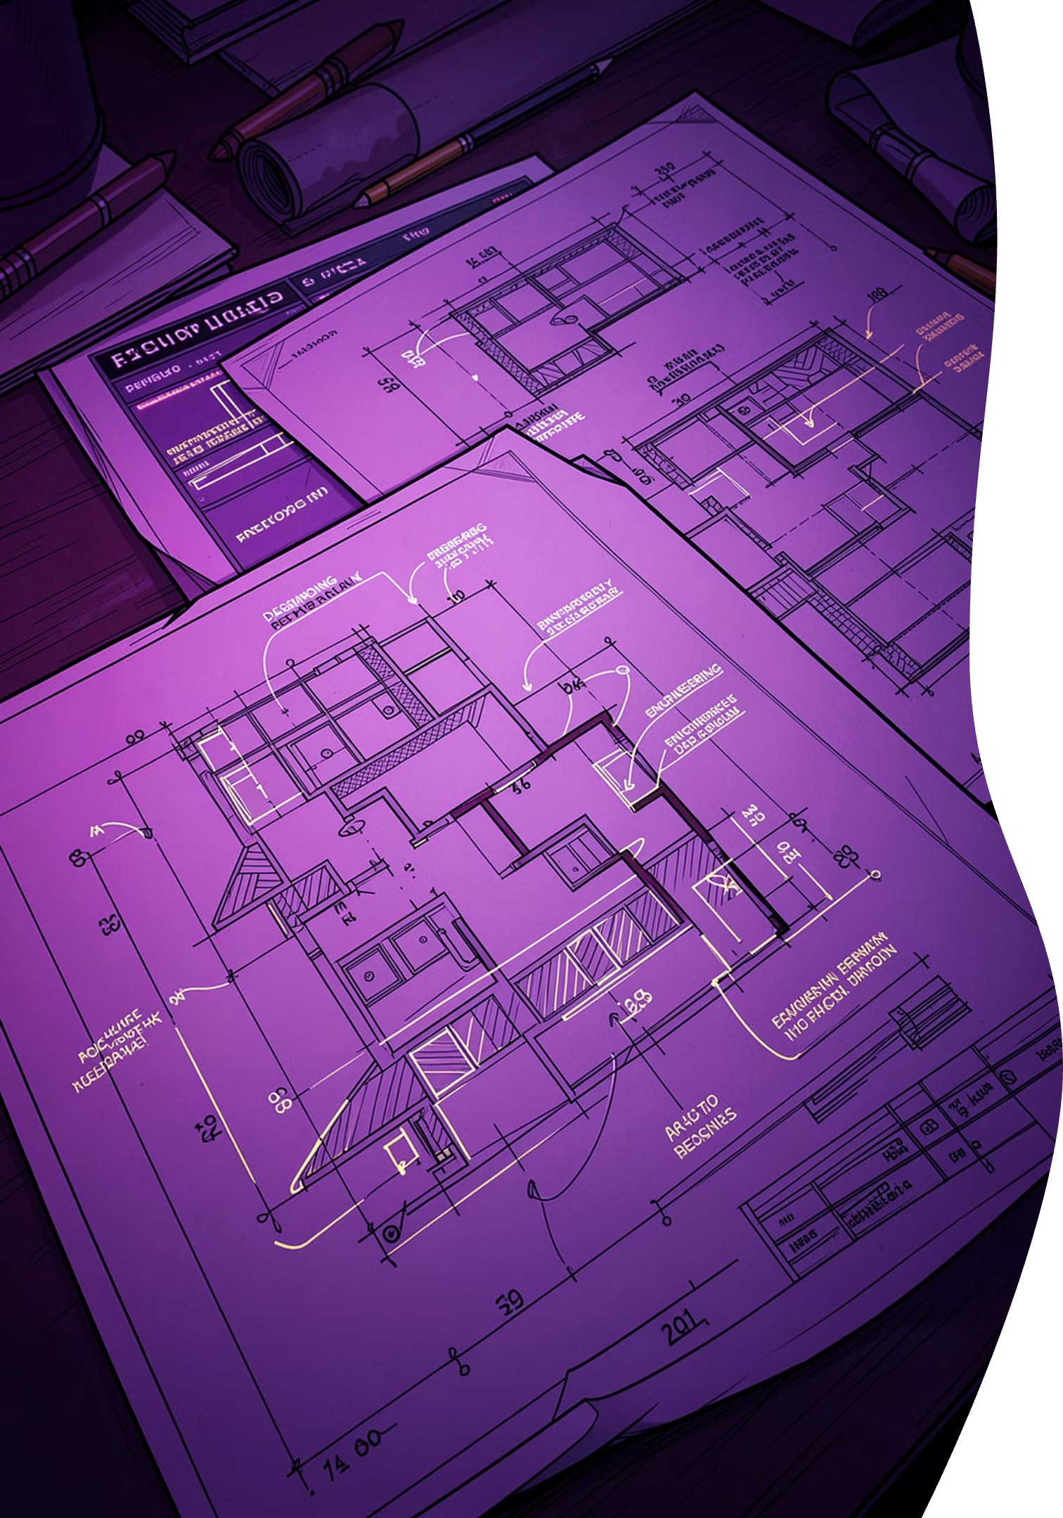
Three Design Decisions We Can Defend
asyncio + aiohttp over a Thread Pool
Network I/O is the bottleneck; cooperative multitasking overlaps all socket waits in a single thread with zero lock contention.
Rejected: ThreadPoolExecutor wastes memory and OS context-switch overhead.
1
Pydantic Settings over Manual Env Parsing
2
Startup fails fast with a readable error if an API key is missing; all values are strictly typed.
Rejected: python-decouple lacks model-level cross-field checks.
Abstract Base Class for Repository
Forces any storage backend to implement the full contract at import time.
Rejected: A plain Protocol would not allow sharing concrete lifecycle methods like seed_defaults.
3

Slide 5
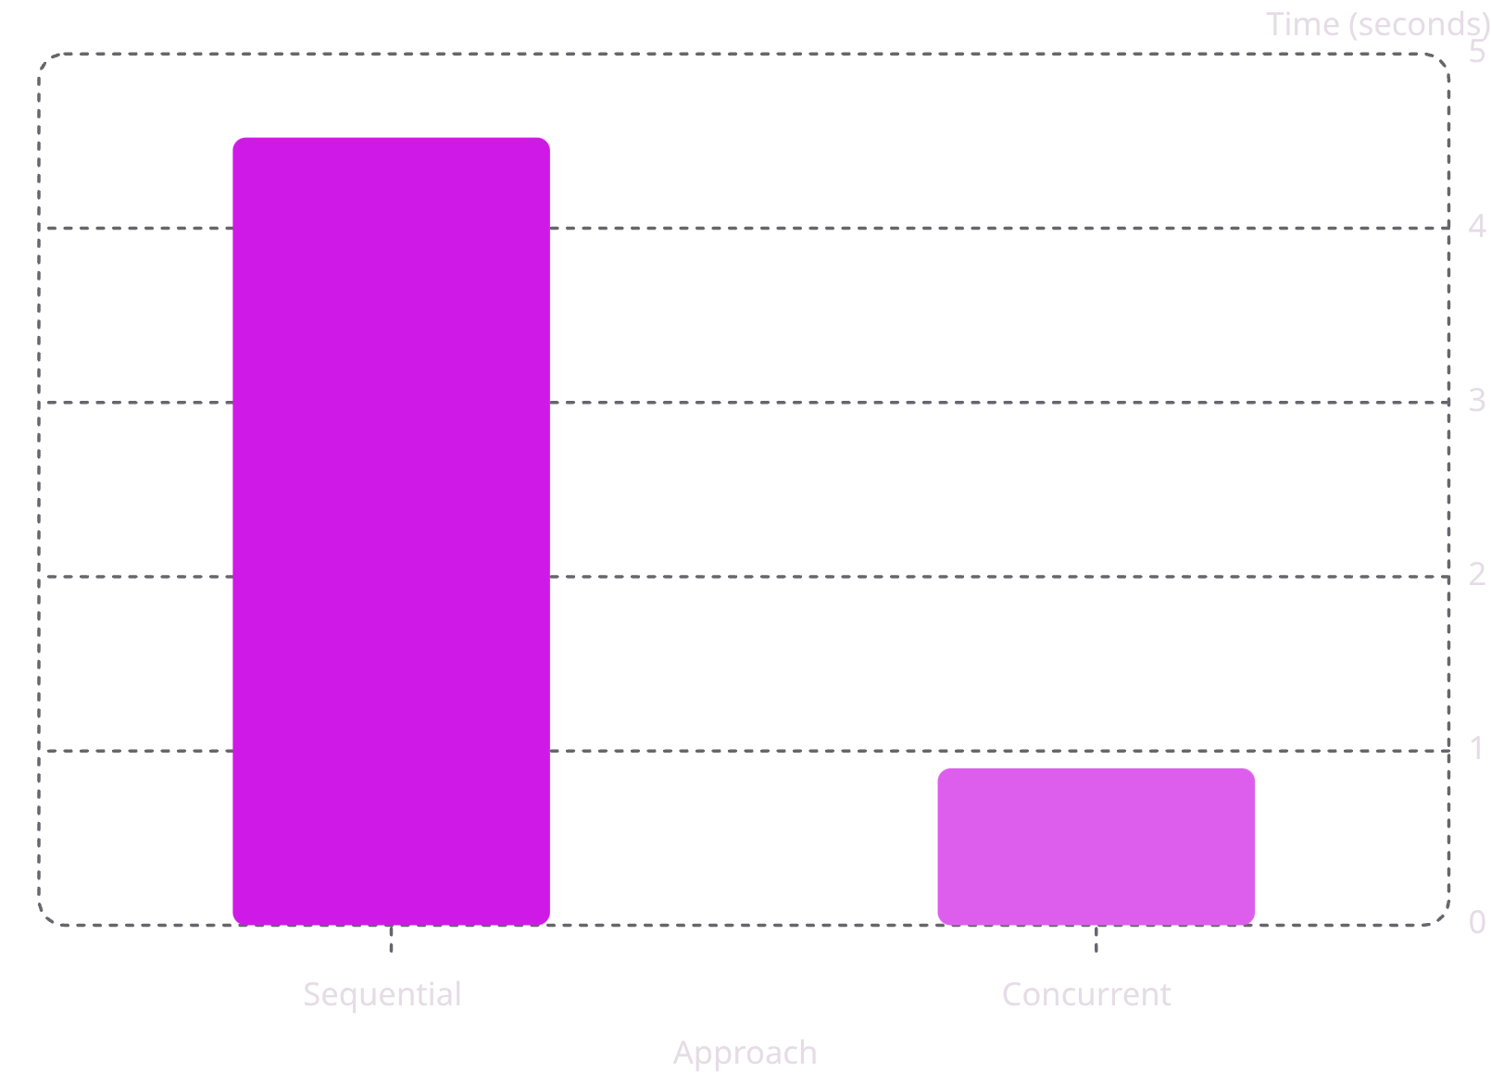
Concurrency: The Benchmark
Workload: 5 configured feeds, 25 articles, cold cache
Why Near-Perfect 5.0×?
All 5 feeds run in parallel; the bottleneck is the slowest host's socket RTT (tail latency), not Python.
AI Stage is Separate
Semaphore(5) caps concurrent Gemini calls independently — no coupling between fetch speed and API rate limits.
5.0× Speedup
Using Semaphore(8)

Slide 6




Robustness: One Concrete Failure Mode
Scenario: Gemini returns HTTP 429 (Rate Limit)
Retry
Validate
tenacity AsyncRetrying triggers exponential backoff (up to 3 total attempts).
ProcessedArticle Pydantic schema rejects any malformed JSON response before it can corrupt the cache.
Log
Degrade
Structured ai_label_failed warning with URL and reason; corrupted cache file is unlinked automatically.
Failed articles are skipped via asyncio.gather(return_exceptions=True); the digest is still produced for all remaining articles.

Slide 7

Live Demo
Commands
docker run --env-file .env finalproj python -m src run-daily --user saida
streamlit run src/app.py
What Happens on Screen
AI-Generated Summaries
2–3 sentence summaries with topic labels and sentiment scores.
Second Run: <0.1s
100% cache hit rate proves our SHA-256 content-hash file cache works end-to-end.

Slide 8
Testing
Coverage & Shape
Three Tests Worth Calling Out
Provided ai/ smoke tests: PASSING
Tooling: pytest, pytest-asyncio, pytest-cov, unittest.mock
1
test_pipeline.py
Happy-path end-to-end with mocked AI and mocked DB.
2
test_concurrency.py
One task raises ProviderError; gather degrades gracefully.
3
test_ai_service_edges.py
Provider 429 triggers tenacity retry; succeeds on 3rd attempt.
81% Coverage
Offline Tests
src/ SE layer coverage
All tests run fully offline (AI module is fully mocked).

Slide 9
Limitations & What We'd Do Next
Where the System is Brittle Today
Given Another Week We Would
01
Single Connection
OpenTelemetry Spans
Pipeline uses a single asyncpg connection — needs a pool for high concurrency.
Trace per-article latency end-to-end.
02
O(k²) Deduplication
asyncpg Connection Pool
Stage 2 Jaccard comparison is in-memory and quadratic — needs MinHash LSH for large archives.
Implement a pool and load-test with k6.
03
No Cross-Process Budget
Persist Digest History
Each process holds its own Semaphore(5) — can exceed provider quota if scaled horizontally.
Store in PostgreSQL for the Streamlit UI.

Slide 10


Team Contributions
Saida Arabova
Fetch Service, Config, Streamlit UI, Integration Tests, Presentation
Nigar Rustamova
AI Service (retry / caching), Deduplication, Tests, Presentation
Laman Mirzayeva
Digest Builder, File Cache, PostgreSQL Repository, Report
Nazrin Aliyeva
Pipeline Orchestration, Benchmarking, Docker Setup, Tests
Thank you! AIngels — github.com/saidaarna/news-briefing-service

