Slide 1
IPL AUCTION

Slide 2
List of top High SR batsmen ( Aggressive Batsmen):
SQL QUERY:
SELECT
batsman,
ROUND((SUM(batsman_runs) * 1.0 / COUNT(ball)) * 100, 2) AS batsman_sr
FROM
IPL_Ball
WHERE
extras_type NOT IN ('wides')
GROUP BY
batsman
HAVING
COUNT(ball) > 500
ORDER BY
batsman_sr DESC
LIMIT 10;
AD Russell" | 182.33
"SP Narine" | 164.27
"HH Pandya" | 159.27
"V Sehwag" | 155.44
"GJ Maxwell" | 154.68
"RR Pant" | 151.97
"AB de Villiers" | 151.91
"CH Gayle" | 150.11
"KA Pollard" | 149.88
"JC Buttler" | 149.56

Slide 3
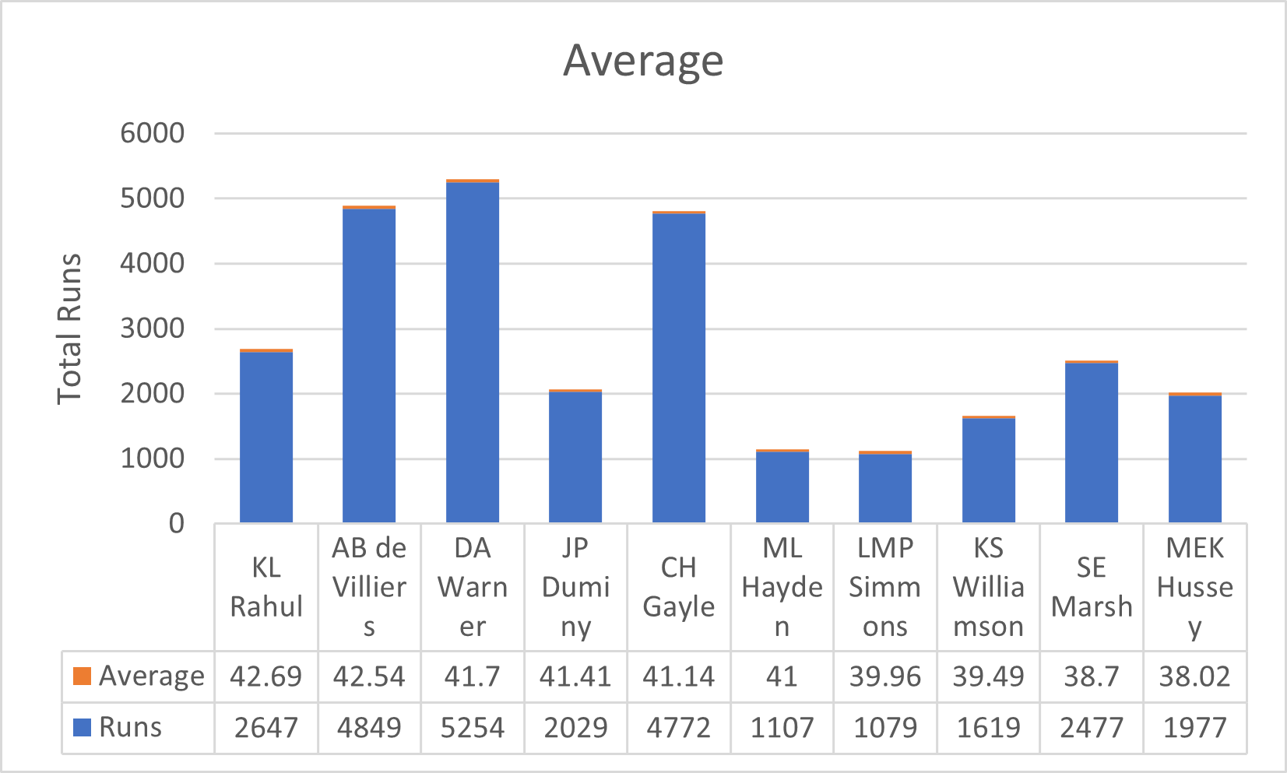
List of top best average batsmen with 2 seasons ( Anchor Batsmen):
SQL Query-
SELECT
batsman,
SUM(batsman_runs) AS runs,
ROUND(SUM(batsman_runs)*
1.0/SUM(CASE WHEN is_wicket THEN 1 ELSE 0 END),2)
AS average
FROM
ipl_ball
GROUP BY
batsman
HAVING
SUM(CASE WHEN is_wicket THEN 1 ELSE 0 END) > 0 AND
COUNT(DISTINCT id) > 28
ORDER BY
average DESC
LIMIT 10;
Batsmen | Runs | Average
KL Rahul | 2647 | 42.69
AB de Villiers | 4849 | 42.54
DA Warner | 5254 | 41.7
JP Duminy | 2029 | 41.41
CH Gayle | 4772 | 41.14
ML Hayden | 1107 | 41
LMP Simmons | 1079 | 39.96
KS Williamson | 1619 | 39.49
SE Marsh | 2477 | 38.7
MEK Hussey | 1977 | 38.02

Slide 4
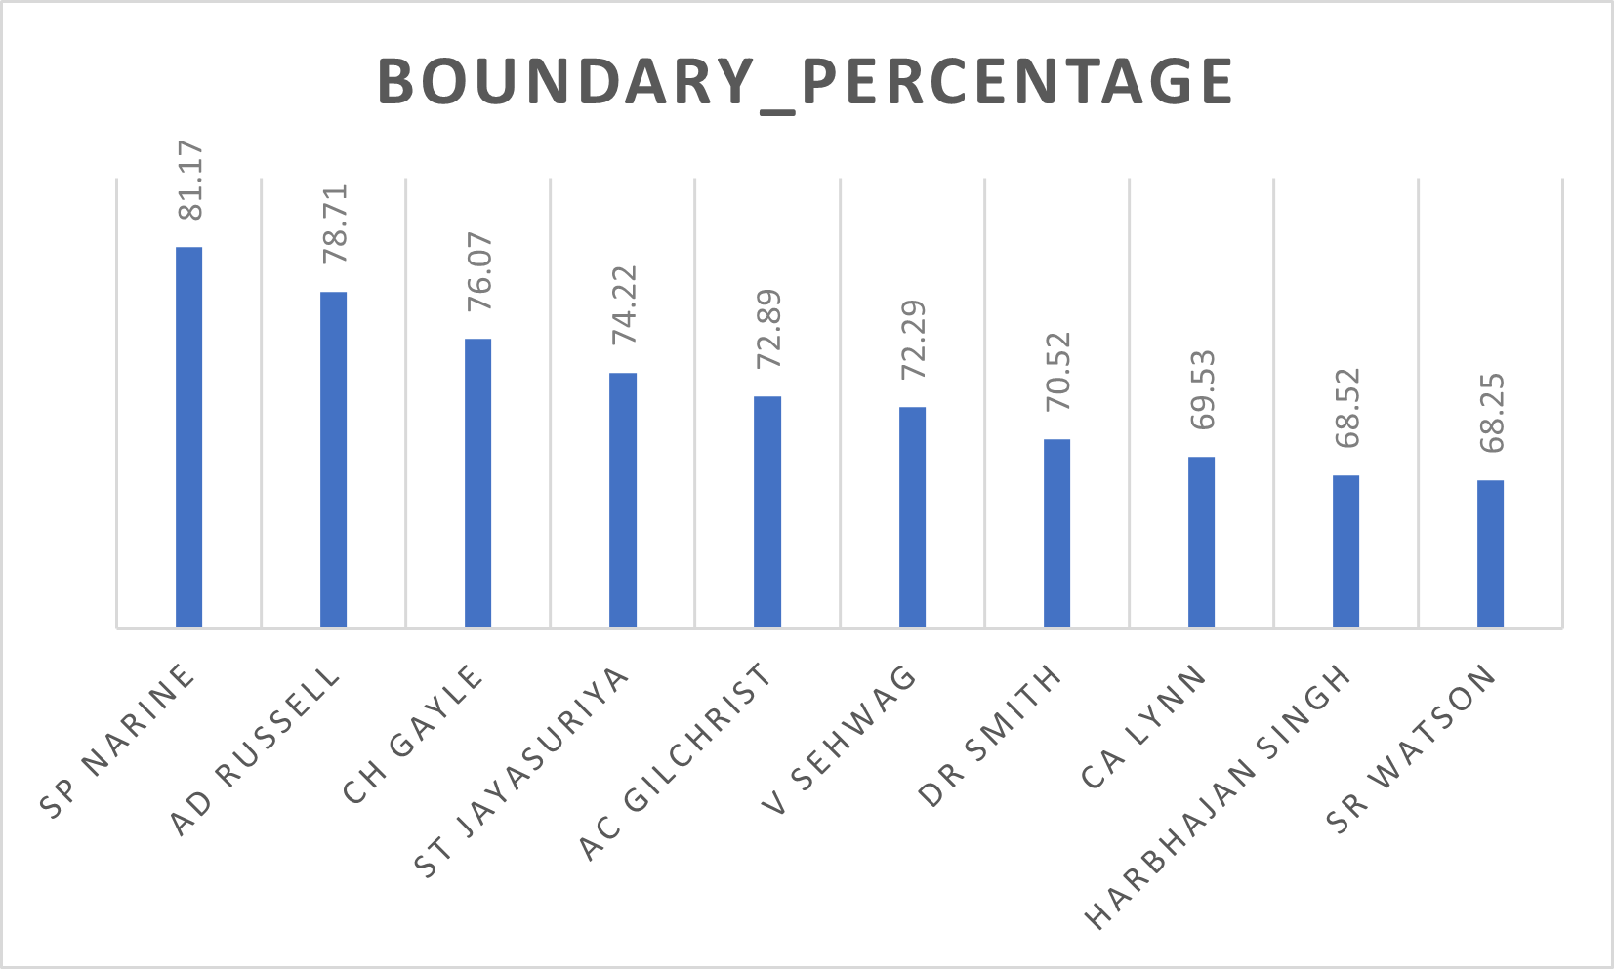
List of top best average batsmen with 2 seasons ( Anchor Batsmen):
SQL Query-
SELECT
batsman,
ROUND(SUM(CASE WHEN batsman_runs in(4,6) THEN batsman_runs else 0 END)
*1.0 / SUM(batsman_runs)*100,2) AS boundary_percentage
FROM ipl_ball
WHERE
extras_type NOT IN ('wides')
GROUP BY
batsman
HAVING
COUNT(DISTINCT id) > 28
ORDER BY
boundary_percentage DESC
LIMIT 10;

Slide 5
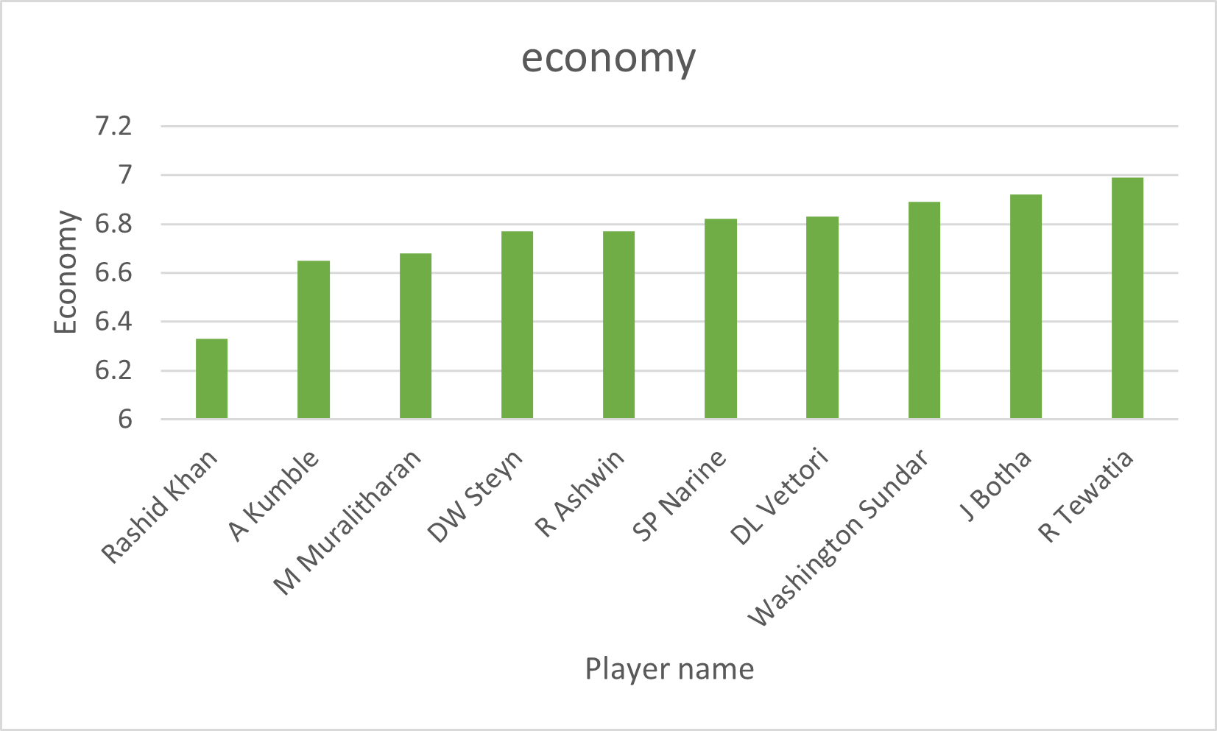
Economical bowlers
SQL Query-
SELECT
bowler,
ROUND(SUM(total_runs)/(COUNT(bowler)/6.0), 2)
as economy
FROM ipl_ball
GROUP BY
bowler
HAVING
COUNT(bowler) > 500
ORDER BY
economy
LIMIT 10;

Slide 6
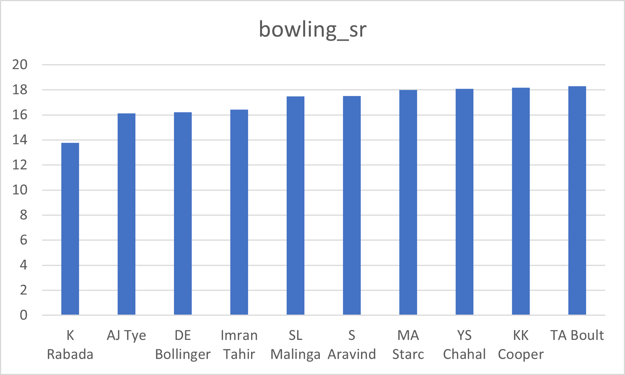
Wicket taking bowlers
SQL Query-
WITH ValidDismissals AS (
SELECT
bowler,
is_wicket,
CASE
WHEN dismissal_kind IN ('bowled', 'caught', 'caught and bowled', 'hit wicket', 'lbw', 'stumped')
THEN 1
ELSE 0
END AS is_valid_dismissal
FROM ipl_ball
)
SELECT
bowler,
ROUND(COUNT(bowler) * 1.0 / SUM(is_valid_dismissal),2) AS bowling_sr
FROM
ValidDismissals
GROUP BY
bowler
HAVING
COUNT(bowler) > 500
ORDER BY
bowling_sr
LIMIT 10;

Slide 7
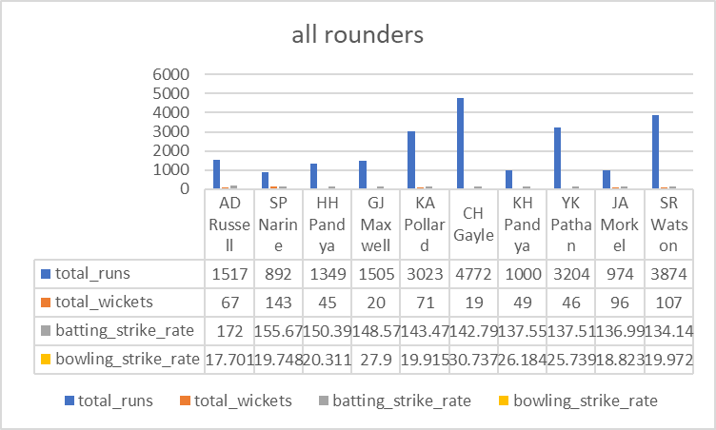
All rounders
SQL Query-
WITH batsman_stats AS ( SELECT batsman AS player, SUM(batsman_runs) AS total_runs, COUNT(*) AS total_balls_faced FROM IPL_Ball GROUP BY batsman HAVING COUNT(*) >= 500),bowler_stats AS ( SELECT bowler AS player, COUNT(*) AS total_balls_bowled, SUM(CASE WHEN is_wicket = 1 THEN 1 ELSE 0 END) AS total_wickets FROM IPL_Ball GROUP BY bowler HAVING COUNT(*) >= 300 AND SUM(CASE WHEN is_wicket = 1 THEN 1 ELSE 0 END) > 0),all_rounders AS ( SELECT b.player, b.total_runs, bo.total_wickets, (CAST(b.total_runs AS FLOAT) / b.total_balls_faced) * 100 AS batting_strike_rate, (CAST(bo.total_balls_bowled AS FLOAT) / bo.total_wickets) AS bowling_strike_rate FROM batsman_stats b JOIN bowler_stats bo ON b.player = bo.player)SELECT player, total_runs, total_wickets, batting_strike_rate, bowling_strike_rateFROM all_roundersORDER BY batting_strike_rate DESC, bowling_strike_rate ASCLIMIT 10;

Slide 8
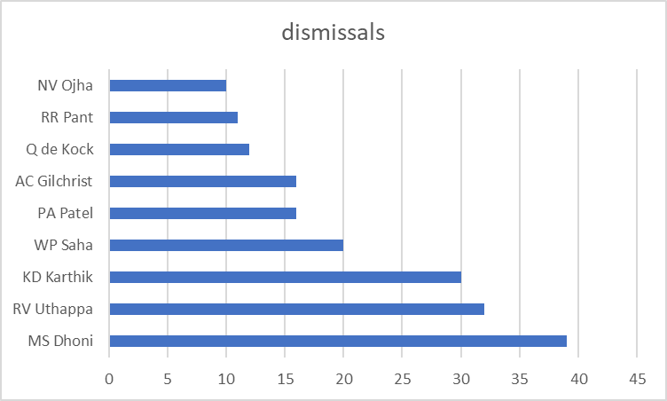
Wicket keepers
CREATE OR REPLACE VIEW wicketkeepers AS
SELECT
fielder AS wicketkeeper,
COUNT(*) AS dismissals
FROM IPL_Ball
WHERE dismissal_kind IN ('stumped')
GROUP BY fielder
HAVING COUNT(*) >= 10
ORDER BY dismissals DESC;
select* from wicketkeepers limit 10;;

Slide 9
Additional questions

Slide 10

Q-1) Get the count of cities that have hosted an IPL match.
Query-
SELECT
COUNT(DISTINCT city) AS city_count
FROM
ipl_matches;
Q-2) Create table deliveries_v02 with all the columns of the table ‘deliveries’ and an additional column ball_result containing values boundary, dot or other depending on the total_run (boundary for >= 4, dot for 0 and other for any other number)
Query-
CREATE TABLE deliveries_v02 AS
SELECT *,
CASE
WHEN total_runs >= 4 THEN 'boundary'
WHEN total_runs = 0 THEN 'dot'
ELSE 'other'
END AS ball_result
FROM ipl_ball;

Slide 11
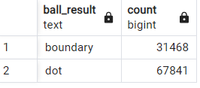
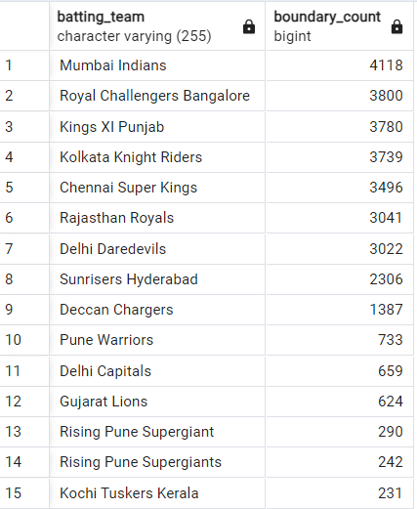
Q-3) Write a query to fetch the total number of boundaries and dot balls from the deliveries_v02 table.
Query-
SELECT
ball_result,
COUNT(*) AS count
FROM
deliveries_v02
WHERE
ball_result IN ('boundary', 'dot')
GROUP BY
ball_result;
Q-4) Write a query to fetch the total number of boundaries scored by each team from the deliveries_v02 table and order it in descending order of the number of boundaries scored.
SELECT
batting_team,
COUNT(*) AS boundary_count
FROM
deliveries_v02
WHERE
ball_result = 'boundary'
GROUP BY
batting_team
ORDER BY
boundary_count DESC;

Slide 12
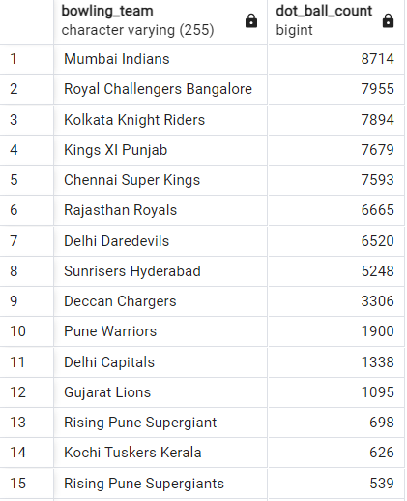
Q-5) Write a query to fetch the total number of dot balls bowled by each team and order it in descending order of the total number of dot balls bowled.
Query-
SELECT
bowling_team,
COUNT(*) AS dot_ball_count
FROM
deliveries_v02
WHERE
ball_result = 'dot'
GROUP BY
bowling_team
ORDER BY
dot_ball_count DESC;

Slide 13

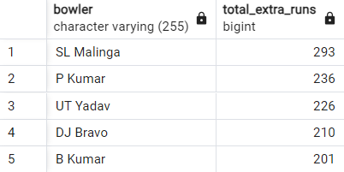
Q-6) Write a query to fetch the total number of dismissals by dismissal kinds where dismissal kind is not NA
Query-
SELECT
COUNT(*) AS total_dismissals
FROM
deliveries_v02
WHERE
dismissal_kind != 'NA’;
Q-7) Write a query to get the top 5 bowlers who conceded maximum extra runs from the deliveries table
Query-
SELECT
bowler,
SUM(extra_runs) AS total_extra_runs
FROM
deliveries_v02
GROUP BY
bowler
ORDER BY
total_extra_runs DESC
LIMIT 5;

Slide 14
Q-8) Write a query to create a table named deliveries_v03 with all the columns of deliveries_v02 table and two additional column (named venue and match_date) of venue and date from table matches
Query-
CREATE TABLE deliveries_v03 AS
SELECT
d.*,
m.venue,
EXTRACT(DAY FROM m.date) AS date
FROM deliveries_v02 d
LEFT JOIN
ipl_matches m ON d.id = m.id;

Slide 15
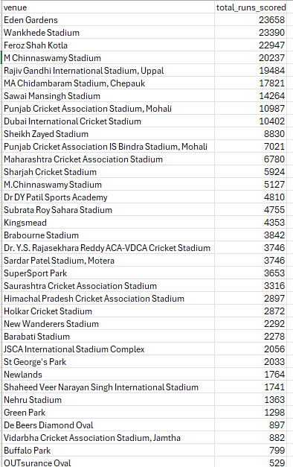
Q-9) Write a query to fetch the total runs scored for each venue and order it in the descending order of total runs scored.
Query-
SELECT
venue,
SUM(total_runs) AS total_runs_scored
FROM
deliveries_v03
GROUP BY
venue
ORDER BY
total_runs_scored DESC;

Slide 16
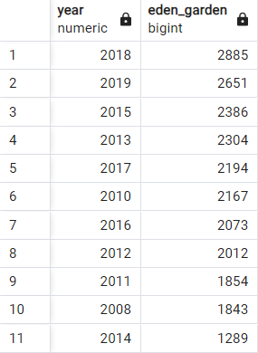
Q-10) Write a query to fetch the year-wise total runs scored at Eden Gardens and order it in the descending order of total runs scored.
Query-
SELECT
EXTRACT(YEAR FROM m.date) AS year,
SUM(d.total_runs) AS Eden_Garden
FROM
deliveries_v03 d
JOIN
ipl_matches m
ON
d.id = m.id
WHERE
d.venue = 'Eden Gardens'
GROUP BY
year
ORDER BY
Eden_Garden DESC;

