Slide 1


Version control systems for actuaries
8th December 2020
© Society of Actuaries in Ireland

Slide 2
Disclaimer
2
The views expressed in this presentation are those of the presenter(s) and not necessarily those of the Society of Actuaries in Ireland or their employers.

Slide 3
Who am I
3
Shane Kennedy FSAI, FIA
13 yrs experience across Life and Healthcare industries
Keen interest in Data Analytics
Member of SAI Data Analytics committee

Slide 4
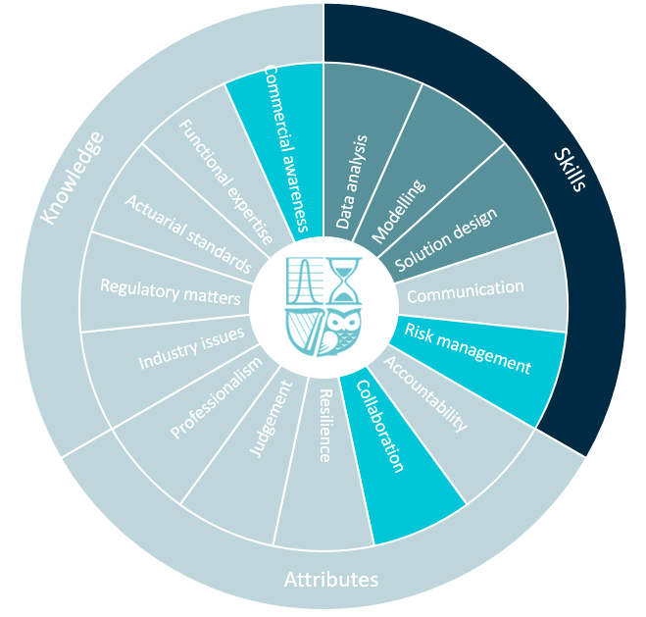
Competency Framework Wheel
4

Slide 5
Agenda
What is a version control system?
Relevance for Actuaries
Demonstration

Slide 6
What is a version control system?
“Version control systems are a category of software tools that help a software team manage changes to source code over time.”
Source: Atlassian.com
Manages the evolution of a set of files (a repository) in a structured way
Complete history of content is tracked and available
This content may include model source code, validation testing code and documentation
Examples include Git, SVN, CVS, Mercurial

Slide 7
What is a Distributed version control system (DVCS)?
Each user has a local project history called a repository
A single remote repository exists which is the source of truth (master)
Users can work offline since they have their own local copy of the project history
DVCS allow users to ‘pull’ content from and ‘push’ content to the master copy

Slide 8
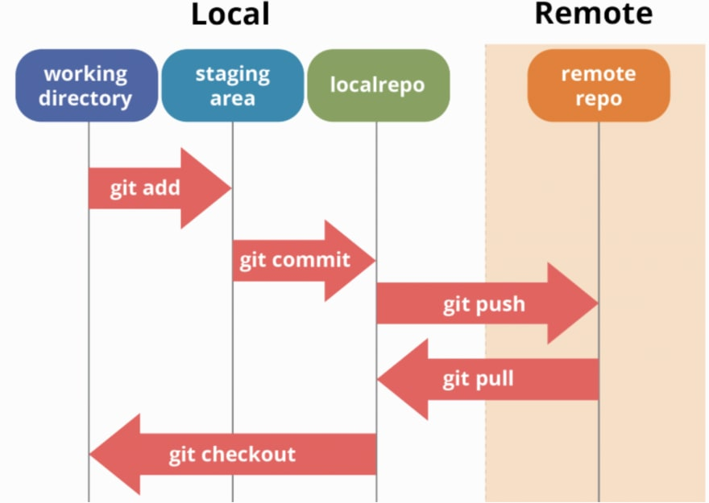
Local and remote hosting
source: https://dev.to/mollynem/git-github--workflow-fundamentals-5496
Note: Git will be used for demonstration purposes throughout this presentation however other version control systems are available
Notes:
Expanding on DVCS description, talk a little bit more about Local and Remote hosting.
User ‘Pulls’ project from Remote repo (master) onto their Local machine
Local machine has three main components (need to be able to describe each of these in detail)
working directory
staging area
local repo
User can add to staging area, commit to local repo, push to remote repo

Slide 9
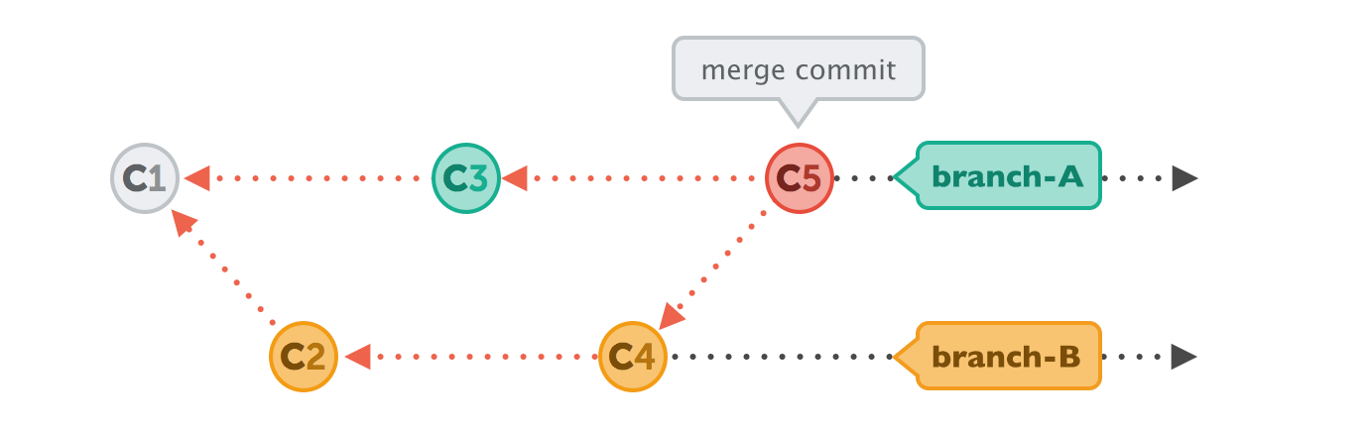
Directed Acyclic Graph (DAG)
source: https://i.stack.imgur.com/yE1kA.gif
Arrows point to the preceding commit, not the subsequent one
Branches are labels on commits
Commits can be merged to incorporate changes from more than one branch
Notes:
Need to get more info on DAG to describe it here e.g. use analogy of people walking into a coffee shop, what do they need to know to understand where they are in the queue
Important to understand this concept in order to understand how Git works
Picture in your head arrows pointng to preceding commit – think about how analogy could be used for commit
Commit
Version control systems manage versions of a project called commits
Each commit is a snapshot of the entire project
Collection of commits contain the history of the project allowing a user to review the history and undo a change if deemed necessary
Branch
All commits belong to a branch which are independent lines of development of the project
Independence of branches allows teams to scale their work, with different people working on different parts of a project
Pull request and Merge
Pull requests allow the user request that their development work is merged with the master branch.
A merge combines the work of separate branches. During a pull request team members can review and approve your changes. If pull request is accepted then your changes are merged and become the latest changes in the master branch.

Slide 10
What is a version control system?
Relevance for Actuaries?
Demonstration

Slide 11
Competency Framework Wheel
11
Notes:
Going back to the competency wheel, focusing on the light blue areas of..
Risk Management, Collaboration and Communication = > version control systems can help Actuaries in these areas
Actuaries need to be mindful of Commercial considerations associated with using different version control systems

Slide 12
Relevance for Actuaries
Risk Management
Tracked changes, maintains history of all changes made
Can have different permissions depending on seniority levels
Collaboration
Facilitates multiple people working at the same time
Actuaries can work with other professionals (Data scientists, Software developers) on projects
Notes:
Risk management
Useful for model developments using R, python or any other language
Can be reviewed before updates are merged into master branches

Slide 13
Commercial considerations
Choice of version control system
Distributed (e.g. Git) more popular in recent times than Centralized (e.g. SVN)
Choice of repository hosting service
Examples include Github, Bitbucket, Gitlab, Assembla, Beanstalk, Sourcetree
Some offer free private repositories to individuals and organisations
Typically cloud based
Need to ensure security and data privacy features are appropriate
Interacting with version control systems
Can use command line however User Interfaces (UIs)are more user friendly
Many applications facilitate easy interaction with version control systems
Examples include R Studio, SAS Enterprise, Visual Studio, Tortoise, Github desktop (Git only)
Notes:
Need to ensure that data not supposed to be uploaded onto hosting service is uploaded.
Company may wish to ensure processes are in place to prevent and or detect this

Slide 14
What is a version control system?
Relevance for Actuaries?
Demonstration

Slide 15
Demonstration
For the purposes of the demonstration we will use the following
Version Control System => Git
Repository hosting service => Github
User Interface => R Studio
Items to be covered include:
Getting set-up on a version control system (Git) and hosting service (Github)
Integrating with User Interface (R Studio)
Useful functions (create branch, stage, commit, push, pull request, resolve conflicts, merge)

Slide 16
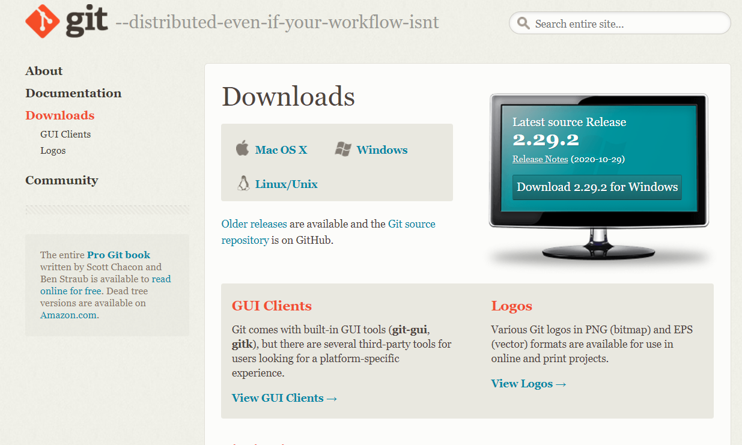
Getting set-up
Downloading Git: https://git-scm.com/downloads

Slide 17

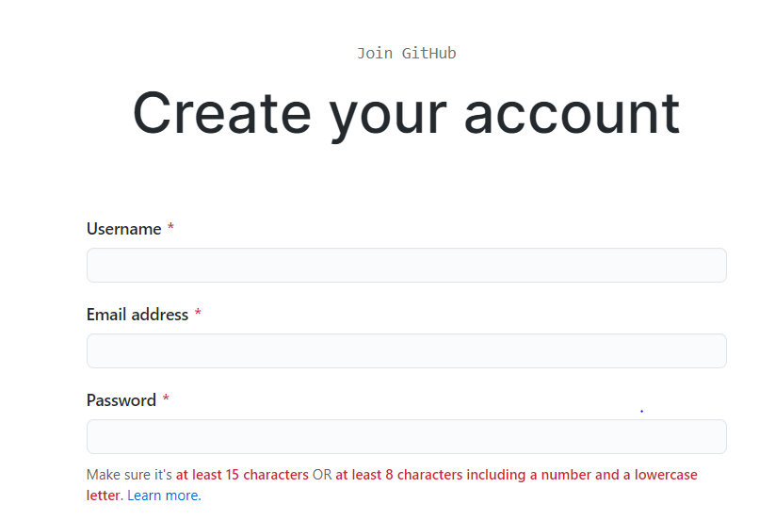
Getting set-up
Creating a Github account: github.com

Slide 18
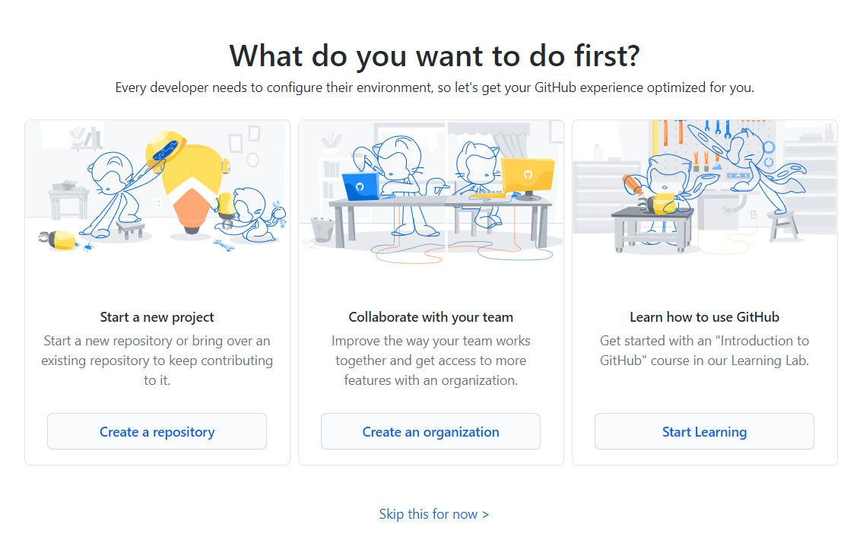
Getting set-up
Starting a new project

Slide 19
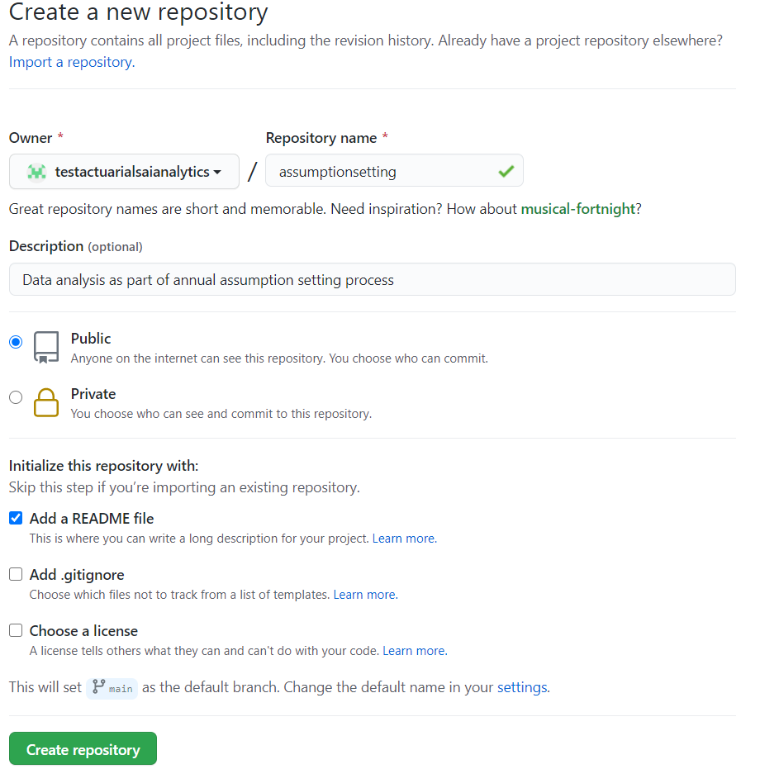
Getting set-up
Creating a new repository

Slide 20
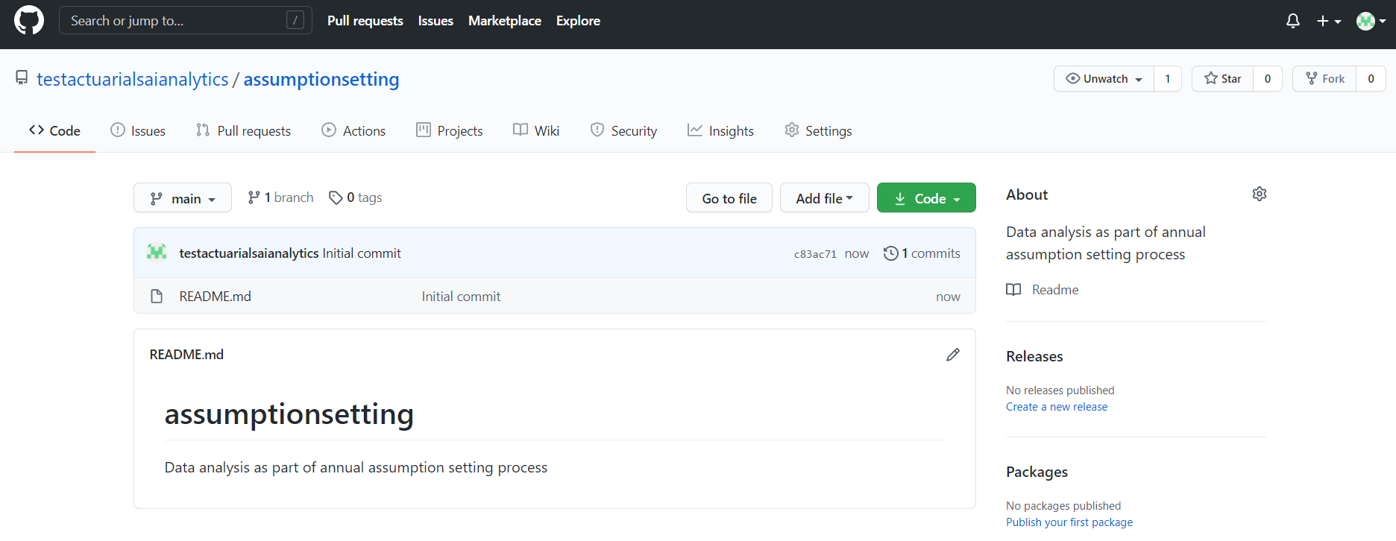
Collaborating
Inviting Collaborators

Slide 21
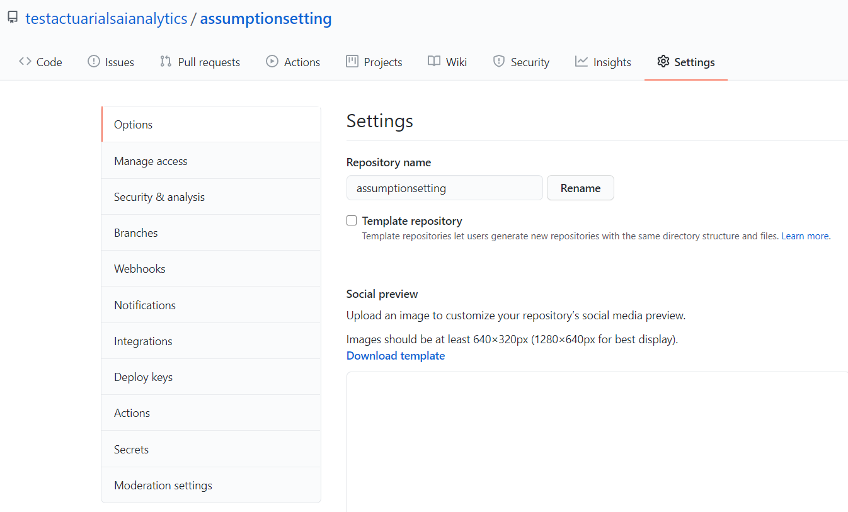
Collaborating
Inviting Collaborators

Slide 22
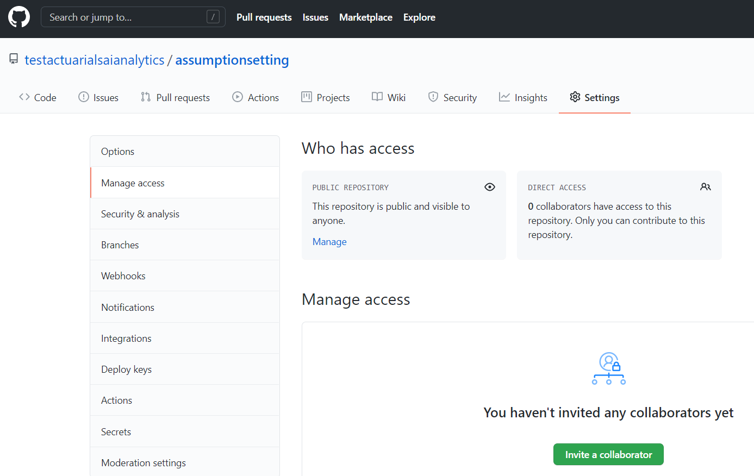
Collaborating
Inviting Collaborators

Slide 23
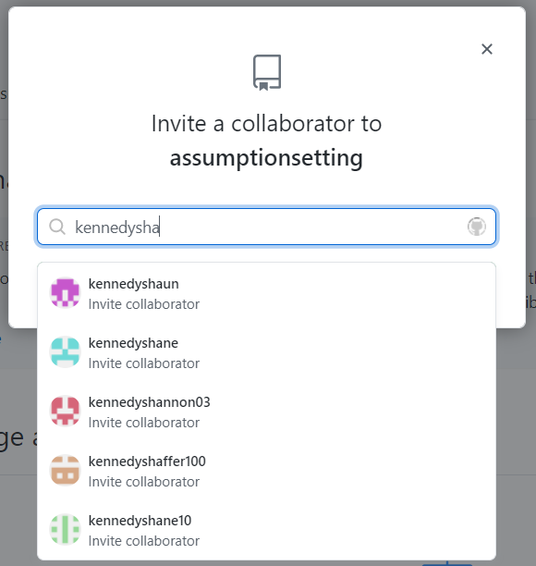
Collaborating
Inviting Collaborators

Slide 24
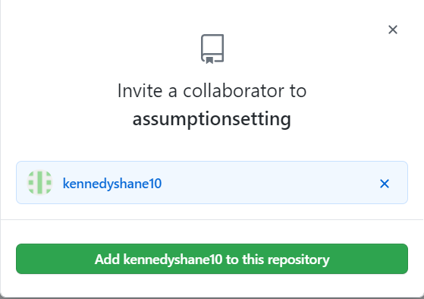
Collaborating
Inviting Collaborators

Slide 25
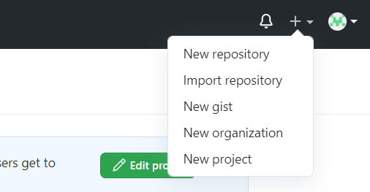
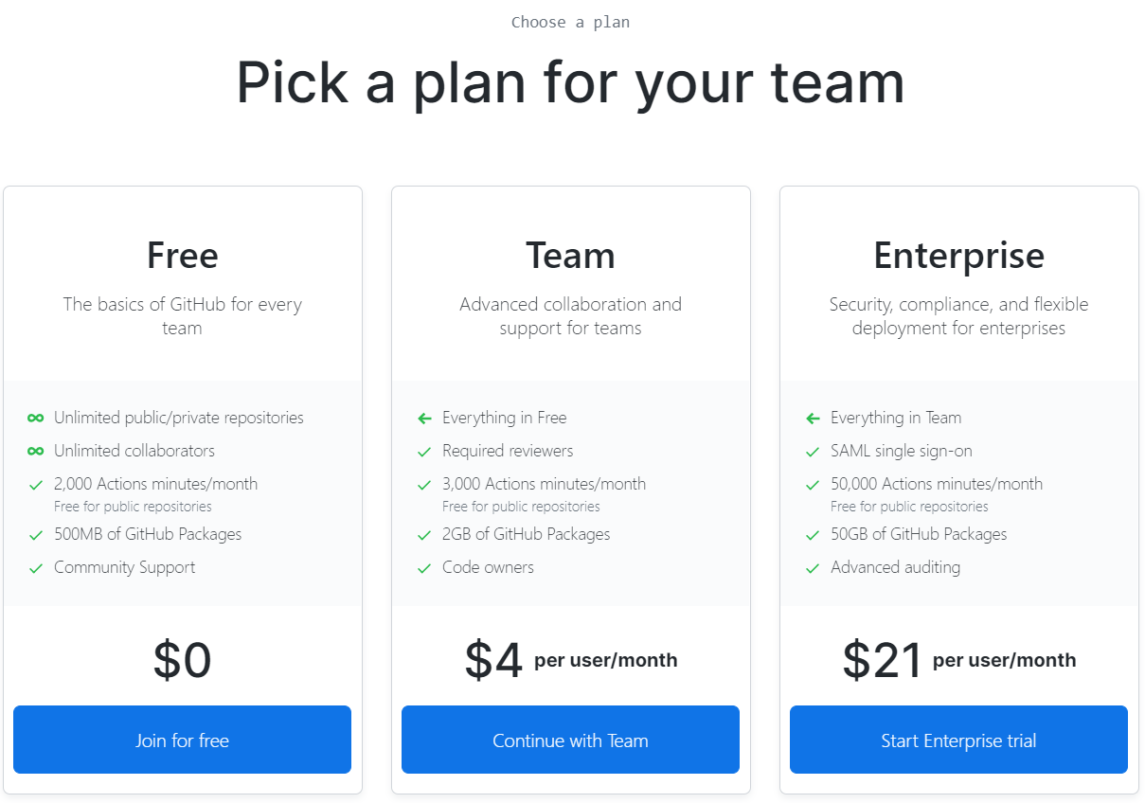
Collaborating
Creating an organization

Slide 26
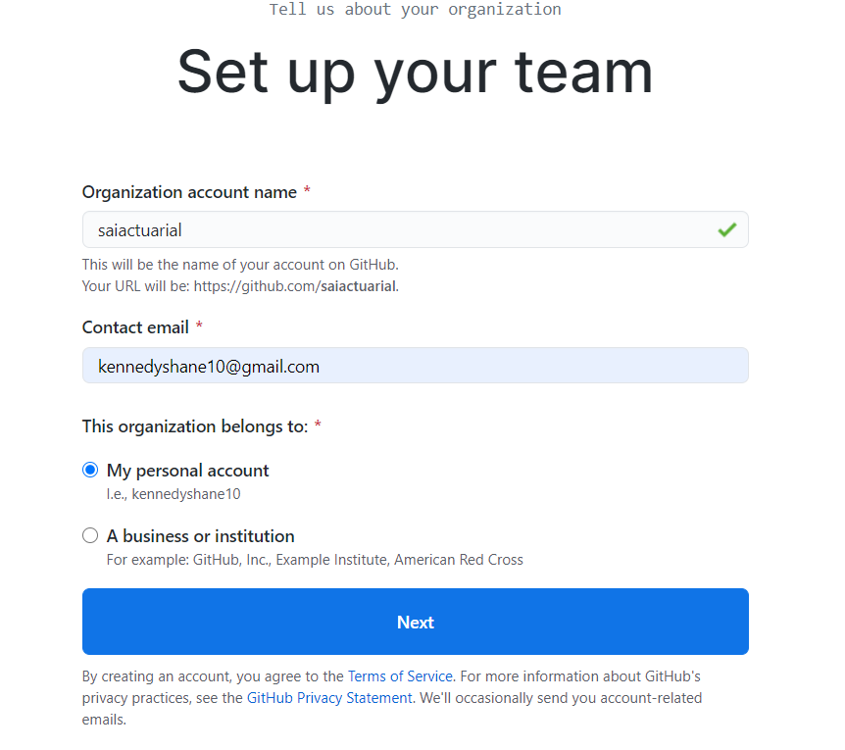
Collaborating
Creating an organization

Slide 27
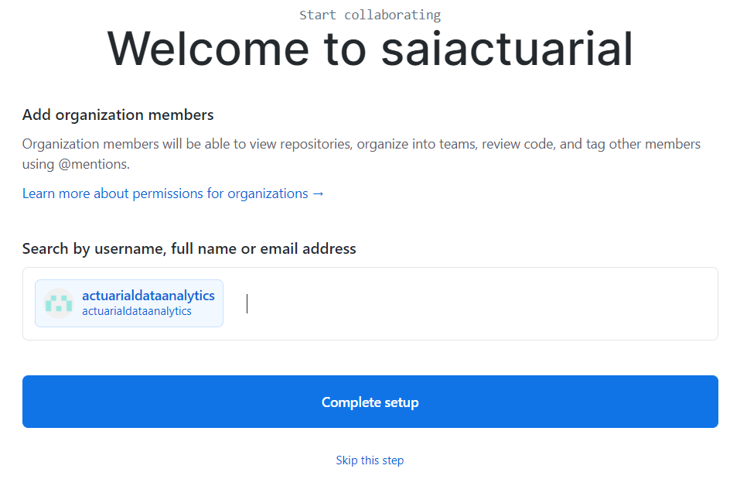
Collaborating
Creating an organization

Slide 28
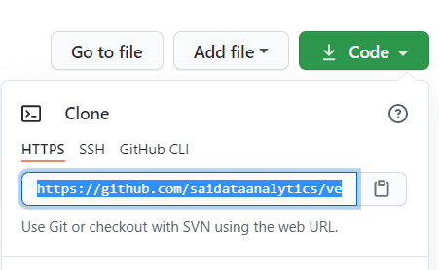
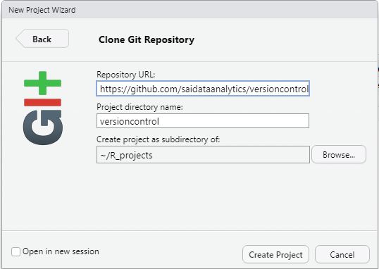
Collaborating
Clone an existing repository
R Studio: File -> New Project -> Version Control -> Git

Slide 29
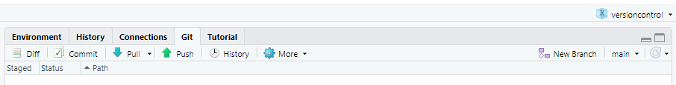
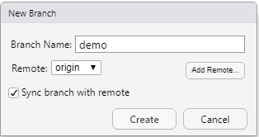
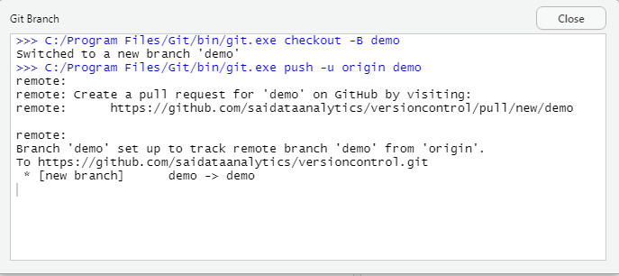
Collaborating
Creating a new branch from R Studio

Slide 30
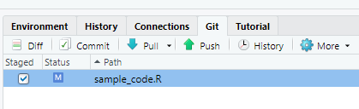
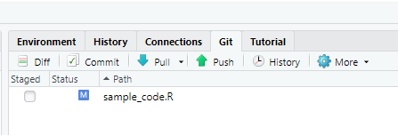
Collaborating
Edit code locally then stage, commit and push to remote host
STAGE

Slide 31
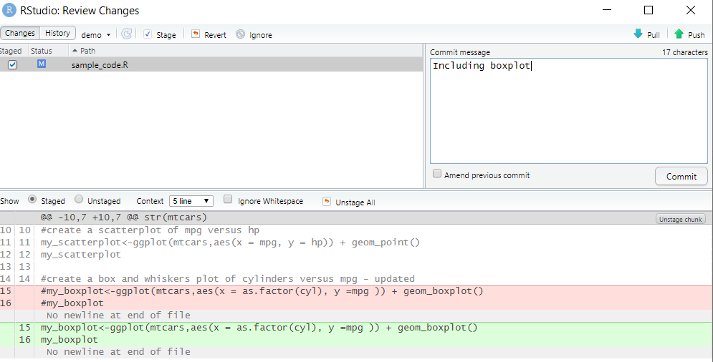
Collaborating
Edit code locally then stage, commit and push to remote host
COMMIT

Slide 32
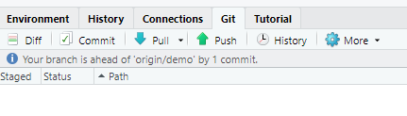
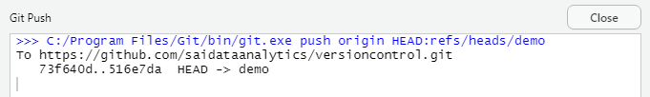
Collaborating
Edit code locally then stage, commit and push to remote host
PUSH

Slide 33
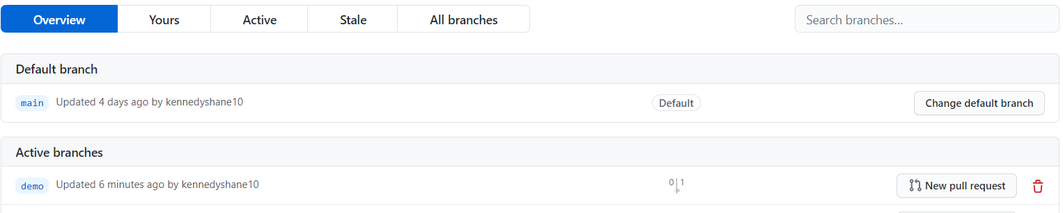
Collaborating
Edit code locally then stage, commit and push to remote host
Back to Github: https://github.com/saidataanalytics/versioncontrol/branches

Slide 34
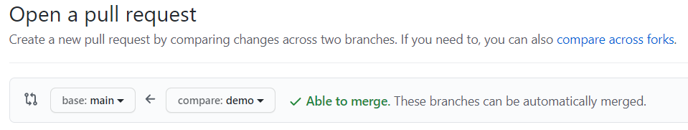
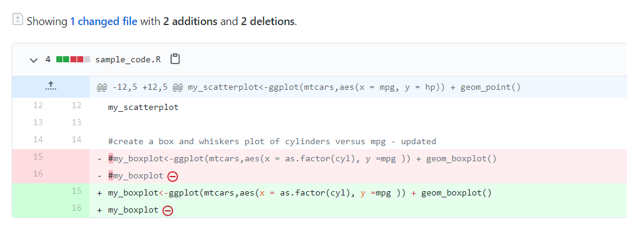

Collaborating
Pull request

Slide 35
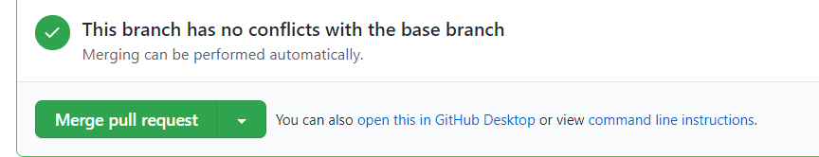
Collaborating
Merge Pull request into base branch

Slide 36
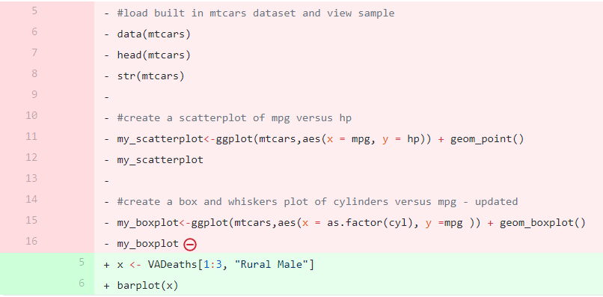
Collaborating
Create pull request with conflicts

Slide 37
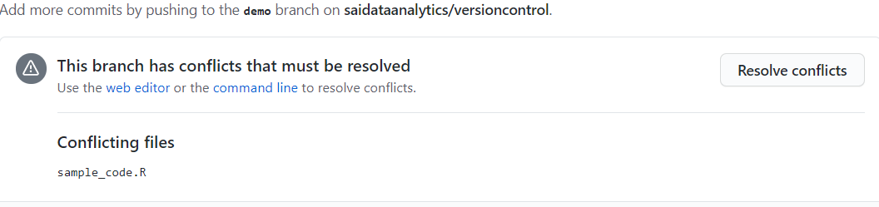
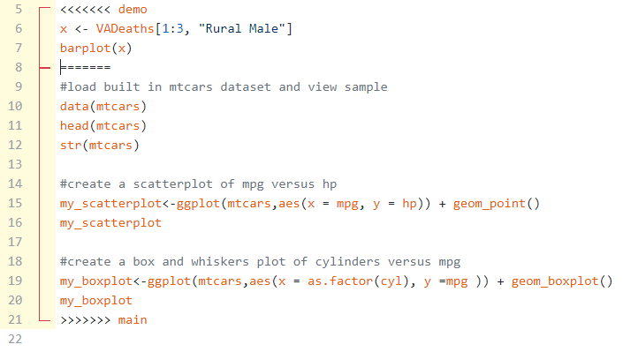
Collaborating
Resolving conflicts

Slide 38
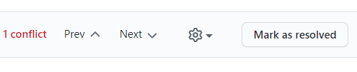
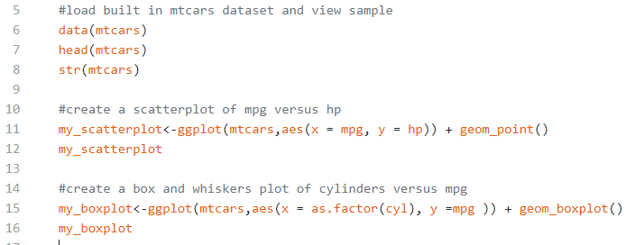


Collaborating
Resolving conflicts
Edit code in Github to resolve conflicts, then commit and merge

Slide 39
Summary
What is a version control system?
Directed Acyclic Graph
Local and Remote Hosting
Relevance for Actuaries
Risk Management
Collaboration
Commercial considerations
Demonstration
Getting set-up on a version control system (Git) and hosting service (Github)
Integrating with User Interface (R Studio)
Useful functions (create branch, stage, commit, push, pull request, resolve conflicts, merge)
Presentation and additional information available on github page:
https://github.com/saidataanalytics/versioncontrol

Slide 40
Thank you
© Society of Actuaries in Ireland

