Slide 1


What could possibly go wrong?
How version control systems can help actuaries
14th December 2020
© Society of Actuaries in Ireland

Slide 2
Disclaimer
2
The views expressed in this presentation are those of the presenter(s) and not necessarily those of the Society of Actuaries in Ireland or their employers.

Slide 3
Who am I
3
Shane Kennedy FSAI, FIA
Associate Director of Actuarial Service, Optum Ireland
13 yrs experience across Life and Healthcare industries
Member of SAI Data Analytics committee

Slide 4
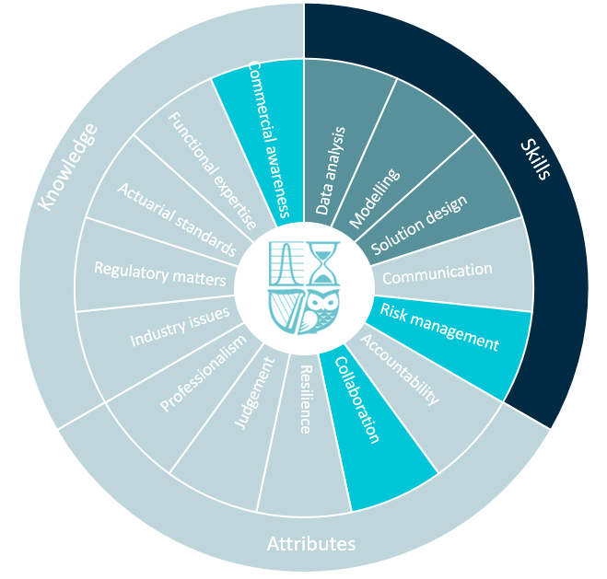
Competency Framework Wheel
4

Slide 5
What could possibly go wrong?
Nasa Mars climate orbiter
Irish Leaving Cert 2020

Slide 6
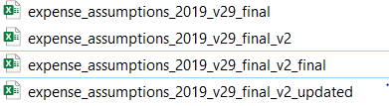

What could possible go wrong?
Excel is a great tool but …
And so is word but …
WOMBAT: Waste Of Money Brains and Time!

Slide 7
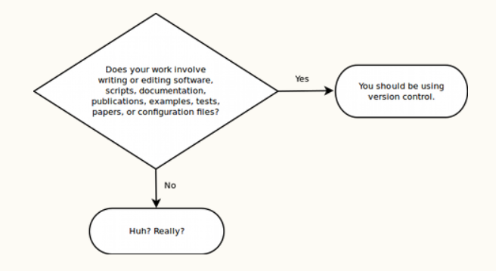
What could possible go wrong?
As actuaries embrace tools such as R and Python version control systems become even more important
Source: http://soundsoftware.ac.uk/why-version-control

Slide 8
Agenda
What is a version control system?
Relevance for Actuaries
Demonstration

Slide 9
What is a version control system?
“Version control systems are a category of software tools that help a software team manage changes to source code over time.”
Source: Atlassian.com
Manages the evolution of a set of files (a repository) in a structured way
Complete history of content is tracked and available
This content may include model source code, validation testing code and documentation
Examples include Git, SVN, CVS, Mercurial

Slide 10
What is a Distributed version control system (DVCS)?
Each user has a local project history called a repository
A single remote repository exists which is the source of truth (master)
Users can work offline since they have their own local copy of the project history
DVCS allow users to ‘pull’ content from and ‘push’ content to the master copy

Slide 11
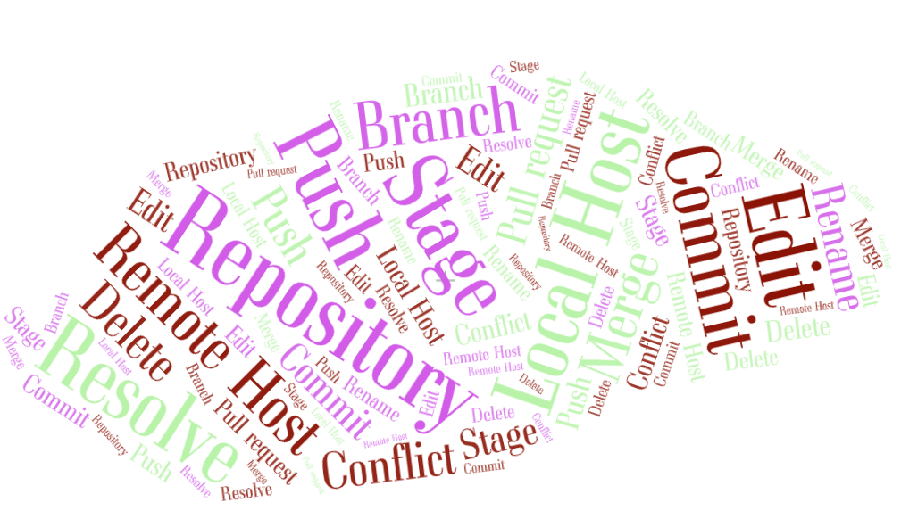
The Lingo!

Slide 12
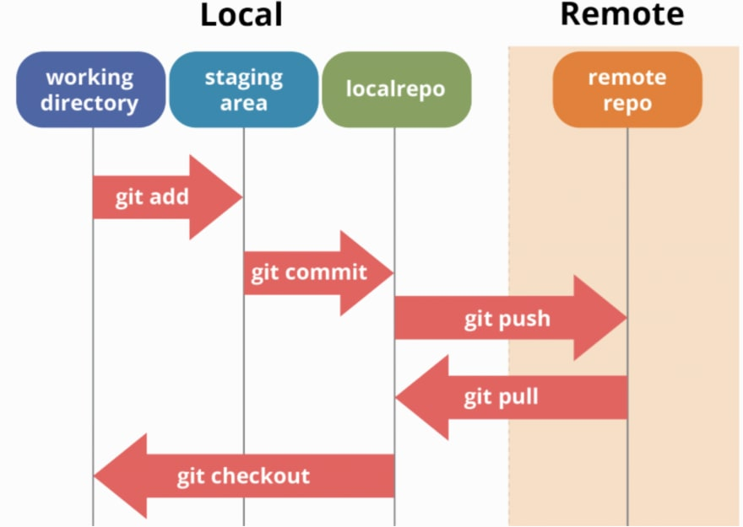
Local and remote hosting
source: https://dev.to/mollynem/git-github--workflow-fundamentals-5496
Git used for demonstration purposes throughout this presentation
User ‘Pulls’ project from Remote repo (master) onto their Local machine
Local machine has three main components: working directory, staging area, local repo
User can add to staging area, commit to local repo, push to remote repo
Notes:
Expanding on DVCS description, talk a little bit more about Local and Remote hosting.
User ‘Pulls’ project from Remote repo (master) onto their Local machine
Local machine has three main components (need to be able to describe each of these in detail)
working directory
staging area
local repo
User can add to staging area, commit to local repo, push to remote repo

Slide 13
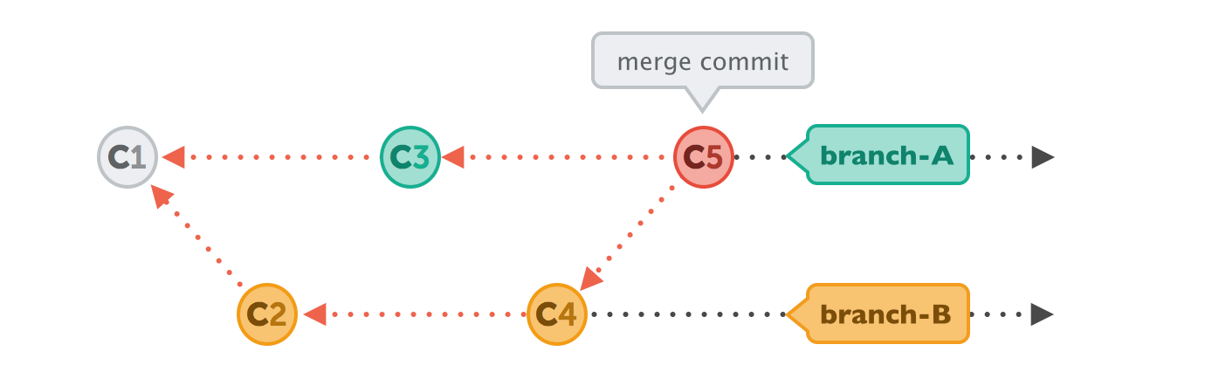
Health warning – some technical stuff!
source: https://i.stack.imgur.com/yE1kA.gif
Arrows point to the preceding commit, not the subsequent one
Branches are labels on commits
Commits can be merged to incorporate changes from more than one branch
Directed Acyclic Graph (DAG)
Notes:
DAG = conceptual representation of a series of activities
Activities shown in circles are called commits (snapshots, different versions of a project, collection of which contain the entire history of the project)
Directed: defined directional flow from one activity to the other (commits)
Acyclic: No loops/cycles i.e. directional flow only goes in one direction

Slide 14
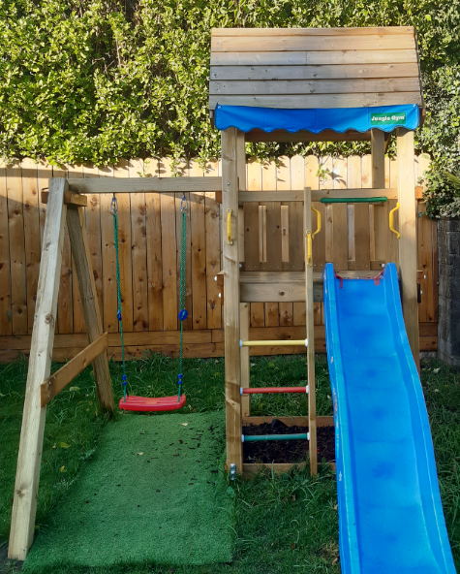
Lets design an outdoor play gym!

Slide 15
Lets design an outdoor play gym!
Standard play gyms include a Tree house and climbing bars so we start with this
Mary and John have been tasked with enhancing the design
Mary wants to remove the climbing bars and replace with a swing
John wants to remove the climbing bars and add a slide
In the end, they agree to include both!!
Conflict!

Slide 16
Conflicts
Conflicts can arise when changes are made that don’t gel
Conflict arises since Climbing bars are no longer in Main branch
C2
Climbing bars
+ Swing
C4
Merge
Mary’s Branch
C5
Tree house
Swing
C1
Main Branch
Tree house
Climbing bars
Tree house
Swing
Slide
John’s Branch
C3
Climbing bars
+ Slide
Resolve conflicts
Notes:
Conflicts can arise when changes are made that don’t gel
It’s a race!!
Mary makes her change first
John – gets a conflict when attempting to merge back into the main branch
Mary and John will need to review and resolve this conflict

Slide 17
What is a version control system?
Relevance for Actuaries?
Demonstration

Slide 18
Competency Framework Wheel
18
Notes:
Going back to the competency wheel, focusing on the light blue areas of..
Risk Management, Collaboration and Communication = > version control systems can help Actuaries in these areas
Actuaries need to be mindful of Commercial considerations associated with using different version control systems

Slide 19
Relevance for Actuaries
Risk Management
Tracked changes, maintains history of all changes made
Can have different permissions depending on seniority levels
Collaboration
Facilitates multiple people working at the same time
Actuaries can work with other professionals (Data scientists, Software developers) on projects
Notes:
Risk management
Useful for model developments using R, python or any other language
Can be reviewed before updates are merged into master branches

Slide 20
Commercial considerations
Choice of version control system
Distributed (e.g. Git) more popular in recent times than Centralized (e.g. SVN)
Choice of repository hosting service
Examples include Github, Bitbucket, Gitlab, Assembla, Beanstalk, Sourcetree
Some offer free private repositories to individuals and organisations
Typically cloud based
Need to ensure security and data privacy features are appropriate
Interacting with version control systems
Can use command line however User Interfaces (UIs)are more user friendly
Many applications facilitate easy interaction with version control systems
Examples include R Studio, SAS Enterprise, Visual Studio, Tortoise, Github desktop (Git only)
Notes:
Need to ensure that data not supposed to be uploaded onto hosting service is uploaded.
Company may wish to ensure processes are in place to prevent and or detect this

Slide 21
What is a version control system?
Relevance for Actuaries?
Demonstration

Slide 22
Demonstration
For the purposes of the demonstration we will use the following
Version Control System => Git
Repository hosting service => Github
User Interface => R Studio
Items to be covered include:
Getting set-up on a version control system (Git) and hosting service (Github)
Integrating with User Interface (R Studio)
Useful functions (create branch, stage, commit, push, pull request, resolve conflicts, merge)
Some advice: Just get set up and get started!!

Slide 23
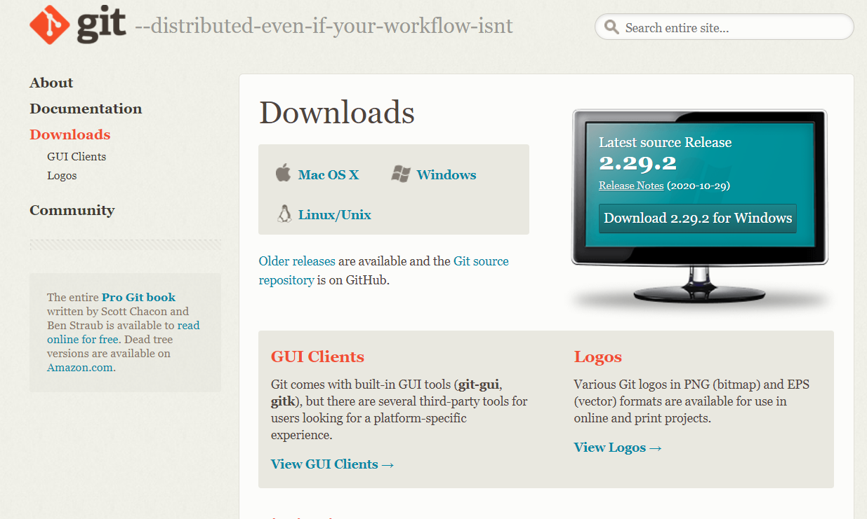
Getting set-up
Downloading Git: https://git-scm.com/downloads

Slide 24

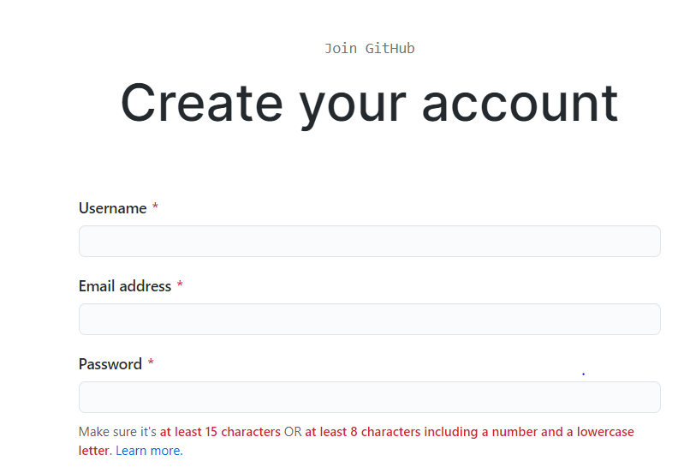
Getting set-up
Creating a Github account: github.com

Slide 25
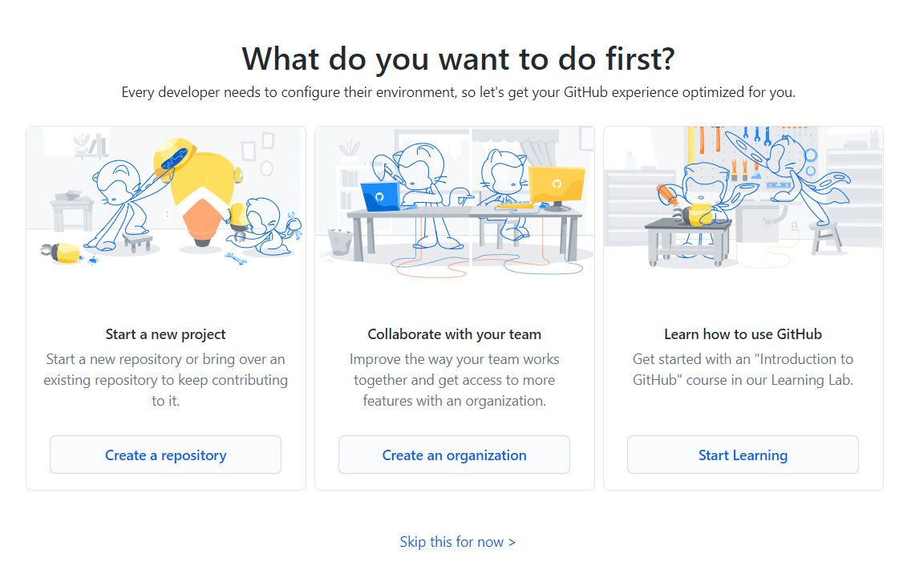
Getting set-up
Starting a new project

Slide 26
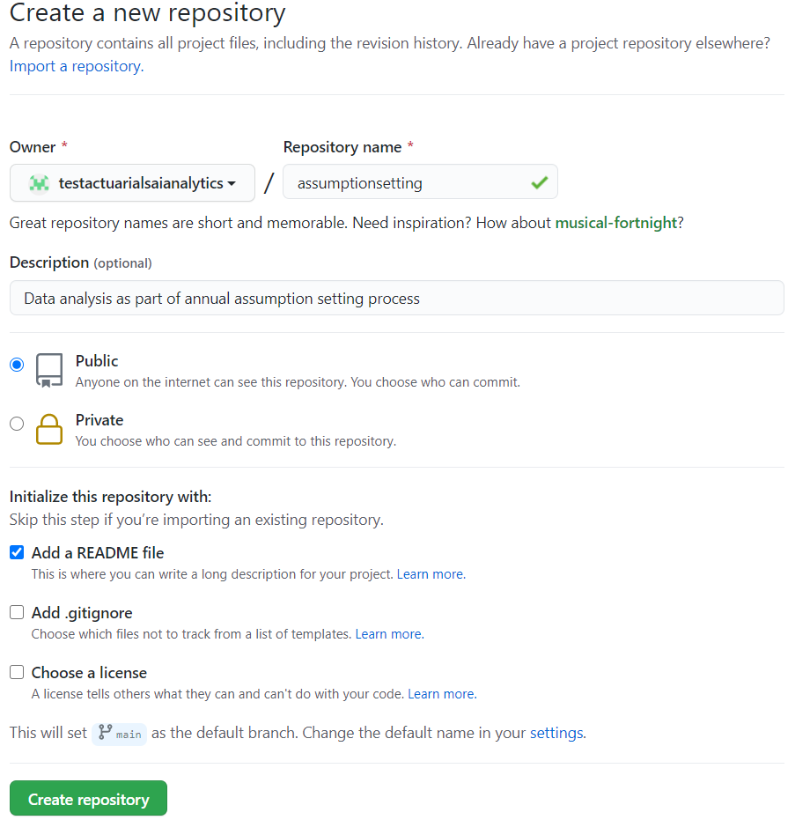
Getting set-up
Creating a new repository

Slide 27
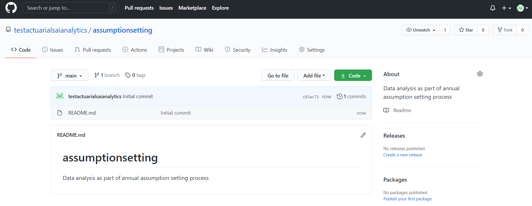
Collaborating
Inviting Collaborators

Slide 28
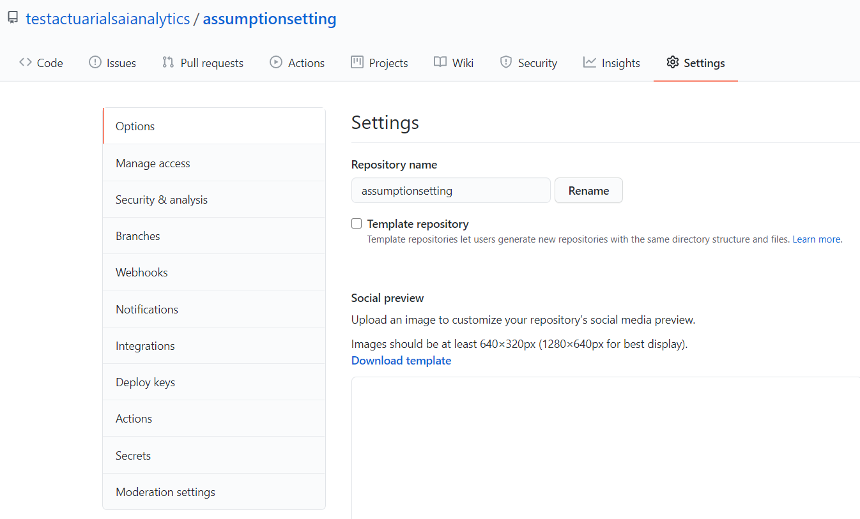
Collaborating
Inviting Collaborators

Slide 29
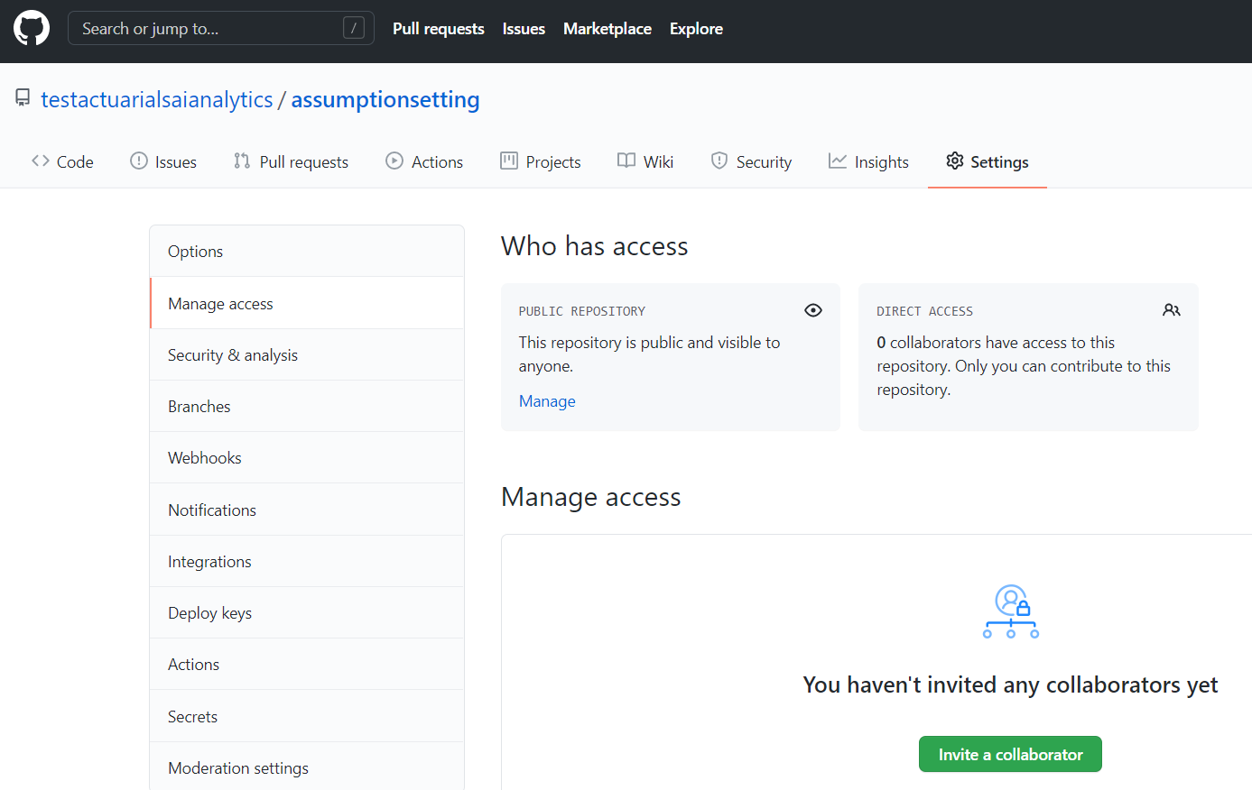
Collaborating
Inviting Collaborators

Slide 30
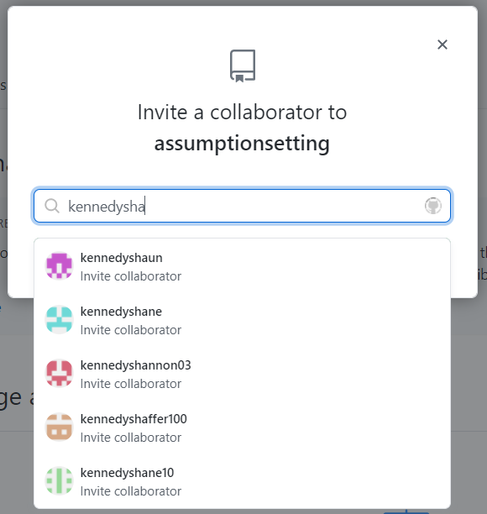
Collaborating
Inviting Collaborators

Slide 31
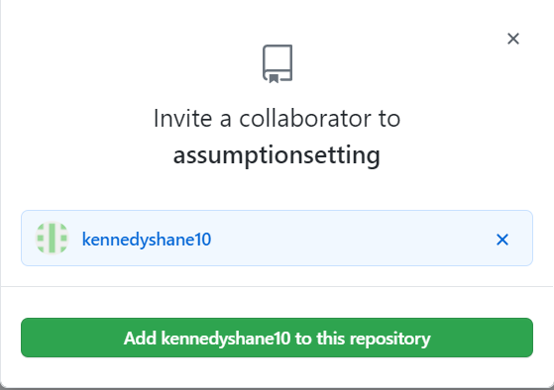
Collaborating
Inviting Collaborators

Slide 32
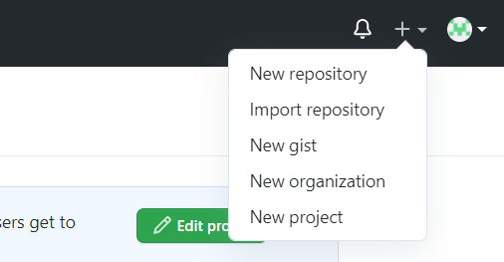
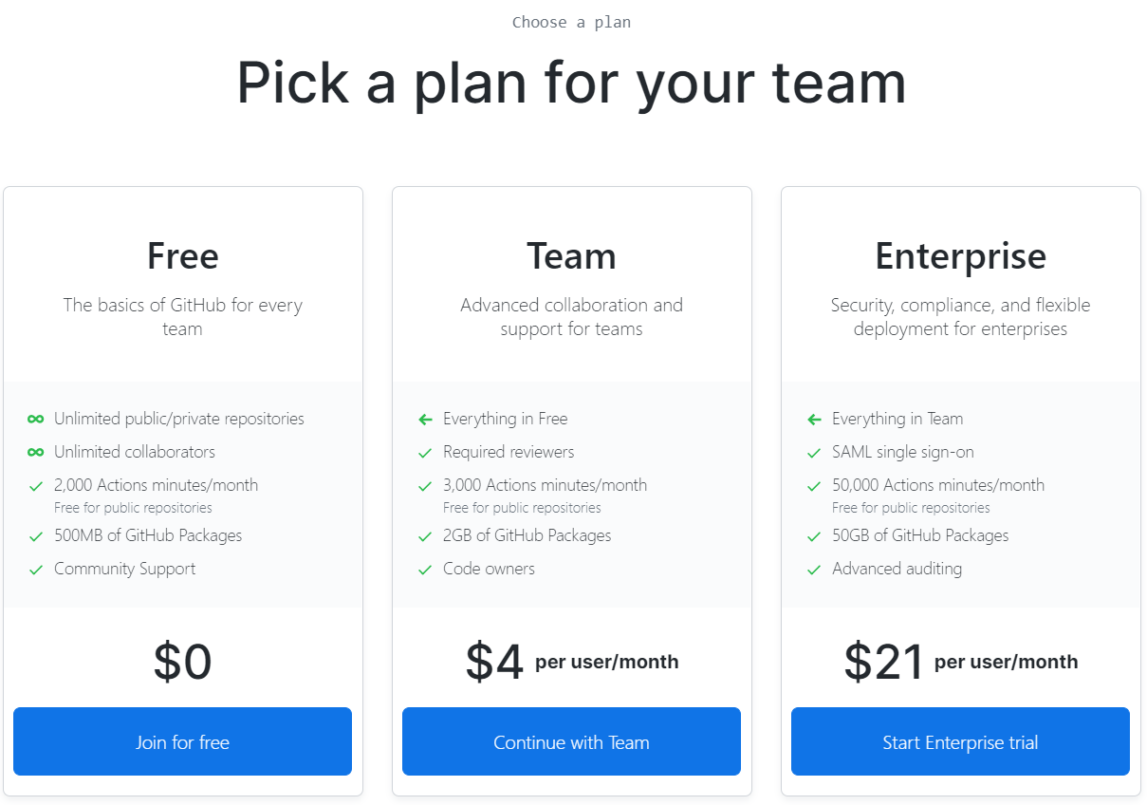
Collaborating
Creating an organization

Slide 33
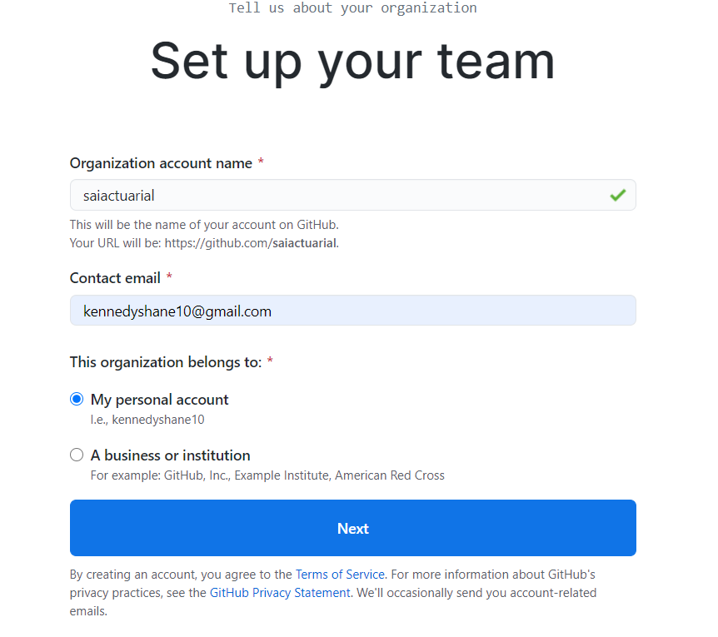
Collaborating
Creating an organization

Slide 34
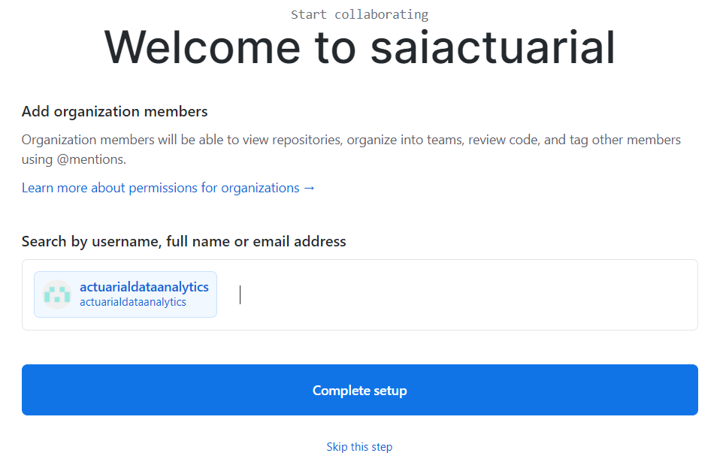
Collaborating
Creating an organization

Slide 35
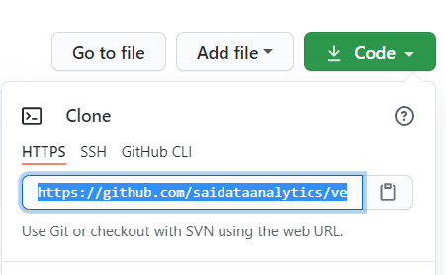
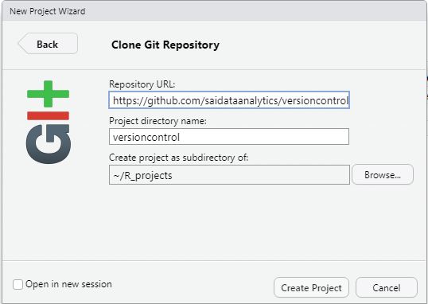
Collaborating
Clone an existing repository
R Studio: File -> New Project -> Version Control -> Git

Slide 36
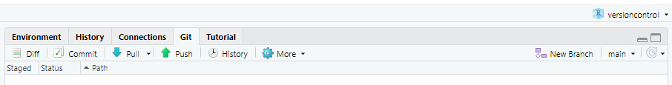
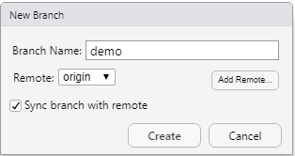
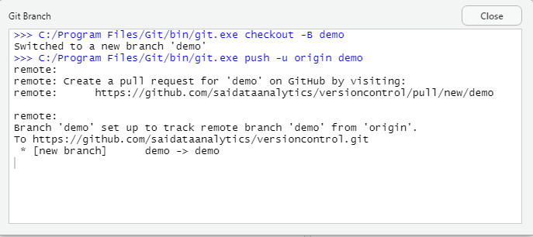
Collaborating
Creating a new branch from R Studio

Slide 37
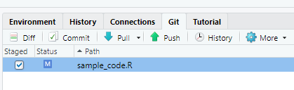
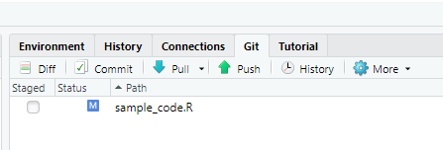
Collaborating
Edit code locally then stage, commit and push to remote host
STAGE

Slide 38
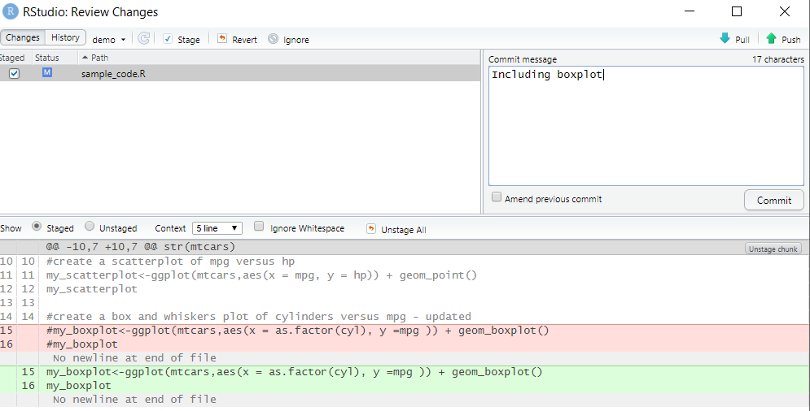
Collaborating
Edit code locally then stage, commit and push to remote host
COMMIT

Slide 39
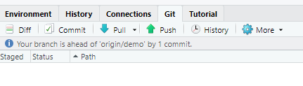
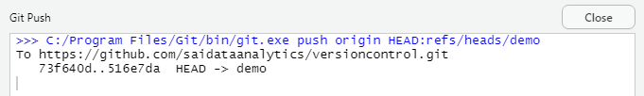
Collaborating
Edit code locally then stage, commit and push to remote host
PUSH

Slide 40
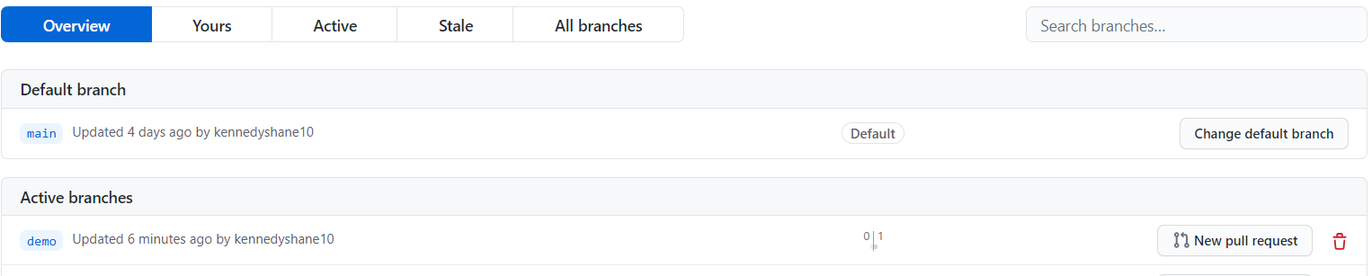
Collaborating
Edit code locally then stage, commit and push to remote host
Back to Github: https://github.com/saidataanalytics/versioncontrol/branches

Slide 41
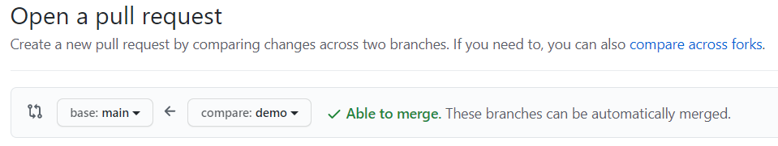
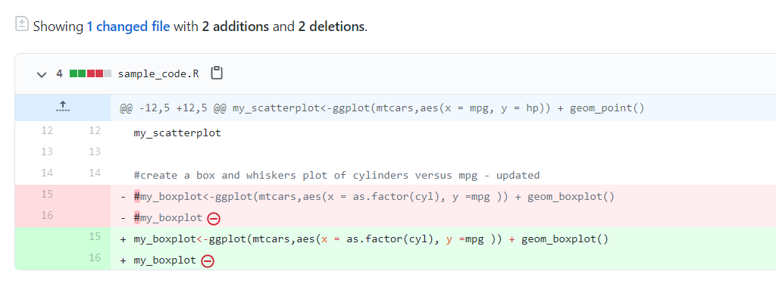

Collaborating
Pull request

Slide 42
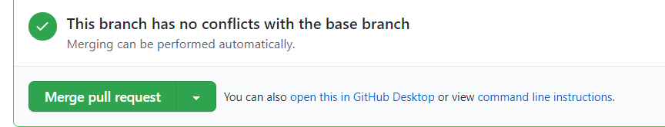
Collaborating
Merge Pull request into base branch

Slide 43
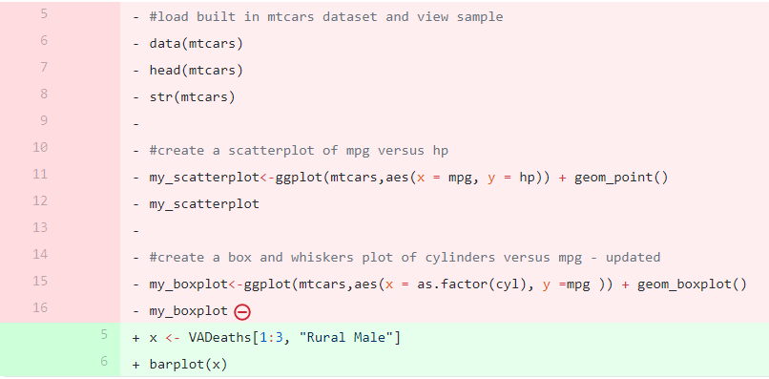
Collaborating
Create pull request with conflicts

Slide 44
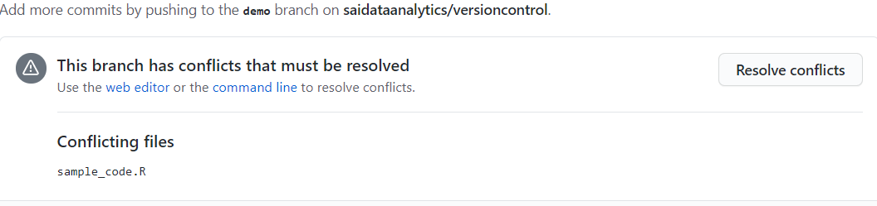
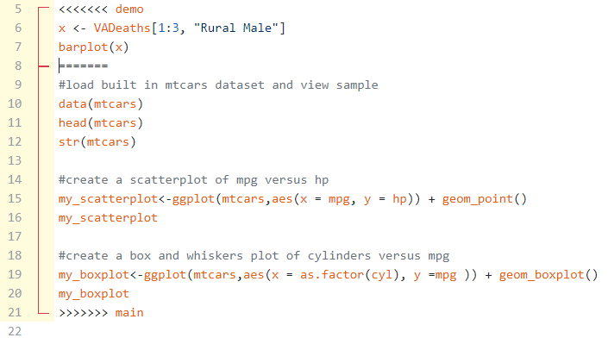
Collaborating
Resolving conflicts

Slide 45
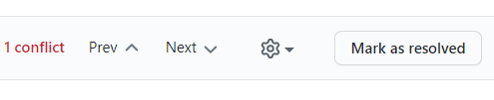
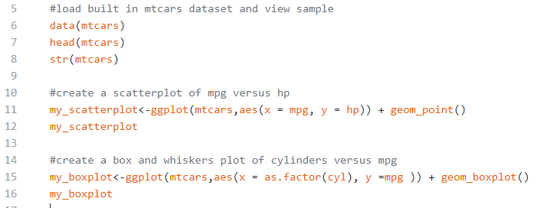


Collaborating
Resolving conflicts
Edit code in Github to resolve conflicts, then commit and merge

Slide 46
Summary
What is a version control system?
Directed Acyclic Graph
Local and Remote Hosting
Relevance for Actuaries
Risk Management
Collaboration
Commercial considerations
Demonstration
Getting set-up on a version control system (Git) and hosting service (Github)
Integrating with User Interface (R Studio)
Useful functions (create branch, stage, commit, push, pull request, resolve conflicts, merge)
Presentation and additional information available on github page:
https://github.com/saidataanalytics/versioncontrol

Slide 47
Thank you
© Society of Actuaries in Ireland

