Slide 1
welcome

Slide 2
Tools for Testing of OO Systems
Use cases
Class diagrams
Sequence diagrams
Activity diagrams
State charts

Slide 3
Sequence diagrams
A sequence diagram represents a sequence of messages passed among objects to accomplish scenario.
A sequence diagram is an interaction diagram that shows how objects operate with one another and in what order.

Slide 4
Constructing Sequence Diagram
The objects that participate in a task are listed horizontally .
The lifetime of object is represented by vertical line from top to bottom.
A dashed line on top represents object construction/activation.
An X in the end indicates destruction of the object.
The messages are represented by horizontal lines between two objects.

Slide 5
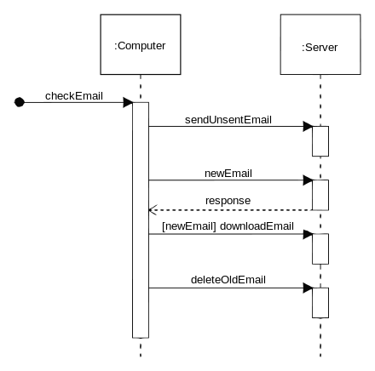
Sequence diagram of e-mail message sequence

Slide 6
sequence diagram helps in testing by :
Identify end-to-end messages.
Tracing the intermediate points in an end-to-end transaction, thereby Enabling easily narrowing down problems.
Clearly shows when objects are created and destroyed.
Limitations
Complex interaction become messy.
Requires lot of space.

Slide 7
Activity diagrams
while Sequence diagram looks at sequence of messages.
Activity diagram depicts the sequence of activities that takes place.
Used for modeling a typical work flow.
Activity diagram similar to the flow charts.

Slide 8
Activity diagrams are constructed from:
Rounded rectangles represent actions.
Diamonds represent decisions. example true or false.
Bars represent the start (split) or end (join) of concurrent activities.
A black circle represents the start (initial node) of the workflow.
An encircled black circle represents the end (final node).

Slide 9
Purpose of activity diagram
It captures the dynamic behavior of the system.
The ability to derive various paths through execution..
Ability to identify the possible messages flows between an activity and an object.

Slide 10
State Diagram
State transition testing is a black box testing technique.
state machine diagrams depict the various states that an object may be in and the transitions between those states.
States like initial, final, transition, etc.

Slide 11
Purpose of state diagram
State Transition Testing Technique is helpful where you need to test different system transitions.
Identifies the system can be in a (finite) number of different states.
Example. If a document is open, you are able to Close it. If no document is open, then “Close” is not available. A document thus has two states: open and closed.

Slide 12
THANK YOU

