Slide 1
MEMORY MANAGEMENT

Slide 2
Swapping
A process can be swapped temporarily out of memory to a backing store, and then brought back into memory for continued execution.
For e.g. Round Robin Scheduling algorithm.
Roll out, roll in – swapping variant used for priority-based scheduling algorithms; lower-priority process is swapped out so higher-priority process can be loaded and executed.
Backing store – fast disk large enough to accommodate copies of all memory images for all users; must provide direct access to these memory images.
System must maintain a ready queue consisting of all processes who are on backing store or in memory &” are ready to run.
The dispatcher checks whether the next process in the queue is in memory.
If it is not & if there is no free memory region, the dispatcher swaps out a process currently in the memory & swaps in the desired process.

Slide 3
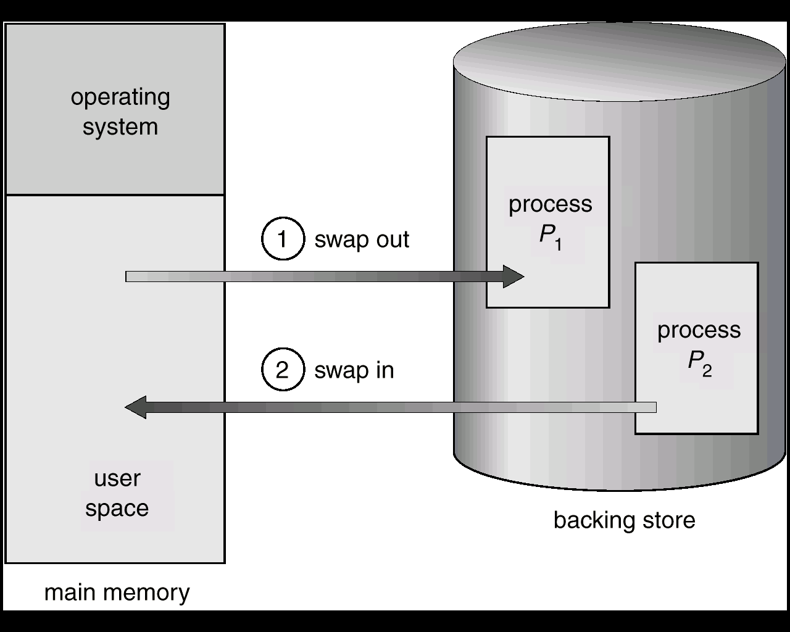

Slide 4
Contiguous Allocation
Main memory usually into two partitions:
Resident operating system, usually held in low memory with interrupt vector.
User processes then held in high memory.
In contiguous memory allocation each process is contained in single contiguous section of memory
Fixed sized partitions
Dividing memory into several fixed sized partitions.
Each partition may contain exactly one process
Initially all memory is available for user processes & is considered as one large block of available memory (hole)
When a process arrives & need memory a hole that is large enough for this process is searched.
When process is allocated space it is loaded into memory.
When a process terminates , it releases the memory.

Slide 5
Dynamic Storage Allocation
First-fit: Allocate the first hole that is big enough.
Best-fit: Allocate the smallest hole that is big enough; must search entire list, unless ordered by size. Produces the smallest leftover hole.
Worst-fit: Allocate the largest hole; must also search entire list. Produces the largest leftover hole.
First-fit and best-fit better than worst-fit in terms of speed and storage utilization.

Slide 6
Fragmentation
External fragmentation – total memory space exists to satisfy a request, but it is not contiguous.
Internal fragmentation – allocated memory may be slightly larger than requested memory; this size difference is memory internal to a partition, but not being used.
Reduce external fragmentation by compaction
Shuffle memory contents so as to place all free memory together in one large block.
Compaction is possible only if relocation is dynamic, and is done at execution time.

Slide 7
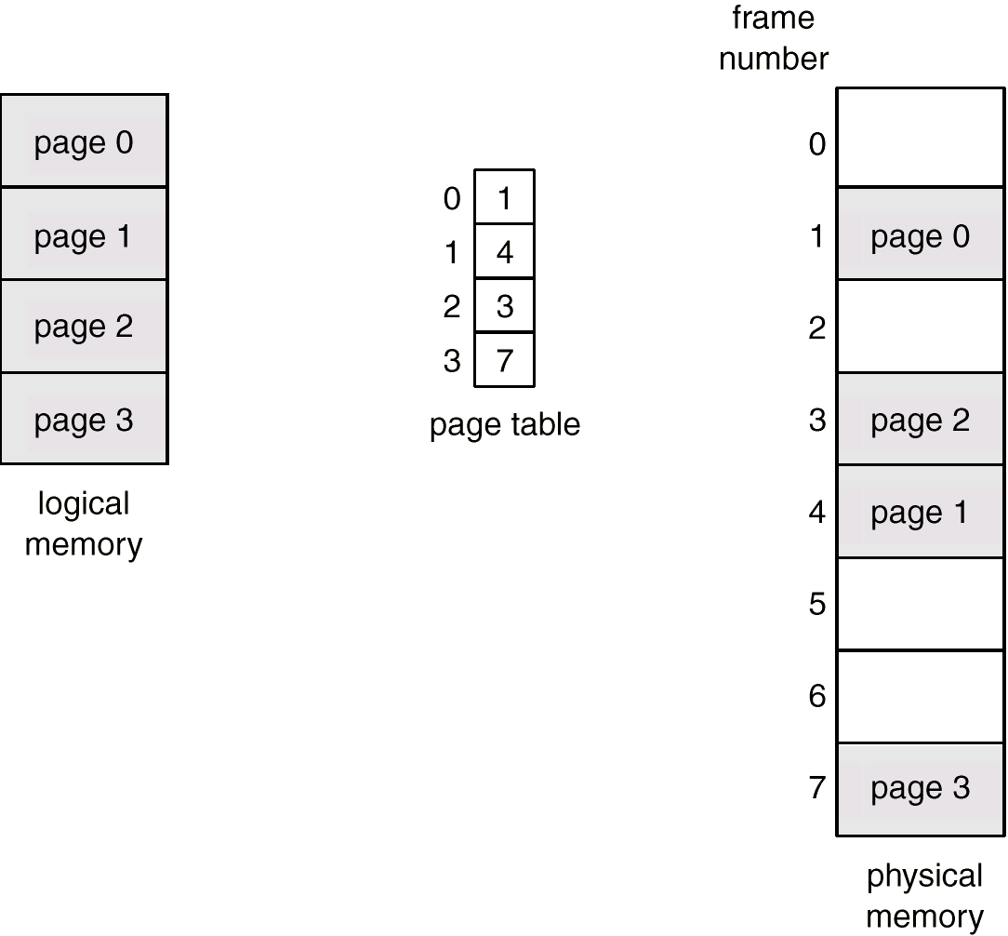
Paging
Logical address space of a process can be noncontiguous; process is allocated physical memory whenever the latter is available.
Divide physical memory into fixed-sized blocks called frames (size is power of 2, between 512 bytes and 8192 bytes).
Divide logical memory into blocks of same size called pages.
Keep track of all free frames.
To run a program of size n pages, need to find n free frames and load program.
Set up a page table to translate logical to physical addresses.
No external fragmentation
Address generated by CPU is divided into:
Page number (p) – used as an index into a page table which contains base address of each page in physical memory.
Page offset (d) – combined with base address to define the physical memory address that is sent to the memory unit.

Slide 8
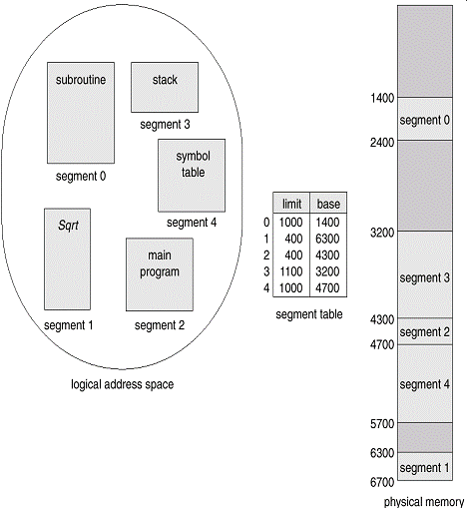
Segmentation
Memory-management scheme that supports user view of memory.
A program is a collection of segments. A segment is a logical unit such as: main program, procedure, function, local variables, global variables, common block, stack, symbol table, arrays
Segment table – maps two-dimensional physical addresses; each table entry has:
base – contains the starting physical address where the segments reside in memory.
limit – specifies the length of the segment.

