Slide 1
File-System
A file is a named collection of related information that is recorded on secondary storage
a file is a sequence of bits, bytes, lines, or records, whose meaning is defined by the file’s creator and user
A file has a certain defined structure, which depends on its type
A text file is a sequence of characters organized into lines
A source code file is a sequence of declarations, statements, and subroutine definitions
An object code file and an executable file each contain a sequence of bytes organized into headers and tables of data and code understandable by a system linker and loader
Operating System Concepts

Slide 2
File Attributes
Name – only information kept in human-readable form.
Type – needed for systems that support different types.
Location – pointer to file location on device.
Size – current file size.
Protection – controls who can do reading, writing, executing.
Time, date, and user identification – data for protection, security, and usage monitoring.
Information about files are kept in the directory structure, which is maintained on the disk.
Operating System Concepts

Slide 3
File Operations
Create-a new file is defined & position within the structure of file
Write-
Read-process reads all/ or portion of data in the file.
Delete-file is removed from the file structure & destroyed. (releases the file space & erase the directory entry)
Truncate-deletes the file but does not allow to delete the attribute of file
Open-a file is declared opened by process, allowing process to perform function on file
Close-file is closed so that process no longer can perform operations on it
Operating System Concepts

Slide 4
ACCESS METHODS
SEQUENTIAL ACCESS
A sequential access is that in which the records are accessed in some sequence i.e the information in the file is processed in order, one record after the other
READ & write make up the bulk of operations on a file.
A read operation –read Next- Reads the next portion of the file & automatically advances a file pointer , which tracks the i/o location.
A write operation- write next- appends to end of file & advances to end of newly written material
Operating System Concepts

Slide 5
2) Direct/Random access
Random access file organization provides, accessing the records directly.
Each record has its own address on the file with by the help of which it can be directly accessed for reading or writing.
Direct access is based on a disk model of a file.
The file is viewed as a numbered sequence of block or records.
Thus, after block 18 has been read, block 57 could be next, and then block 3.
There are no restrictions on the order of reading and writing for a direct access file.
Direct access files are of great use for intermediate access to large amounts of information.
The file operations must be modified to include the block number as a parameter.
Thus, we have "read n", where n is the block number, rather than "read next", and "write n", rather that "write next".
Operating System Concepts

Slide 6
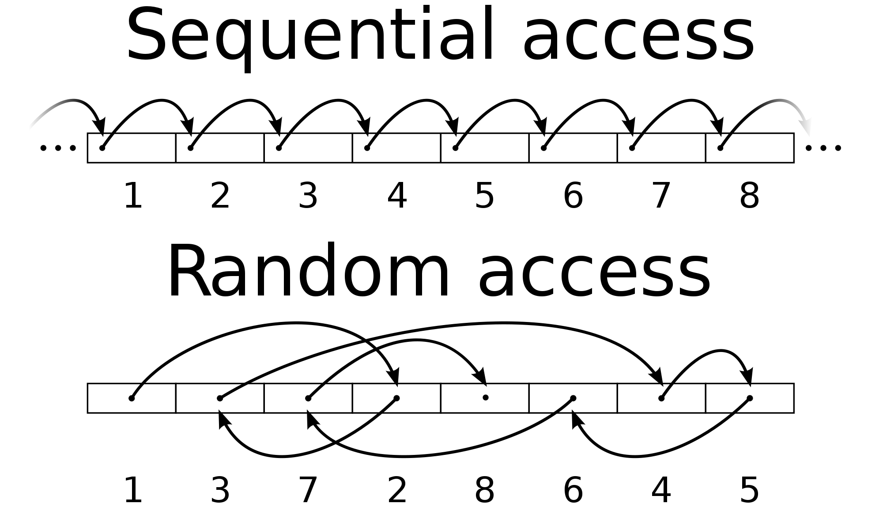
Operating System Concepts

Slide 7
Directory Structure
A collection of nodes containing information about all files.
Directory
Files
F 1
F 2
F 3
F 4
F n
Operating System Concepts

Slide 8
Operations Performed on Directory
Search for a file- search a directory structure to find the entry for a particular file.
Create a file-new files need to be created & added to the directory.
Delete a file-when a file is no longer needed , we want to be able to remove it from the directory
List a directory- we need to list the files in a directory
Rename a file-we must be able to change the name of a file when the content or use of the file changes. Renaming a file may also allow its position within the directory structure to be changed
Traverse the file system-we may wish to access every directory & every file within a directory structure
Operating System Concepts

Slide 9

Single-Level Directory
A single directory for all users.
Naming problem
Operating System Concepts

Slide 10

Two-Level Directory
Separate directory for each user
Each user gets their own directory space.
File names only need to be unique within a given user's directory.
A master file directory is used to keep track of each users directory, and must be maintained when users are added to or removed from the system.
this structure effectively isolates one user from another.
Operating System Concepts

Slide 11

Tree-Structured Directories
Operating System Concepts

Slide 12
Tree-Structured Directories (Cont.)
It allows users to create their own subdirectories & to organize their files accordingly.
The tree has root directory & every file in the system has a unique path name
Absolute or relative path name.
Absolute path name begins at root & follows a path down to the specified files.
Relative path name defines a path from the current directory
Creating a new file is done in current directory.
Delete a file
rm <file-name>
Creating a new subdirectory is done in current directory.
  mkdir <dir-name>
Example: if in current directory /spell/mail
mkdir count
mail
prog
copy
prt
exp
count
Deleting “mail” ⇒ deleting the entire subtree rooted by “mail”.

Slide 13

Acyclic-Graph Directories
Have shared subdirectories and files.
Operating System Concepts

Slide 14
Acyclic-Graph Directories (Cont.)
An acyclic graph has no cycles.
It allows directories to share subdirectories & files
With a shared file, only one actual file exists, so any changes made by one person are immediately visible to the other
Operating System Concepts

Slide 15

General Graph Directory
Operating System Concepts

Slide 16
General Graph Directory (Cont.)
It allows cycles
How do we guarantee no cycles?
  Allow only links to file not subdirectories.
  Garbage collection.
  Every time a new link is added use a cycle detection
  algorithm to determine whether it is OK.
Operating System Concepts

Slide 17
Protection
File owner/creator should be able to control:
  what can be done
  by whom
Types of access
  Read
  Write
  Execute
  Append
  Delete
  List
Operating System Concepts

Slide 18
Access Lists and Groups
Mode of access: read, write, execute
Three classes of users
RWX
a) owner access 7 ⇒ 1 1 1
RWX
b) groups access 6 ⇒ 1 1 0
RWX
c) public access 1 ⇒ 0 0 1
Ask manager to create a group (unique name), say G, and add some users to the group.
For a particular file (say game) or subdirectory, define an appropriate access.
owner
group
public
chmod
761
game
Attach a group to a file
chgrp G game
Operating System Concepts

