Slide 1


Jawaharlal Nehru Technological University Hyderabad
University College of Engineering Jagtial (Autonomous)
DEPARTMENT OF COMPUTER SCIENCE ENGINEERING
BRANCH : INFORMATION TECHNOLOGY
MAJOR PROJECT
LIP VISION
Real-Time Audio-Free Visual Speech Recognition on Consumer Hardware
with a Spatiotemporal CNN–BiGRU and an Optimised Conformer Pipeline
Under the guidance of
Mr. B. Rajesh
Assistant Professor (C), Dept. of CSE
Batch 09
Kiran Dasari | 23JJ1A1217
Shiva Jatavath | 23JJ1A1229
Sai Dattathreya K | 23JJ1A1232
Akhila Nagapuri | 23JJ1A1243
Notes:
Title slide. Introduce the team, the guide and the project name. Say that this review covers the existing Lip Vision build and the proposed Lip Vision 2.0, which serves people with many kinds of communication disability.

Slide 2
AGENDA
Contents
01
02
03
04
05
06
Abstract
Introduction
Literature Survey
Existing System
Existing Outputs
Proposed Architecture
07
08
09
10
11
12
Pipeline & Alignment
Model & Detection
Requirements
Results
Comparison
Conclusion

Slide 3
ABSTRACT
Silent lips in, text out: in real time
Lip Vision reads the silent lip movements of a speaker from an ordinary webcam and turns them into text. It uses no audio, so people who cannot produce voice can still communicate.
The existing system ran on a laptop CPU in Visual Studio Code. Its output was often “[Unclear]” because the mouth crop did not match the model's training data and decoding took 1 to 5 s.
The proposed system tracks the face in the browser, sends a small mouth crop to a free Kaggle or Colab GPU, aligns it exactly as in training and decodes with the Auto-AVSR Conformer model. Final text arrives 0.7 s to 1.5 s after the lips stop.
≈ 250 M
parameters in the Auto-AVSR model
3,291 h
of video used to train the model
< 1.6 s
decode time per sentence on a T4 GPU

Slide 4
INTRODUCTION
Problem statement and objectives
Problem
Objectives
People after a laryngectomy or with vocal cord paralysis can move their lips but cannot make sound.
Research lip readers work on clean, pre-cut clips and need powerful hardware.
Our first system was slow and often wrong in live use on a laptop.
Goal: read lips live from a webcam, with low delay, without overloading the laptop, using free resources.
▪ Prepare every frame exactly as in training: mean-face alignment, 96 × 96 patch, 25 FPS.
▪ Detect speech from lip motion alone, with no microphone.
▪ Show live partial text and a final sentence shortly after the user stops.
▪ Run the 250 M model on a free cloud GPU; keep the laptop light.
▪ Remove lag; start with one click (Kaggle) or one key (F5 in VS Code).

Slide 5
LITERATURE SURVEY
Research the system builds on
Work | Idea | Use in Lip Vision
LipNet (2016) | 3D CNN + GRU + CTC for sentences | Historical baseline
LRW, LRS3 | Large word and sentence datasets | Standard benchmarks
Conformer + joint CTC/attention | Self-attention with convolution; two decoding objectives | Encoder and decoder design
Auto-AVSR (ICASSP 2023) | Automatic labels, 3,291 h, 20.3% LRS3 WER | Recognition engine of both systems
MediaPipe Face Mesh | 478 face landmarks in real time on GPUs | Face tracking in the browser
WildVSR (WACV 2024) | Accuracy drops on video unlike LRS3 | Realistic expectations for webcams

Slide 6
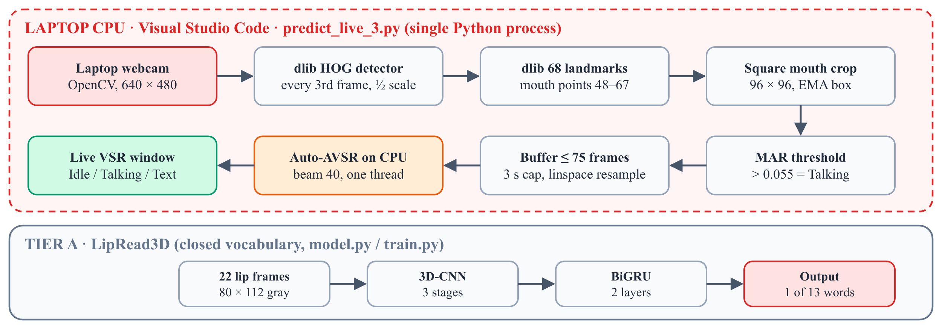
EXISTING SYSTEM · LIPVISION REPOSITORY
Version 1: laptop-only lip reading
1.44 M
parameters in LipRead3D (13 words)
681
webcam clips used for training
1–5 s
Architecture of the existing system (predict_live_3.py and LipRead3D)
CPU decode per sentence (INT8)
▪ Run in: Visual Studio Code on a laptop CPU; OpenCV window titled “Live VSR”.
▪ Segmentation: mouth aspect ratio above 0.055 = Talking; 8 still frames end the clip; at most 75 frames (3 s).

Slide 7
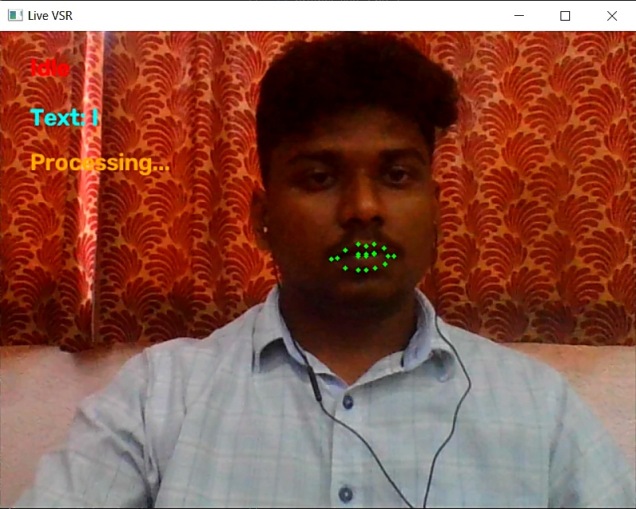
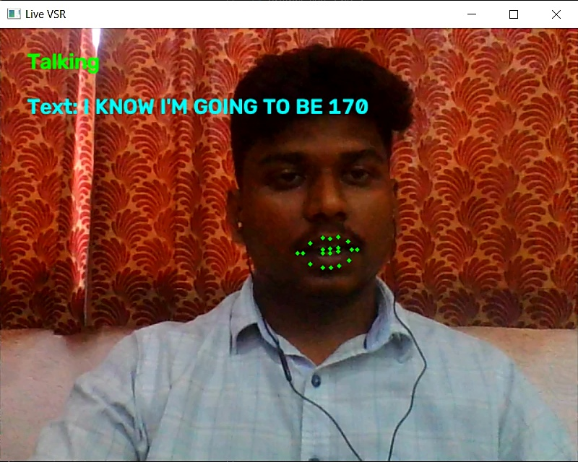
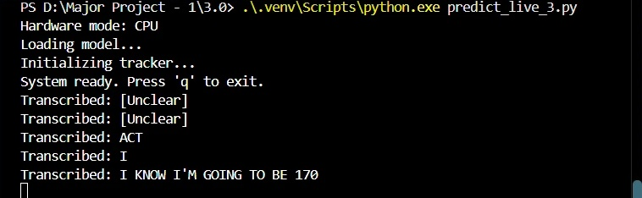
EXISTING SYSTEM · OUTPUT
What the existing system produced
Limitations
▪ Crop mismatch: box crop, not the mean-face alignment used in training.
▪ Cut sentences: fixed threshold ends clips on /p/, /b/, /m/ → “ACT”, “I”.
▪ Slow: 8–30 s FP32, 1–5 s INT8 on CPU; laptop runs hot.
▪ Closed vocabulary: 13 words; 3 s cap.
▪ Broken repo: unavailable model, removed MediaPipe API, LFS stubs.
Idle state (left) and Talking state with a sentence (right)

Slide 8
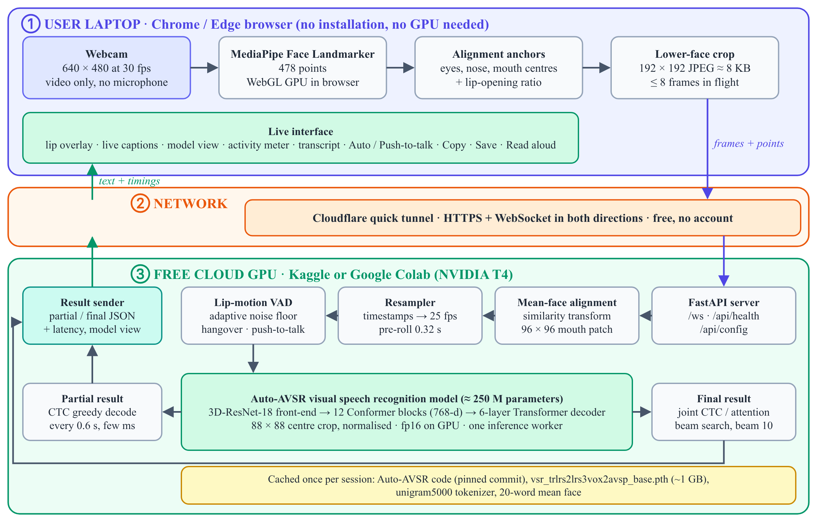
PROPOSED SYSTEM · MAJORPROJECT REPOSITORY
Complete system architecture
▪ Laptop: browser only; MediaPipe tracks 478 points; sends an 8 KB crop.
▪ Network: free Cloudflare HTTPS tunnel; one WebSocket both ways; ≤ 8 frames in flight.
▪ Cloud GPU: align → 25 FPS → speech detection → Conformer; partial and final text.

Slide 9
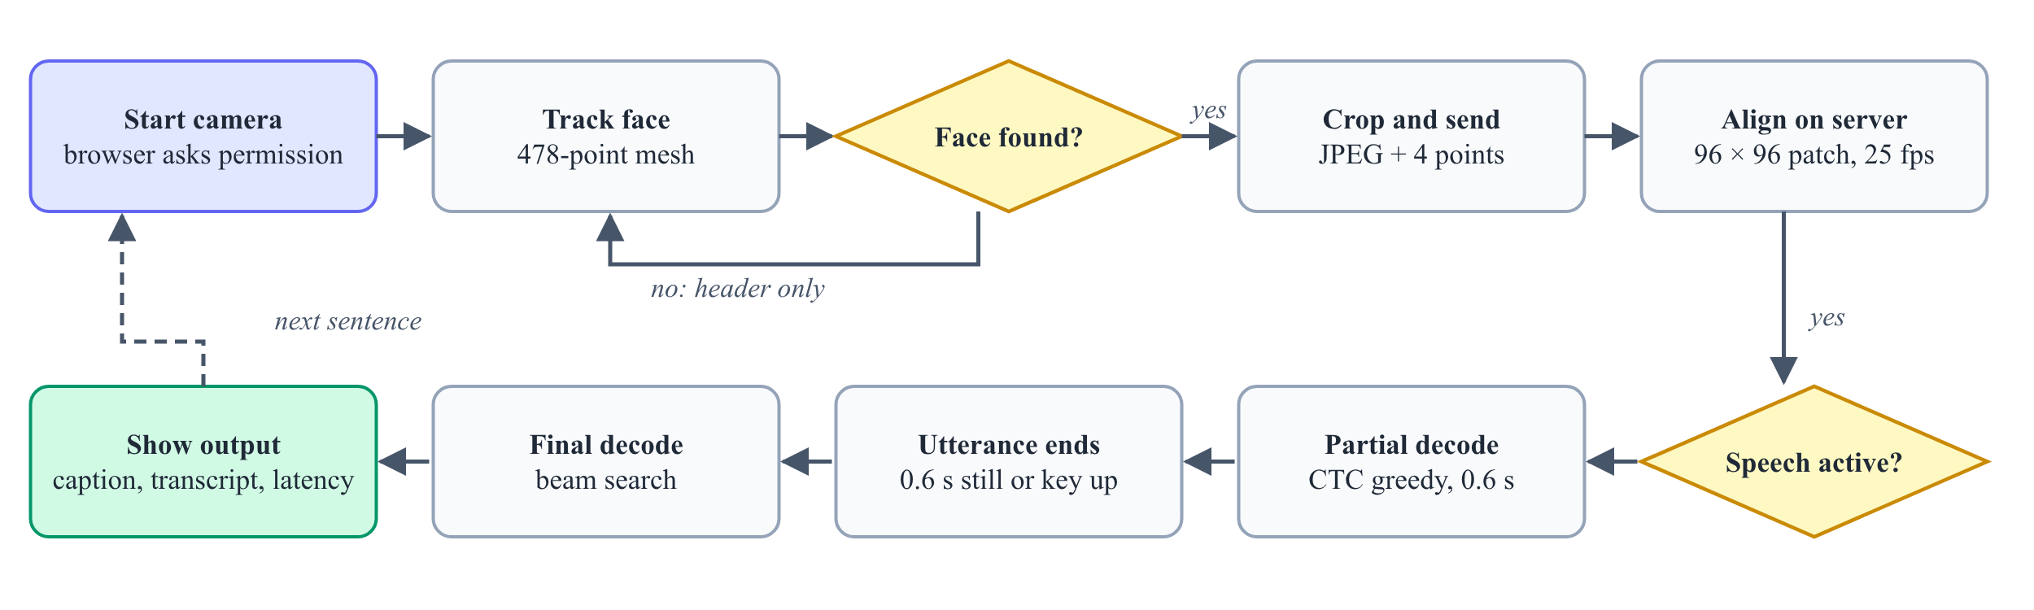
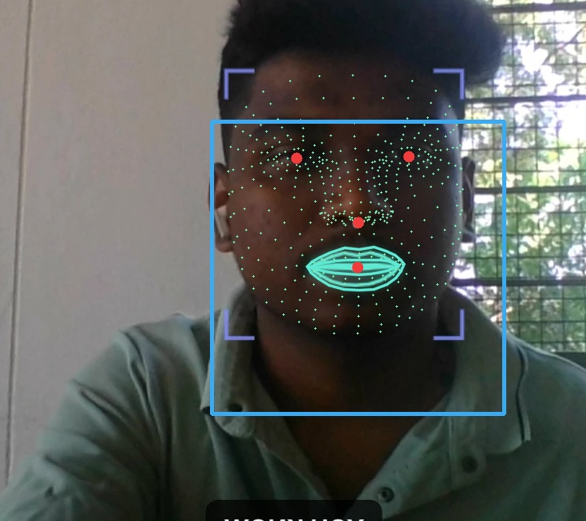
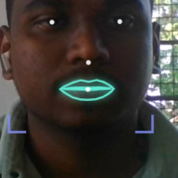
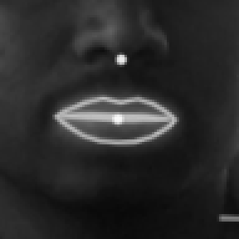
PROPOSED SYSTEM · DESIGN
From a webcam frame to a sentence
478 landmarks + 4 anchors
Input-to-output flowchart
192 × 192 crop sent
Mouth alignment. A similarity transform puts the eyes, nose and mouth on the Auto-AVSR mean face. A 96 × 96 patch is cut around the mouth and the model uses its central 88 × 88 region. Anchors are averaged over 5 frames to remove jitter.
aligned 96 × 96 patch

Slide 10
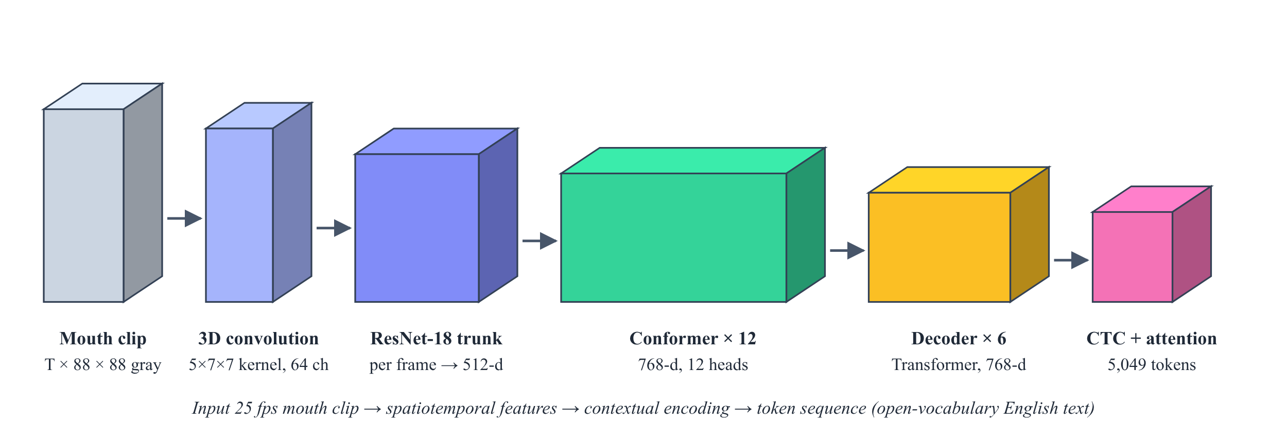
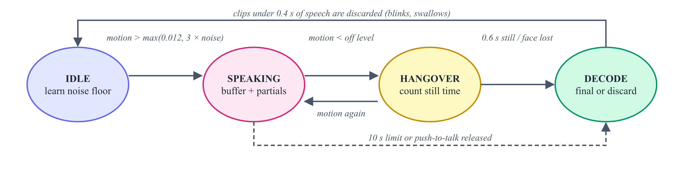
PROPOSED SYSTEM · RECOGNITION
Recognition model and speech detection
▪ Partial: greedy CTC every 0.6 s, a few ms.
▪ Final: joint CTC/attention beam search, beam 10 on GPU (4 on CPU).
▪ FP16: encoder in half precision on the T4.
▪ Detection: lip-motion energy above max(0.012, 3 × noise); ends after 0.6 s still; push-to-talk option.
Auto-AVSR visual model (≈ 250 M parameters, 3,291 h of training video)

Slide 11
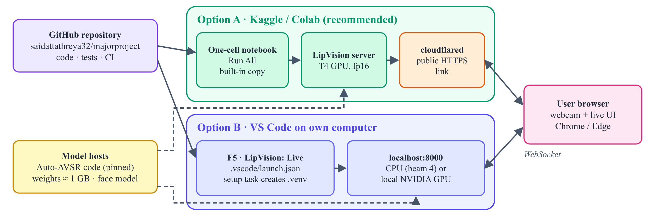
REQUIREMENTS AND DEPLOYMENT
What it needs and how it runs
Item | Specification
User computer | Any laptop with a webcam; Chrome or Edge; no GPU
Inference host | Kaggle or Colab, NVIDIA T4 (16 GB), Internet on
Software | Python 3.10+, PyTorch, OpenCV, FastAPI, MediaPipe Tasks
Local option | VS Code + Python extension; press F5
Deployment: Kaggle / Colab notebook or Visual Studio Code
▪ One cell: Run All installs, starts the server, opens the HTTPS link and shows an Open button; a built-in code copy works with a private repository.
▪ Quality: 24 automated tests run on every push through GitHub Actions.

Slide 12
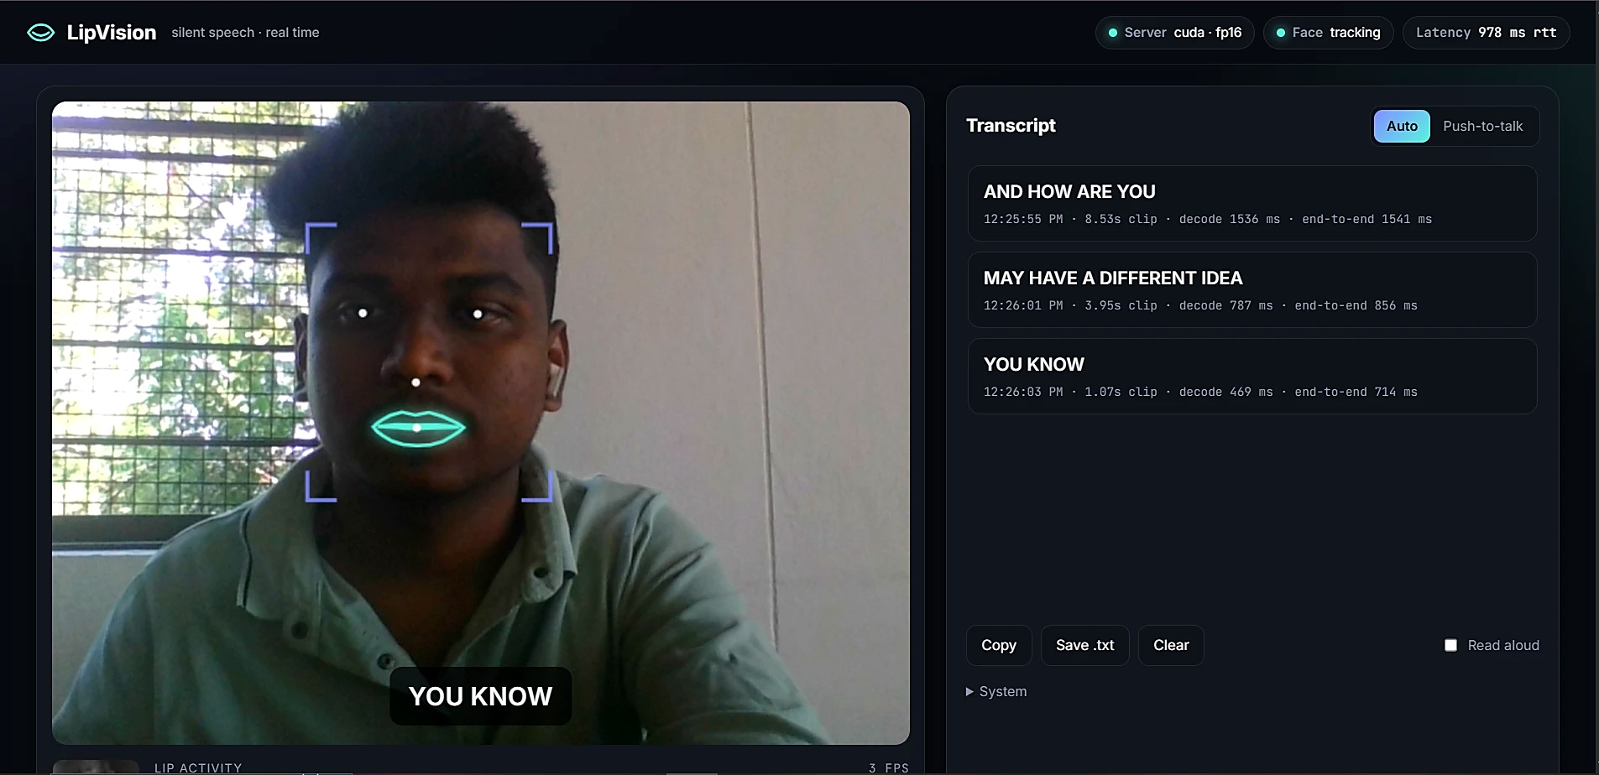
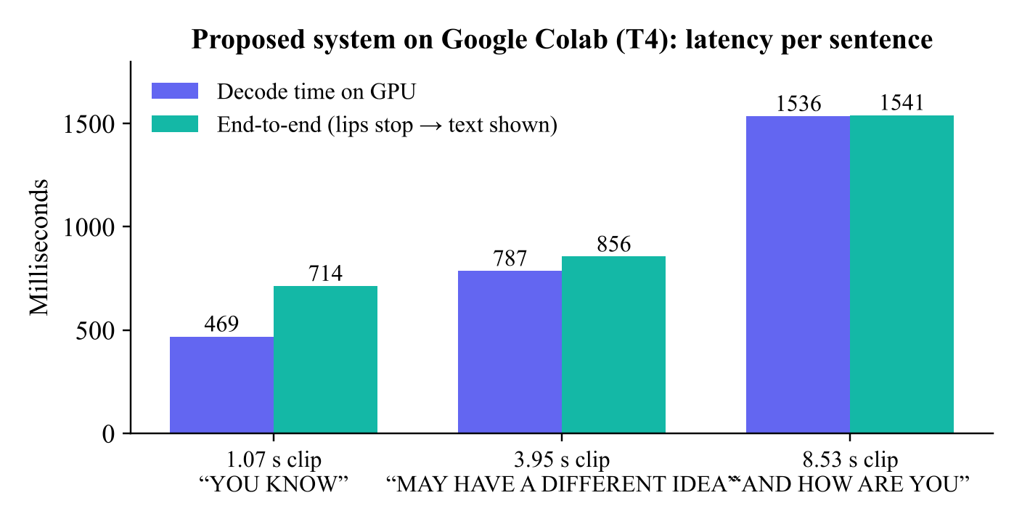
RESULTS
Proposed system live on Google Colab
▪ An 8.5 s clip decodes in 1.54 s: faster than real time.
▪ Text appears 0.71–1.54 s after the lips stop.
▪ The session ran at 3 FPS with a 978 ms round trip over the tunnel; the model expects 25 FPS, which explains most errors.
Live session: CUDA · FP16 server, lip overlay, captions and timed transcript

Slide 13
COMPARISON
Existing system versus proposed system
13 → open
1–5 s → < 1.6 s
3 s → 10 s
0 → 24
vocabulary
decode per sentence
longest utterance
automated tests
Aspect | Existing (LipVision) | Proposed (majorproject)
Runs on | Laptop CPU, VS Code | Free T4 GPU (Kaggle / Colab); browser; optional F5
Mouth crop | dlib box, not aligned | Similarity transform to training mean face
Speech detection | Fixed threshold 0.055 | Adaptive lip-motion energy + push-to-talk
Frame rate | Index spacing, 3 s cap | Timestamp resampling to 25 FPS, 10 s
Output | Final text only, often “[Unclear]” | Live partial + final, timings, model view
Lag control · setup | None · manual | ≤ 8 frames in flight · one cell or F5

Slide 14
CONCLUSION
Conclusion, future work and references
Conclusion. Lip Vision reads lips live from a webcam without audio. Training-identical alignment, lip-motion detection, 25 FPS resampling and a free cloud GPU fix the causes of the existing errors; final text arrives 0.7–1.5 s after the lips stop.
References
[1] T. Afouras et al., “LRS3-TED,” arXiv:1809.00496, 2018.
[2] P. Ma et al., “Auto-AVSR: Audio-visual speech recognition with automatic labels,” IEEE ICASSP, 2023.
[3] P. Ma, “auto_avsr,” GitHub, github.com/mpc001/auto_avsr.
[4] Y. A. D. Djilali et al., “Do VSR models generalize beyond LRS3?,” WACV, 2024.
[5] Y. M. Assael et al., “LipNet,” arXiv:1611.01599, 2016.
[6] A. Gulati et al., “Conformer,” Interspeech, 2020.
[7] S. Watanabe et al., “Hybrid CTC/attention architecture,” IEEE JSTSP, 2017.
[8] Y. Kartynnik et al., “Real-time facial surface geometry from monocular video on mobile GPUs,” CVPR Workshops, 2019.
[9] S. D. Kushanapelli and T. Mudavath, “Lip Vision,” JNTUH UCEJ, 2026, manuscript.
Future work
▪ Adaptive crop size to keep 25 FPS over slow tunnels.
▪ Measure live WER on consented speakers.
▪ Fine-tune on Indian speakers; Telugu and Hindi output.

Slide 15
Thank you
Questions and suggestions are welcome
Batch 09 · Kiran Dasari · Shiva Jatavath · Sai Dattathreya K · Akhila Nagapuri
Guide: Mr. B. Rajesh, Assistant Professor (C), Dept. of CSE
Notes:
Thank the panel and the guide.

