Slide 1

Seasonal Agriculture Performance Analysis
AICTE STU ID : STU6a6cb0045f0c31785507844
Student Name: Chillarige Sai Dedeepya
College Name: Stanley College of Engineering and Technology for Women

Slide 2

PROBLEM STATEMENT
Agricultural performance is shaped by seasonal variations in environmental conditions, resource availability, and market factors.
Raw agricultural data does not clearly reveal how performance changes across seasons.
This project investigates seasonal differences in yield, resource usage, and profitability using data analytics, to support evidence-based agricultural planning.

Slide 3
Project Description
Analyzing seasonal patterns in a 4,000-record farm dataset
Dataset: 4,000 farm records across 3 seasons (Kharif, Rabi, Zaid), 8 states, 10 districts, and 8 crops.
Variables cover environment (rainfall, temperature, humidity), resources (fertiliser, water, irrigation method), and economics (cost, revenue, profit).
Objective: clean and explore the data, compare performance across seasons, examine relationships between environmental/resource factors and yield, apply statistical testing, and derive evidence-based insights and recommendations.

Slide 4

WHO ARE THE END USERS?
Farmers - deciding which season and crop to prioritize
Agricultural planners and policymakers - regional resource allocation
Agri-business analysts - profitability and market planning
Researchers - studying seasonal crop performance patterns

Slide 5

Technology Used
  Python (Google Colab)
pandas, numpy - data cleaning and manipulation
matplotlib, seaborn - visualization
scipy.stats - statistical hypothesis testing

Slide 6
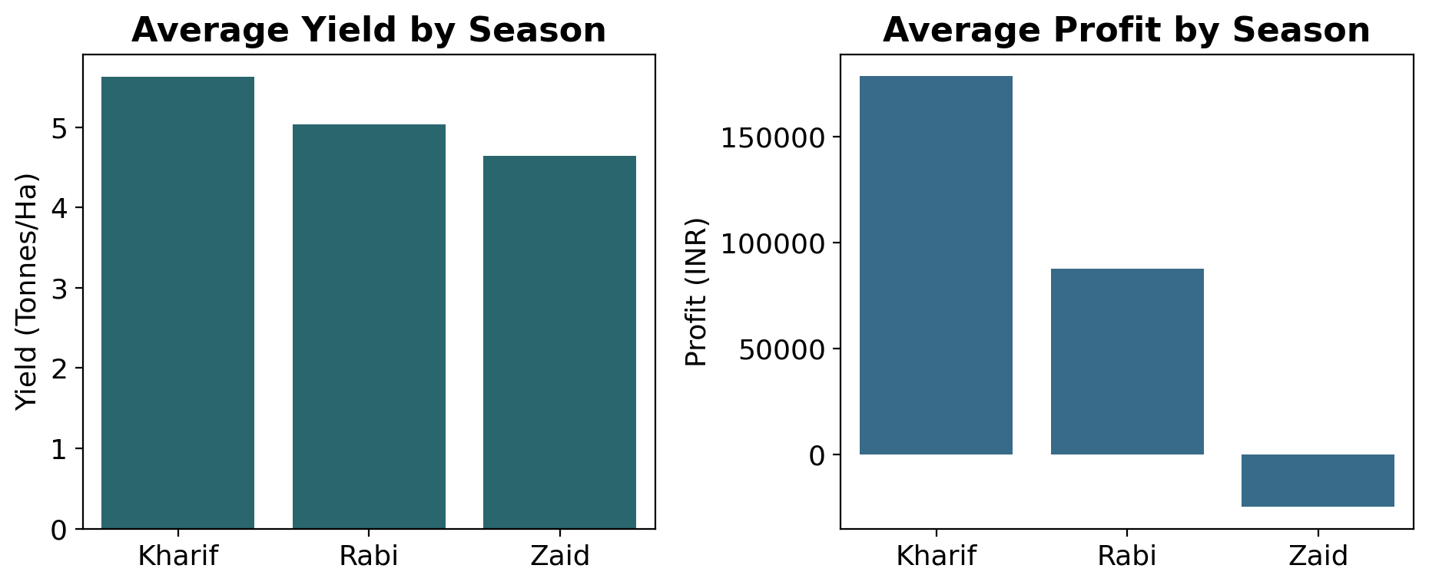
Results: Seasonal Performance
Kharif season leads in both average yield (5.64 T/Ha) and average profit (Rs 178,914.65)
Zaid season is the weakest: lowest yield (4.67 T/Ha), highest water use, lowest water efficiency, and negative average profit (Rs -24,804.82)
Kruskal-Wallis test confirms the difference is statistically significant (p < 0.05)

Slide 7
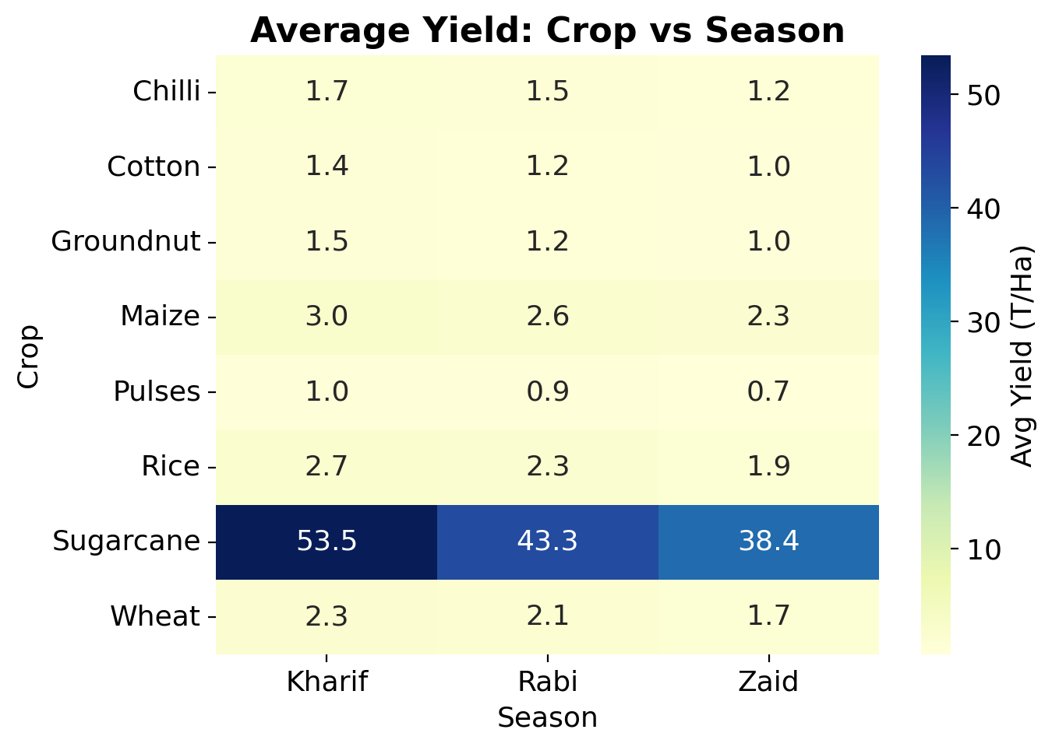
Results: Crop Performance
Sugarcane dominates both yield (46.94 T/Ha) and profit (Rs 817,187.99), far ahead of every other crop
Wheat, Rice and Maize show negative average profit despite decent yields, since their market prices are much lower than Sugarcane's or Chilli's
Yield alone does not guarantee profitability

Slide 8
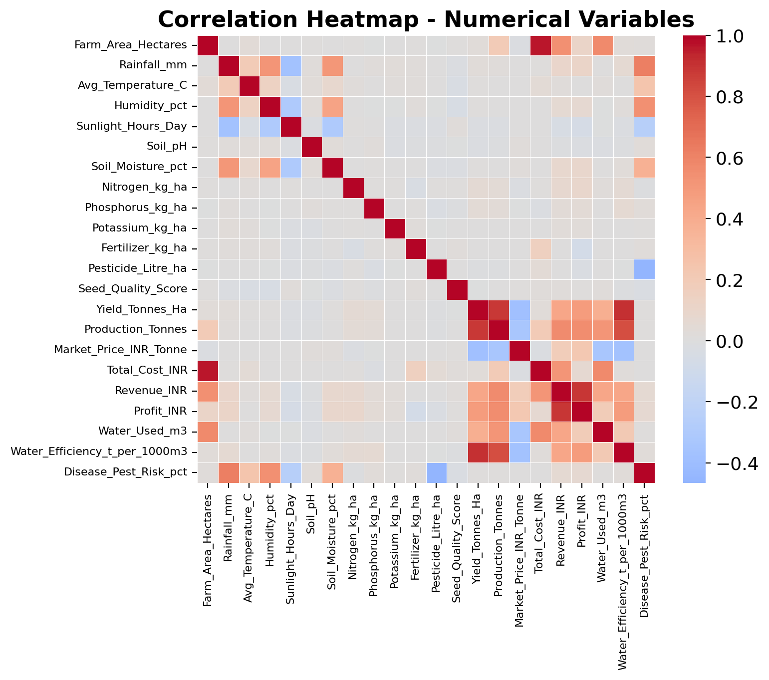
Results: Correlation & Environment
Individual environmental factors (Rainfall, Temperature, Humidity, Sunlight) show almost no correlation with Yield (all between -0.015 and 0.031)
Water Efficiency correlates much more strongly with Yield (0.915) than raw Water Used (0.389)
Strongest correlation overall: Farm Area & Total Cost (0.962) - larger farms cost more to run

Slide 9
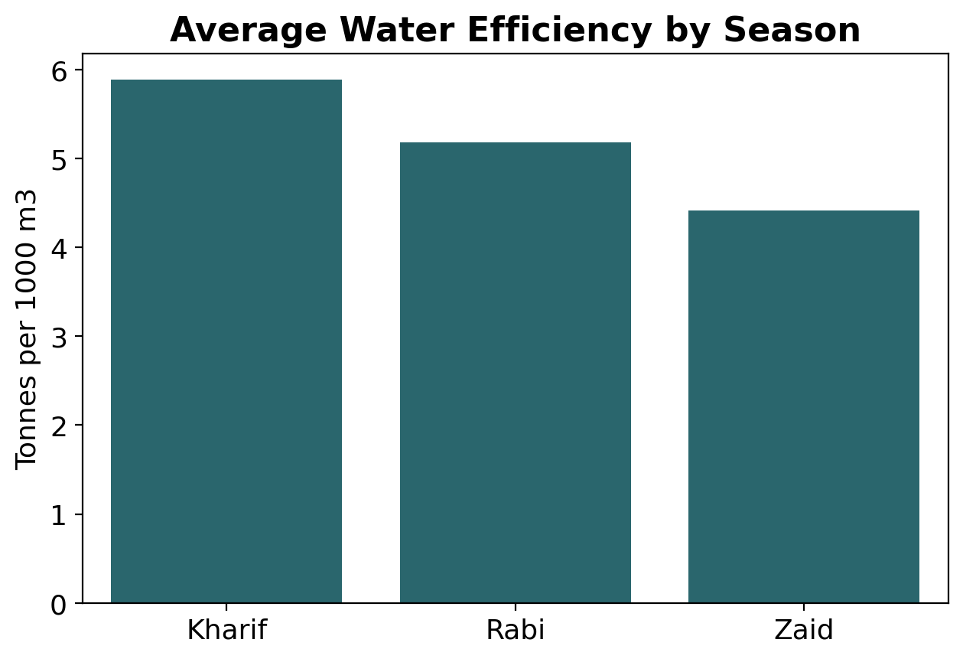
Results: Resource Efficiency & Geography
Zaid season uses the most water (6,419.89 m3) but has the lowest water efficiency (4.41 T per 1000 m3)
Punjab has the highest average yield (6.12 T/Ha) and profit among states; Andhra Pradesh has the lowest yield
Fertiliser, pesticide, and seed quality show almost no correlation with yield on their own

Slide 10
Key Insights
Kharif season outperforms Rabi and Zaid on nearly every metric (statistically confirmed, p < 0.05)
Sugarcane is an outlier crop, skewing overall yield and profit averages upward
Yield and profit don't always move together - Wheat, Rice and Maize show high yield but negative profit
Water efficiency matters more than water volume for predicting yield
Environmental factors (rainfall, temperature, humidity, sunlight) alone are weak predictors of yield in this dataset

Slide 11
Recommendations
Prioritize Kharif-season cultivation where feasible
Investigate Zaid season's low water efficiency and negative profit before scaling it up
Re-evaluate cost structure for Wheat, Rice and Maize despite their reasonable yields
Focus resource management on efficiency (output per unit input) rather than raw volume

Slide 12
Limitations & Conclusion
Limitations: single-season snapshot (no multi-year trend), limited to 8 states, observational data (correlation is not causation), some missing values were median-imputed
Conclusion: Kharif season and efficient water use emerge as the strongest patterns linked to better agricultural performance in this dataset
Findings are associative, not causal, and should guide - not replace - further ground-level agricultural investigation

Slide 13
GitHub Link
https://github.com/saidedeepya78/Seasonal-Agriculture-Performance-Analysis

Slide 14

VOIS Course completion certificate -
Course name- Data Visualization

Slide 15
Thank you
.
.

