Slide 1

Face Emotion Recognition
Anuja Prakash Kolse
Saideep Samineni
Aishwarya Kumar Arvind
Rohith Chandra Kandambeth

Slide 2
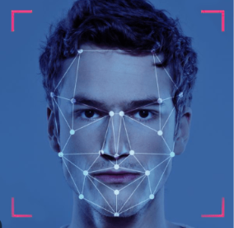
Contents
Introduction
Procedure
Dataset
Pre-processing
Modeling
Results
Conclusion
Future Work

Slide 3
Introduction
Purpose of Emotion Detection:
Enhance user experience in human-computer interactions (HCI).
Applications:
Mental health diagnostics
Customer service
Adaptive learning.

Slide 4
Introduction
This project aims to create a Machine Learning (ML) model that can detect and classify emotions from facial images. It involves identifying key facial features and linking them to emotions like happiness, sadness, anger, and more. The goal is to develop an efficient model using advanced ML techniques for accurate emotion detection, evaluated by its accuracy and adaptability.

Slide 5
Project Workflow
Images dataset
Embeddings
Final transformed embeddings
Classifier
Result analysis
Run the images through pre-trained models
Try transforming the data to reduce dimensionality
Fit the embeddings to different models (SVM, MLP)
Use the trained classifier to predict on test dataset
Analysis on predicted classes based on evaluation metrics
1
2
3
4
5

Slide 6
Dataset
Datasets selected have a comprehensive coverage of facial expressions under varied conditions.
Datasets Employed:
Expression in-the-wild (ExpW)
Facial Expression Recognition 2013 (FER2013)
Features of Datasets:
ExpW: Real-world, spontaneous expressions.
FER2013: Grayscale images, consistent expression labeling across diverse demographics.

Slide 7
Pre-processing
Data cleaning
Feature Engineering
Normalization
Removing duplicates, normalizing labels.
Extraction of facial landmarks, intensity features.
Reduction of dimensionality and noise via PCA.
Standardization (zero mean, unit variance) to optimize SVM performance.

Slide 8
Feature extraction
FaceNet reps
This model directly learns a mapping from face images to a compact Euclidean space where distances directly correspond to a measure of face similarity.
Dimensionality - 512
VGG face reps
It is a pretrained model which uses deep convolutional neural network.
Dimensionality - 4096

Slide 9
Feature transformation (PCA)
FaceNet reps
Actual dimensionality - 512
Transformed Dimensionality - 50
VGG face reps
Actual dimensionality - 4096
We did not reduce it as we didn’t achieve good results for FaceNet

Slide 10
Modeling: SVM
Rationale for choosing SVM: capability to effectively model high-dimensional data.
Configuration and Optimization:
Kernel tricks to handle non-linear relationships.
Parameter tuning (C, gamma) using grid search.
Cross-Validation:
N-fold cross-validation to ensure stability and reliability of the model predictions.

Slide 11
Modeling: MLP
Rationale for choosing MLP: Simple neural network with faster processing
Configuration and Optimization:
Hidden layer sizes
Activation function
Solver, Alpha, Learning rate
Cross-Validation:
N-fold cross-validation to ensure stability and reliability of the model predictions.

Slide 12
Data Augmentation
Implemented to increase robustness through rotations, translations, scaling, shearing, flipping, color perturbation, and noise injection.
Aims to train models on images in varied scenarios, mimicking different orientations, movements, distances, and environmental conditions.
Despite intentions to improve generalization, augmentation resulted in lower test accuracies for both SVM and MLP models.
Possible causes include a significant divergence between the training and test data distributions or the models' insufficient complexity to handle the enhanced dataset variance.

Slide 13
Challenges
Human emotions are complex, subtle, and highly subjective
Variability due to cultural, contextual, and individual differences
Failure in detection while generating embeddings
Hyperparameter tuning (Every run took a lot of time)
Class imbalance in datasets

Slide 14
Results: SVM with FaceNet reps
 | Training | Testing
Precision | 0.98 | 0.60
Recall | 0.98 | 0.58
F1 Score | 0.98 | 0.59
Accuracy | 0.98 | 0.57

Slide 15
Results: SVM with VGG reps
 | Training | Testing
Precision | 0.99 | 0.68
Recall | 0.99 | 0.60
F1 Score | 0.99 | 0.62
Accuracy | 0.99 | 0.68

Slide 16
Results: MLP with FaceNet reps
 | Training | Testing
Precision | 0.71 | 0.42
Recall | 0.71 | 0.44
F1 Score | 0.71 | 0.43
Accuracy | 0.69 | 0.45

Slide 17
Results: MLP with VGG reps
 | Training | Testing
Precision | 0.99 | 0.63
Recall | 0.99 | 0.58
F1 Score | 0.99 | 0.60
Accuracy | 0.99 | 0.65

Slide 18
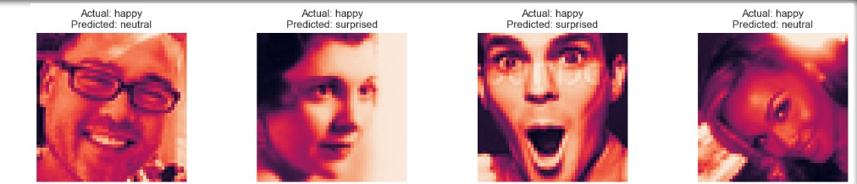
Analysis of Misclassified Cases
Neutral Instead of Happy: The classifier incorrectly identified a 'happy' expression as 'neutral'. The flatness of the lips, which lacked the characteristic upward curve of a smile, likely contributed to this misinterpretation.
Surprised Instead of Happy: A facial expression intended to show happiness was misclassified as 'surprised'. The presence of widened eyes, which are typically associated with surprise, might have overshadowed the subtle signs of a smile.
Surprised Instead of Happy (Repeated Issue): In a similar error, another 'happy' expression was wrongly classified as 'surprised', indicating a pattern where the classifier confuses the facial cues of happiness with those of surprise.
Neutral Instead of Happy (Repeated Issue): Another instance where an expression meant to convey happiness was classified as 'neutral'. Again, the minimal lip movement and absence of a distinct smile curve were likely factors in this misclassification.

Slide 19
Conclusion
SVM's efficacy in classifying complex emotional states from facial expressions.
SVM model fares well as compared to MLP model.
VGG face reps are better indicators of face emotions than FaceNet reps.
Positive emotions such as Happy, Surprised and negative emotions such as Sad, Anger might have closer face reps and thus tend to get misclassified more often than others.

Slide 20
Future Work
Exploration of deep learning models
Real-time implementation in interactive systems
Increasing the size of dataset by either custom augmentation techniques or collecting new samples, especially for classes which have lesser number of images

Slide 21
DEMO

Slide 22
