Slide 1

Power Electronics Applications to Power Systems (EE26005) Assignment - 1
National Institute of Technology Warangal
Department of Electrical Engineering
By
Name : sai deepak kothula
Roll no : 24eem2s03
Specialization: power system engineering

Slide 2
QUESTION 1
Simulate a single-phase PWM rectifier with hysteresis current controller. The rectifier is fed from a 230 V, 50 Hz supply and the output dc voltage is regulated at 500 V. The rectifier must draw a sinusoidal current (THD must be <5%) with unity power factor. Observe the supply current waveform by connecting a second order (100 Hz) notch filter in the measurement of dc voltage. Also, observe regeneration capability of rectifier.

Slide 3
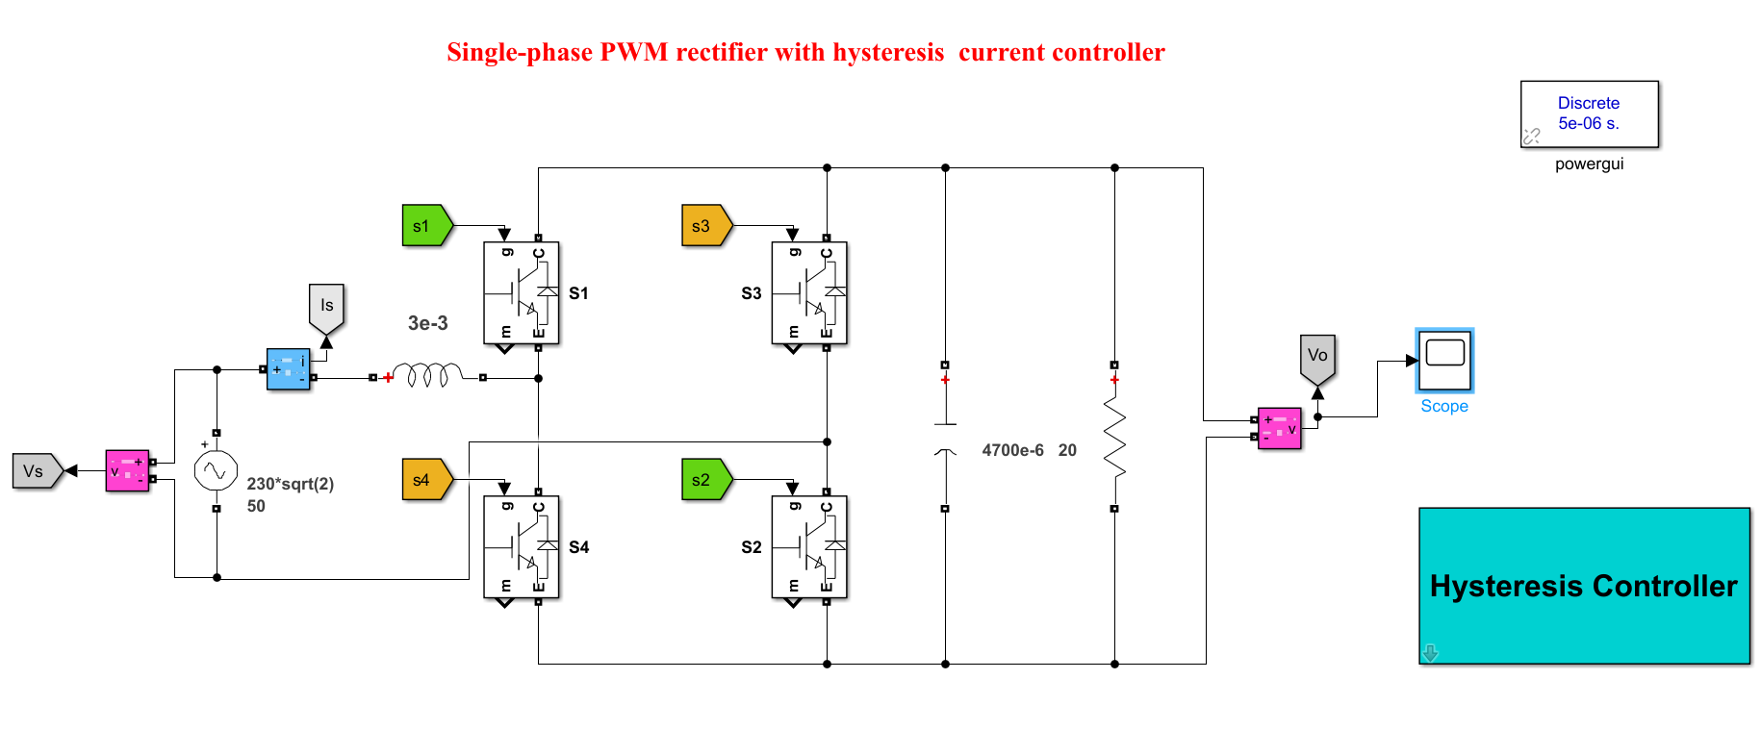
1-ϕ PWM Rectifier Simulink

Slide 4
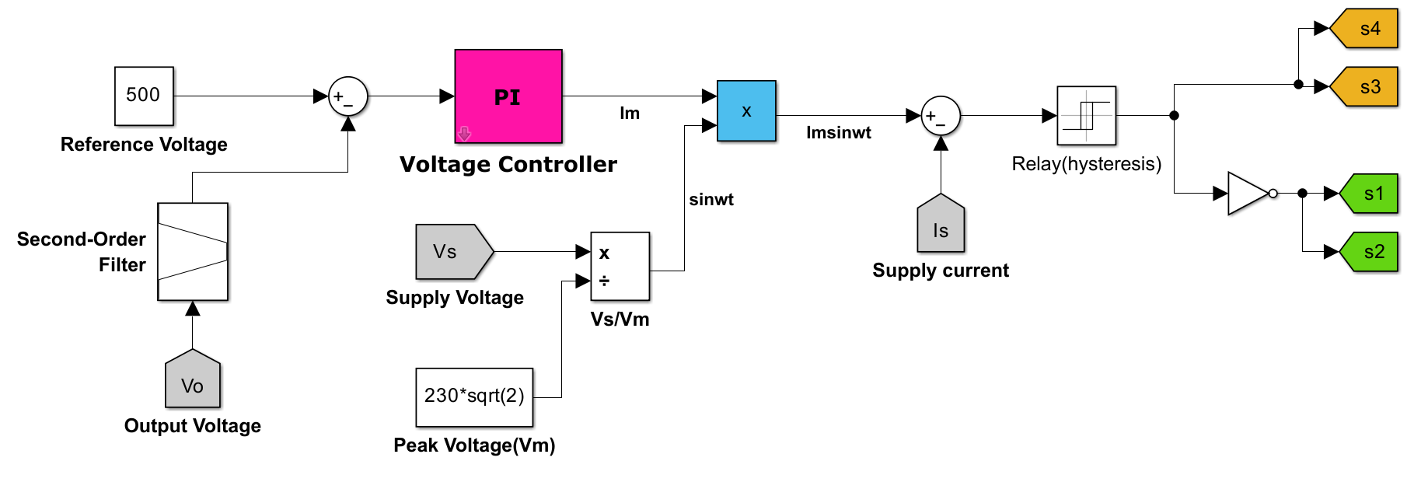
Hysteresis controller

Slide 5
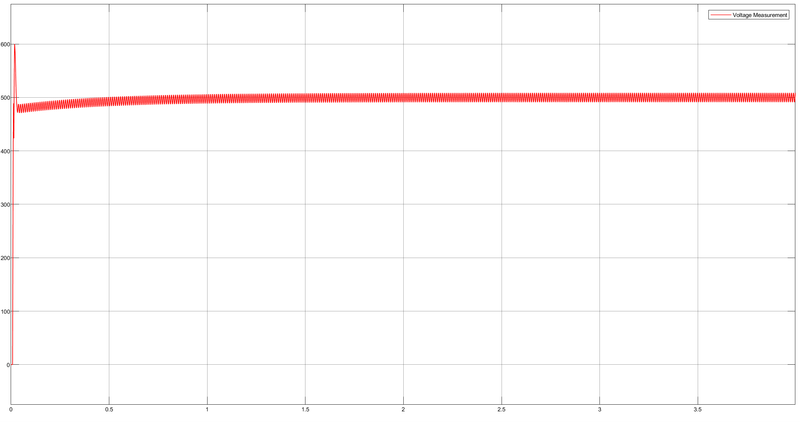
Output Voltage

Slide 6
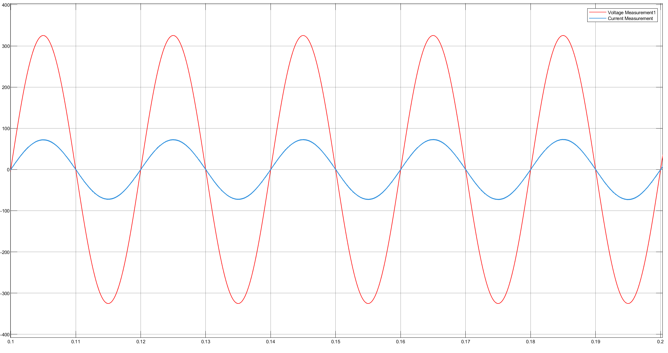
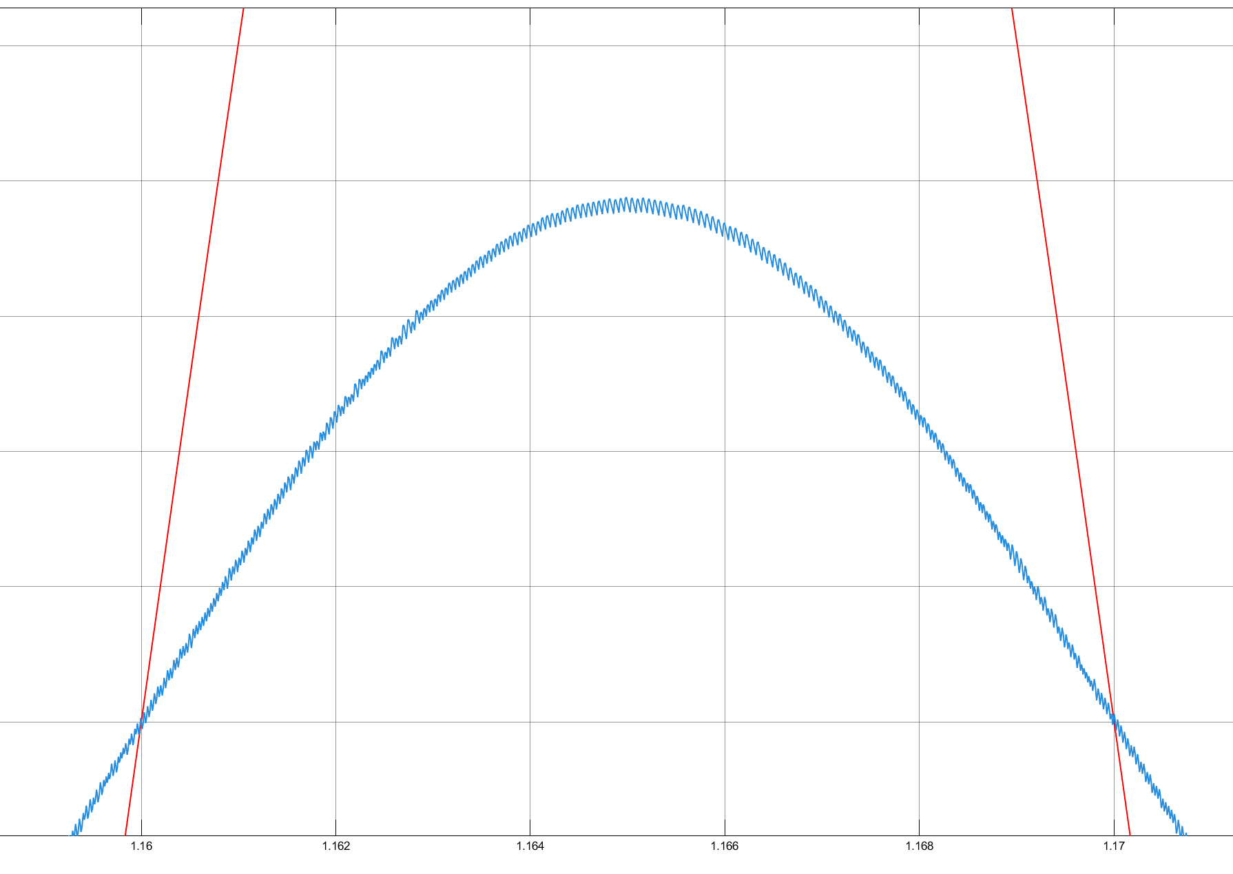
Supply voltage and current

Slide 7
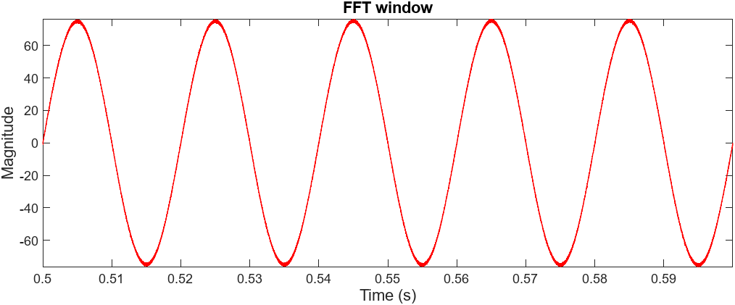
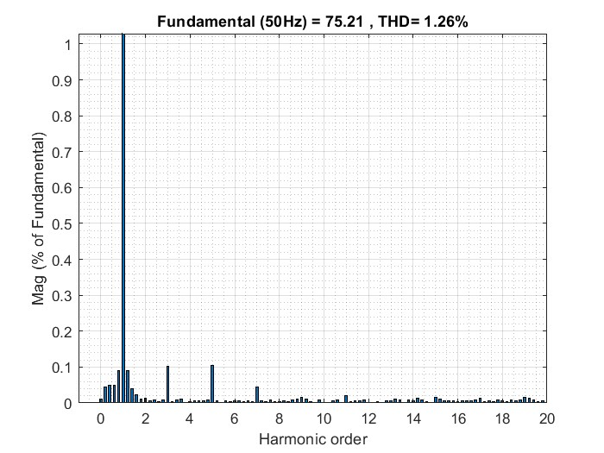
THD Analysis

Slide 8
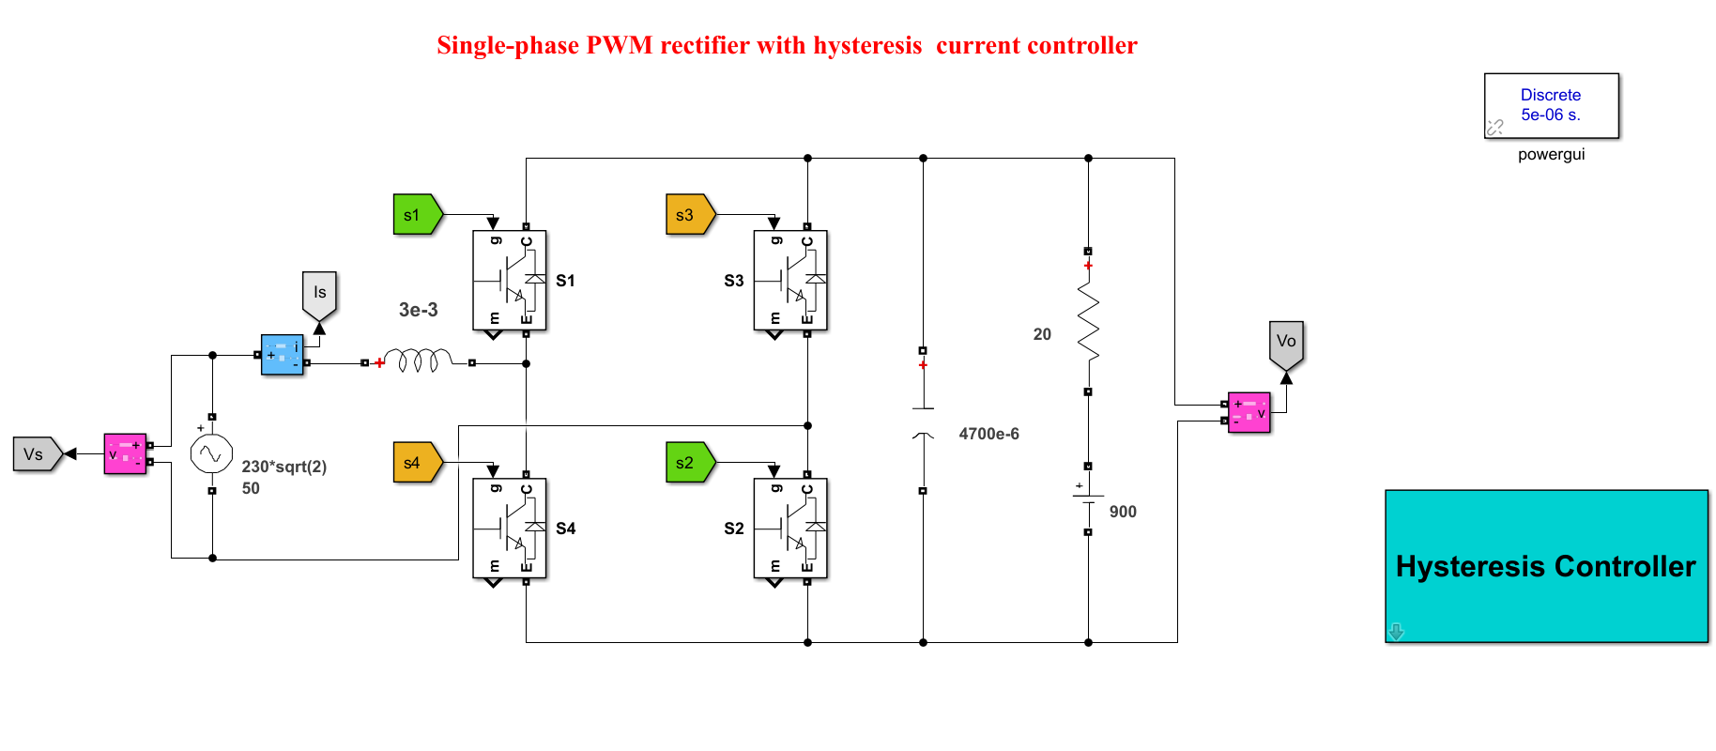
Regeneration capability of rectifier

Slide 9
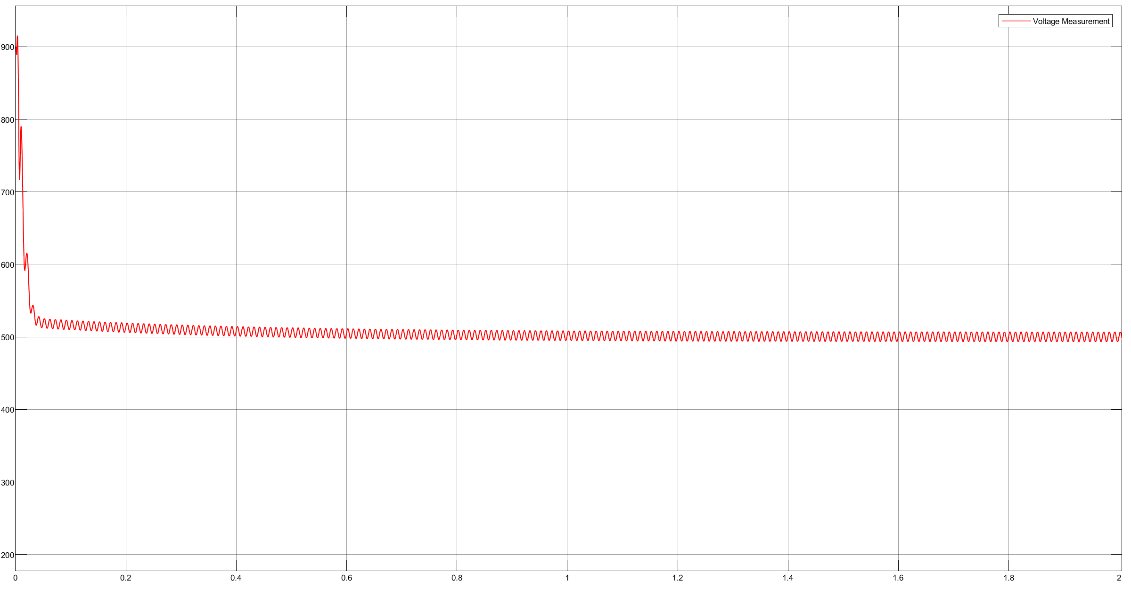
Output Voltage

Slide 10
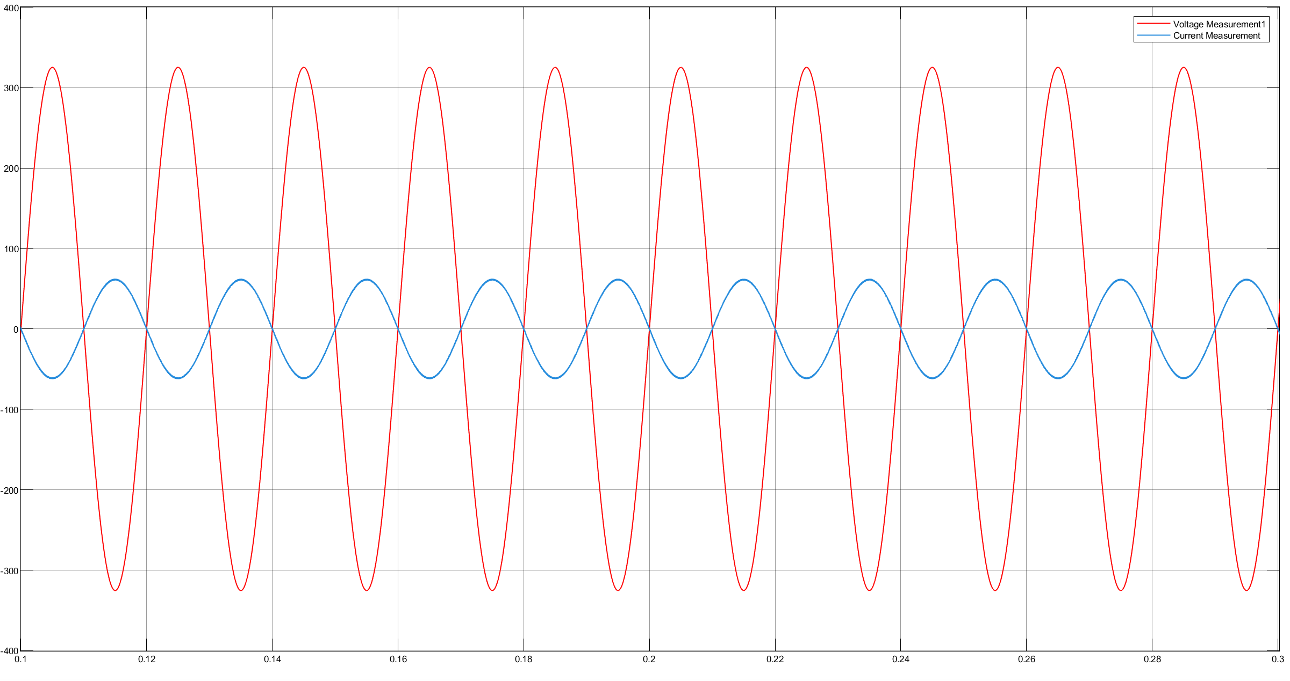
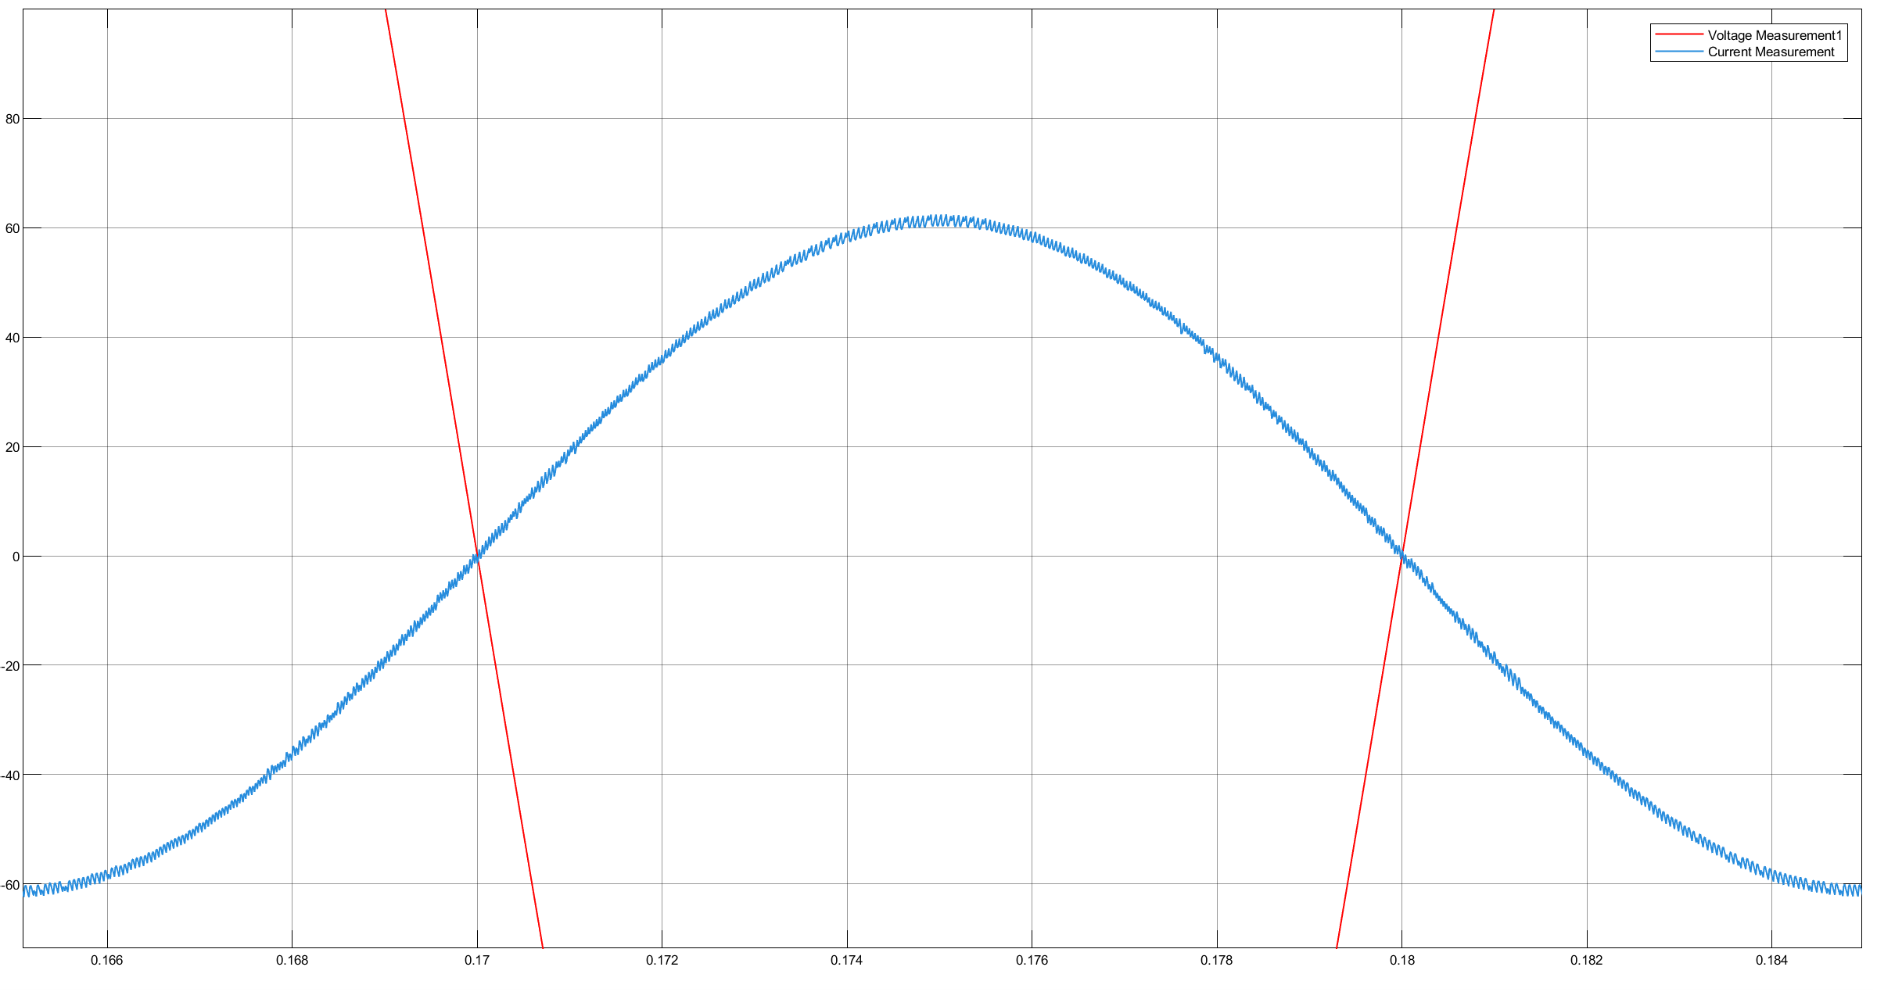
Supply voltage and current

Slide 11
Question 2
Simulate three-phase five-level cascade H-bridge multilevel inverter using phase-shifted pulse width modulation technique. Assume carrier frequency is 2 kHz.

Slide 12
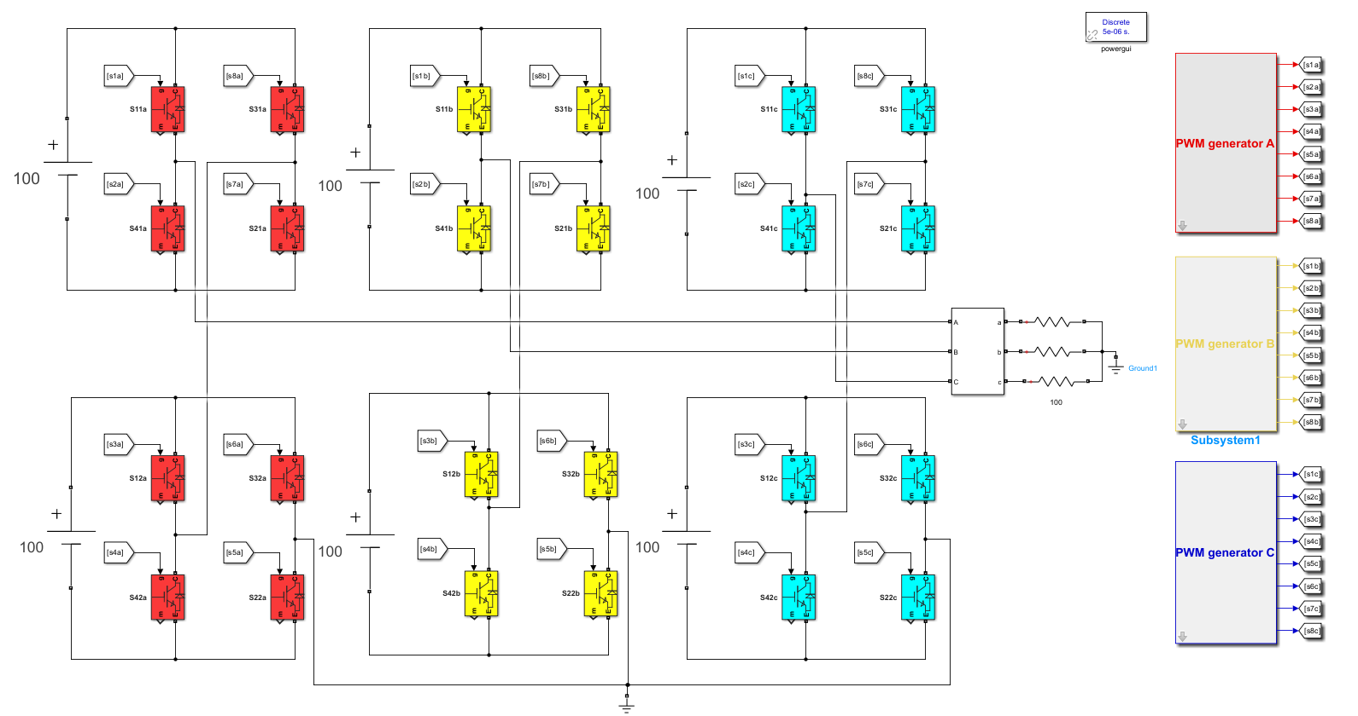
3-ϕ 5-level CHB MLI Simulink

Slide 13
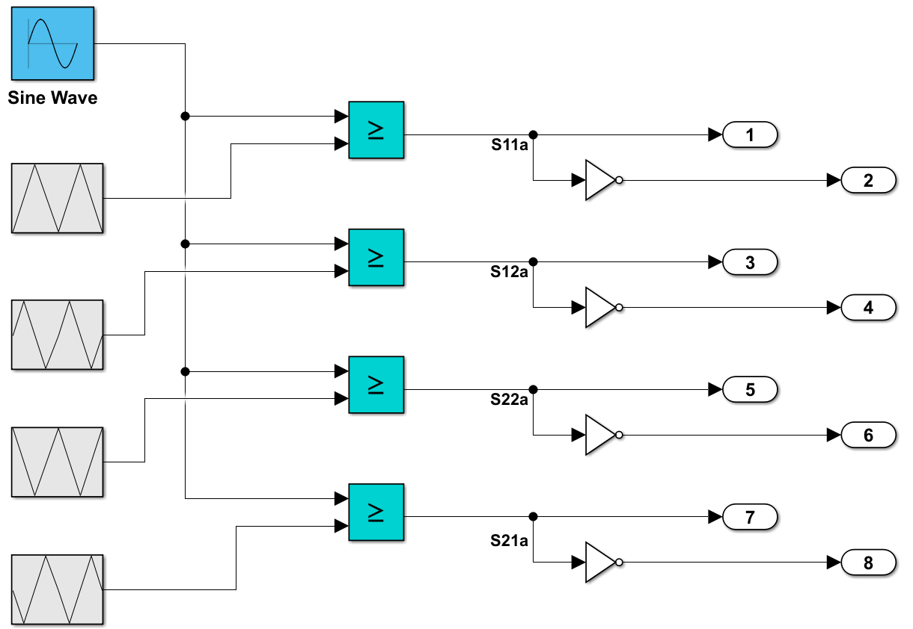
Phase shift PWM Simulink

Slide 14
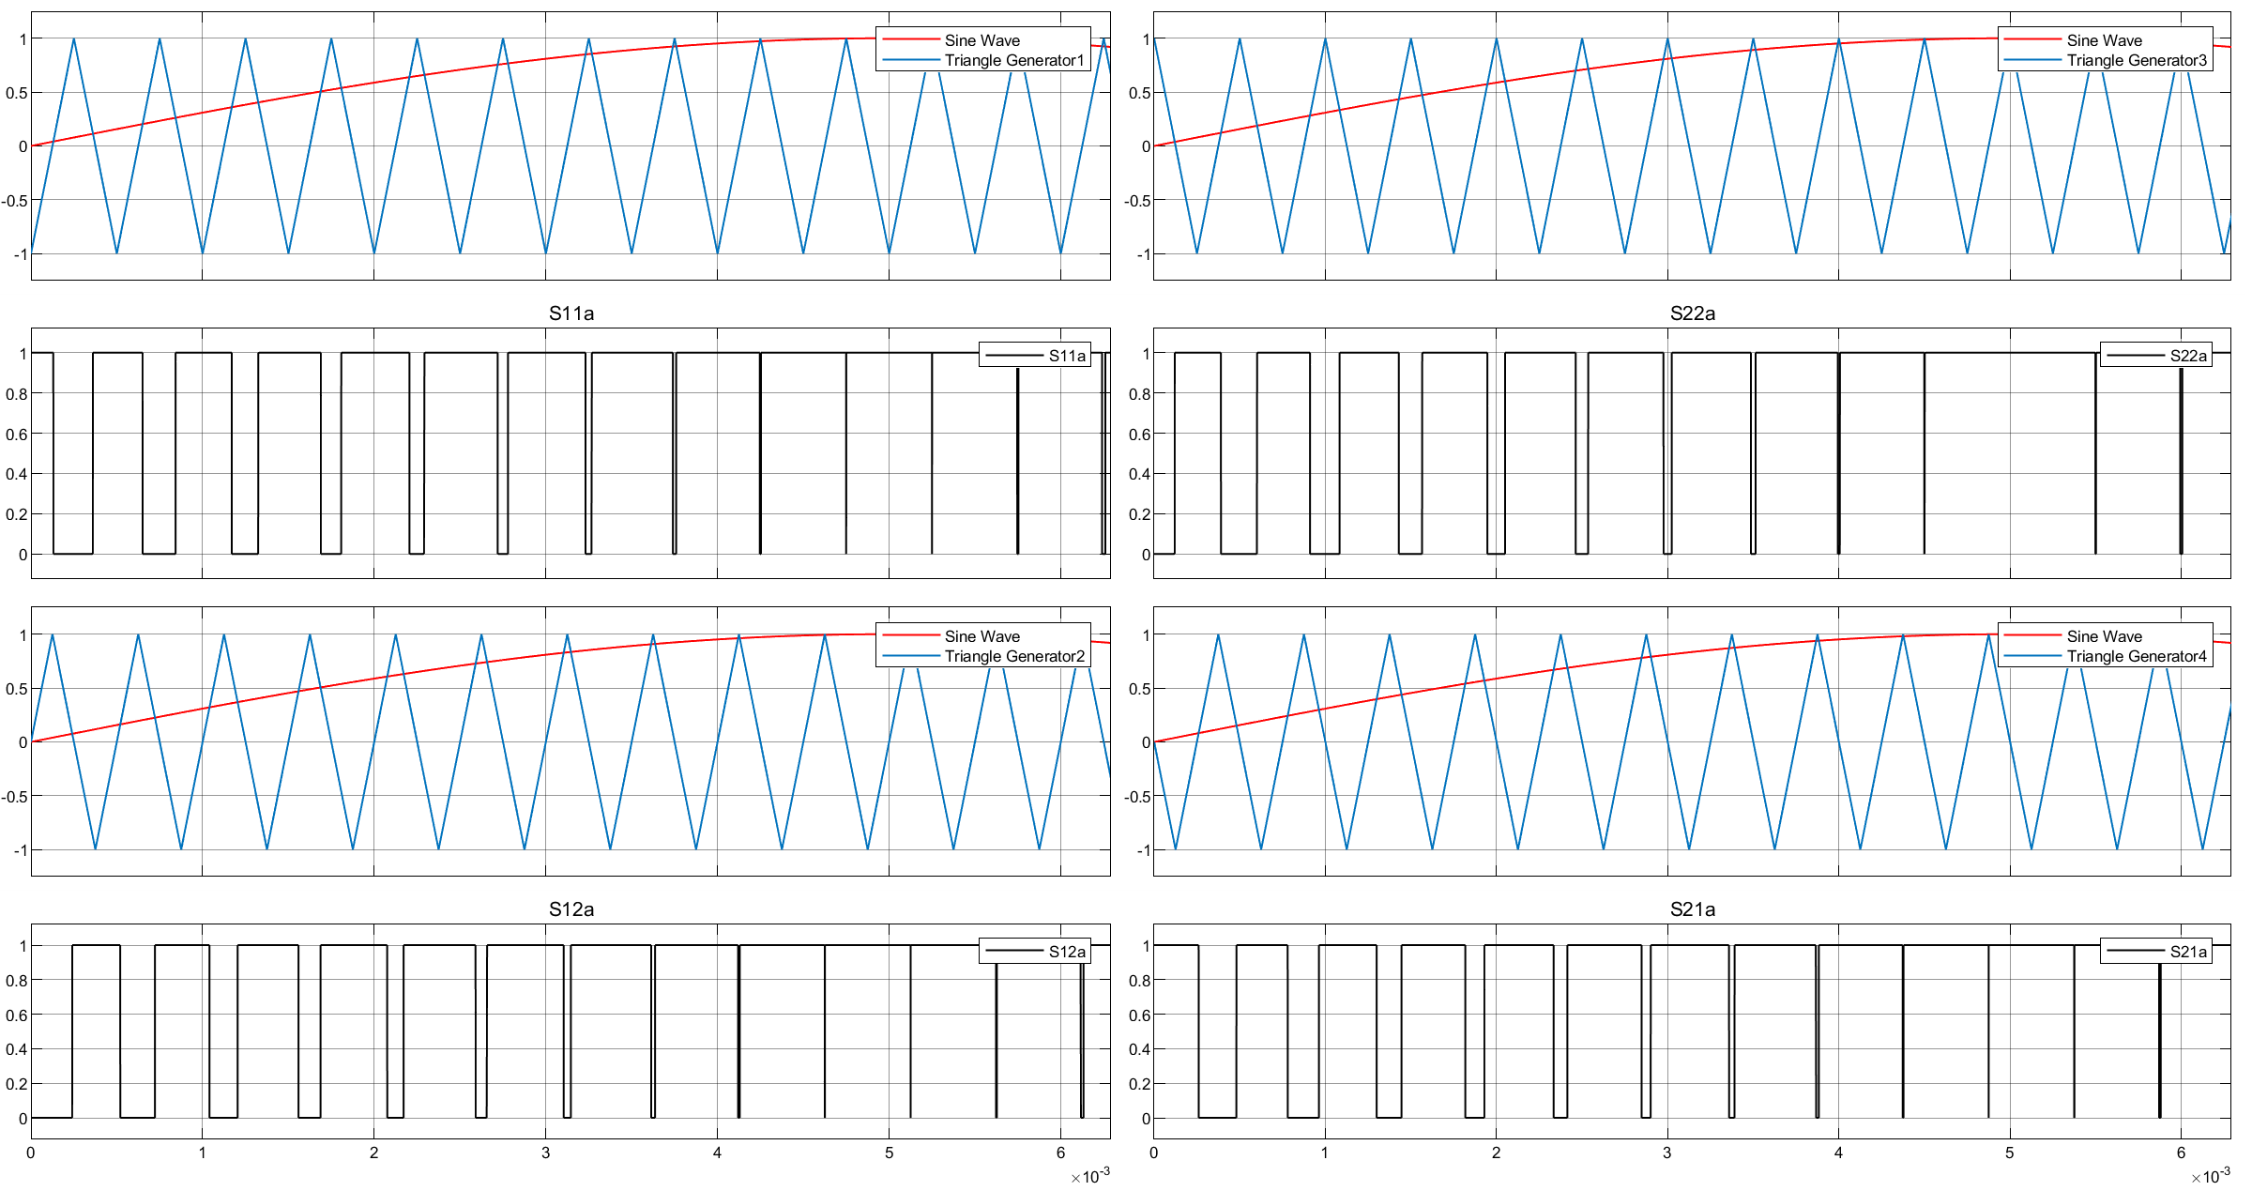
Phase-shifted multicarrier modulation

Slide 15
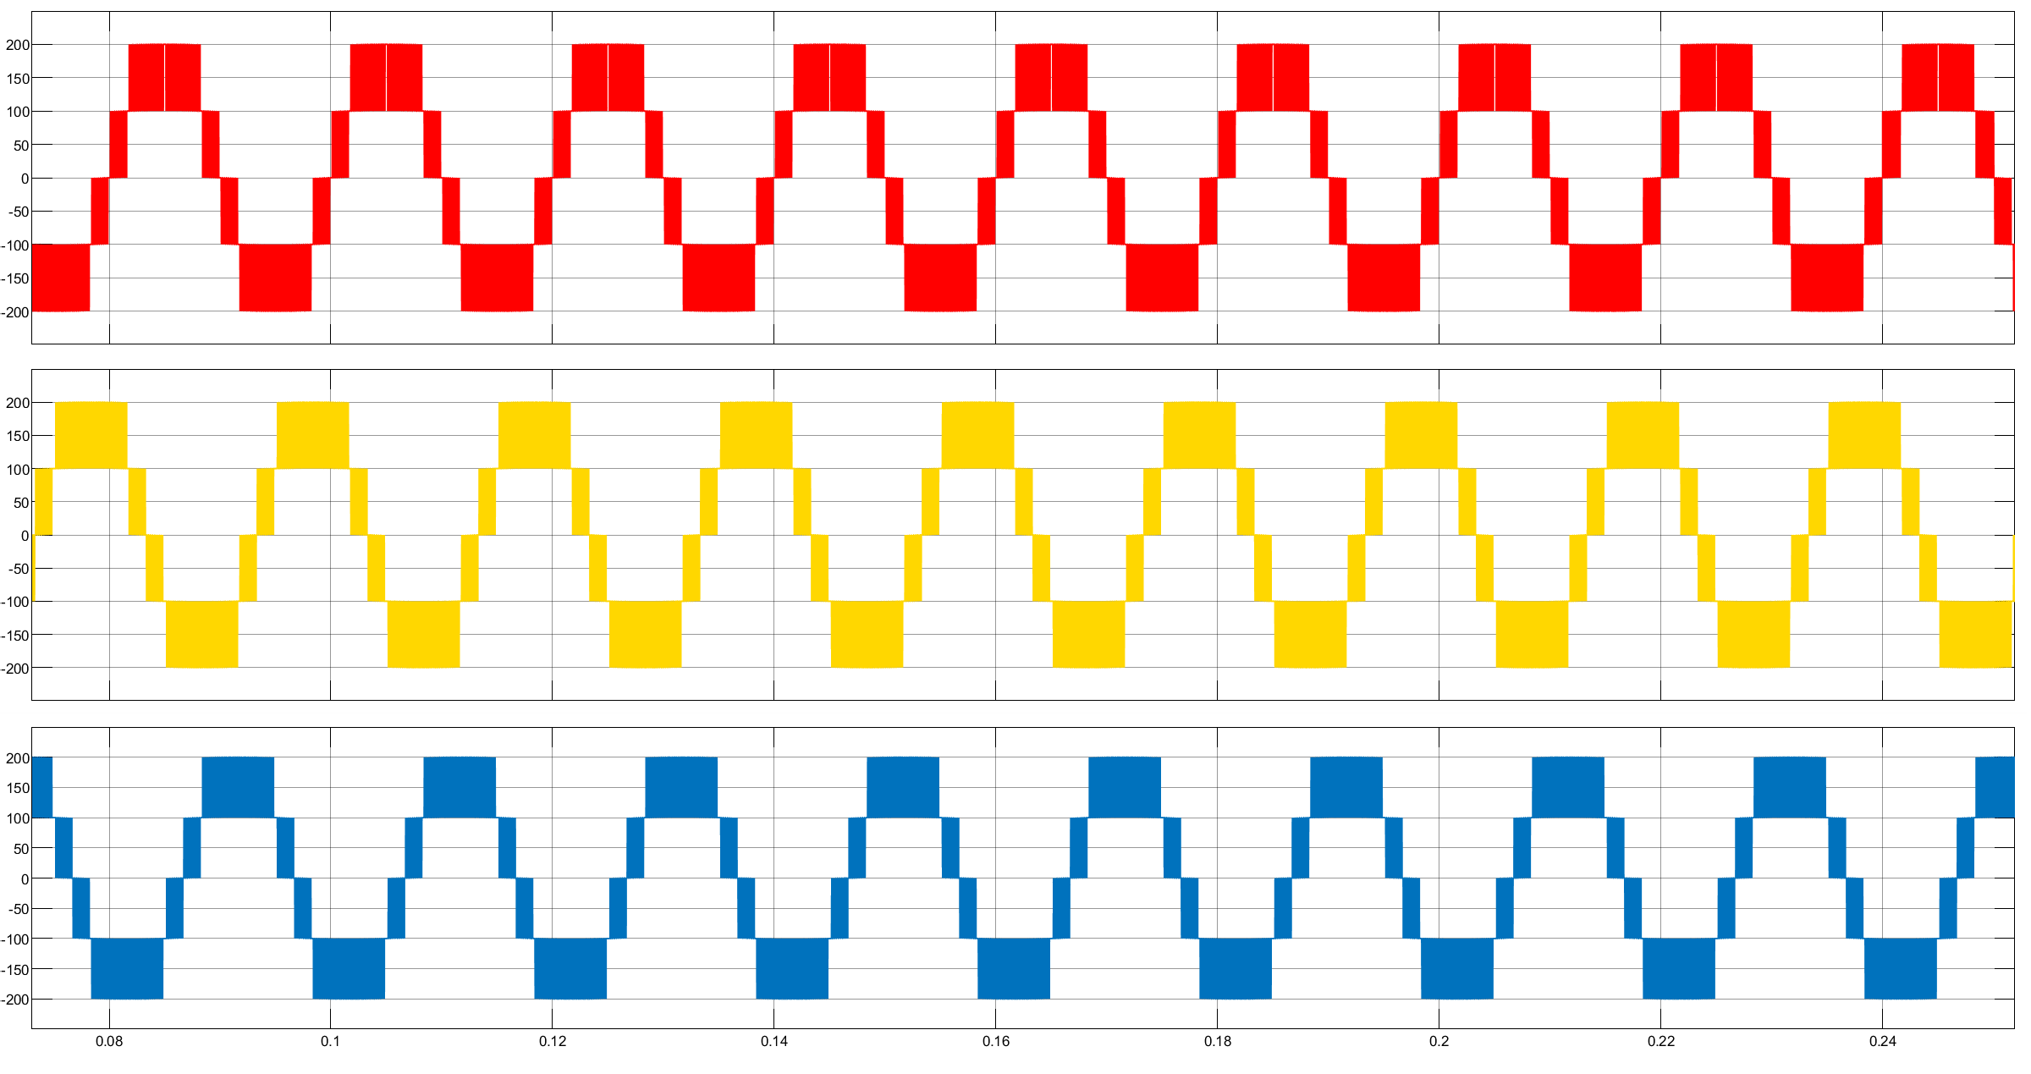
Output voltage

Slide 16
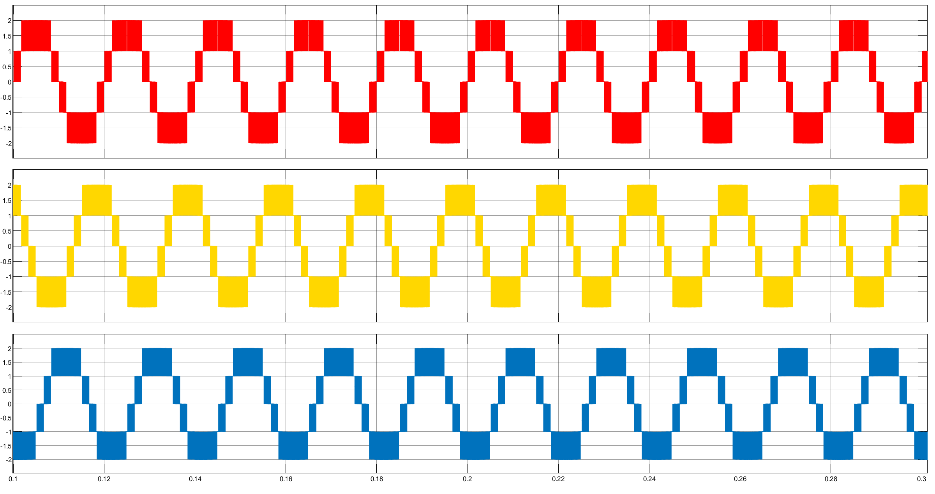
Output current

Slide 17
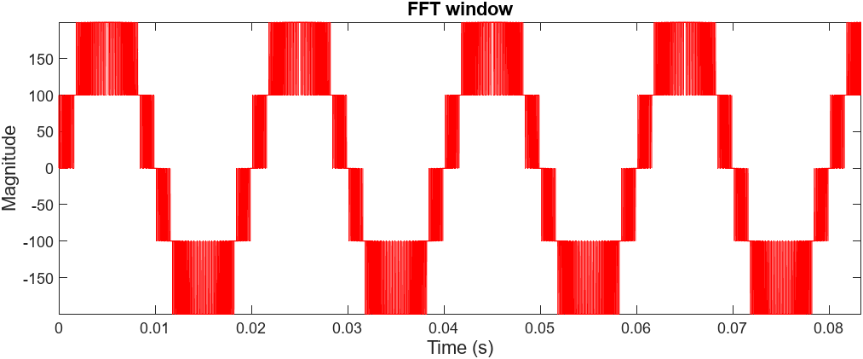
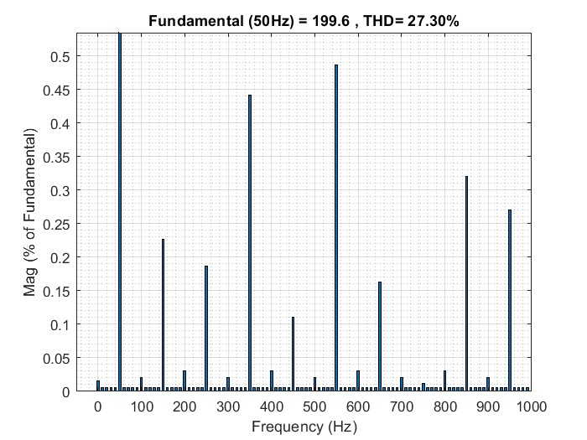
FFT analysis of phase voltage

Slide 18
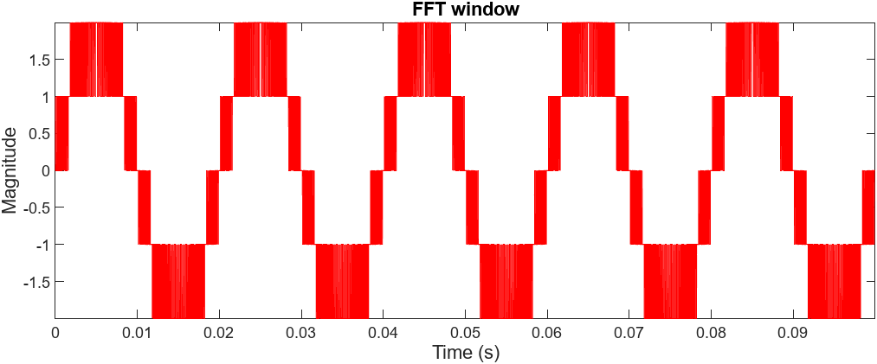

FFT analysis of current

