Slide 1

Data Science Applications to Power Systems (EE26003) Course Project on
National Institute of Technology Warangal
Department of Electrical Engineering
Power Quality Improvement in Distribution System using ANN Based Shunt Active Power Filter(SAPF)
BY
NAME | ROLL NO
Ganjikunta Jyothendra Sai | 24EEM2R07
Rathla Meena | 24EEM2R19
Neela Vinuthna | 24EEM2R28
Kothula Sai Deepak | 24EEM2S03
B Naidu | 24EER1P01
Subject Faculty
Prof. M. Sailaja Kumari
Department of Electrical Engineering,
National Institute of Technology, Warangal

Slide 2
INTRODUCTION
Shunt-type active power filter (SAPF) is used to eliminate the current harmonics. The SAPF topology is connected in parallel for current harmonic compensation. The shunt active power filter has the capability to maintain the mains current balanced and sinusoidal after compensation regardless of whether the load is non-linear and unbalanced or balanced
Objective:
Compensate poor load power factor such that the current drawn from the source has a unity power factor.(it compensate reactive power)
Suppress harmonics in loads so that the current drawn from source is sinusoidal.

Slide 3
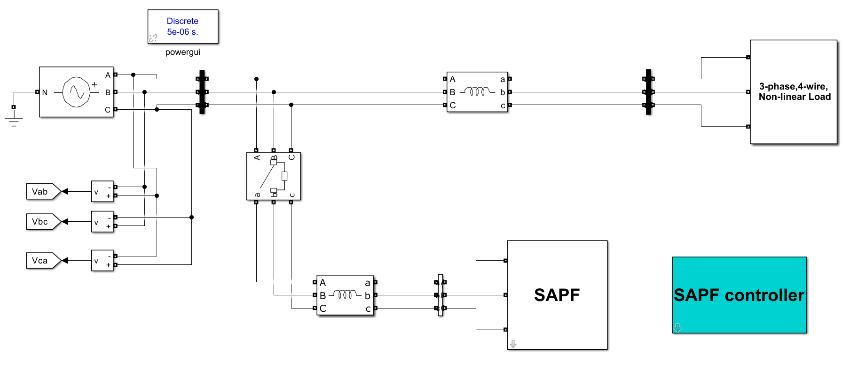
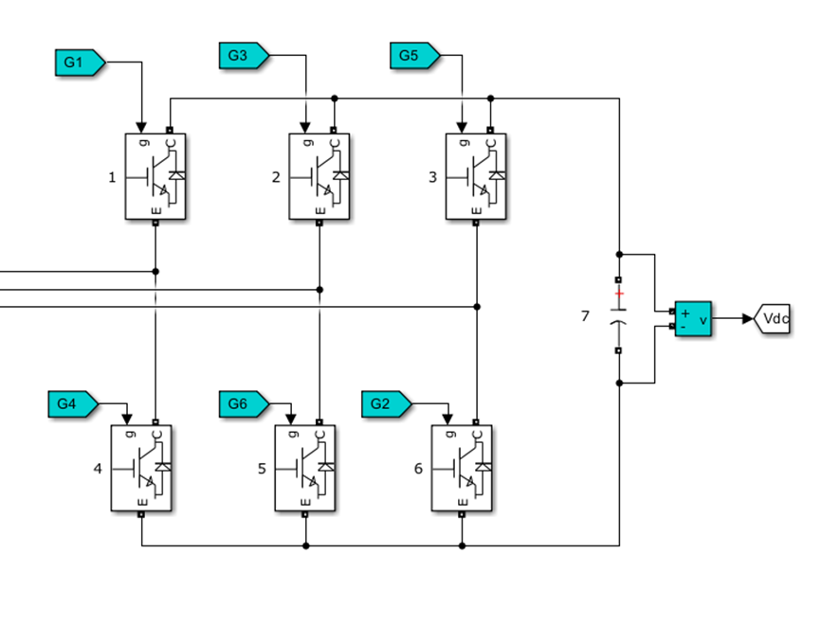
SAPF Simulink

Slide 4
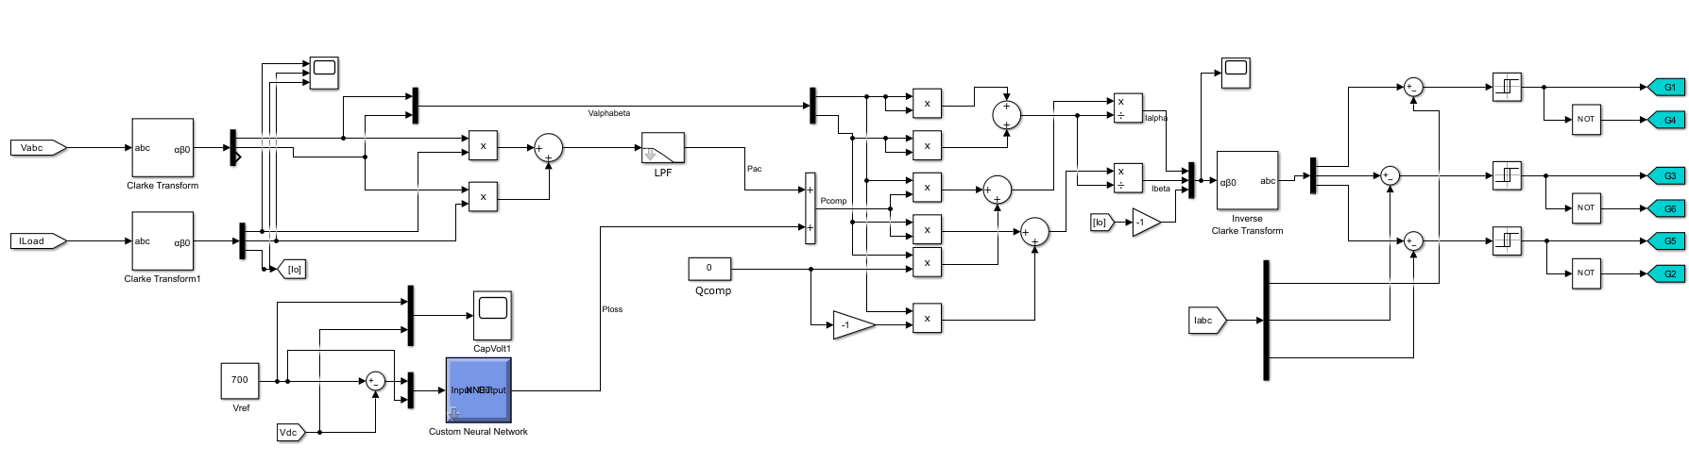
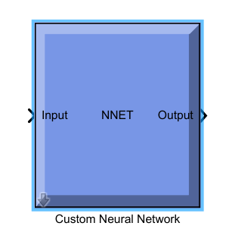
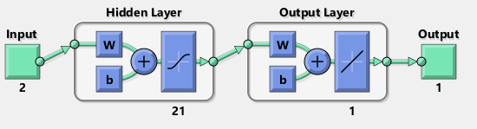
Controller

Slide 5
Control of SAPF
Measuring source and load currents
Measuring source voltages
Reference current generation (done by instantaneous PQ theory)
DC voltage regulation

Slide 6
DC - Voltage regulation
Ideally, there is no loss in the SAPF circuit; therefore, the capacitor voltages remain constant. However, in practice, the SAPF has switching losses associated with the PWM operation of its semiconductor switches.
If these losses are actually obtained from the capacitor energy stored in the capacitor, the capacitor voltage reduces, so when the capacitor voltage reduces, the performance will be affected. Therefore, we need to provide the controller with whatever amount of real power wasted due to conduction of various switches that much amount of real power drawn from the grid.
This can be done by adding a dc voltage regulator to the control strategy.

Slide 7
Algorithm for ANN
Step 1: Enter the number of inputs for a fed network(There are two inputs
given by {ref, error} and one output {O} ).
Step 2: Enter the number of layers.
Step 3: Create a new feed forward back propagation network with ‘TANSIG’ and ‘PURELIN’ transfer functions.
Step 4: Enter the number of epochs.
Step 5: Train the network for given input and targeted output.
Step 6: Generate simulation of the given network with a command ‘gensim’

Slide 8
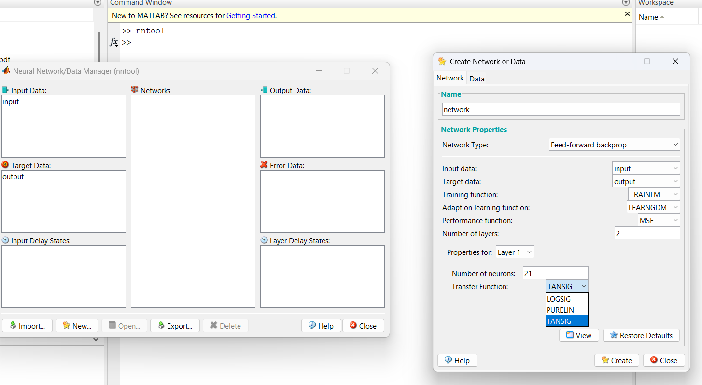

Slide 9
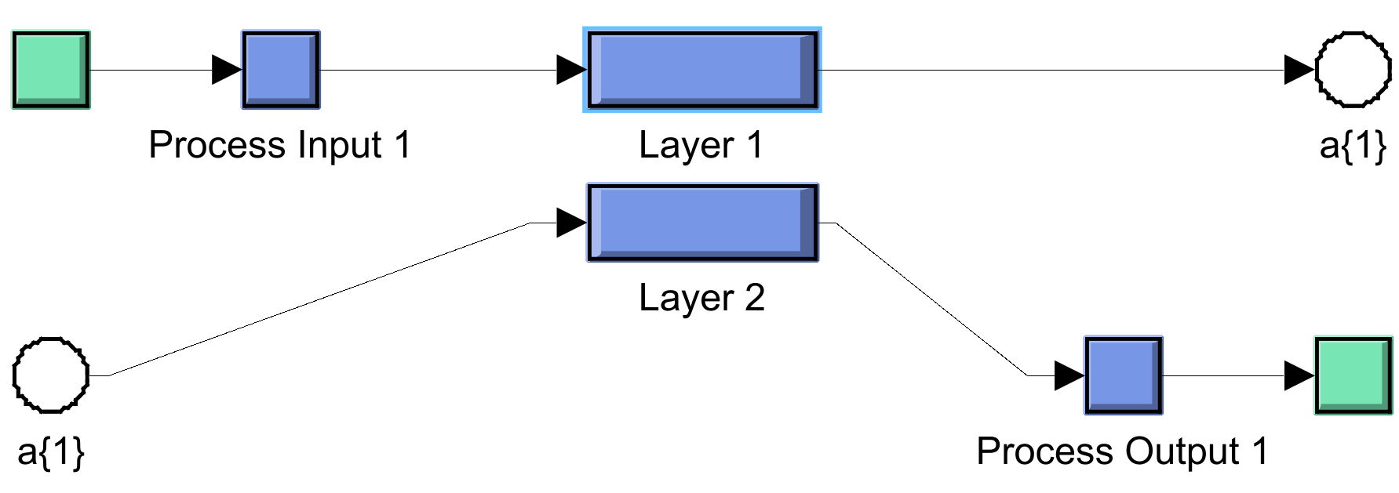
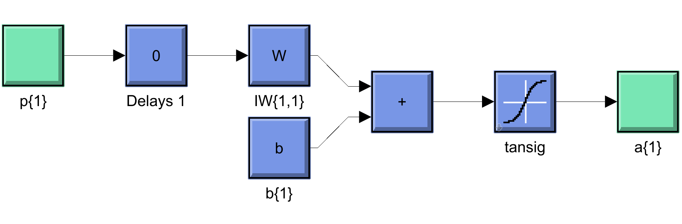
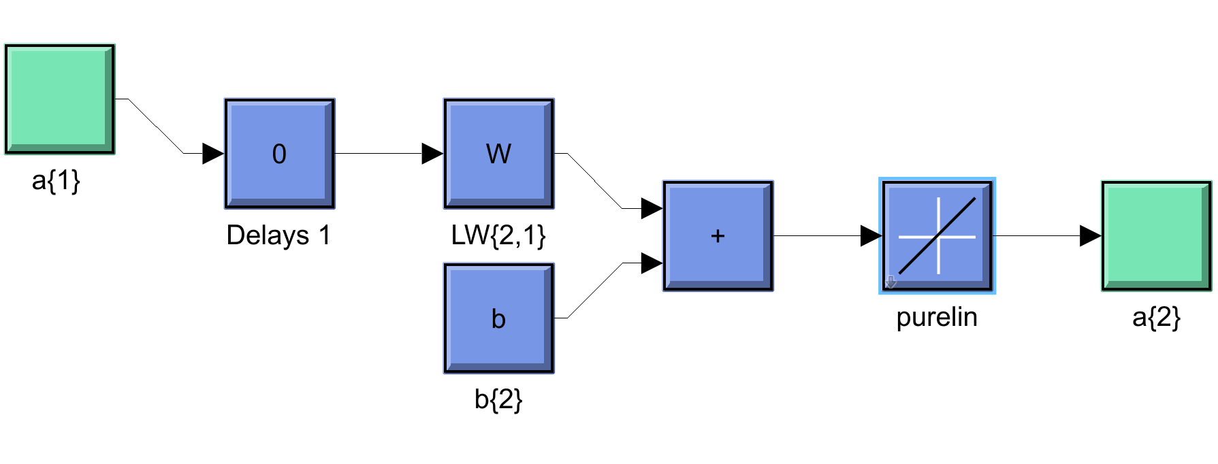
Back propagation neural network

Slide 10
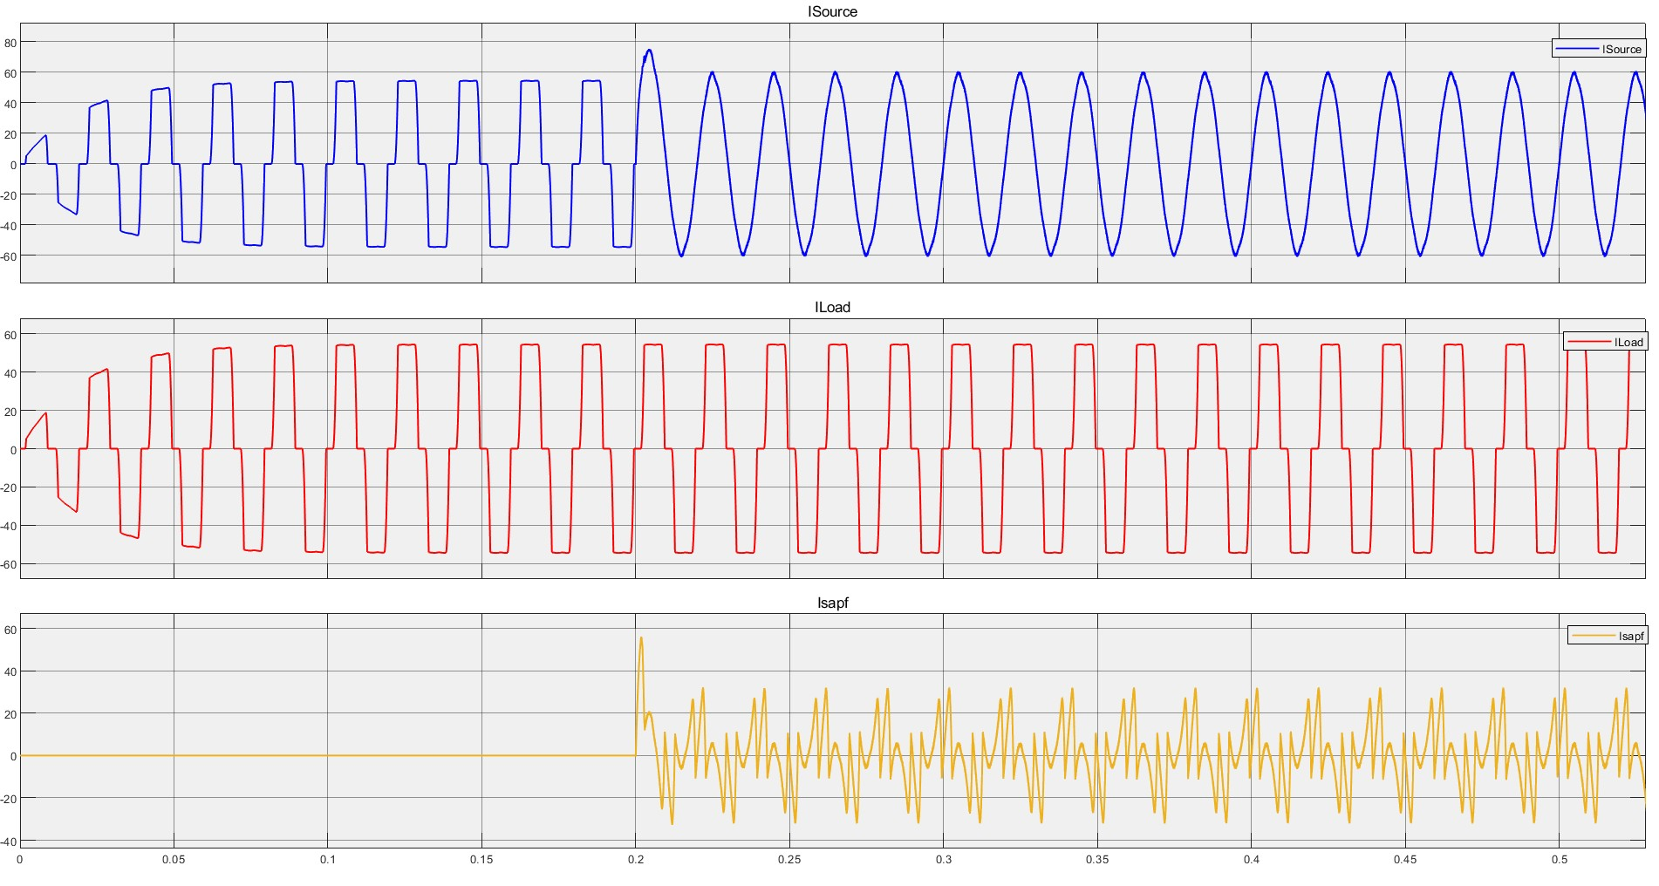
Currents

Slide 11
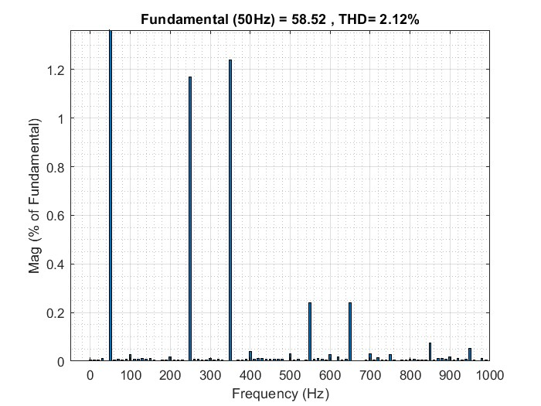
THD Analysis with ANN

Slide 12
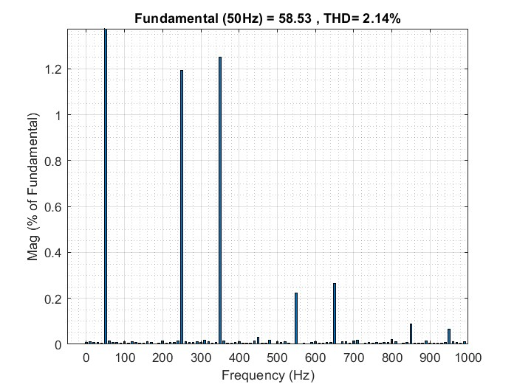
THD Analysis with PI

Slide 13
THD Analysis
THD% | With out SAPF | With SAPF
 |  | PI | ANN
 | 30.18% | 2.14% | 2.12%

Slide 14
Conclusion
The obtained results show the simplicity and the effectiveness of the proposed intelligent controller under nonlinear load conditions. From the results, it can be observed that the current total harmonic distortion reduces better with ANN controlled active filter compared to without filter and with PI controller. The simulation and experimental results also show that the new control method is not only easy to be calculated and implemented, but also very effective in reducing harmonics.

