Slide 1





Database Fundamentals And
Microsoft Access
For Beginners
Prepared By :
Said Fawzy
Manager of Information Center
Tendering Department
Arab Contractors

Slide 2
Database Fundamentals And Microsoft Access For Beginners
Introduction
Prepared By :
Said Fawzy
Manager of Information Center
Tendering Department
Arab Contractors

Slide 3


About Me
B.SC In Civil Engineering ..Alex University …………….........................………………..1987.
High Diploma in Construction Project Management ……Eien Shams University..................................….1988.

Slide 4


About Me (cont.)
Microsoft Certified Professional (MCP) ……………………..…………………...1999.
Certified InternetWebmaster(CIW)..2000.
Oracle Certified Master (OCM)……2001.
Microsoft Certified Technology Specialist(MCTS) …………………………………………...2006.

Slide 5



About Me (cont.)
Quality Management Systems ………..2009
ISO 9001:2008
Quality Management Systems ………..2016
ISO 9001:2015

Slide 6

About Me (cont.)
Advanced Data Analysis Nanodegree ……...2021
Nanodegree UX Research Cross-Skilling….2022
Nanodegree Advance Marketing Analytics ………...2022
IBM Certified Data Analysist Professional ………...2023

Slide 7
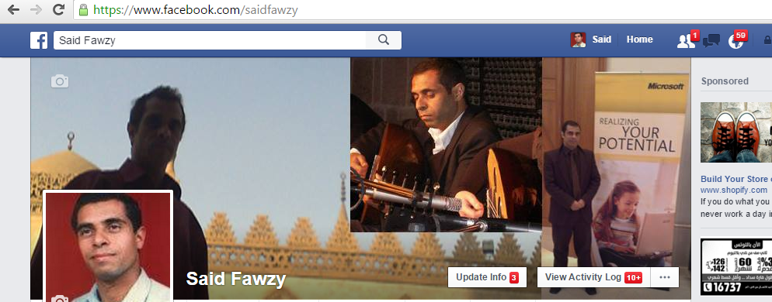
https://www.facebook.com/saidfawzy

Slide 8
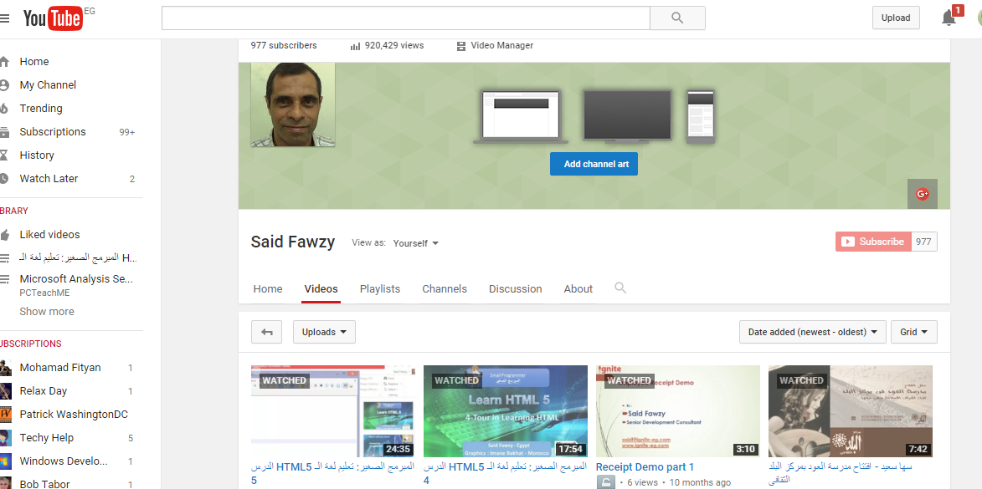
https://www.youtube.com/user/saidfawzy

Slide 9
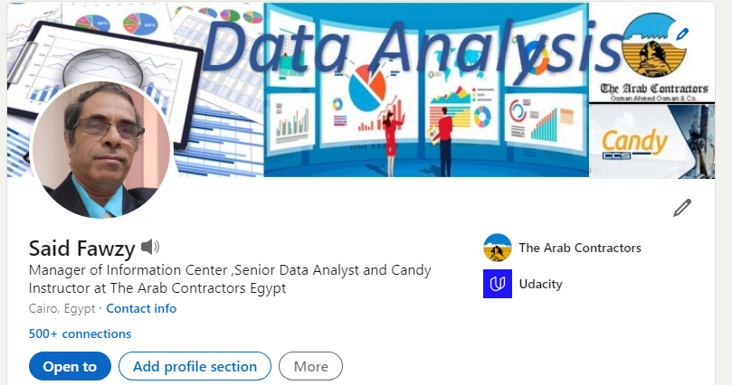
https://www.linkedin.com/in/saidfawzy/

Slide 10



Happy to hear from you
Said Fawzy
0122 744 99 87
Said_fawzy@hotmail.com
https://www.facebook.com/saidfawzy
@saidfawzy

Slide 11
Course Outline

Slide 12
Chapter 1: What is a Database.
Chapter 2: Exploring MS Access.
Chapter 3: Entity Relationship Diagram ERD
Chapter 4: Logical Model
Chapter 5: Tables in MS Access

Slide 13
Chapter 6: Structured Query Language (SQL).
Chapter 7: Query Basics in MS Access.
Chapter 8: Form Basics in MS Access.
Chapter 9: Report Basics in MS Access.
Chapter 10: Project.

Slide 14

Training
Tell me I will forget.
Show me I might remember something.
Let me do it I will understand.

Slide 15





Slide 16



You are Allowed to Talk
about anything except
Religion
Soccer
Policy

Slide 17


