Slide 1





Database Fundamentals And
Microsoft Access
For Beginners
7 Query Basics in MS Access
Prepared By :
Said Fawzy
Manager of Information Center
Tendering Department
Arab Contractors

Slide 2
Contents
Create Query Using Wizard
reate Query using design view
Customize Query with Criteria

Slide 3

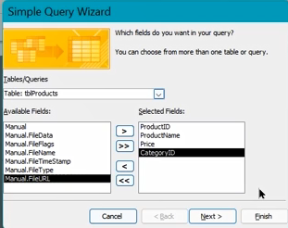
Task 11: Create Query Using Wizard

Slide 4
Task 12: Create Query using design view

Slide 5
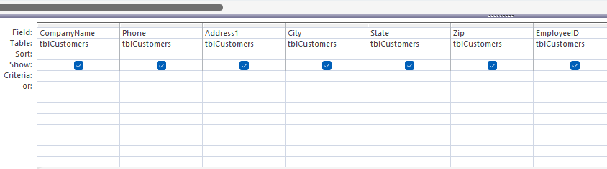
Task 13: Customize Query with Criteria

Slide 6


