Slide 1





Database Fundamentals And
Microsoft Access
For Beginners
9 Report Basics in MS Access
Prepared By :
Said Fawzy
Manager of Information Center
Tendering Department
Arab Contractors

Slide 2
Contents
Creating a Form Using Wizard
Create a form Using Design View
Create a Form from a table
Add Record to a Form

Slide 3

Task 18: Create Report from a query

Slide 4
Task 19: Create Report in Design View

Slide 5
Task 16: Create a Form from a table

Slide 6
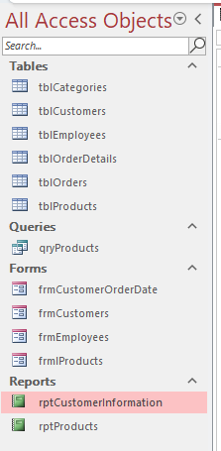
A look at Navigation Pane

Slide 7


