Slide 1




Data Modeling in Power BI
Prepared By :
Said Fawzy
Manager of Information Center
Tendering Department
Arab Contractors

Slide 2

Data Modeling in Power BI

Slide 3
Introduction
Prepared By :
Said Fawzy
Manager of Information Center
Tendering Department
Arab Contractors

Slide 4


Contact
Cert.
Cert.
Certif.
Quali
JOB
Said Fawzy
Manager of Information Center
Quality Manager
Tendering Department
Arab Contractors

Slide 5
Contact
Cert.
Cert.
Cert.
Quali.
JOB
Said Fawzy
Manager of Information Center
Quality Manager
Tendering Department
Arab Contractors

Slide 6


B.SC In Civil Engineering
1987
Alex University
Contact
Cert.
Cert.
Cert.
Quali.
JOB
Said Fawzy
Manager of Information Center
Tendering Department
Arab Contractors
High Diploma in Construction Project Management
1998
Ein Shams
University

Slide 7



Microsoft Certified Professional (MCP)
1999
B.SC In Civil Engineering
1987
Certified Internet Webmaster(CIW)
2000
Alex University
Contact
Cert.
Cert.
Cert.
Quali.
JOB
Said Fawzy
Manager of Information Center
Tendering Department
Arab Contractors
High Diploma in Construction Project Management
2001
Oracle Certified Master (OCM)
1998
Ein Shams
University
Microsoft Certified Technology Specialist(MCTS)
2006

Slide 8



Microsoft Certified Professional (MCP)
1999
Lead Auditor Quality Management Systems
B.SC In Civil Engineering
2009
1987
Certified Internet Webmaster(CIW)
2000
Alex University
Contact
Cert.
Cert.
Cert.
Quali.
JOB
Said Fawzy
Manager of Information Center
Tendering Department
Arab Contractors
High Diploma in Construction Project Management
2001
Oracle Certified Master (OCM)
1998
Lead Auditor Quality Management Systems
Ein Shams
University
2016
Microsoft Certified Technology Specialist(MCTS)
2006

Slide 9

Advanced Data Analysis Nanodegree
2021
Microsoft Certified Professional (MCP)
1999
Lead Auditor Quality Management Systems
B.SC In Civil Engineering
2009
1987
2022
2000
Nanodegree UX Research Cross-Skilling
Certified Internet Webmaster(CIW)
Alex University
Contact
Cert.
Cert.
Cert.
Quali.
JOB
Said Fawzy
Manager of Information Center
Tendering Department
Arab Contractors
High Diploma in Construction Project Management
2022
2001
Nanodegree Advanced Marketing Analytics
1998
Oracle Certified Master (OCM)
Lead Auditor Quality Management Systems
Ein Shams
University
2016
2023
2006
Microsoft Certified Technology Specialist(MCTS)
IBM Certified Data Analysist Professional

Slide 10


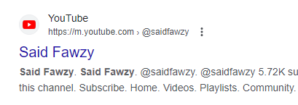
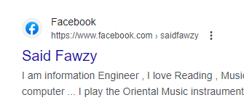
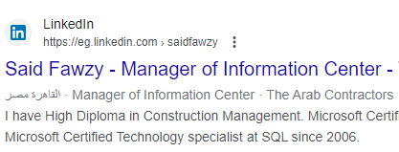


Advanced Data Analysis Nanodegree
2021
Microsoft Certified Professional (MCP)
1999
Lead Auditor Quality Management Systems
B.SC In Civil Engineering
2009
1987
2022
2000
Nanodegree UX Research Cross-Skilling
Certified Internet Webmaster(CIW)
Alex University
Contact
Cert.
Cert.
Cert.
Quali.
JOB
Said Fawzy
Manager of Information Center
Tendering Department
Arab Contractors
High Diploma in Construction Project Management
2022
2001
Nanodegree Advanced Marketing Analytics
1998
Oracle Certified Master (OCM)
Lead Auditor Quality Management Systems
Ein Shams
University
2016
0122 744 99 87
2023
2006
Microsoft Certified Technology Specialist(MCTS)
IBM Certified Data Analysist Professional
Saidfawzy@arabcont.com
Said_fawzy@hotmail.com

Slide 11


Slide 12


Preparing Data for Analysis in Power BI

Slide 13


Slide 14
Chapter 1
Introduction to Data Models
Chapter 2
Tables Relationships
Chapter 3
Star and Snowflake Schema
Chapter 4
Introduction to DAX
Chapter 5
Measures

Slide 15
Chapter 6
More About DAX
Chapter 7
Time Intelligence Functions
Chapter 8
Data Modeling Project
Chapter 9
Practical Exam

Slide 16




How would we train?

Slide 17

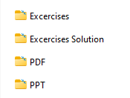
Student Folder

Slide 18


