Slide 1

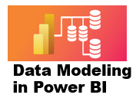



3 Star and Snowflake Schema
Prepared By :
Said Fawzy
Manager of Information Center
Tendering Department
Arab Contractors

Slide 2
3 Star and Snowflake Schema
Prepared By :
Said Fawzy
Manager of Information Center
Tendering Department
Arab Contractors

Slide 3

1
Setting up a Star schema in Power BI
2
Exercise 3: Setting up a Star schema
3
Setting up a Snowflake schema
4
Exercise 4:Setting up a Snowflake schema

Slide 4
5
Exercise 5: Convert Start Schema to Snowflake

Slide 5
1
Setting up a Star schema in Power BI

Slide 6

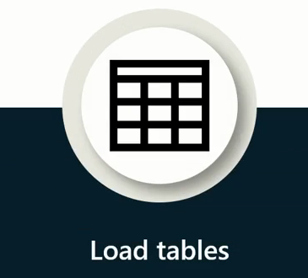


the steps for setting opera star schema

Slide 7
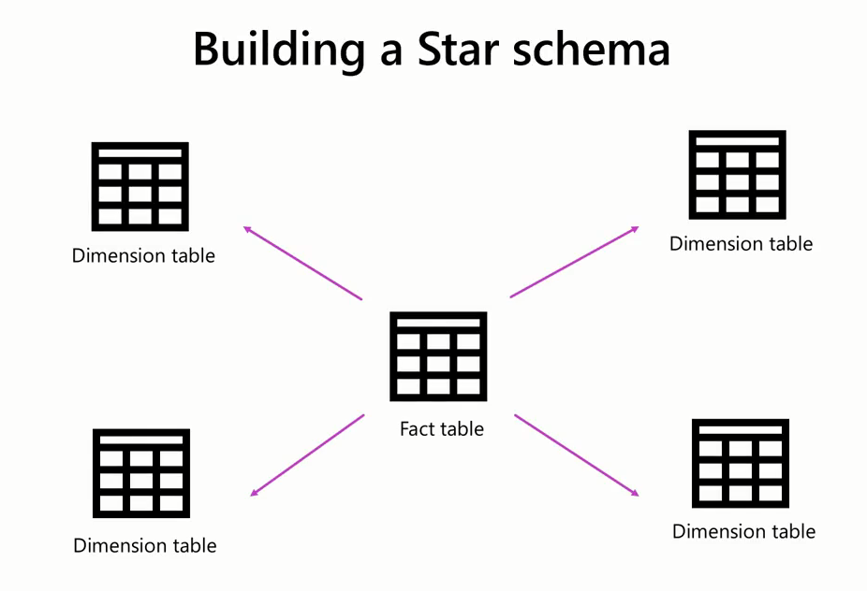
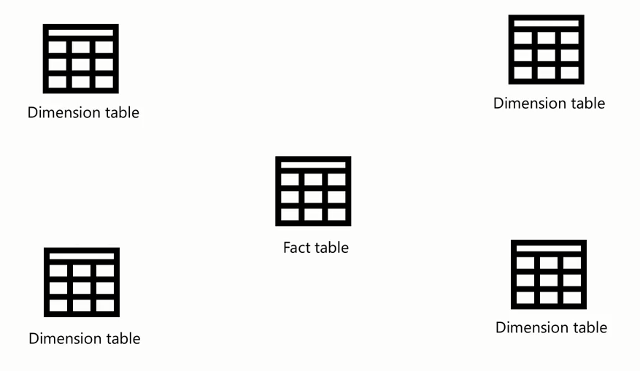

Slide 8
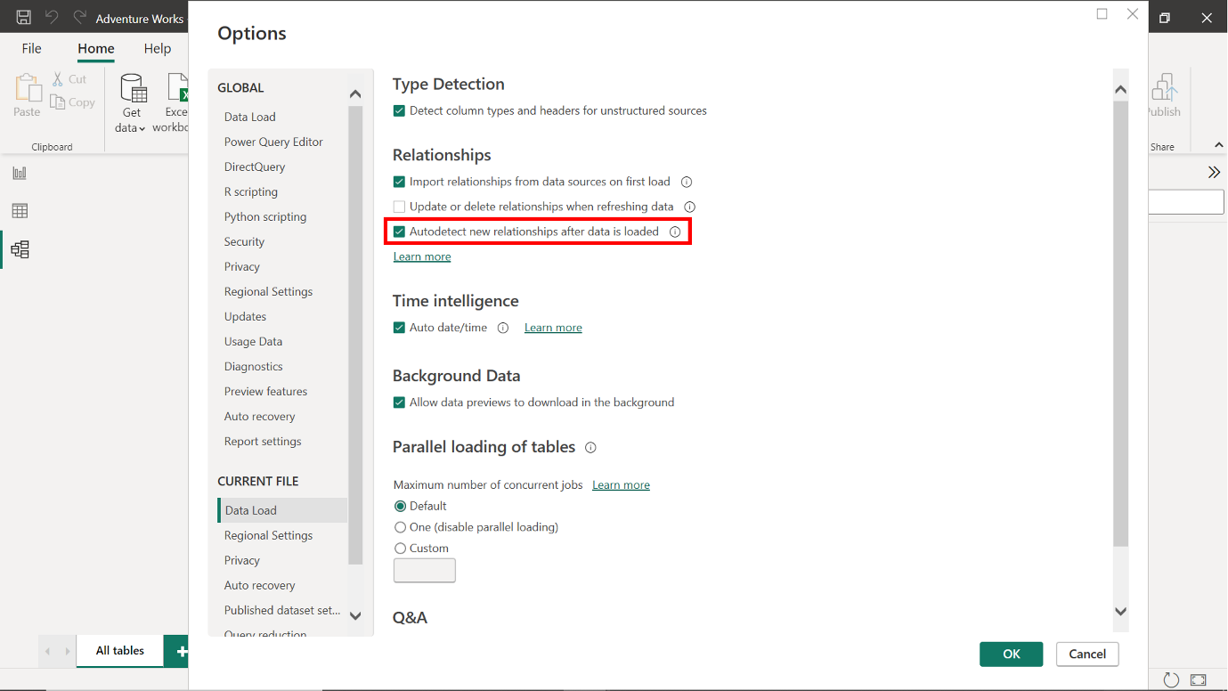

Slide 9
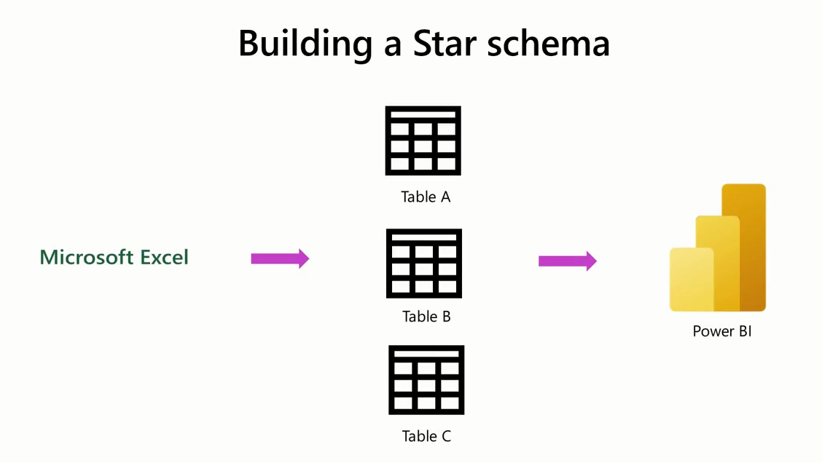

Slide 10
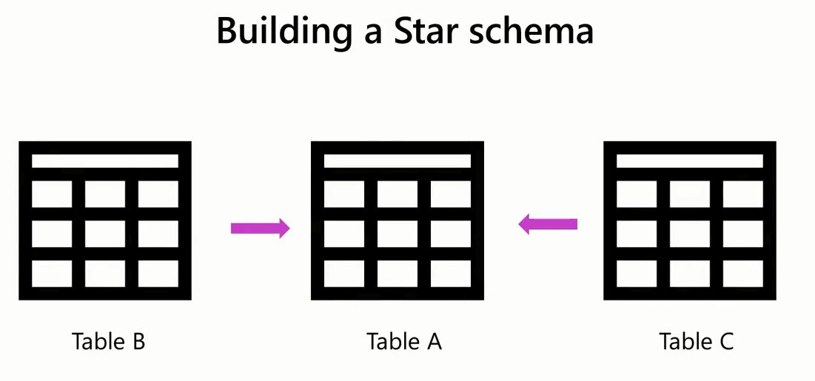

Slide 11
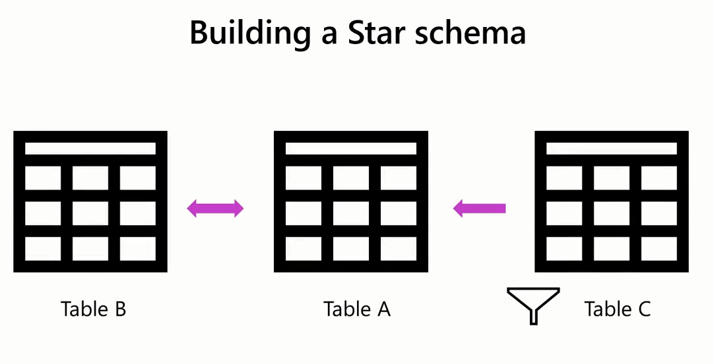

Slide 12

Question
True or False: The autodetect function must be disabled before loading multiple tables. This is to prevent Power BI from automatically creating relationships between tables.
True
False

Slide 13
ANSWER
True or False: The autodetect function must be disabled before loading multiple tables. This is to prevent Power BI from automatically creating relationships between tables.
True
False

Slide 14

Exercise 3:
Configuring a Star schema

Slide 15
Scenario
Adventure Works wants to analyze its Sales data to generate insights into its business.
It needs to create a data model using a Star schema.
You can help the company to build this schema using the datasets within the workbook AdventureWorksData.

Slide 16
Steps:
Step 1: Explore the Excel File.
Step 2: Disable autodetect relationships in Power BI.
Step 3: Load the data from the Excel workbook.
Step 4: Configure a Star Schema.

Slide 17
Question 1
Exercise Questions
True or False: The Sales table was identified as a dimension table in the exercise.
True
False

Slide 18
ANSWER 1
Exercise Questions
True or False: The Sales table was identified as a dimension table in the exercise.
True
False

Slide 19
Question 2
Exercise Questions
Which relationship type was configured between the Fact table and dimension tables in the exercise?
Many-to-many
Many-to-one
One-to-one

Slide 20
ANSWER 2
Exercise Questions
Which relationship type was configured between the Fact table and dimension tables in the exercise?
Many-to-many
Many-to-one
One-to-one

Slide 21
Question 3
Exercise Questions
True or False: The default cross-filter direction is set to Single, meaning that filters applied to the Products table will also apply to the Sales table, but not vice versa.
True
False

Slide 22
ANSWER 3
Exercise Questions
True or False: The default cross-filter direction is set to Single, meaning that filters applied to the Products table will also apply to the Sales table, but not vice versa.
True
False

Slide 23
3
Setting up a Snowflake schema

Slide 24
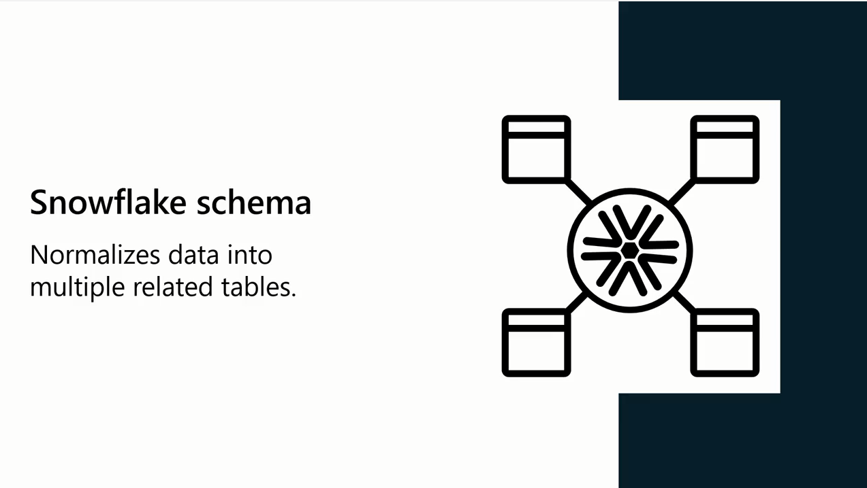

Slide 25

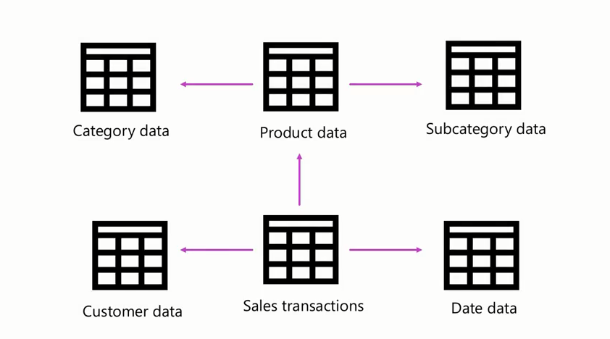

Slide 26
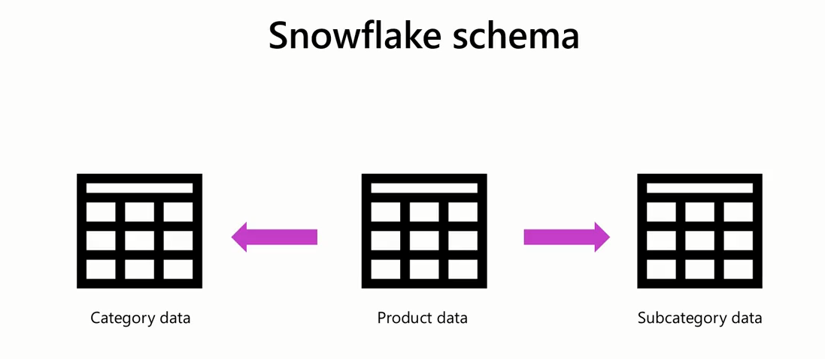



Slide 27
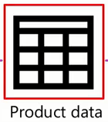

Filtering in Star Schema

Slide 28
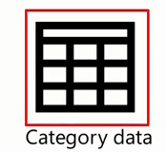
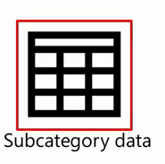
Filtering in Snowflake Schema

Slide 29
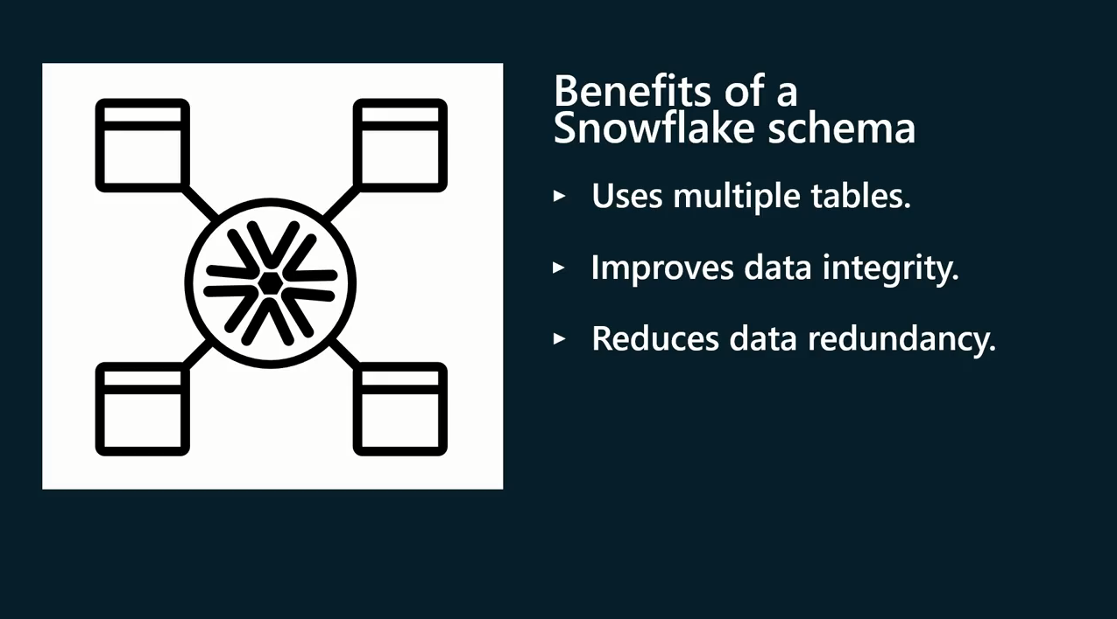
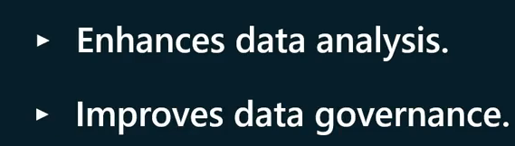

Slide 30
Exercise 4:
Setting up Snowflake schema

Slide 31
Scenario
Adventure Works has created a Star schema to store its sales data.
However, the Star schema poses several issues with data analysis and visualization.
A solution to these issues is to change the schema to a Snowflake schema. A Snowflake schema will create a more complex structure, leading to better performance and easier maintenance. Adventure Works provides you with an Excel file called Adventure Works Data. The Excel file contains six tables. These tables are called Sales, Product, Region,Salesperson,Category, and Subcategory.

Slide 32
Steps:
Step 1: Explore the Excel File.
Step 2: Disable autodetect relationships in Power BI.
Step 3: Load the data from the Excel workbook.
Step 4: Configure a Snowflake Schema.

Slide 33
Question 1
Exercise Questions
What is the primary advantage of using a Snowflake schema in Power BI over a Star schema?
The Snowflake schema reduces query complexity.
The Snowflake schema is more suitable for complex data structures.
The Snowflake schema requires less storage space.

Slide 34
ANSWER 1
Exercise Questions
What is the primary advantage of using a Snowflake schema in Power BI over a Star schema?
The Snowflake schema reduces query complexity.
The Snowflake schema is more suitable for complex data structures.
The Snowflake schema requires less storage space.

Slide 35
Exercise 5:
Changing Star schema into a Snowflake schema

Slide 36
Scenario
Adventure Works has created a Star schema to store its sales data.
However, the Star schema poses several issues with data analysis and visualization.
A solution to these issues is to change the schema to a Snowflake schema. A Snowflake schema will create a more complex structure, leading to better performance and easier maintenance. Adventure Works provides you with an Excel file called Adventure Works Data.
The Excel file contains four tables.
These tables are called Sales, Product, Region, and Salesperson.

Slide 37
Steps:
Step 1: Create a Star Shcema like the one you have created in the previous exercise 3, Configuring a Star schema.
Step 2: Identify the dimension tables in the star schema that can be normalized further into related tables. .
Step 3: Configure the Snowflake schema.

Slide 38


Slide 39

Question 1
Which of the following statements is correct regarding a Star schema Fact table?
A Fact table stores an accumulation of business entities.
A Fact table must have a unique column
A Fact table stores an accumulation of business events.

Slide 40
ANSWER 1
Which of the following statements is correct regarding a Star schema Fact table?
A Fact table stores an accumulation of business entities.
A Fact table must have a unique column
A Fact table stores an accumulation of business events.

Slide 41
Question 2
How are dimension tables structured in a Snowflake schema?
They are connected in a hierarchical structure with multiple levels.
They are normalized with a separate table for each attribute.
They are fully denormalized, with all attributes in a single table.

Slide 42
ANSWER 2
How are dimension tables structured in a Snowflake schema?
They are connected in a hierarchical structure with multiple levels.
They are normalized with a separate table for each attribute.
They are fully denormalized, with all attributes in a single table.

Slide 43
Question 3
What is the primary benefit of normalizing dimension tables in Power BI?
It simplifies data querying and reporting.
It reduces storage requirements.
It improves data quality and accuracy.

Slide 44
ANSWER 3
What is the primary benefit of normalizing dimension tables in Power BI?
It simplifies data querying and reporting.
It reduces storage requirements.
It improves data quality and accuracy.

Slide 45
Question 4
Which of the following statements is true about relationships in Power BI?
Relationships can only be created between columns that contain the same data type.
Relationships can only be created between tables with the same number of rows.
Relationships can be created between tables that contain different types of data.

Slide 46
ANSWER 4
Which of the following statements is true about relationships in Power BI?
Relationships can only be created between columns that contain the same data type.
Relationships can only be created between tables with the same number of rows.
Relationships can be created between tables that contain different types of data.

Slide 47
Question 5
True or False: A Star schema is more suitable for complex hierarchies and relationships.
True
False

Slide 48
ANSWER 5
True or False: A Star schema is more suitable for complex hierarchies and relationships.
True
False

Slide 49


