Slide 1

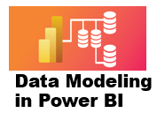



5 Measures
Prepared By :
Said Fawzy
Manager of Information Center
Tendering Department
Arab Contractors

Slide 2
5 Measures
Prepared By :
Said Fawzy
Manager of Information Center
Tendering Department
Arab Contractors

Slide 3

1
What are Measures
2
Benefits of Measures
3
Measure Syntax
4
Exercise 9: Creating Measures

Slide 4
5
Exercise 10: IF Function
6
Exercise 11 DISTINCTCOUNT Function
7
Exercise 12 Creating Aggregation Function
8
Exercise 13: Using CALCULATE FUNCTION

Slide 5
9
Exercise 14: Variables in DAX
10
Exercise 15: OR Condition
11
Exercise 16: Organize your Measures
4
Exercise 9: Creating Measures

Slide 6
1
What are Measures?

Slide 7
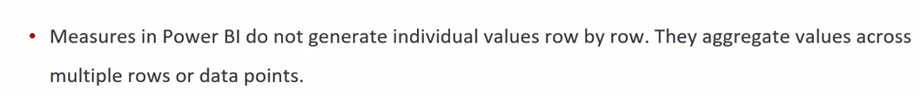
What is Measures

Slide 8
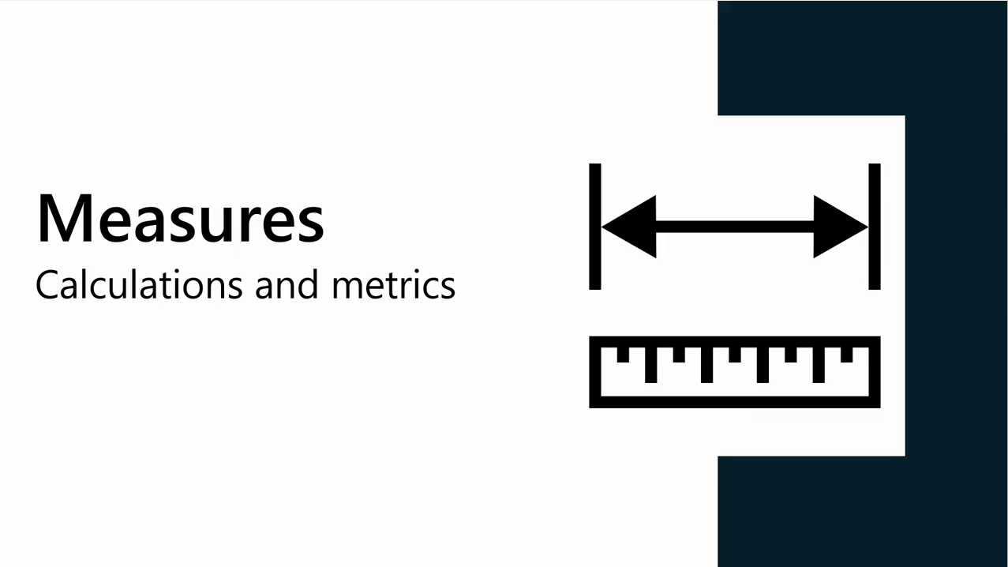
What is Measures

Slide 9
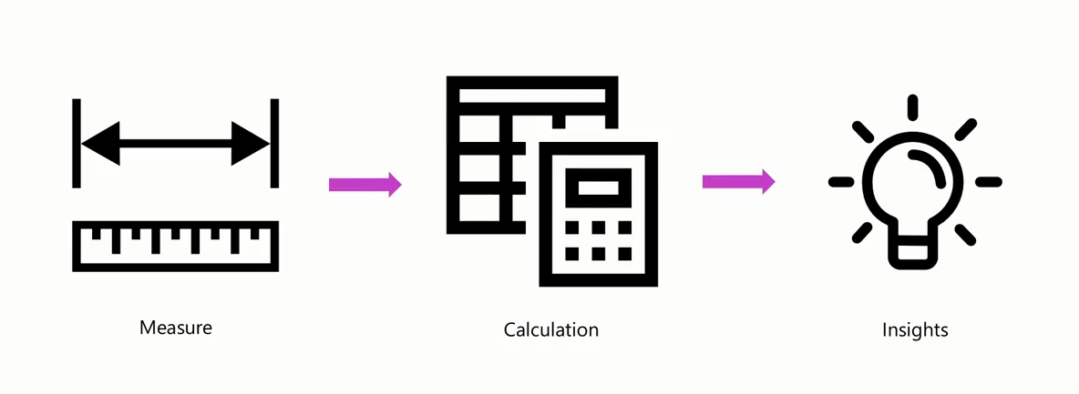
What is Measures
Measures are used in Power BI to perform aggregations, calculations or evaluations on data that provide meaningful insights

Slide 10
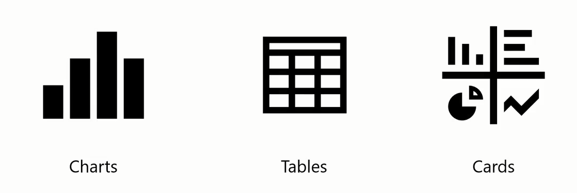
What is Measures
Measures are typically used in data visualization elements

Slide 11
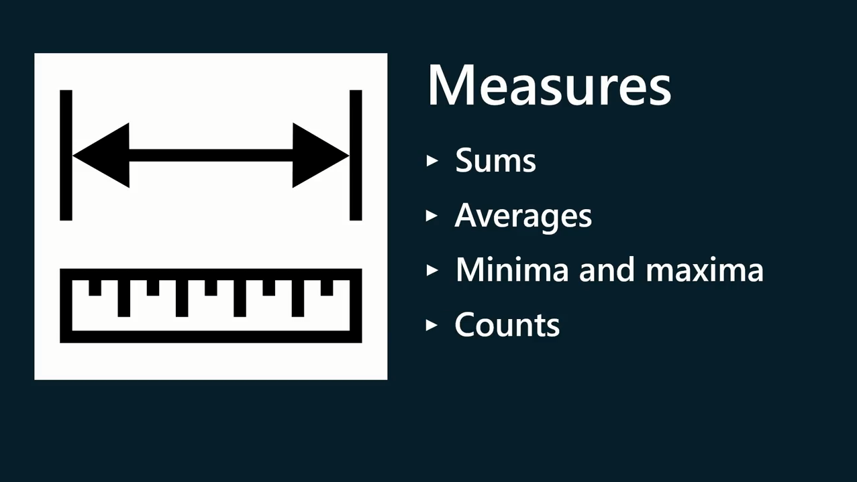
What is Measures

Slide 12
2
Benefits of Measures

Slide 13
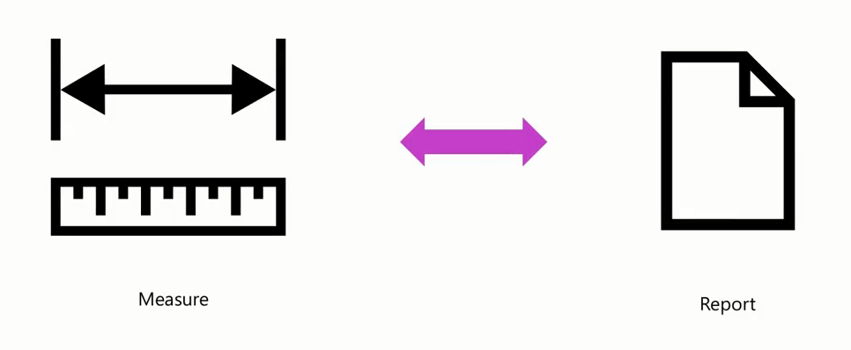
Benefits of Measures
Measures are calculated in the context of the visualization

Slide 14
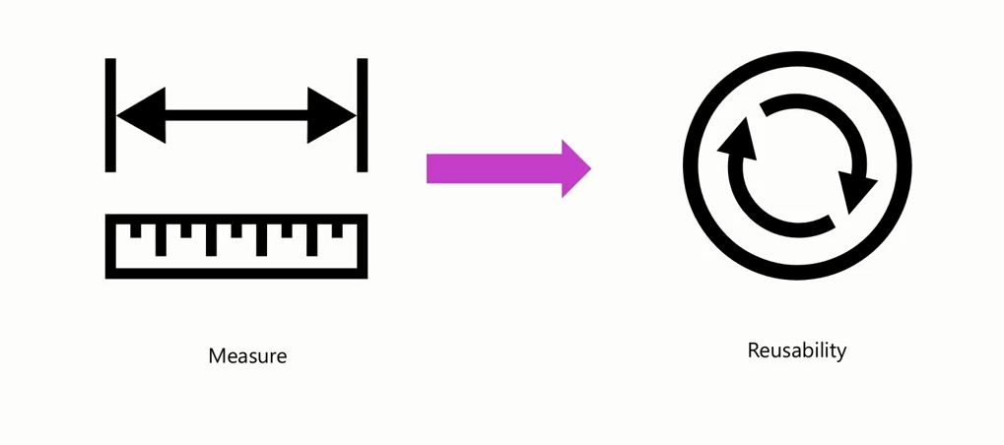
Benefits of Measures
Measures are reusable

Slide 15
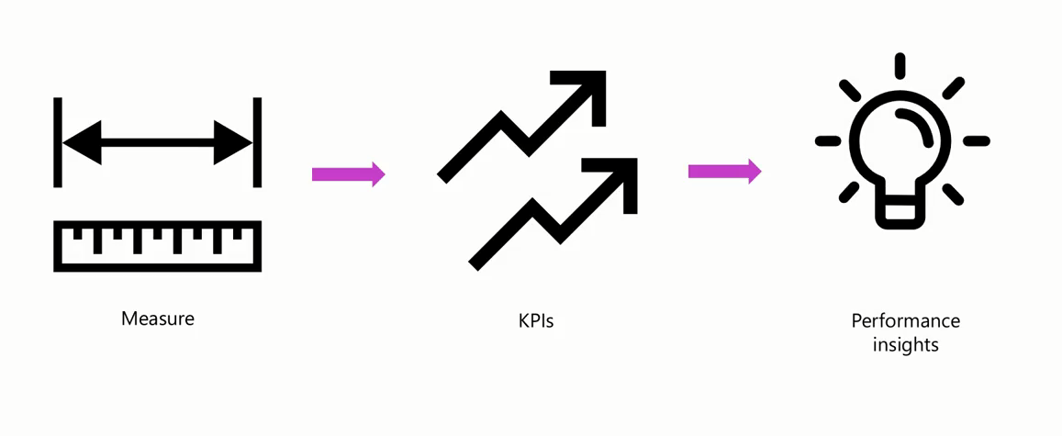
Benefits of Measures
Track Performance

Slide 16
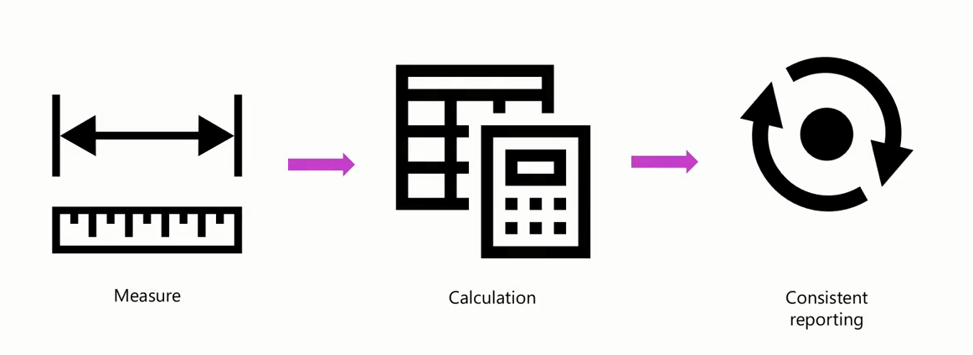
Benefits of Measures
Maintain consistency

Slide 17
3
Measure Syntax

Slide 18
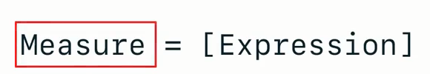
Measure Syntax
Measure Name
Example

Slide 19
Question
Why are measures used in Power BI?
To filter and categorize data.
To perform calculations and aggregations.
To store descriptive attributes.

Slide 20
ANSWER
Why are measures used in Power BI?
To filter and categorize data.
To perform calculations and aggregations.
To store descriptive attributes.

Slide 21

Exercise 9:
Creating Measures

Slide 22
Exercise 10:
IF Function

Slide 23
Exercise 11
DISTINCTCOUNT Function

Slide 24
Exercise 12
Aggregation Functions

Slide 25
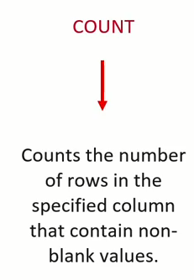
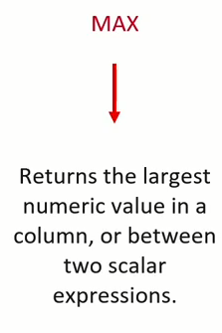
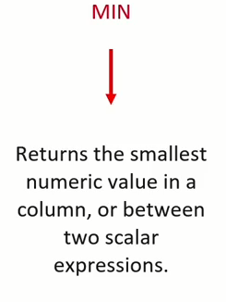
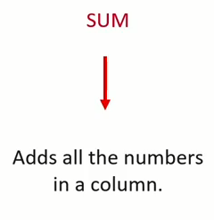
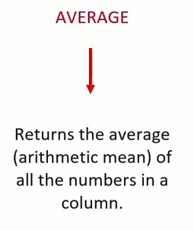
Aggregation Functions

Slide 26
Exercise 13
Using CALCULATE FUNCTION

Slide 27
Exercise 14
Variables in DAX

Slide 28
Exercise 15:
OR Condition

Slide 29
Exercise 16:
Organize your Measures
in one table

Slide 30


Slide 31

Question 1
Which of the following statements about the measures is correct?
Measures can reference columns directly.
Measures store values in the model.
Measures can reference other measures directly.

Slide 32
ANSWER 1
Which of the following statements about the measures is correct?
Measures can reference columns directly.
Measures store values in the model.
Measures can reference other measures directly.

Slide 33
Question 2
Which DAX function can summarize the number of entries in a table?
COUNTROWS
SUM
AVERAGE

Slide 34
ANSWER 2
Which DAX function can summarize the number of entries in a table?
COUNTROWS
SUM
AVERAGE

Slide 35
Question 3
How can measures help with data analysis in Power BI?
By creating new tables and relationships between data tables in your models.
By combining data from various external data sources.
By performing calculations and aggregations for data visualization and analysis

Slide 36
ANSWER 3
How can measures help with data analysis in Power BI?
By creating new tables and relationships between data tables in your models.
By combining data from various external data sources.
By performing calculations and aggregations for data visualization and analysis

Slide 37
Question 4
True or False: Measures in Power BI are calculated columns that store results based on a specific DAX expression.
True
False

Slide 38
ANSWER 4
True or False: Measures in Power BI are calculated columns that store results based on a specific DAX expression.
True
False

Slide 39


