Slide 1

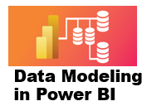



6 More About DAX
Prepared By :
Said Fawzy
Manager of Information Center
Tendering Department
Arab Contractors

Slide 2
6 More About DAX
Prepared By :
Said Fawzy
Manager of Information Center
Tendering Department
Arab Contractors

Slide 3

1
About DAX
2
Row context
3
Exercise 17: Row Context
4
Iterators

Slide 4
5
Exercise 18: Iterators
6
Filter Context
7
Exercise 19: Filter Context

Slide 5
1
About DAX

Slide 6
About DAX
• DAX seems to be easy to understand but takes whole life to master.
• Repetition is the key
(How to become a great photographer? Take thousands of Pictures).
• Always keep fundamentals of DAX in your mind while working with code.

Slide 7
2
Row Context

Slide 8
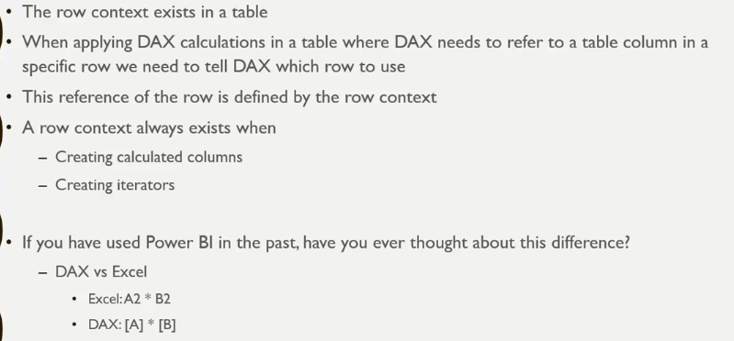
Row Context

Slide 9

Exercise 17:
Row Context

Slide 10
3
Iterators

Slide 11
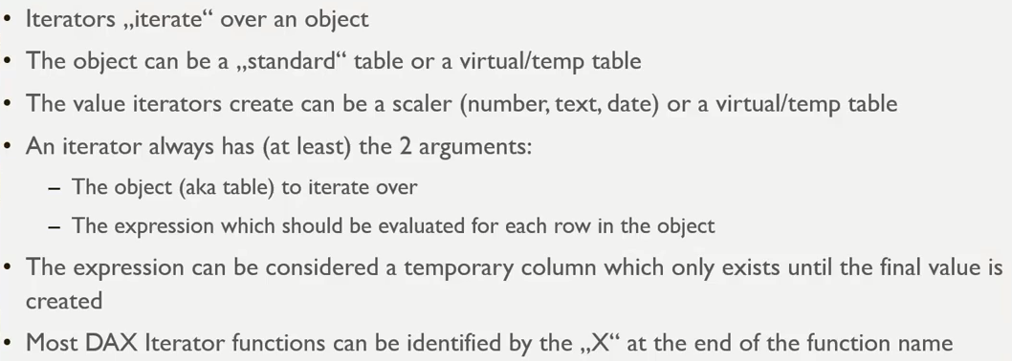
Iterators
Iterators has row context (They iterate row by row)

Slide 12
Iterators
Iterators has row context (They iterate row by row)
Temp/Virtual tables are the one generated in a measure for temporary use. They only exist when the measure needs them to calculate, then removed and never exist in model.
The iterator can return a scaler means one value.
Also, Iterator can return a Virtual/Temp table.
Iterator needs two arguments at least:
The table to iterate through.
The expression that will be evaluated row by row.
As the iterator use table and table has Row Context also Iterator has Row Context.
You can consider the expression as a virtual column, it exists until the calculation finished then removed.
Most iterator functions end with the X letter (SUMX, MINX,MAXX……).

Slide 13
Iterators
Iterators has row context (They iterate row by row)
Temp/Virtual tables are the one generated in a measure for temporary use. They only exist when the measure needs them to calculate, then removed and never exist in model.
The iterator can return a scaler means one value.
Also, Iterator can return a Virtual/Temp table.
Iterator needs two arguments at least:
The table to iterate through.
The expression that will be evaluated row by row.
As the iterator use table and table has Row Context also Iterator has Row Context.
You can consider the expression as a virtual column, it exists until the calculation finished then removed.
Most iterator functions end with the X letter (SUMX, MINX,MAXX……).

Slide 14
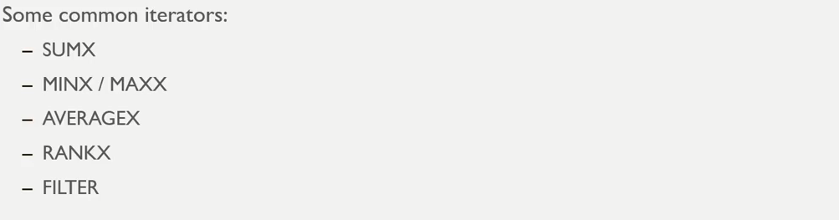
Iterators

Slide 15
Exercise 18:
Iterators

Slide 16
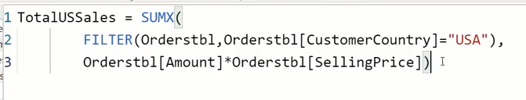
Combine Iterators

Slide 17
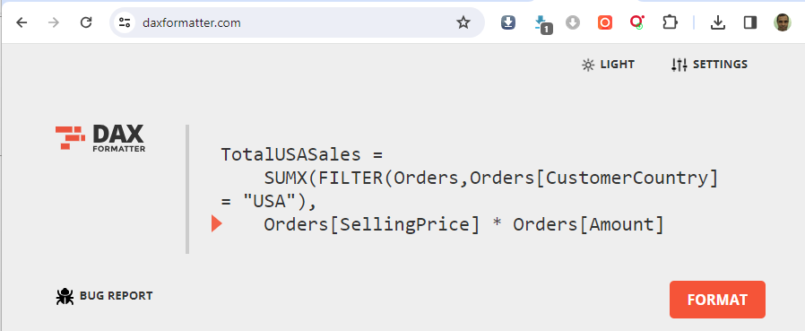
DAX Formatter
https://www.daxformatter.com/

Slide 18
3
Filter Context

Slide 19
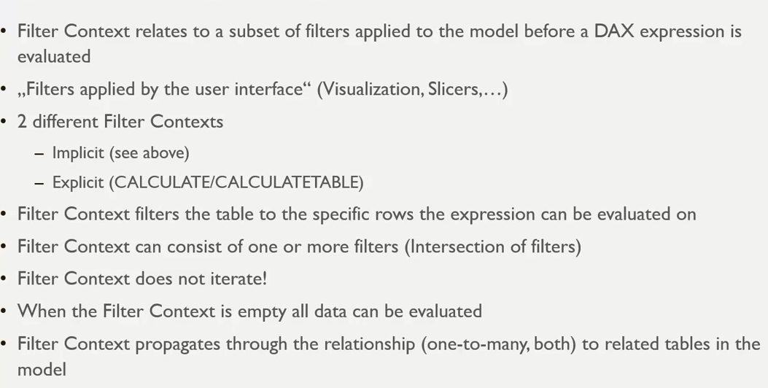
Filter Context

Slide 20
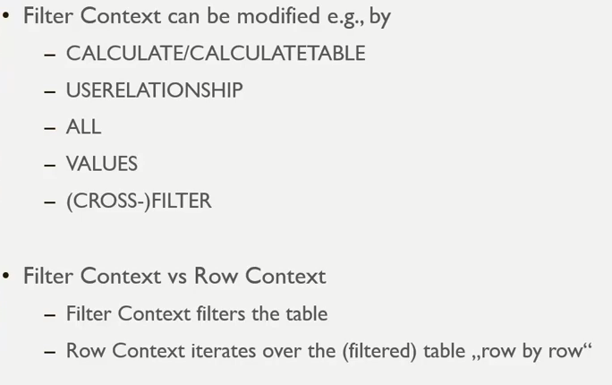
Filter Context

Slide 21
Exercise 19:
Filter Context

Slide 22
