Slide 1

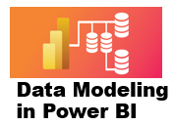



7 Time Intelligence Functions
Prepared By :
Said Fawzy
Manager of Information Center
Tendering Department
Arab Contractors

Slide 2
7 Time Intelligence Functions
Prepared By :
Said Fawzy
Manager of Information Center
Tendering Department
Arab Contractors

Slide 3

1
What is Time Intelligence Functions?
2
Setting up a common date table
3
Exercise 20: Set up a common date table Using DAX
4
Exercise 21: Set up a common date table Using M Language

Slide 4
5
Exercise 22: Calculating MTD , QTD , and YTD
6
Exercise 23: Comparing same period last year
7
Exercise 24: Compare to previous period
8
Exercise 25: DATEADD Function

Slide 5
9
Exercise 14: Variables in DAX
10
Exercise 15: OR Condition
11
Exercise 16: Organize your Measures
4
Exercise 9: Creating Measures

Slide 6
1
What is Time Intelligence Functions?

Slide 7
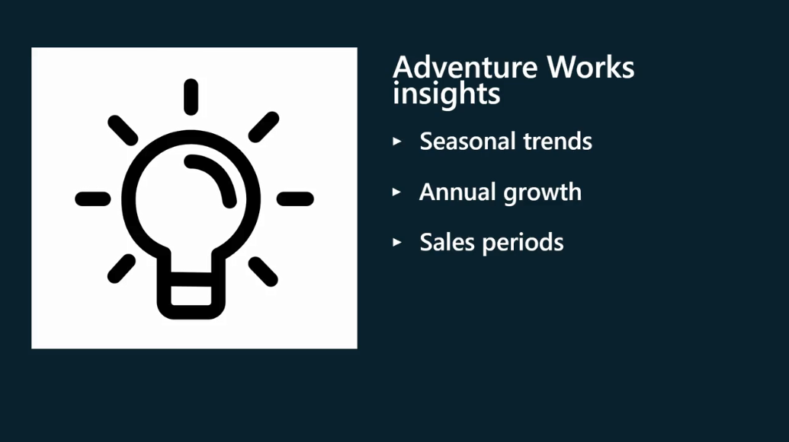
Time Intelligence Functions

Slide 8
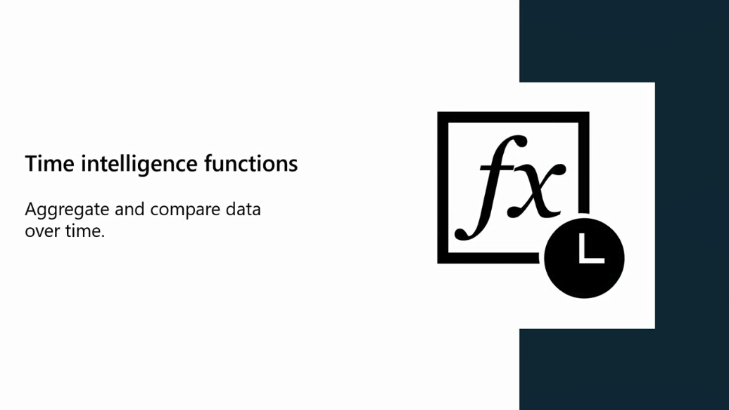
Time Intelligence Functions

Slide 9
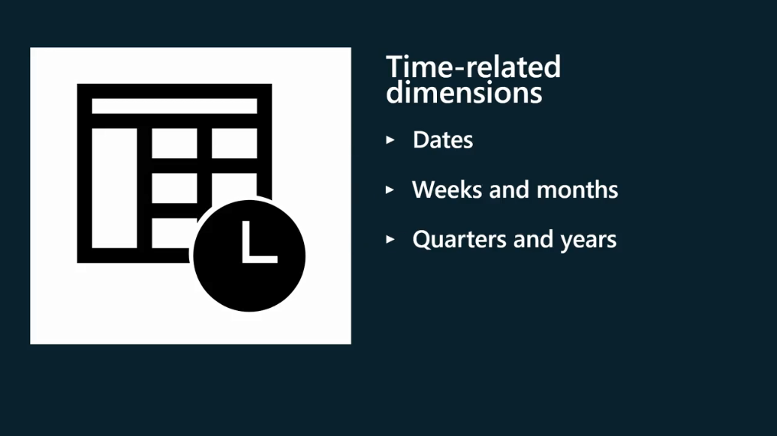

Time Intelligence Functions

Slide 10
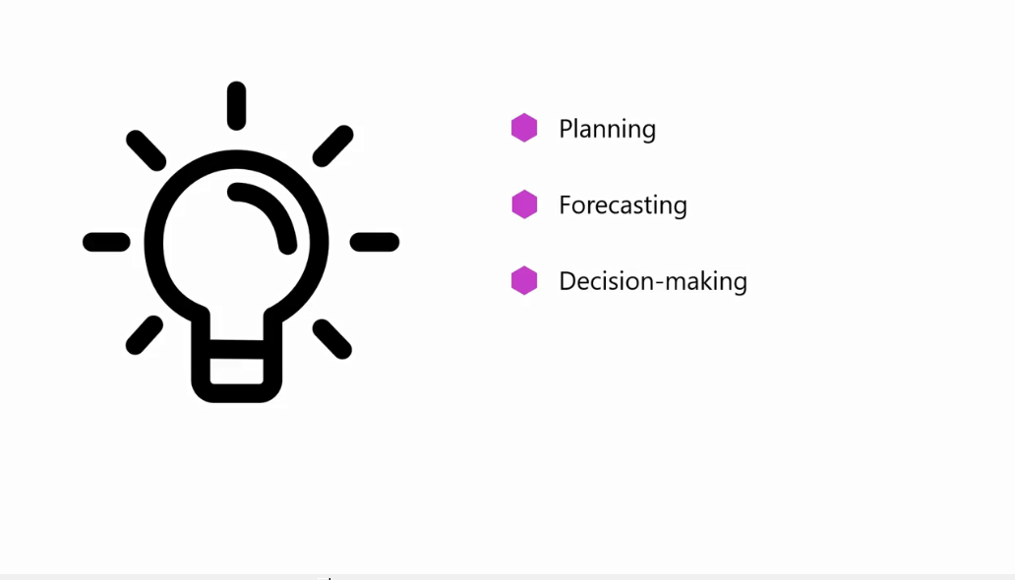
Time Intelligence Functions

Slide 11
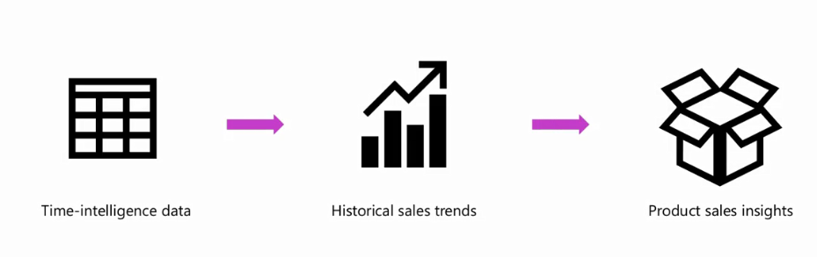

Benefits of Time Intelligence

Slide 12
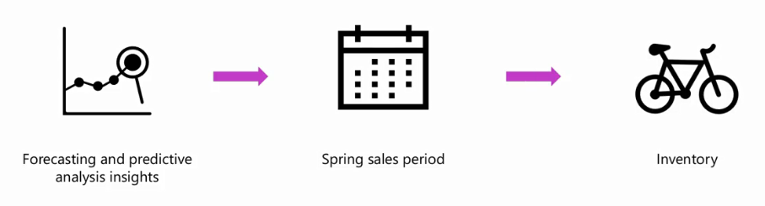
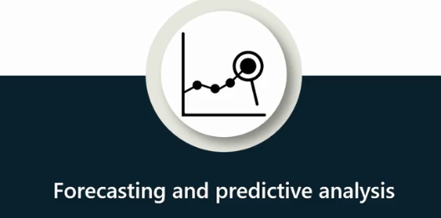
Benefits of Time Intelligence

Slide 13
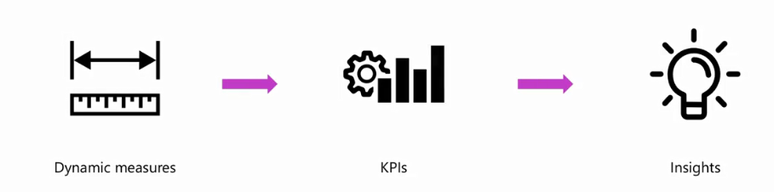

Benefits of Time Intelligence

Slide 14
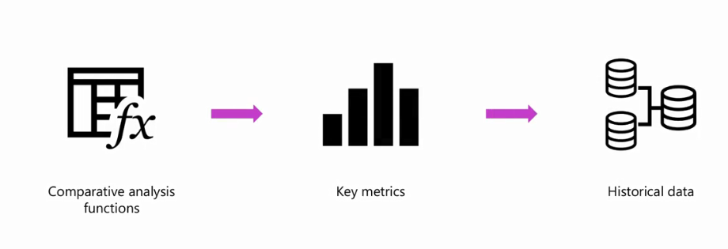
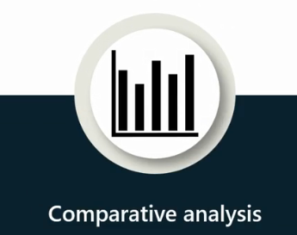
Benefits of Time Intelligence

Slide 15
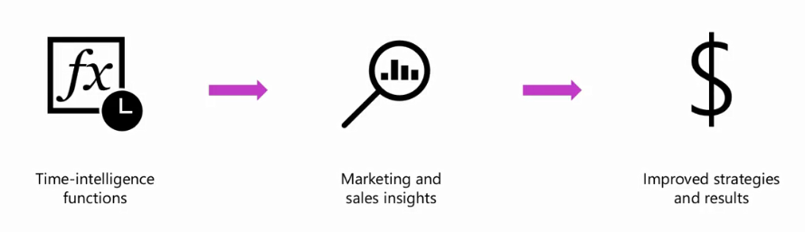

Benefits of Time Intelligence

Slide 16
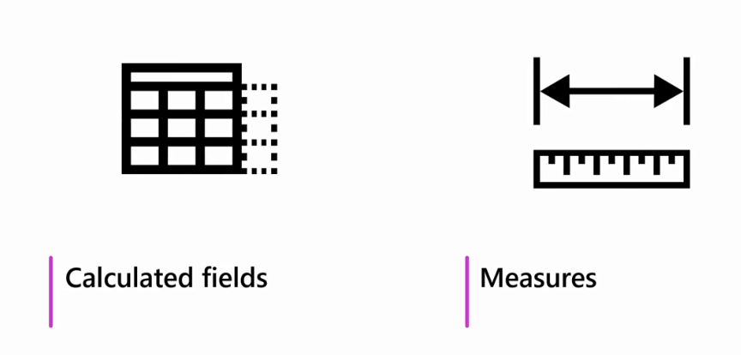
Implementing Time Intelligence

Slide 17

Implementing Time Intelligence

Slide 18
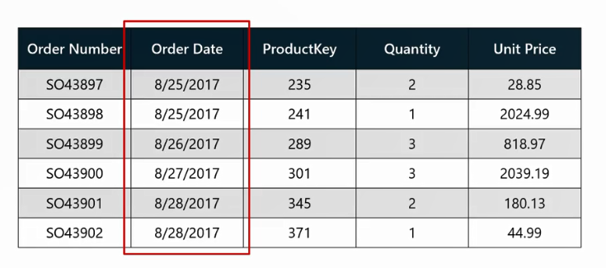
Implementing Time Intelligence
Power BI automatically creates a one date table for each date column in the data model to analyze data, but different data attributes.

Slide 19
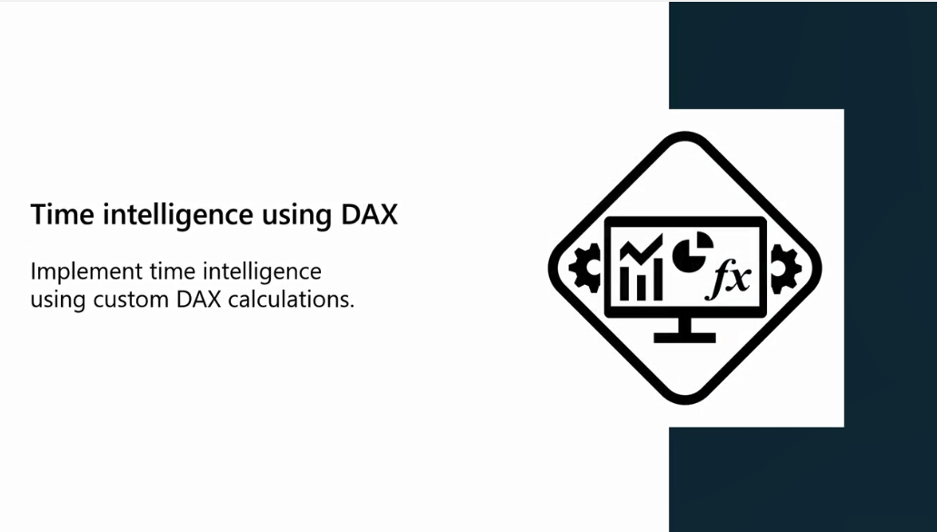
Implementing Time Intelligence

Slide 20
Question
What is the advantage of time intelligence in Power BI for businesses?
It enables businesses to analyze data based on time-related dimensions.
It enables businesses to analyze data through real-time data processing.
It enables businesses to create hierarchies based on date data for visualization.

Slide 21
ANSWER
What is the advantage of time intelligence in Power BI for businesses?
It enables businesses to analyze data based on time-related dimensions.
It enables businesses to analyze data through real-time data processing.
It enables businesses to create hierarchies based on date data for visualization.

Slide 22
2
Setting up a common date table

Slide 23
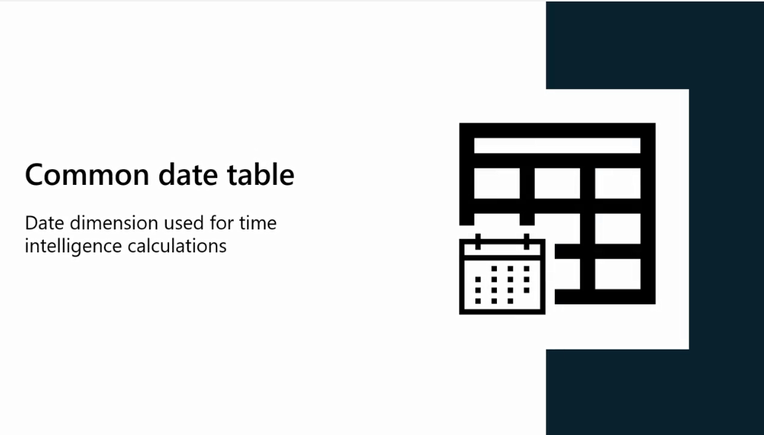
Common Date Table (Date Dimension Table)
Is a prerequisite for time intelligence calculations.
You can't execute them without a date dimension.

Slide 24
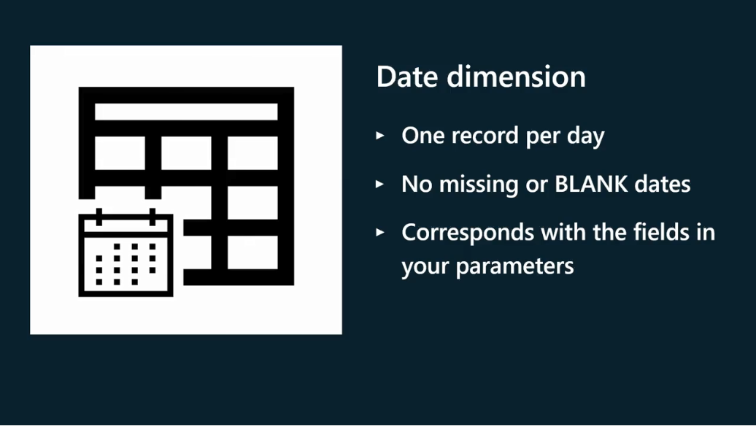
The Date Dimension Requirements

Slide 25
What if your data model is missing a date dimension?
You can use Power BI’s auto date/time intelligence

Slide 26


What if your data model is missing a date dimension?
You can also create a date dimension in Power Bi

Slide 27
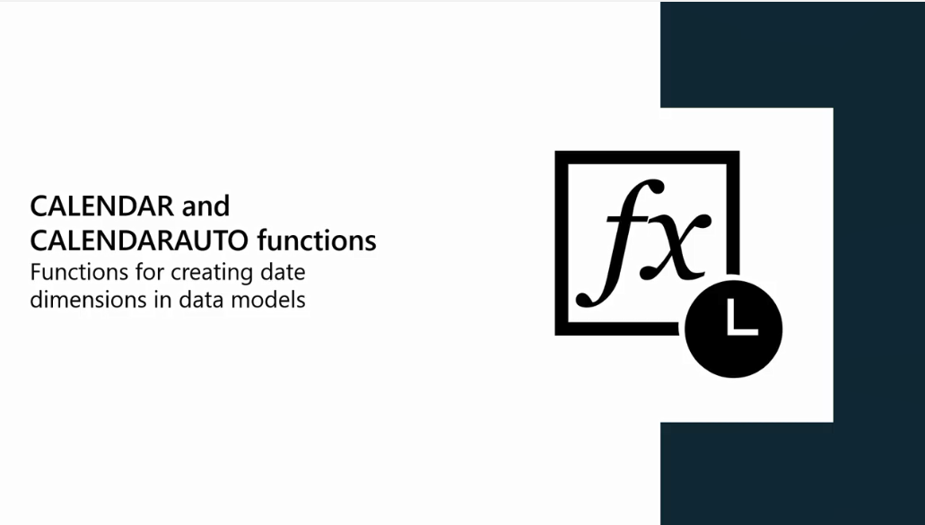
CALENDER and CALENDERAUTO

Slide 28
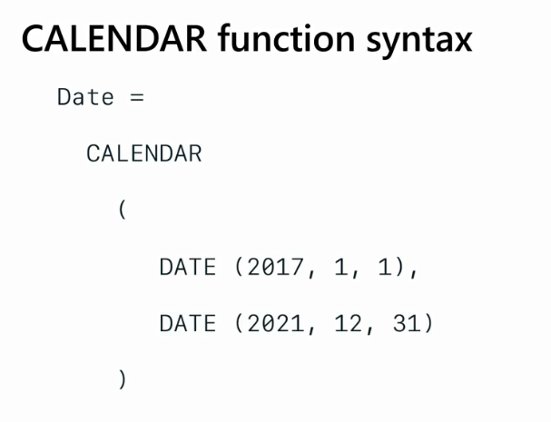
CALENDER

Slide 29
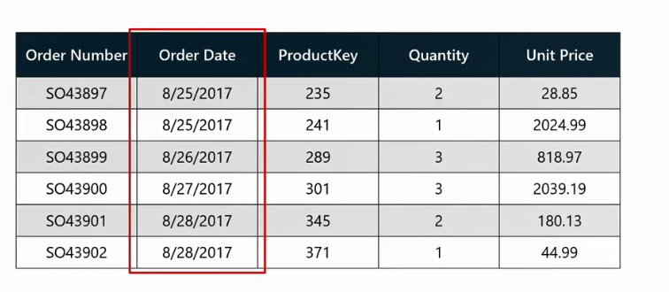
CALENDERAUTO
CALENDERAUTO scans the data model for the Date column

Slide 30
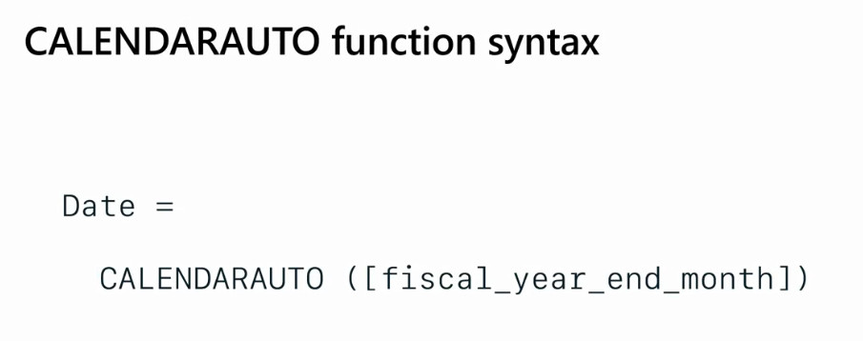
CALENDERAUTO

Slide 31
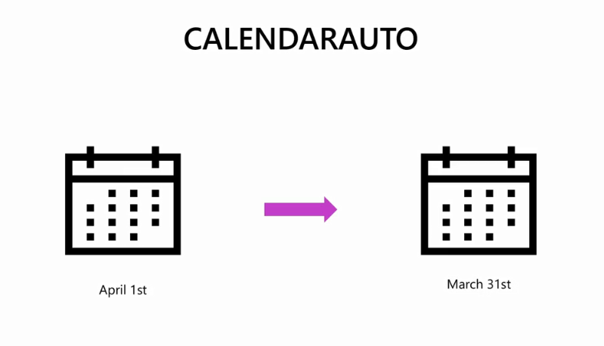
CALENDERAUTO
You can specify start and end of the year

Slide 32

CALENDERAUTO
Default

Slide 33
Question
True or False: The CALENDARAUTO function takes both the start and the end date from a dataset.
True
False

Slide 34
ANSWER
True or False: The CALENDARAUTO function takes both the start and the end date from a dataset.
True
False

Slide 35

Exercise 20:
Set up a common date table Using DAX

Slide 36
Exercise 21:
Set up a common date table Using M Language

Slide 37
Exercise 22:
Calculating MTD ,
QTD , and YTD

Slide 38
Exercise 23:
Comparing same
period last year

Slide 39
Exercise 24:
Compare to
previous period

Slide 40
Exercise 25:
DATEADD Function

Slide 41


Slide 42

Question 1
Why is it important to have a properly defined date column in the data model to execute time intelligence functions?
To enable the use of advanced data visualization techniques.
To create calculated columns and measures in the data model.
To ensure data accuracy and consistency in time-based calculations.

Slide 43
ANSWER 1
Why is it important to have a properly defined date column in the data model to execute time intelligence functions?
To enable the use of advanced data visualization techniques.
To create calculated columns and measures in the data model.
To ensure data accuracy and consistency in time-based calculations.

Slide 44
Question 2
Which of the following features of Power BI can you use to add a date or common-dimension table to the data model? Select all that apply.
Data Analysis Expressions
The Data modeling tab
Power Query and M language
Manual data entry

Slide 45
ANSWER 2
Which of the following features of Power BI can you use to add a date or common-dimension table to the data model? Select all that apply.
Data Analysis Expressions
The Data modeling tab
Power Query and M language
Manual data entry

Slide 46
Question 3
True or False: DAX time intelligence functions can be used with Power BI’s autogenerated date/time dimension.
True
False

Slide 47
ANSWER 3
True or False: DAX time intelligence functions can be used with Power BI’s autogenerated date/time dimension.
True
False

Slide 48


