Slide 1





Data Visualization
in Power BI
02 Report Design Basics
Prepared By :
Said Fawzy
Manager of Information Center
Tendering Department
Arab Contractors

Slide 2

1
Design an appealing Report Page
2
Conditional Formatting
3
Align and Positioning
4
Working with Themes

Slide 3
1
Design an appealing Report Page

Slide 4

Exercise 7:
Design an appealing Report Page

Slide 5
Site you might use for design
Try searching for words like Dashboard on those sites
Adobe Stoke
https://stock.adobe.com/eg/search?k=dashboard&search_type=recentsearch
Freepik
https://www.freepik.com/search?format=search&last_filter=query&last_value=dashborad&query=dashborad
Pinterest
https://www.pinterest.com/search/pins/?q=dashboard&rs=typed

Slide 6
1
Conditional Formatting

Slide 7
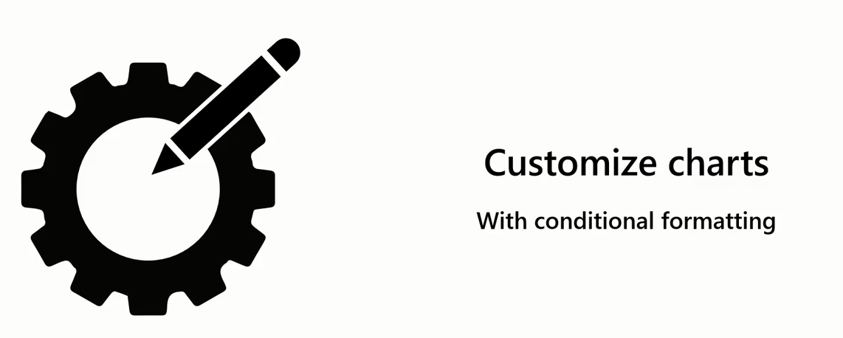
Conditional Formatting

Slide 8
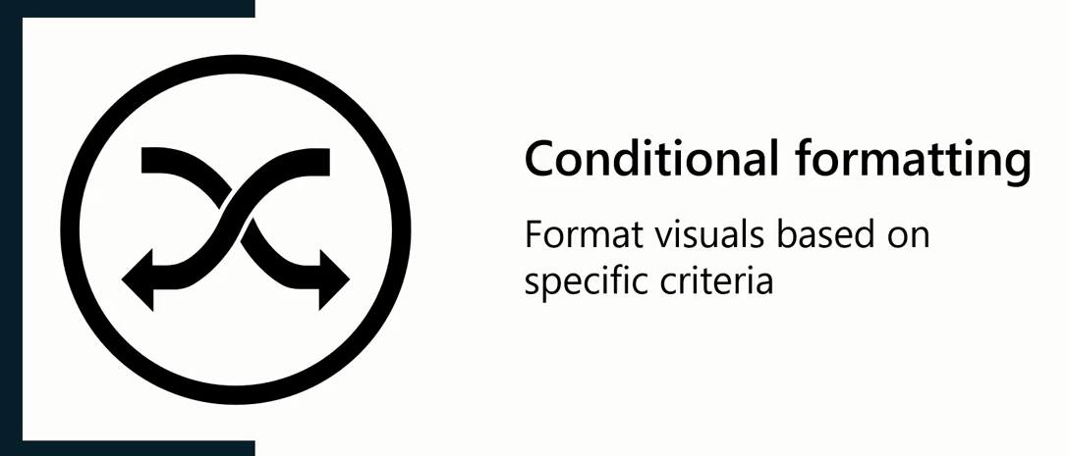
Conditional Formatting

Slide 9
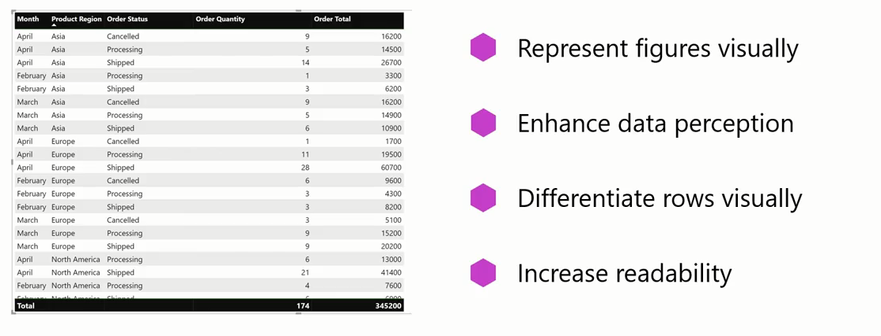
Conditional Formatting

Slide 10
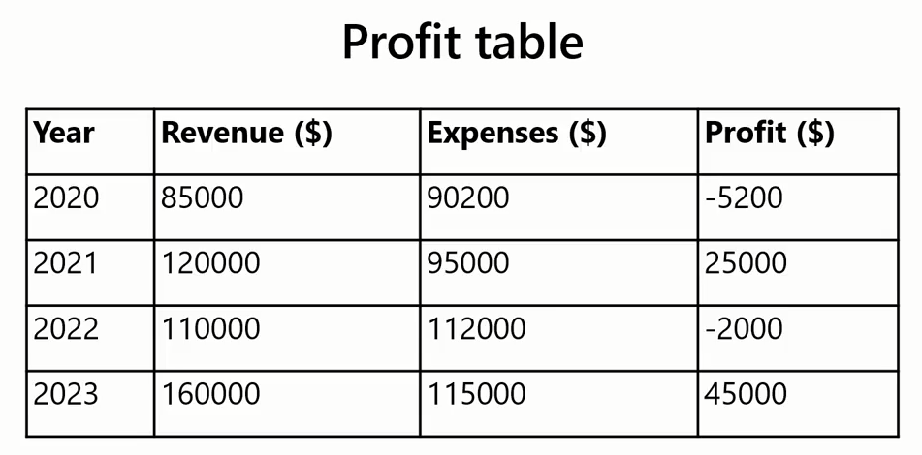
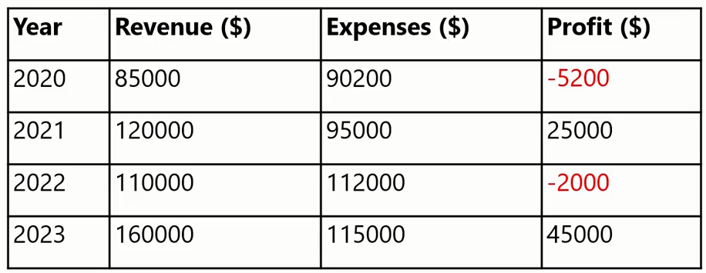
Conditional Formatting
Example

Slide 11
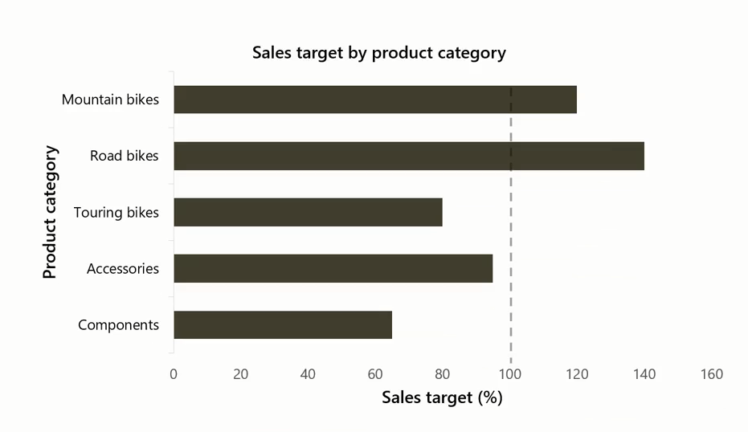
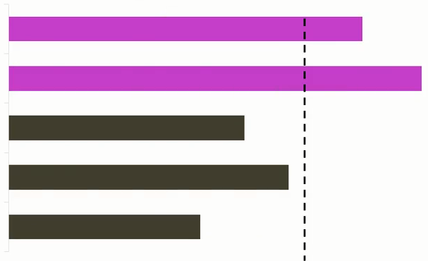
Conditional Formatting
Example

Slide 12


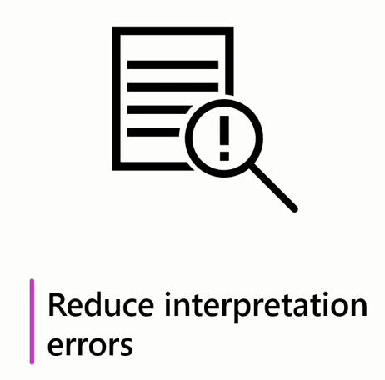

Conditional Formatting

Slide 13
Exercise 8:
Conditional Formatting

Slide 14
Question
Which of the following are examples of conditional formatting in Power BI? Select all that apply.
A. Changing the background color of a cell in a table based on certain conditions.
B. Customizing the color of bars in a bar chart based on predefined thresholds.
C. Changing the color of data bars based on their values.
D. Changing the font size and color of a text field.

Slide 15
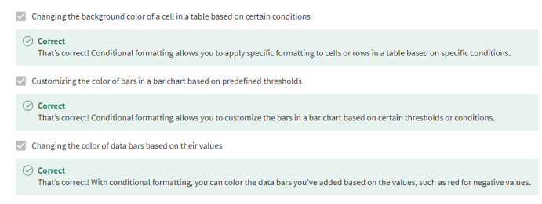
Answer
Which of the following are examples of conditional formatting in Power BI? Select all that apply.
A. Changing the background color of a cell in a table based on certain conditions.
B. Customizing the color of bars in a bar chart based on predefined thresholds.
C. Changing the color of data bars based on their values.
D. Changing the font size and color of a text field.

Slide 16
3
Align and Positioning

Slide 17
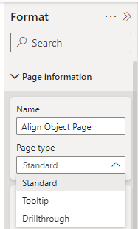
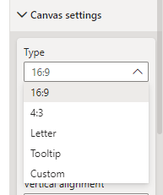
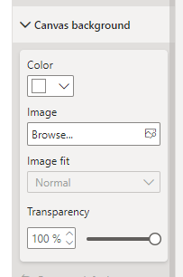
Page Information

Slide 18
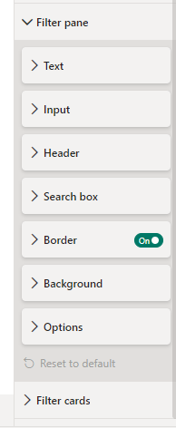
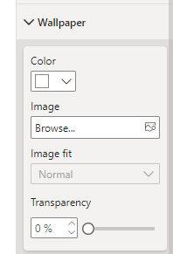
Page Information

Slide 19
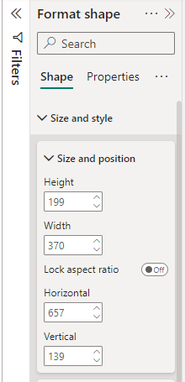
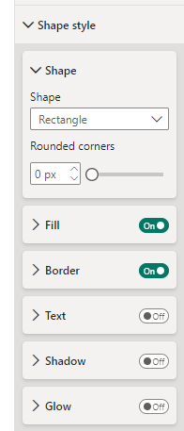
Shape Formatting

Slide 20
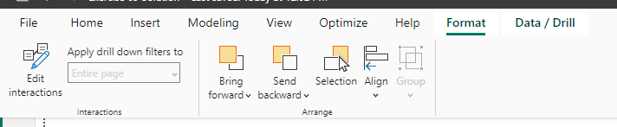
Format Tab

Slide 21
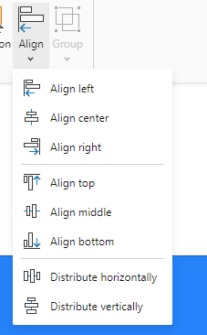
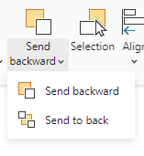
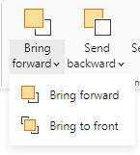
Format Tab

Slide 22
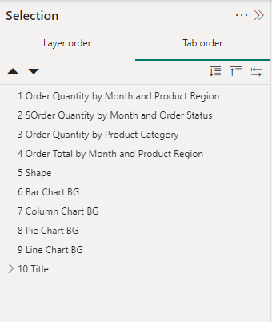
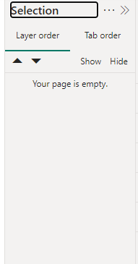
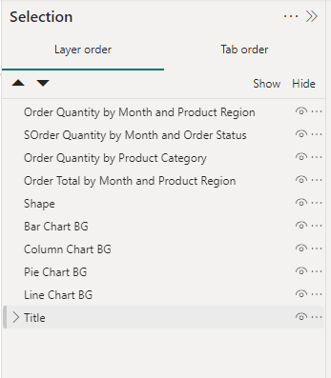
Selection Pane

Slide 23
Exercise 9:
Position and Alignment

Slide 24
4
Working with Themes

Slide 25

Themes
Your report should always align with the company's brand, colors, and style guide.
To update the design elements of the report to reflect the company's brand aesthetics would be a tedious, time-consuming task.
Luckily, themes in Microsoft Power BI could simplify the task at hand and save you a lot of time and effort.

Slide 26
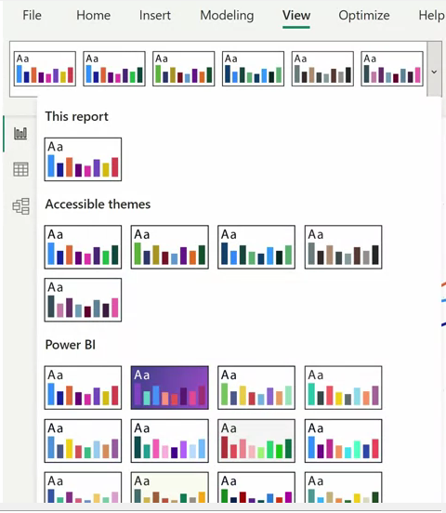
What are Themes ?
Themes in Power BI are predefined sets of colors, fonts, and visual styles that you can apply to your reports easily and quickly

Slide 27
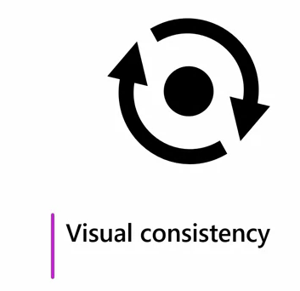
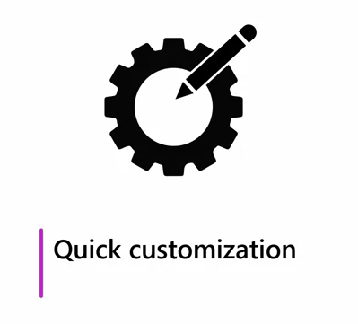
Themes

Slide 28

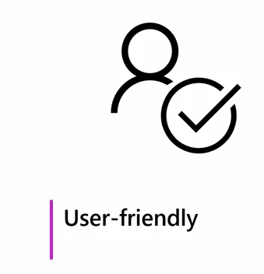
Themes

Slide 29

Themes

Slide 30

Themes
Power BI offers theme customization options you can use to cater to specific accessibility needs, such as high contrast themes for users with visual impairments.

Slide 31
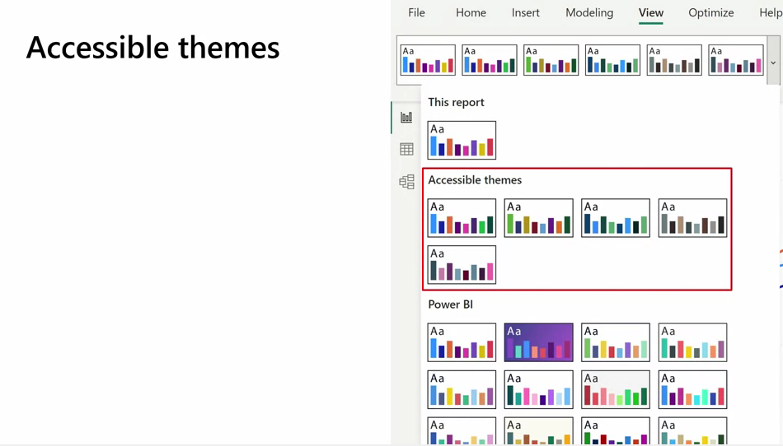
Themes

Slide 32
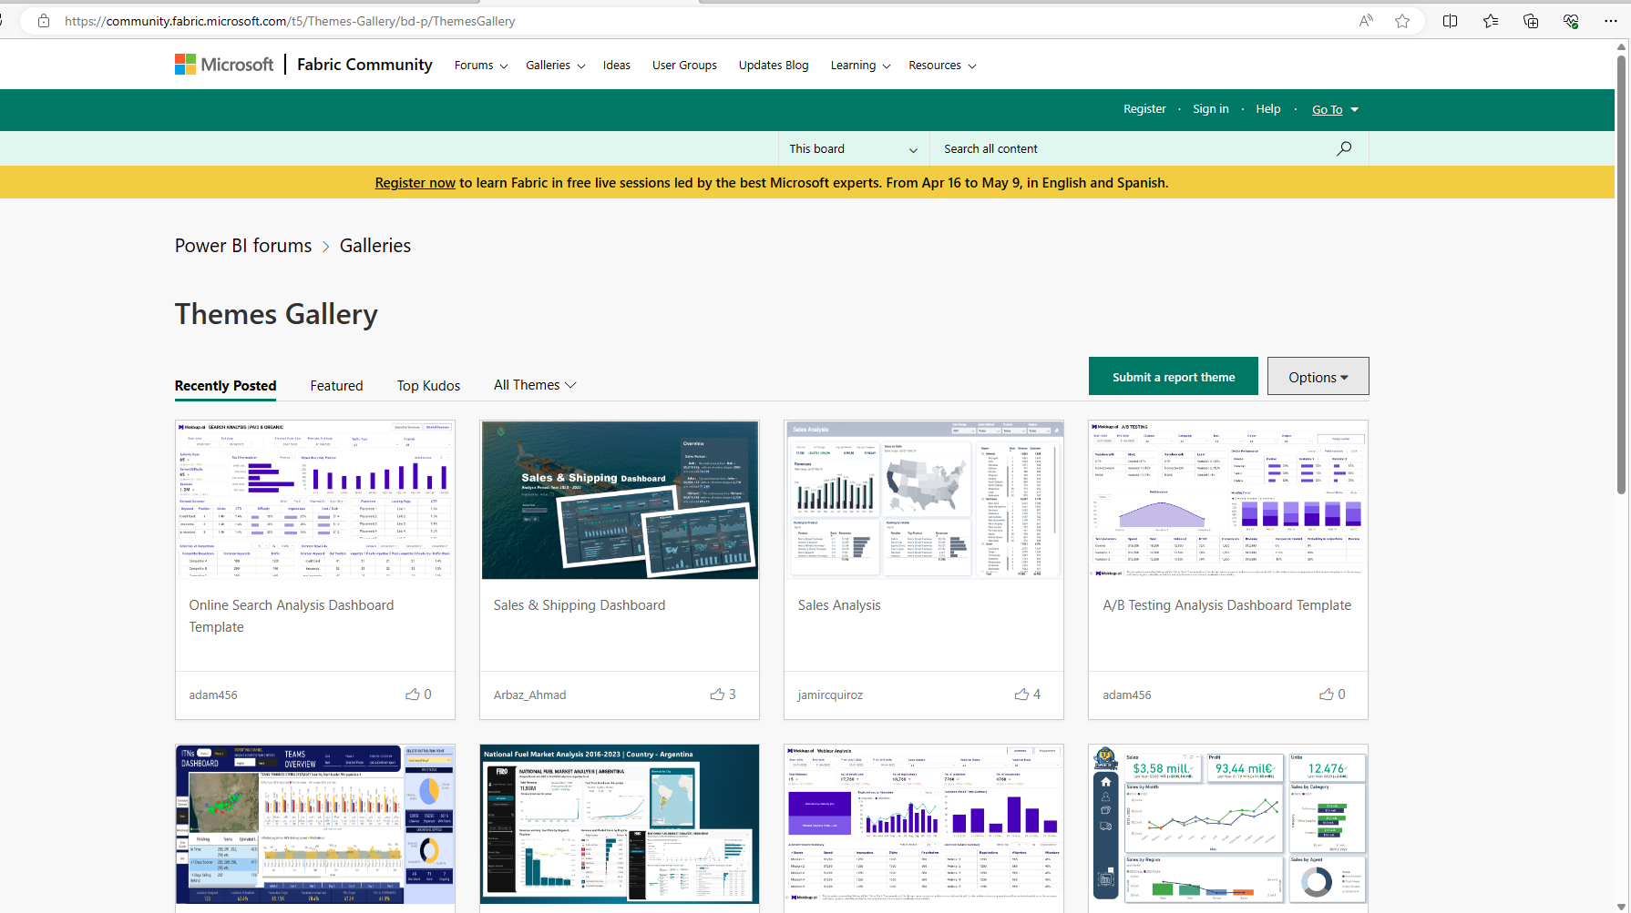
Theme Gallery

Slide 33
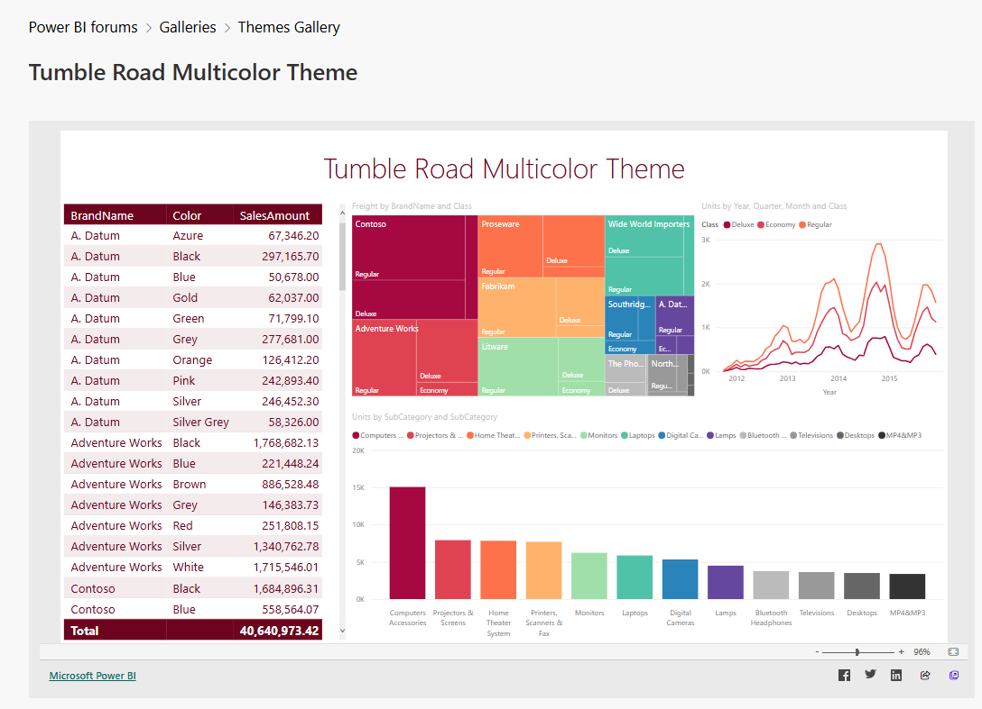
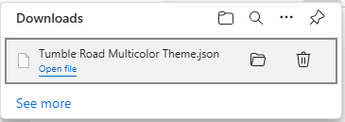
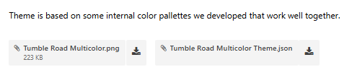
Theme Gallery

Slide 34
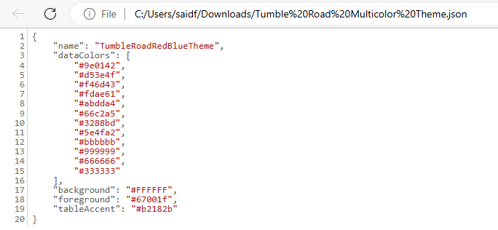
Theme Gallery

Slide 35
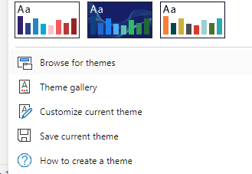
Theme Gallery

Slide 36
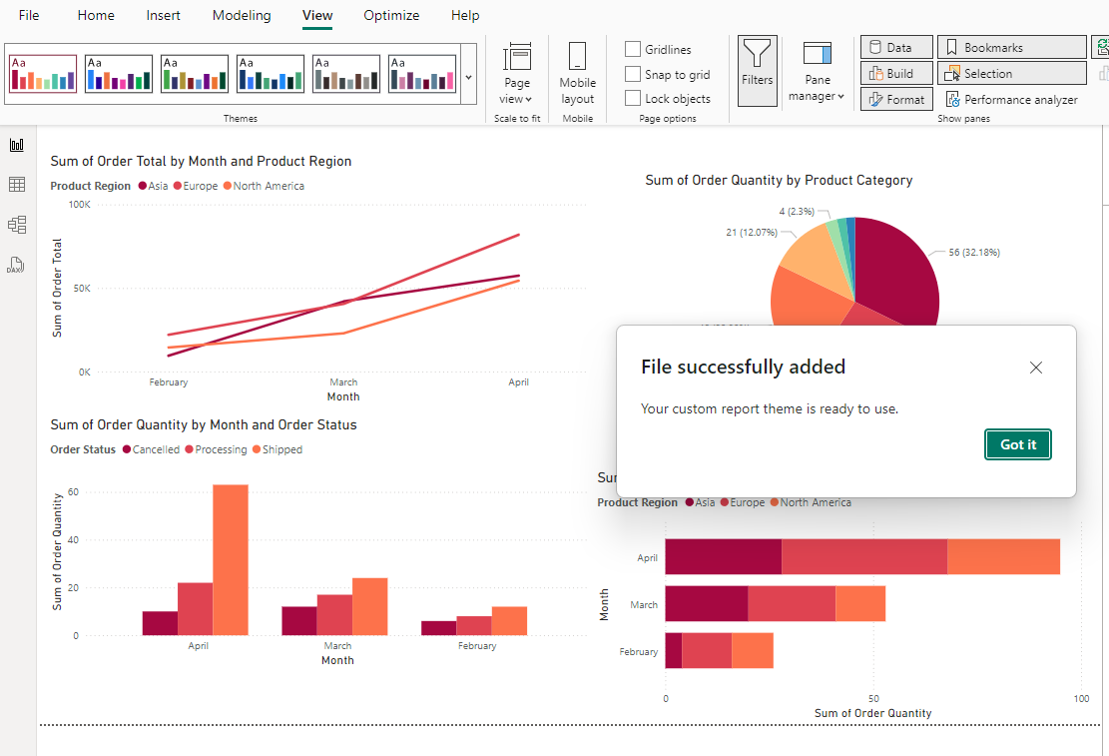
Theme Gallery

Slide 37
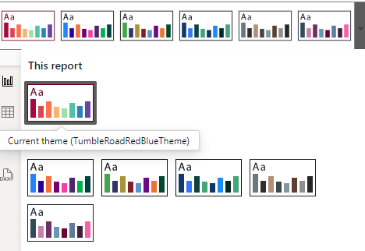
Theme Gallery

Slide 38
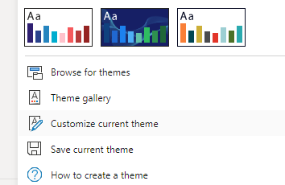
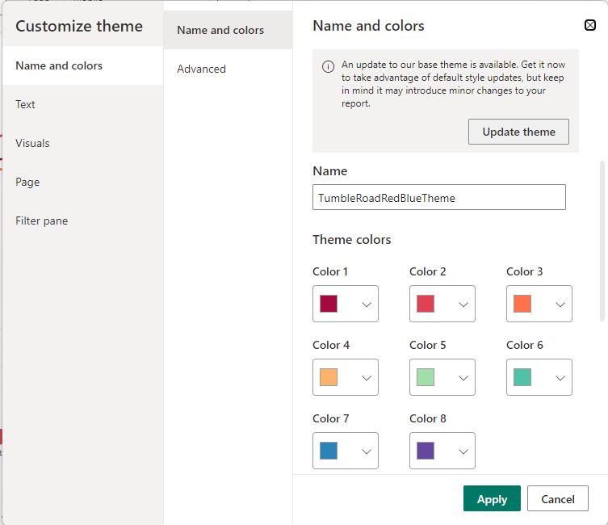
Customize theme

Slide 39
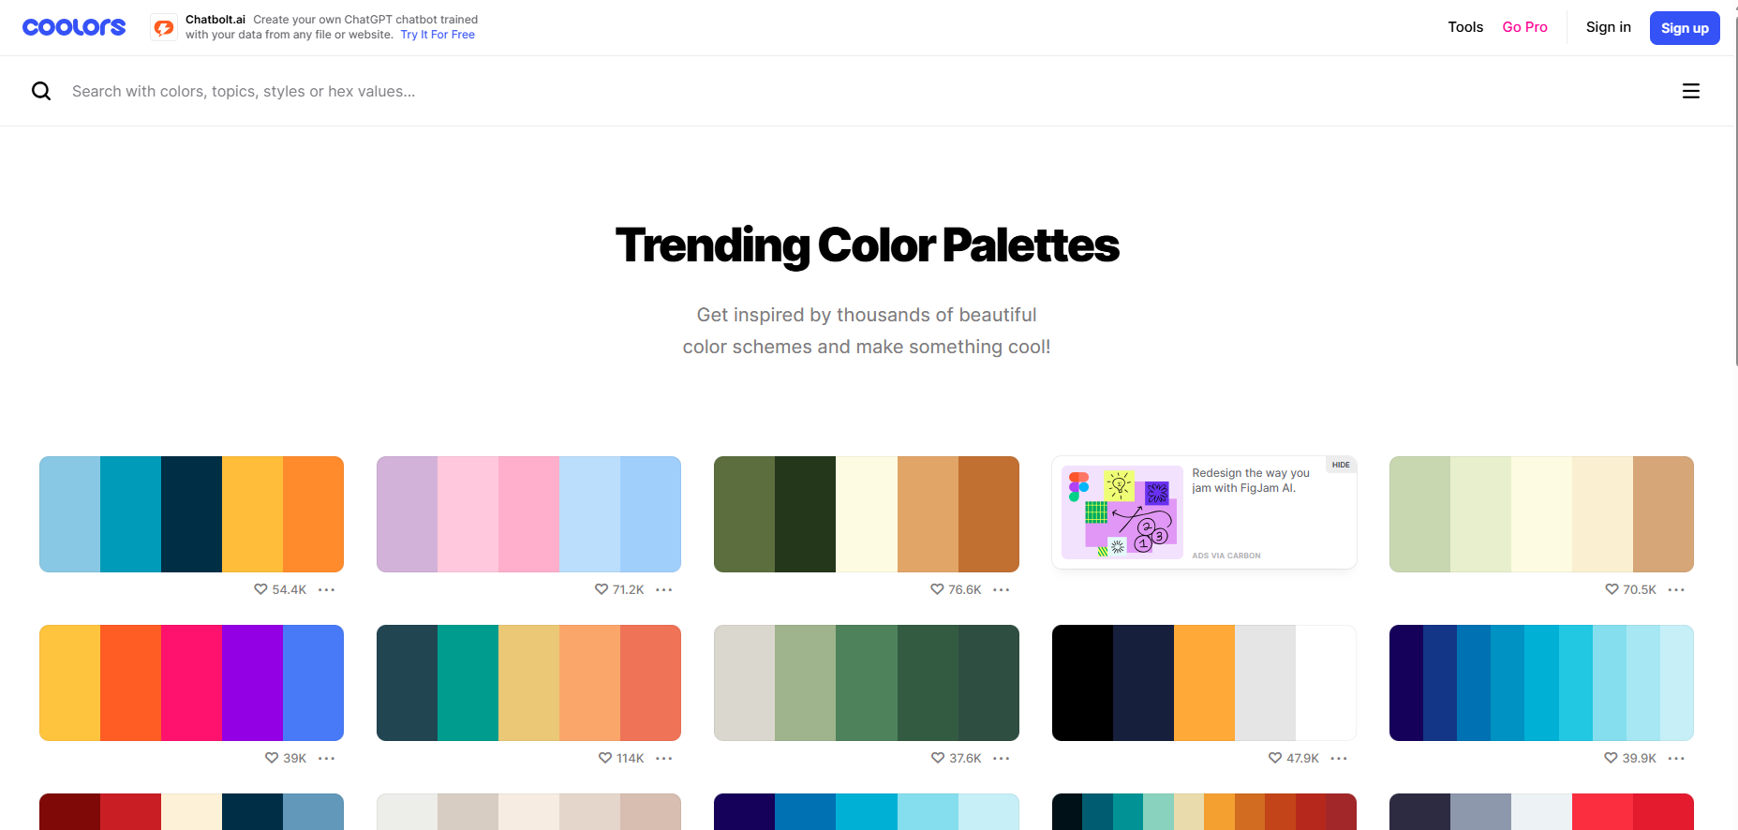
Customize theme
Trending Color Palettes - Coolors

Slide 40
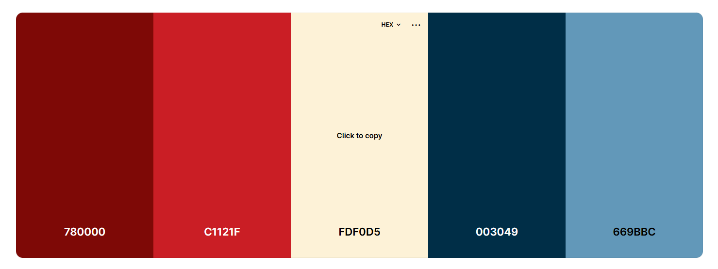
Customize theme

Slide 41
Exercise 10:
Working with Themes

Slide 42
Question
What is the function of themes in Microsoft Power BI? Select all that apply.
A. Enabling alignment of reports with brand guidelines
B. Improving the accessibility and readability of reports
C. Enhancing the visual consistency across reports
D. Changing the colors of each report visual based on various conditions

Slide 43
ANSWER
What is the function of themes in Microsoft Power BI? Select all that apply.
A. Enabling alignment of reports with brand guidelines
B. Improving the accessibility and readability of reports
C. Enhancing the visual consistency across reports
D. Changing the colors of each report visual based on various conditions

Slide 44


