Slide 1
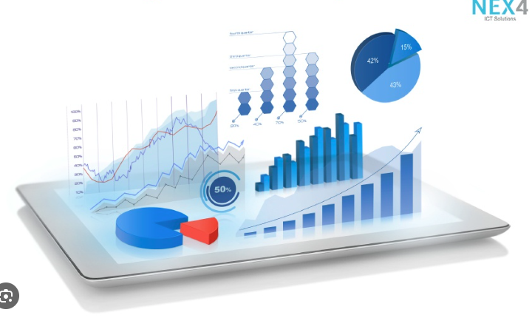




Data Visualization
in Power BI
05 Power BI Service
Prepared By :
Said Fawzy
Manager of Information Center
Tendering Department
Arab Contractors

Slide 2

1
The Structure of .pbix file
2
Publish Your Report Power BI Service
3
Create a Power BI Account
4
Dashboard

Slide 3
5
Quick Insights
6
Q&A

Slide 4
1
The Structure of .pbix file

Slide 5
What is a pbix File ?
SalesReport.pbix
Report
Semantic Model
Dataset
Page1
Page2
Visual 1
Visual 1
Visual 2

Slide 6
2
Publish Your Report Power BI Service

Slide 7
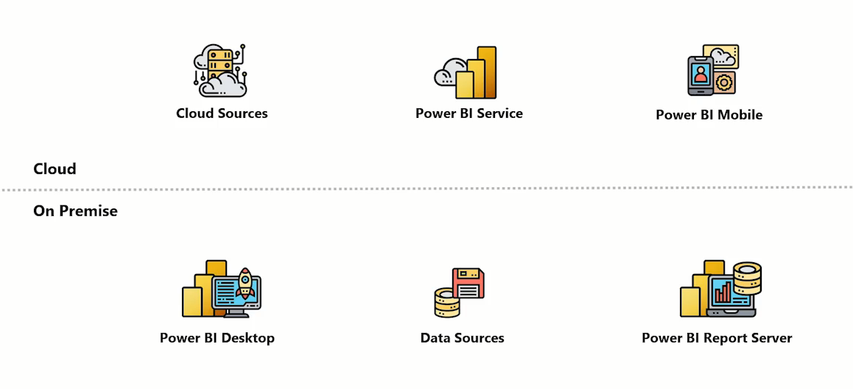
Power BI Architecture
Publish
Gateway

Slide 8
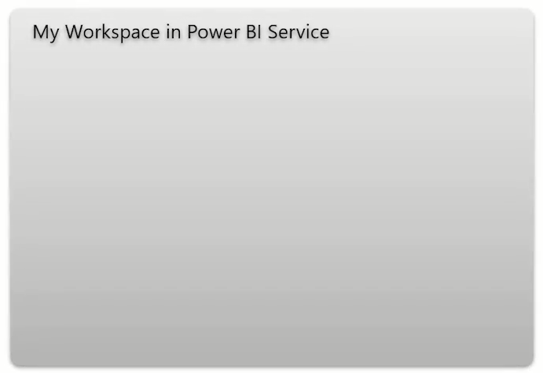

Publish Your Report
SalesReport.pbix
Semantic Model
Report

Slide 9
Publish Your Report
SalesReport.pbix
Semantic Model SalesReport
Report
SalesReport
Dashboard
Report
MarketReport
Semantic Model Finance
Report
MarketReport

Slide 10
3
Create a Power BI Account

Slide 11


Create Power BI Account
Free Account
Pro Account

Slide 12
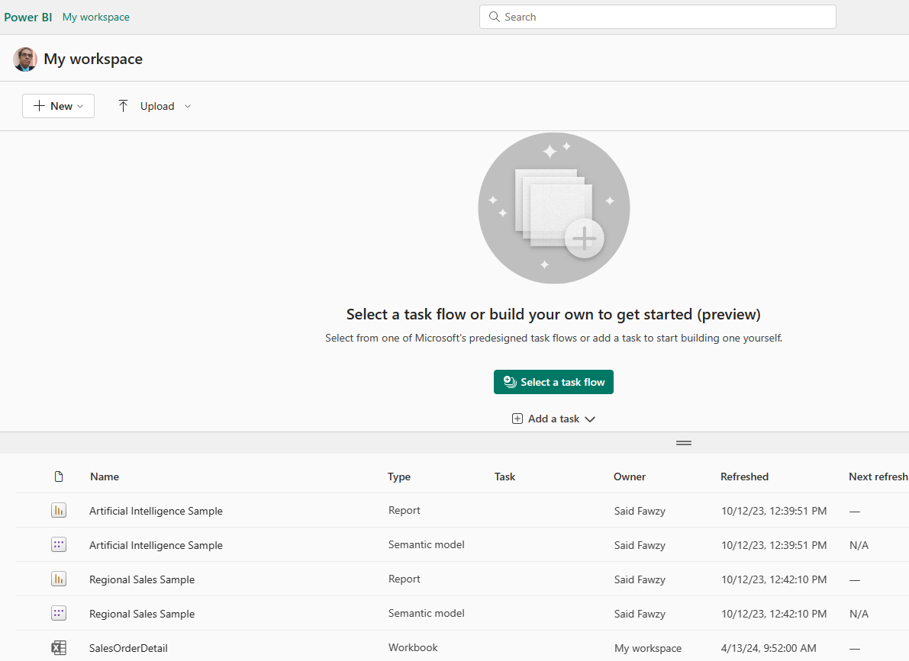
Create Power BI Account
Personal

Slide 13
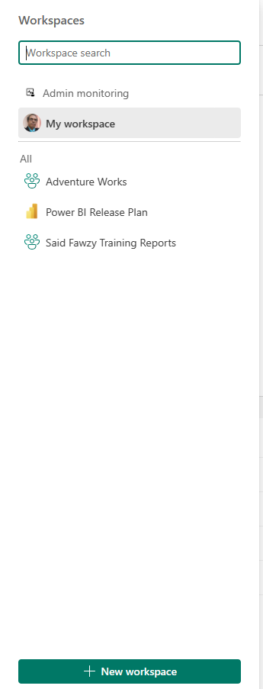
Create Power BI Account

Slide 14
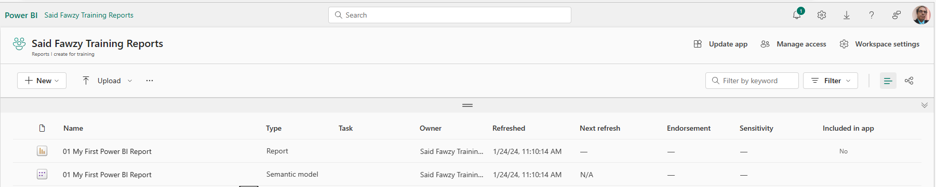
Workspace

Slide 15
Workspace

Slide 16
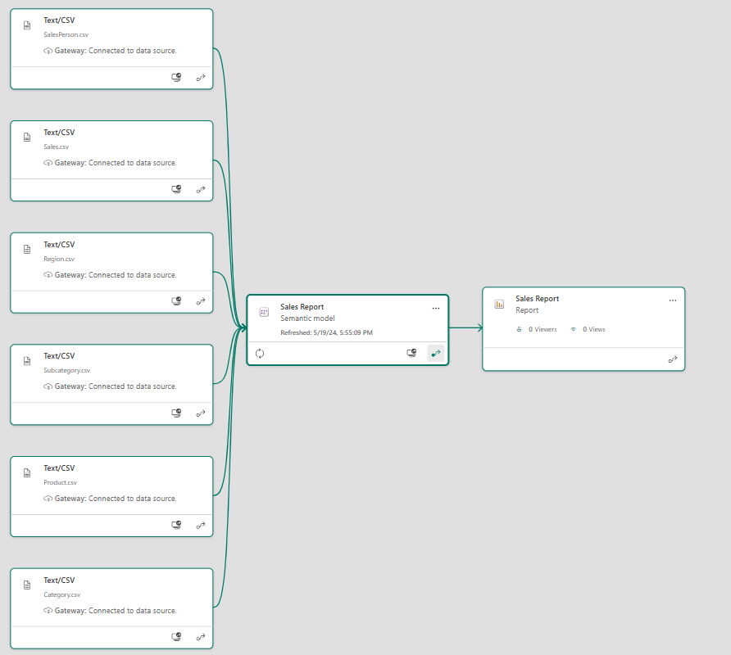
Workspace
Lineage View

Slide 17

Exercise 30 :
Publish a Report

Slide 18
Exercise 31 :
Creating Reports Using the Same Semantic Model

Slide 19
Question
What is the primary function of publishing reports in Microsoft Power BI?
A. To connect your Power BI report with other data visualization tools.
B. To move your report from Power BI Desktop to Power BI Service.
C. To create a report using Power BI Desktop.
D. To analyze data in your report using Power BI tools.

Slide 20
ANSWER
What is the primary function of publishing reports in Microsoft Power BI?
A. To connect your Power BI report with other data visualization tools.
B. To move your report from Power BI Desktop to Power BI Service.
C. To create a report using Power BI Desktop.
D. To analyze data in your report using Power BI tools.

Slide 21
4
Dashboard

Slide 22




What is a Dashboard

Slide 23
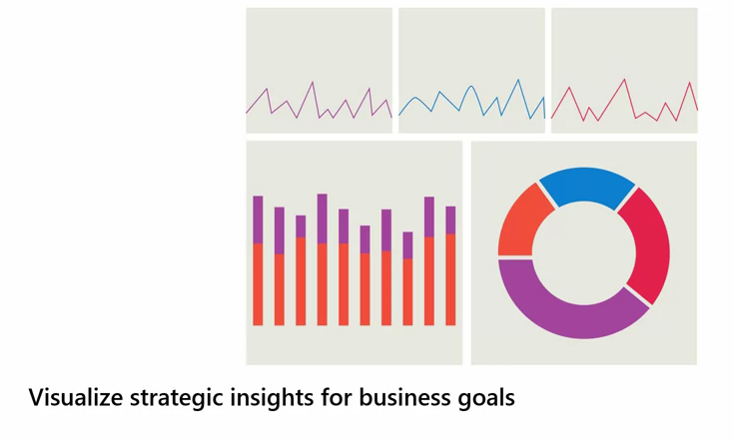
What is a Dashboard

Slide 24
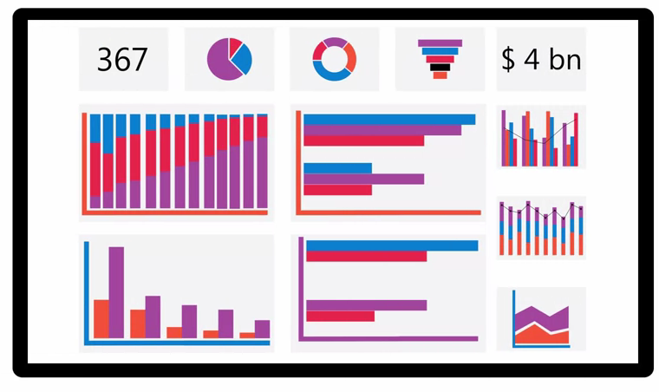
What is a Dashboard

Slide 25
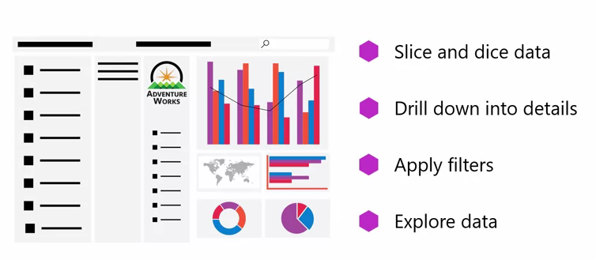
Difference between Report and Dashboard
Report

Slide 26
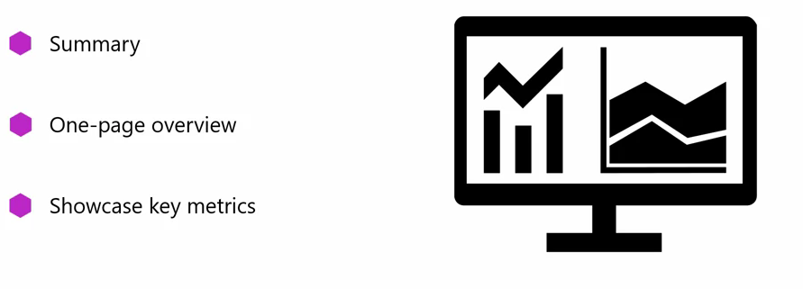
Difference between Report and Dashboard
Report
Dashboard

Slide 27



Difference between Report and Dashboard
Report
Dashboard

Slide 28
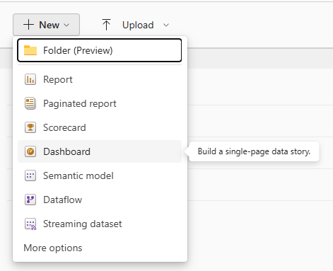
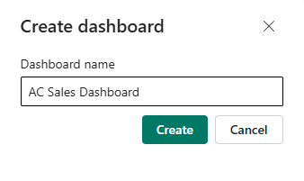
Create Dashboard

Slide 29
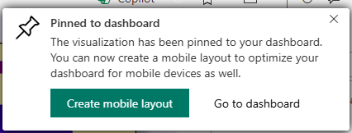
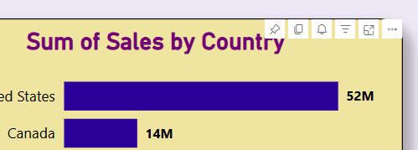
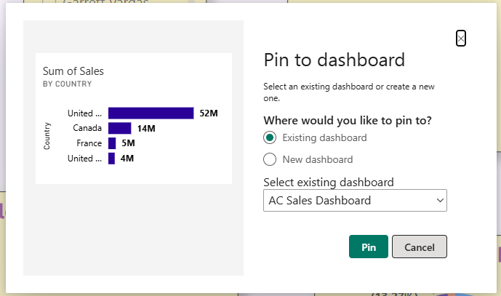
Pin a Visual to Dashboard

Slide 30
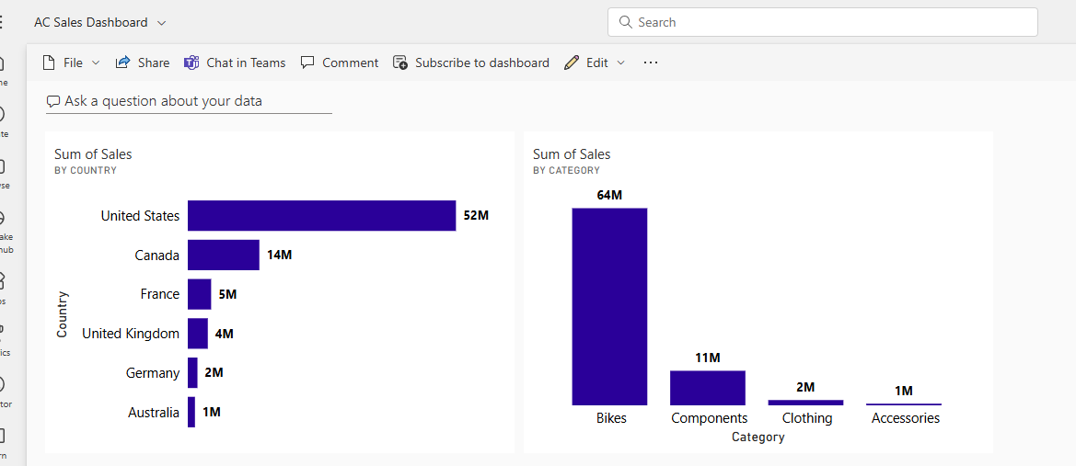
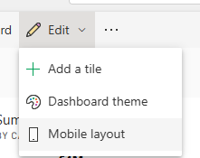
Dashboard Mobile View

Slide 31
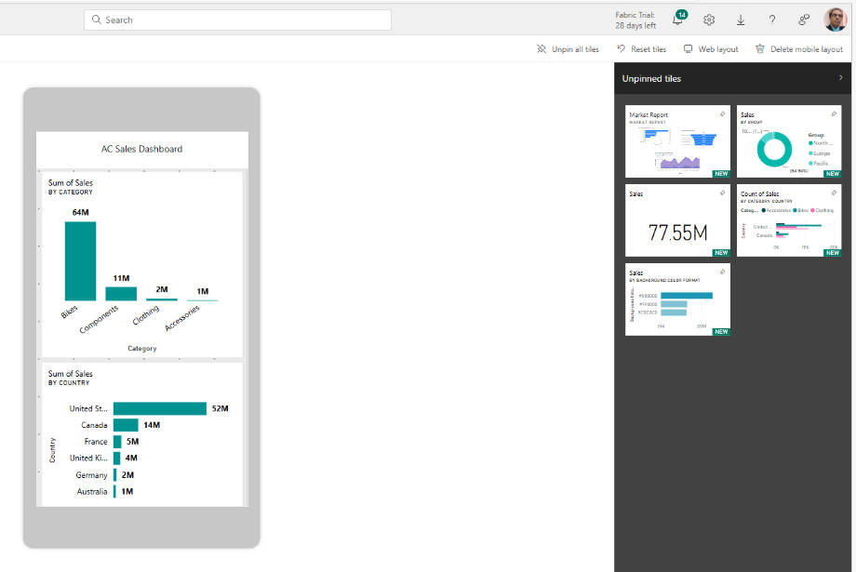
Dashboard Mobile View

Slide 32
Dashboard Mobile View

Slide 33
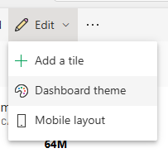
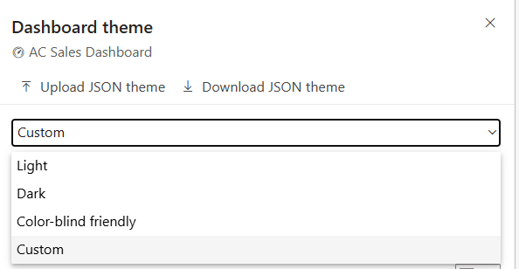
Change the theme of a Dashboard

Slide 34
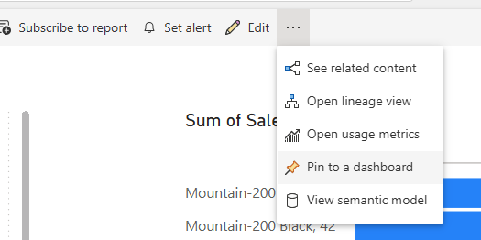
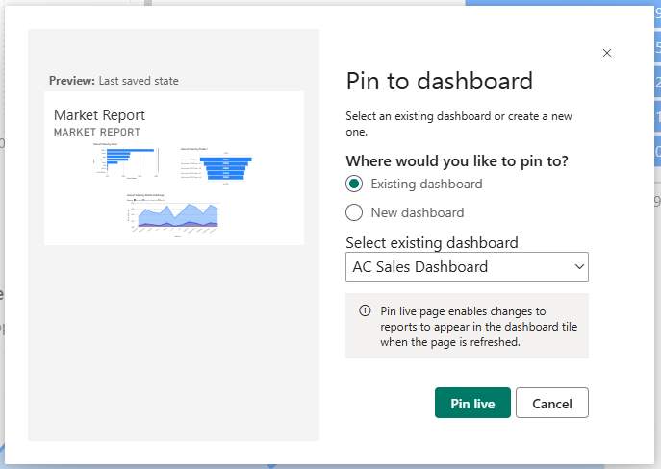
Pinning a Live Report

Slide 35
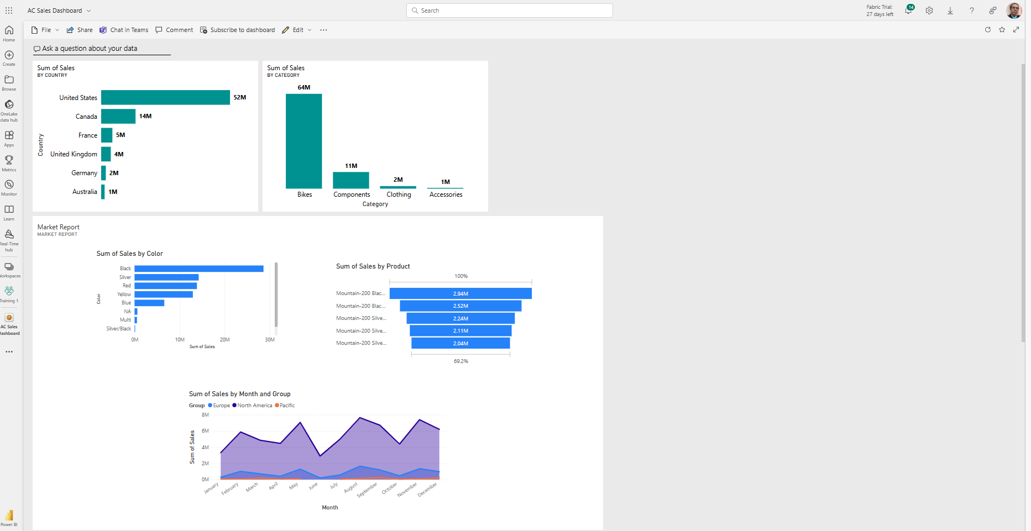
Pinning a Live Report

Slide 36
Question 1
How does a report in Power BI differ from a dashboard?
A. There is no difference between a report and a dashboard in Power BI.
B. A report is an in-depth, interactive view of a specific dataset, while a dashboard provides a summary of the most important metrics.
C. A report provides a summary of the most important metrics, while a dashboard is an in-depth, interactive view of a specific dataset.
D. A dashboard in Power BI allows for interactive analysis, while a report does not.

Slide 37
ANSWER 1
How does a report in Power BI differ from a dashboard?
A. There is no difference between a report and a dashboard in Power BI.
B. A report is an in-depth, interactive view of a specific dataset, while a dashboard provides a summary of the most important metrics.
C. A report provides a summary of the most important metrics, while a dashboard is an in-depth, interactive view of a specific dataset.
D. A dashboard in Power BI allows for interactive analysis, while a report does not.

Slide 38
Question 2
In configuring the mobile layout for a Microsoft Power BI dashboard, how do you select which visuals to show on the mobile layout?
A. The visuals that fit best within the mobile screen size are automatically selected.
B. By selecting the pin icons next to the desired visualizations.
C. The visuals are chosen based on their alignment with the dashboard's theme.
D. The visuals are automatically chosen by Power BI based on their related data.

Slide 39
ANSWER 2
In configuring the mobile layout for a Microsoft Power BI dashboard, how do you select which visuals to show on the mobile layout?
A. The visuals that fit best within the mobile screen size are automatically selected.
B. By selecting the pin icons next to the desired visualizations.
C. The visuals are chosen based on their alignment with the dashboard's theme.
D. The visuals are automatically chosen by Power BI based on their related data.

Slide 40
Question 3
What is the primary limitation of pinned visuals in Power BI Dashboard.
A. They are challenging to create.
B. They can only show limited data.
C. They are not visually appealing.
D. They lack interactivity.

Slide 41
ANSWER 3
What is the primary limitation of pinned visuals in Power BI Dashboard.
A. They are challenging to create.
B. They can only show limited data.
C. They are not visually appealing.
D. They lack interactivity.

Slide 42
5
Quick Insights

Slide 43

Quick Insights
•Quick insights is a feature in Power BI that automatically searches datasets to discover and visualize potential insights

Slide 44

Quick Insights

Slide 45
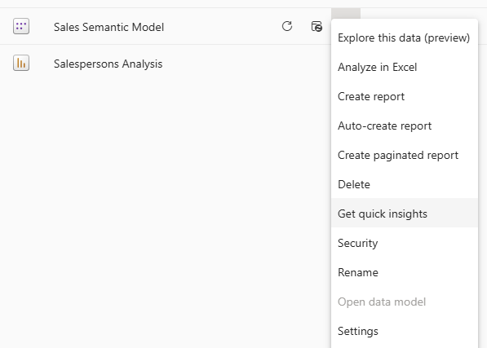
Quick Insights

Slide 46
Exercise 32 :
Quick Insights

Slide 47
6
Q&A

Slide 48

Q&A
The Q&A feature is a natural language processing tool in Power BI.
It allows you to ask questions about your data in plain English and provides answers in the form of charts, graphs, or simple numeric results.

Slide 49

Q&A

Slide 50

Q&A

Slide 51
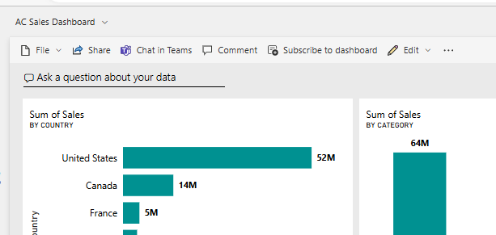
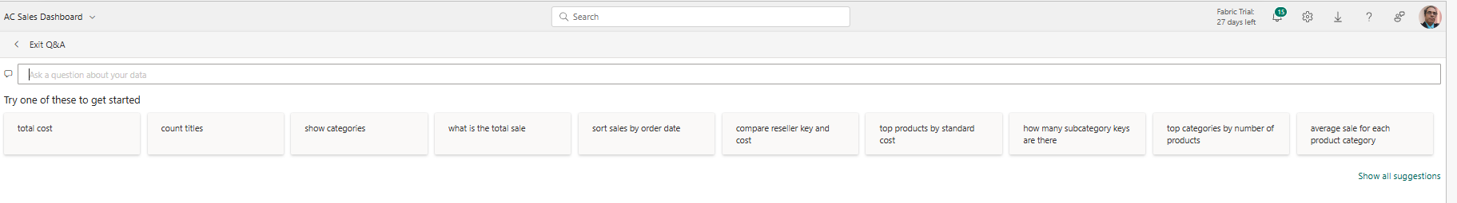
Q&A

Slide 52
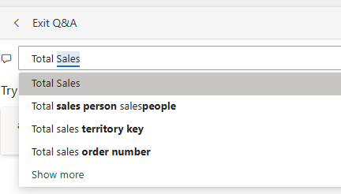
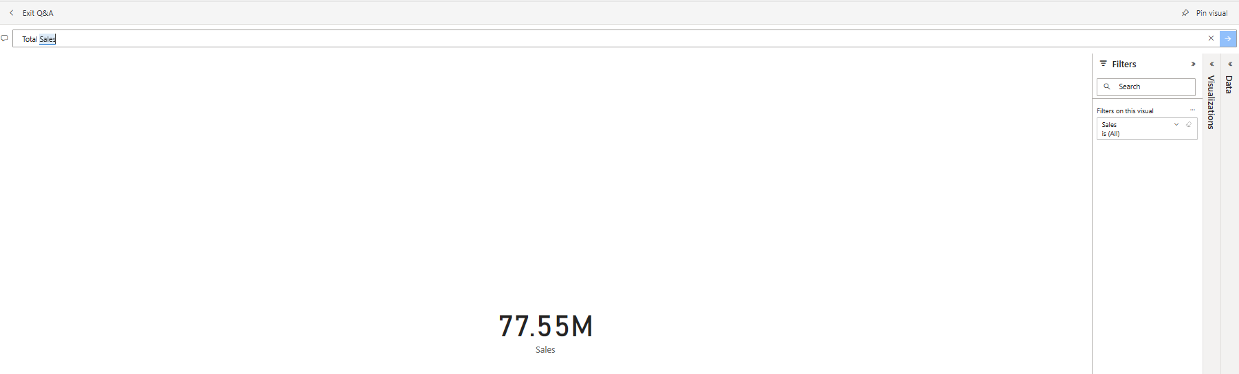
Q&A

Slide 53
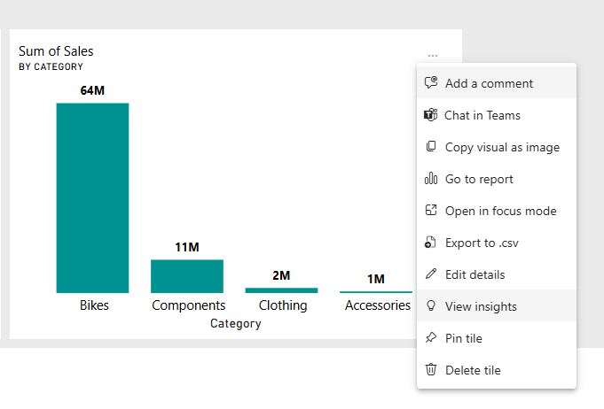
Scope Insight

Slide 54
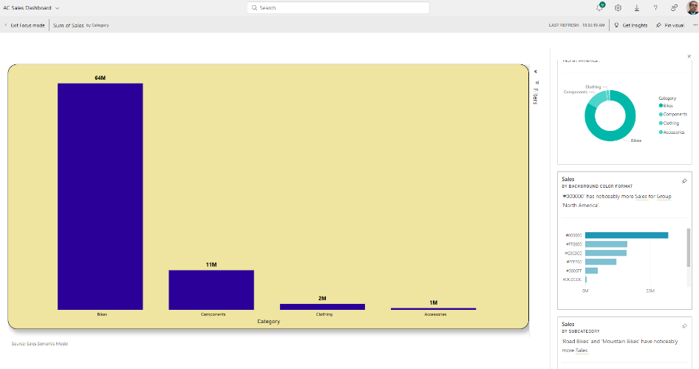
Scope Insight

Slide 55
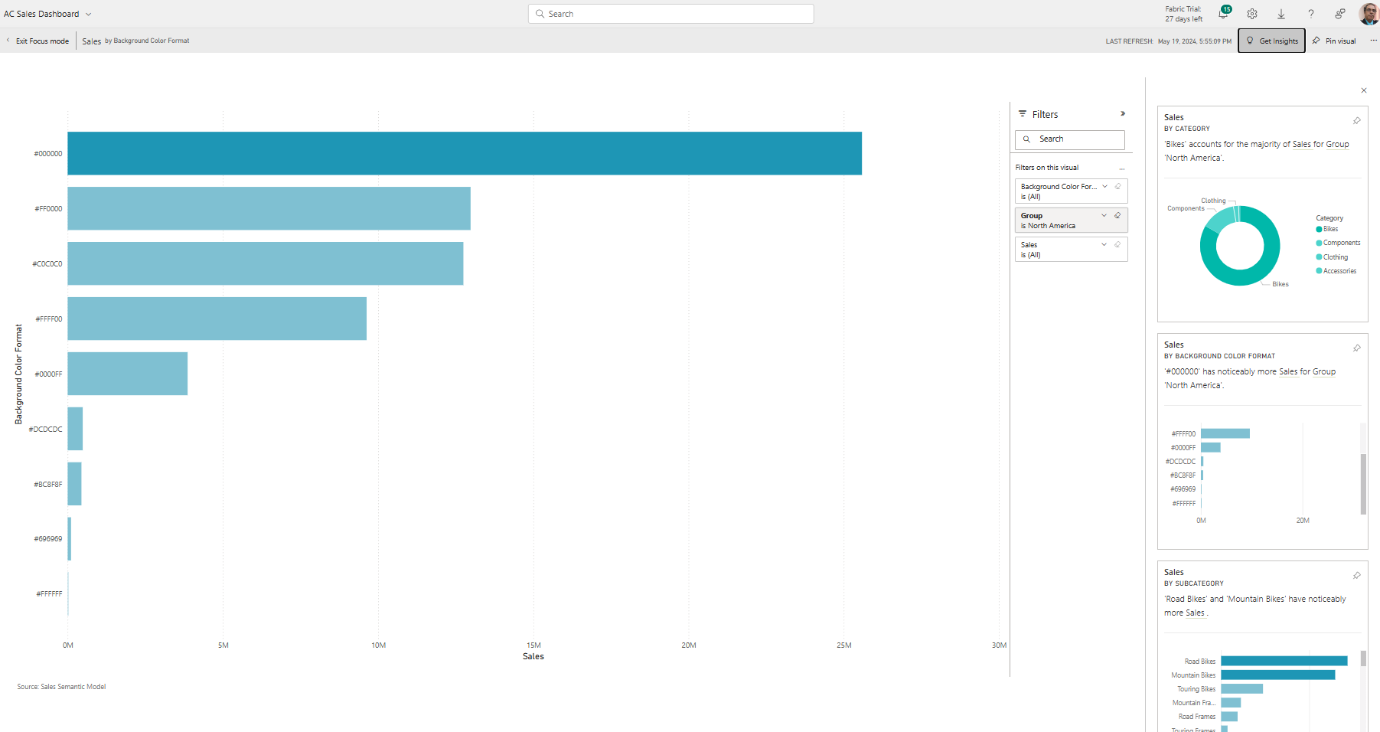
Scope Insight

Slide 56
Exercise 33 :
Q&A

Slide 57
Question
What is the primary role of the Quick Insights feature in Power BI?
A. To immediately implement changes in the dataset.
B. To ask questions about the dataset in plain English.
C. To automatically search datasets and visualize potential insights.
D. To store additional data for future analysis.

Slide 58
ANSWER
What is the primary role of the Quick Insights feature in Power BI?
A. To immediately implement changes in the dataset.
B. To ask questions about the dataset in plain English.
C. To automatically search datasets and visualize potential insights.
D. To store additional data for future analysis.

Slide 59


Slide 60
Question 1
How does a dashboard differ from a report in Microsoft Power BI?
A. Unlike a report, a dashboard provides an in-depth, interactive, multi-perspective view of a specific dataset.
B. A dashboard is a one-page view of the most important metrics or key performance indicators (KPIs) selected from various pages of one or more reports.
C. A report is a one-page view of the most important metrics or key performance indicators (KPIs) selected from one or more dashboards.
D. A report is less interactive than a dashboard.

Slide 61
ANSWER 1
How does a dashboard differ from a report in Microsoft Power BI?
A. Unlike a report, a dashboard provides an in-depth, interactive, multi-perspective view of a specific dataset.
B. A dashboard is a one-page view of the most important metrics or key performance indicators (KPIs) selected from various pages of one or more reports.
C. A report is a one-page view of the most important metrics or key performance indicators (KPIs) selected from one or more dashboards.
D. A report is less interactive than a dashboard.

Slide 62
Question 2
In Microsoft Power BI, what is the primary role of the Quick Insights feature?
A. It allows you to ask questions about your data in plain English.
B. It displays data in the form of charts and graphs.
C. It automatically searches datasets to discover and visualize potential insights.
D. It scans and cleans your data for analysis.

Slide 63
ANSWER 2
In Microsoft Power BI, what is the primary role of the Quick Insights feature?
A. It allows you to ask questions about your data in plain English.
B. It displays data in the form of charts and graphs.
C. It automatically searches datasets to discover and visualize potential insights.
D. It scans and cleans your data for analysis.

Slide 64
Question 3
What is the advantage of pinning live reports to your Microsoft Power BI dashboard over pinning static visuals?
A. Live reports automatically update every minute.
B. Live reports maintain the interactivity of the original report.
C. Live reports display only a single type of visualization.
D. You can pin live reports to multiple dashboards.

Slide 65
ANSWER 3
What is the advantage of pinning live reports to your Microsoft Power BI dashboard over pinning static visuals?
A. Live reports automatically update every minute.
B. Live reports maintain the interactivity of the original report.
C. Live reports display only a single type of visualization.
D. You can pin live reports to multiple dashboards.

Slide 66
Question 4
What is a crucial prerequisite for publishing a report to Power BI Service from Power BI Desktop?
A. The report needs to be a specific size before publishing.
B. You need to delete the report from Power BI Desktop to avoid duplication when publishing.
C. You need to save the report on Power BI Desktop before publishing.
D. You need to open the report in Power BI Service before publishing.

Slide 67

ANSWER 4
What is a crucial prerequisite for publishing a report to Power BI Service from Power BI Desktop?
A. The report needs to be a specific size before publishing.
B. You need to delete the report from Power BI Desktop to avoid duplication when publishing.
C. You need to save the report on Power BI Desktop before publishing.
D. You need to open the report in Power BI Service before publishing.

Slide 68


