Slide 1





Data Visualization
in Power BI
06 Data Visualization Project
Prepared By :
Said Fawzy
Manager of Information Center
Tendering Department
Arab Contractors

Slide 2

1
Create two Page Report
2
Publish your report
3
Create a Dashboard
4
Create Mobile View

Slide 3
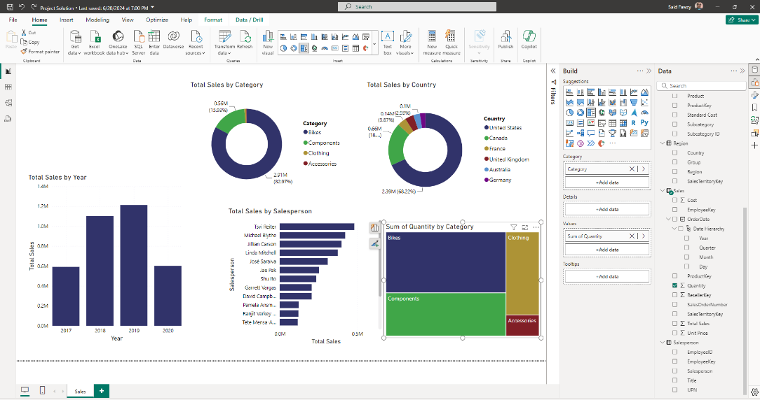
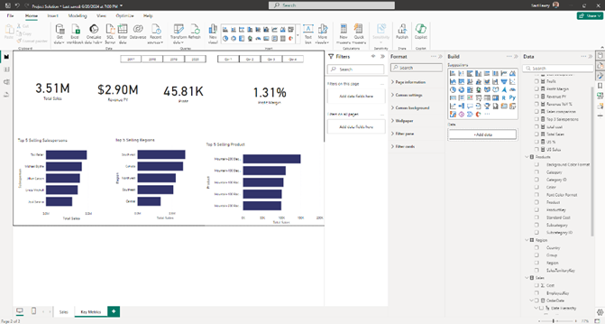
Create two Page Report

Slide 4
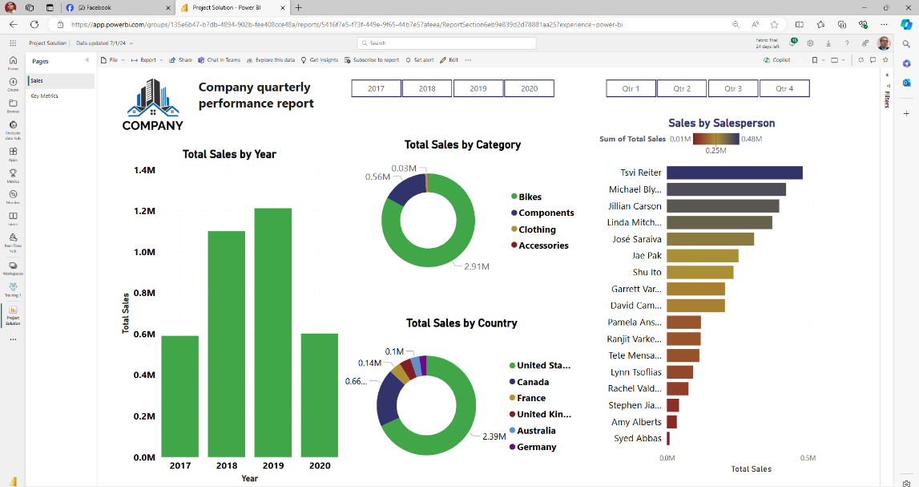
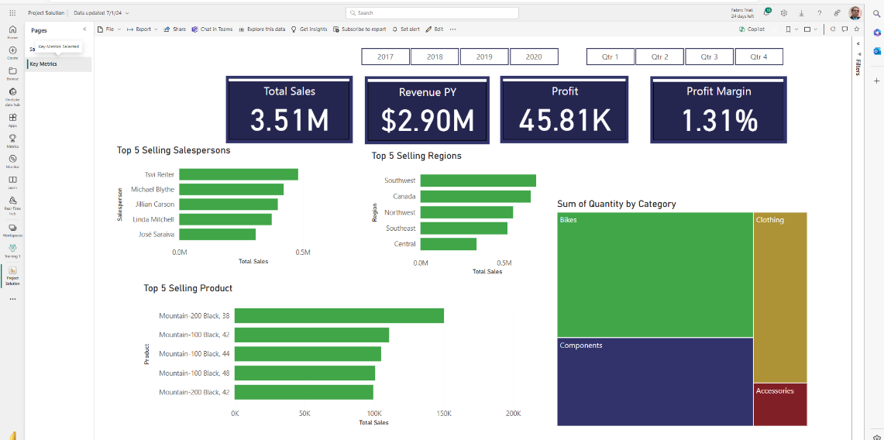
Publish your report

Slide 5
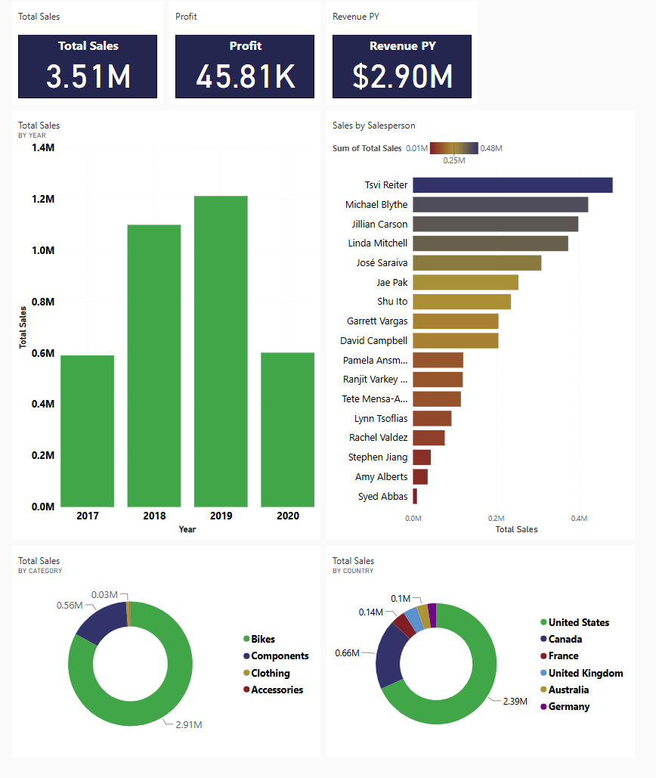
Create a Dashboard

Slide 6
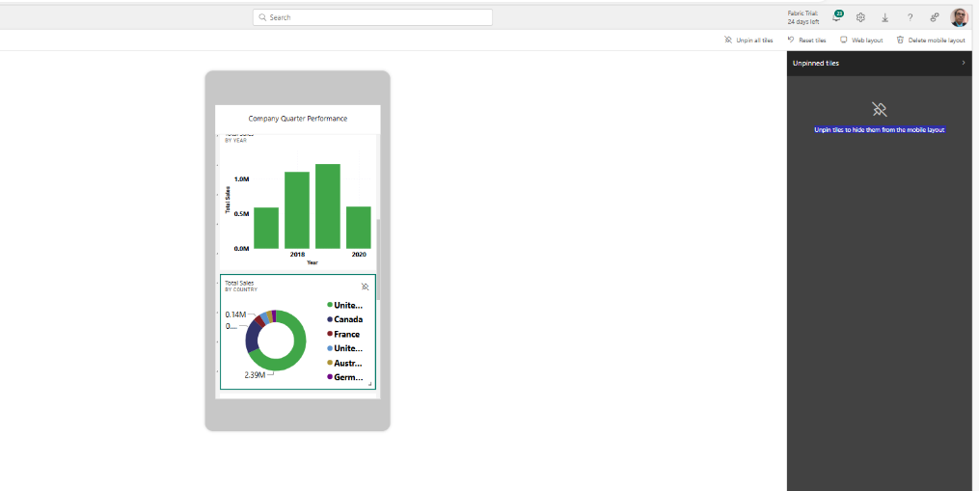
Create Mobile View

Slide 7


