Slide 1




Excel
Training
for Beginners
SAID FAWZY
Manager of Information Center
Tendering Department
Arab Contractors

Slide 2


Excel
Training
for Beginners
Course Introduction

Slide 3


Contact
Cert.
Cert.
Certif.
Quali
JOB
Said Fawzy
Manager of Information Center
Quality Manager
Tendering Department
Arab Contractors

Slide 4
Contact
Cert.
Cert.
Cert.
Quali.
JOB
Said Fawzy
Manager of Information Center
Quality Manager
Tendering Department
Arab Contractors

Slide 5


B.SC In Civil Engineering
1987
Alex University
Contact
Cert.
Cert.
Cert.
Quali.
JOB
Said Fawzy
Manager of Information Center
Tendering Department
Arab Contractors
High Diploma in Construction Project Management
1998
Ein Shams
University

Slide 6



Microsoft Certified Professional (MCP)
1999
B.SC In Civil Engineering
1987
Certified Internet Webmaster(CIW)
2000
Alex University
Contact
Cert.
Cert.
Cert.
Quali.
JOB
Said Fawzy
Manager of Information Center
Tendering Department
Arab Contractors
High Diploma in Construction Project Management
2001
Oracle Certified Master (OCM)
1998
Ein Shams
University
Microsoft Certified Technology Specialist(MCTS)
2006

Slide 7



Microsoft Certified Professional (MCP)
1999
Lead Auditor Quality Management Systems
B.SC In Civil Engineering
2009
1987
Certified Internet Webmaster(CIW)
2000
Alex University
Contact
Cert.
Cert.
Cert.
Quali.
JOB
Said Fawzy
Manager of Information Center
Tendering Department
Arab Contractors
High Diploma in Construction Project Management
2001
Oracle Certified Master (OCM)
1998
Lead Auditor Quality Management Systems
Ein Shams
University
2016
Microsoft Certified Technology Specialist(MCTS)
2006

Slide 8

Advanced Data Analysis Nanodegree
2021
Microsoft Certified Professional (MCP)
1999
Lead Auditor Quality Management Systems
B.SC In Civil Engineering
2009
1987
2022
2000
Nanodegree UX Research Cross-Skilling
Certified Internet Webmaster(CIW)
Alex University
Contact
Cert.
Cert.
Cert.
Quali.
JOB
Said Fawzy
Manager of Information Center
Tendering Department
Arab Contractors
High Diploma in Construction Project Management
2022
2001
Nanodegree Advanced Marketing Analytics
1998
Oracle Certified Master (OCM)
Lead Auditor Quality Management Systems
Ein Shams
University
2016
2023
2006
Microsoft Certified Technology Specialist(MCTS)
IBM Certified Data Analysist Professional

Slide 9


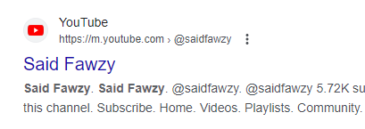




Advanced Data Analysis Nanodegree
2021
Microsoft Certified Professional (MCP)
1999
Lead Auditor Quality Management Systems
B.SC In Civil Engineering
2009
1987
2022
2000
Nanodegree UX Research Cross-Skilling
Certified Internet Webmaster(CIW)
Alex University
Contact
Cert.
Cert.
Cert.
Quali.
JOB
Said Fawzy
Manager of Information Center
Tendering Department
Arab Contractors
High Diploma in Construction Project Management
2022
2001
Nanodegree Advanced Marketing Analytics
1998
Oracle Certified Master (OCM)
Lead Auditor Quality Management Systems
Ein Shams
University
2016
0122 744 99 87
2023
2006
Microsoft Certified Technology Specialist(MCTS)
IBM Certified Data Analysist Professional
Saidfawzy@arabcont.com
Said_fawzy@hotmail.com

Slide 10

Prerequisite
Basic Computer Skills
Turn on and operate a computer or laptop.
Use a mouse and keyboard comfortably.
Open and close programs and files.
Navigate folders and drives to find and save documents.

Slide 11


Slide 12

Sharing Workbooks
Inserting Objects
Managing the Excel Workspace
Printing Worksheets
Copy Paste and Links
Worksheet Layout and Styles
Introduction to Excel
Working with Workbooks and Worksheets
Mastering Formula and Functions
Formatting Data
1
2
3
4
5
6
7
8
9
10

Slide 13
Sharing Workbooks
Inserting Objects
Managing the Excel Workspace
Printing Worksheets
Copy Paste and Links
Worksheet Layout and Styles
Introduction to Excel
Working with Workbooks and Worksheets
Mastering Formula and Functions
Formatting Data
1
2
3
4
5
6
7
8
9
10

Slide 14
1
Introduction to Excel
Sharing Workbooks
Inserting Objects
Managing the Excel Workspace
Printing Worksheets
Copy Paste and Links
Worksheet Layout and Styles
Working with Workbooks and Worksheets
Mastering Formula and Functions
Formatting Data
2
3
4
5
6
7
8
9
10

Slide 15
1
Introduction to Excel
2
Working with Workbooks and Worksheets
Sharing Workbooks
Inserting Objects
Managing the Excel Workspace
Printing Worksheets
Copy Paste and Links
Worksheet Layout and Styles
Mastering Formula and Functions
Formatting Data
3
4
5
6
7
8
9
10

Slide 16
1
Introduction to Excel
2
Working with Workbooks and Worksheets
3
Mastering Formula and Functions
Sharing Workbooks
Inserting Objects
Managing the Excel Workspace
Printing Worksheets
Copy Paste and Links
Worksheet Layout and Styles
Formatting Data
4
5
6
7
8
9
10

Slide 17
1
Introduction to Excel
2
Working with Workbooks and Worksheets
3
Mastering Formula and Functions
4
Formatting Data
Sharing Workbooks
Inserting Objects
Managing the Excel Workspace
Printing Worksheets
Copy Paste and Links
Worksheet Layout and Styles
5
6
7
8
9
10

Slide 18
1
Introduction to Excel
2
Working with Workbooks and Worksheets
3
Mastering Formula and Functions
4
Formatting Data
5
Worksheet Layout and Styles
Sharing Workbooks
Inserting Objects
Managing the Excel Workspace
Printing Worksheets
Copy Paste and Links
6
7
8
9
10

Slide 19
1
Introduction to Excel
2
Working with Workbooks and Worksheets
3
Mastering Formula and Functions
4
Formatting Data
5
Worksheet Layout and Styles
6
Copy Paste and Links
Sharing Workbooks
Inserting Objects
Managing the Excel Workspace
Printing Worksheets
7
8
9
10

Slide 20
1
Introduction to Excel
2
Working with Workbooks and Worksheets
3
Mastering Formula and Functions
4
Formatting Data
5
Worksheet Layout and Styles
6
Copy Paste and Links
7
Inserting Objects
Sharing Workbooks
Managing the Excel Workspace
Printing Worksheets
8
9
10

Slide 21
1
Introduction to Excel
2
Working with Workbooks and Worksheets
3
Mastering Formula and Functions
4
Formatting Data
5
Worksheet Layout and Styles
6
Copy Paste and Links
7
Inserting Objects
8
Managing the Excel Workspace
Sharing Workbooks
Printing Worksheets
9
10

Slide 22
1
Introduction to Excel
2
Working with Workbooks and Worksheets
3
Mastering Formula and Functions
4
Formatting Data
5
Worksheet Layout and Styles
6
Copy Paste and Links
7
Inserting Objects
8
Managing the Excel Workspace
Sharing Workbooks
9
Printing Worksheets
10

Slide 23
1
Introduction to Excel
2
Working with Workbooks and Worksheets
3
Mastering Formula and Functions
4
Formatting Data
5
Worksheet Layout and Styles
6
Copy Paste and Links
7
Inserting Objects
8
Managing the Excel Workspace
9
Printing Worksheets
10
Sharing Workbooks

Slide 24


Training
Tell me I will forget.
Show me I might remember something.
Let me do it I will understand.

Slide 25





How would we train?
Exercise

Slide 26

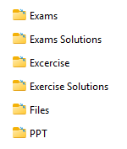
Student Folder

Slide 27


TRAINING ARE BASED ON BOOKS
TRAINING ARE BASED ON BOOKS
https://github.com/saidfawzy

Slide 28
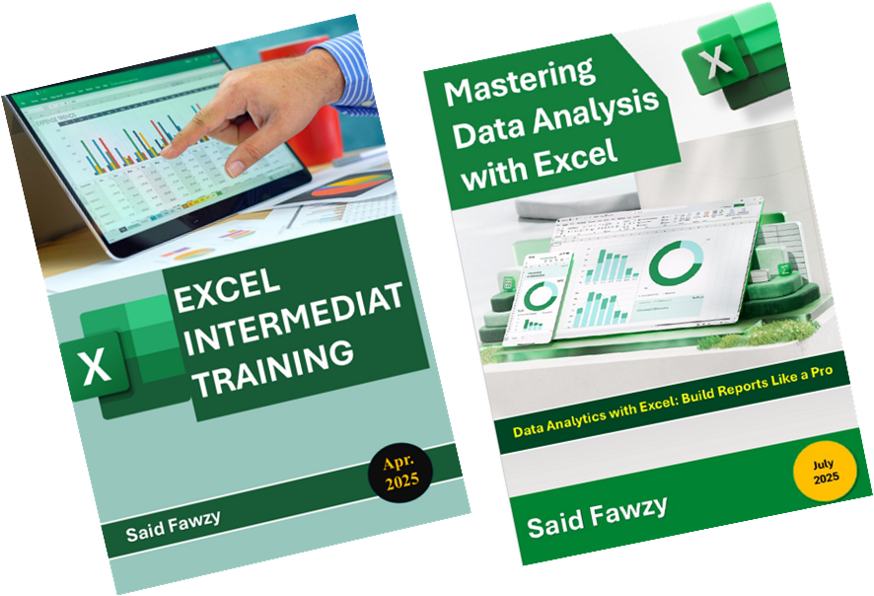
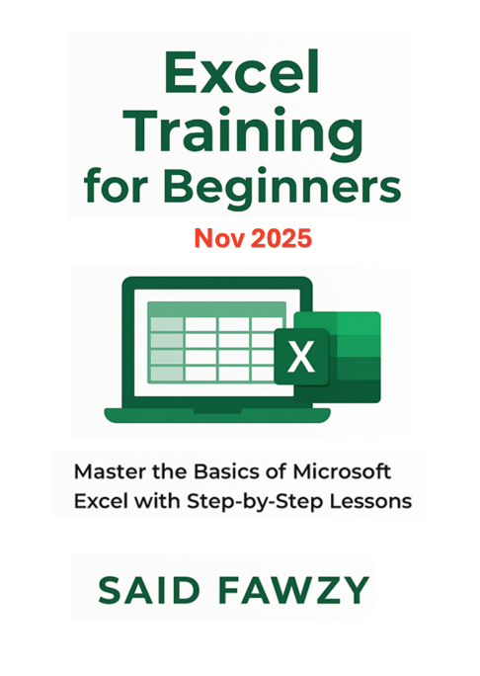

TRAINING ARE BASED ON BOOKS
TRAINING ARE BASED ON BOOKS
https://github.com/saidfawzy

Slide 29



TRAINING ARE BASED ON BOOKS
TRAINING ARE BASED ON BOOKS
https://github.com/saidfawzy

Slide 30




JOINE TRAINING GROUPS
Telegram Group
WhatsApp Group
LinkedIn Group
Facebook Group

Slide 31



You are Allowed to Talk
about anything except
Religion
Policy
Soccer

Slide 32


Slide 33



EXCEL INTERMEDIATE TRAINING

